Slide 1
NDACC Data Host Facility
M&A Directory
Data submission status
Continuing datasets
Inactive datasets
Campaign datasets
• Rapid Delivery Data Considerations
Lidar metadata file status
Hot News
Lidar WG meeting – May 2018

Slide 2
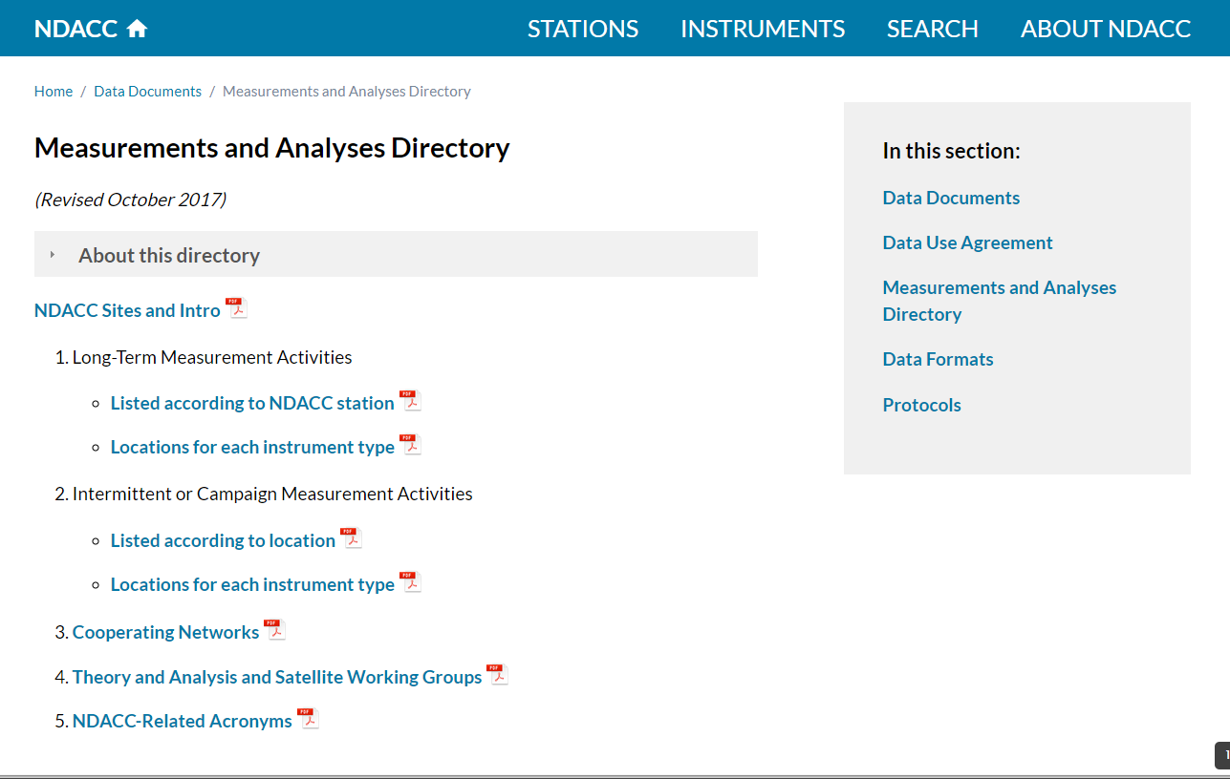
Measurements and Analyses Directory
The main document listing NDACC Affiliated Measurements
Please review the lidar only documents being passed around. Initial your sections if you have reviewed it and all is OK. Make any changes directly on the document.
Lidar WG meeting – May 2018

Slide 3
Lidar Data Submission Status as of 5/9/2018
In following slides note:
Data submitted to the RD archive is not submitted to NDACC. RD is for data prior to full validation, and contains datasets that are not NDACC affiliated.
Note to be considered up to date, all data should be in up to 5/2017. Some which have submitted data this year are still not up to date.
Data sets that are up to date (data through 5/2017) shows the entire line in green.
Data sets that have submitted data this year, but are not fully up to date shows the entire line in blue.
Datasets with addition between 5/16 (last meeting) and one year ago in black.
Datasets with extenuating circumstances for archival (H2O data or instrument down) shows the entire line in orange.
No data since last Lidar Working Group Meeting shows the entire line in red.
A dataset is determined to be ‘INACTIVE’ when the PI stops sending data and when ties to WG and SC (sending Annual Reports) are missing.
Lidar WG meeting – May 2018

Slide 4
Lidar Data Submission Status (Continuing Measurements – as stated in M&A)
Site / PI | Annual Report 2017? | Ames | HDF | Comments
Eureka / Carswell, Strawbridge, Drummond, Tikhomirov (T, O3) | Yes | 93 – 09 |  | No data since transition to Drummond & Tikhomirov
Ny Alesund / Ritter, Neuber (Aer) | Yes | 91 – 17 |  | Last archive 2/17
Thule / Fiocco, Di Sarra, Di Iorio (T) | Yes | 93 – 14, 17 |  | No data measured in 2015 winter.
Sondrestromfjord / Heinselman, McCready, Bhatt (T) | No | 94 – 15 |  | Database set up for Bhatt in fall 2017
Hohenpeissenberg / Steinbrecht (T, O3) | Yes | 87 – 18 | 87 – 18
KEY: Last Data submitted:
> 2 yrs ago > 1 yr ago < 1 yr ago, but not up to date < 1 year ago & up to date
Lidar WG meeting – May 2018

Slide 5
Lidar Data Submission Status (Continuing Measurements – as stated in M&A)
Site / PI | Annual Report 2017? | Ames | HDF | Comments
Payerne / Haefele (H2O) | Yes
OHP / David, Khaykin (Aer) | Yes | 91 – 16 |  | Last archive 4/17
OHP / Hauchecorne (T) | Yes | 91 – 17
OHP / Godin-Beekmann (O3) | Yes | 85 – 16 | 03 – 18
OHP / Ancellet (Trop O3) | Yes | 90 – 17
London, Ontario / Sica (T, H2O) | Yes |  | 93 – 10 | Temp. only archived in 2012. Long break in record while system down.
Rome / Liberti (H2O) | Yes
KEY: Last Data submitted:
> 2 yrs ago > 1 yr ago < 1 yr ago, but not up to date < 1 year ago & up to date
Lidar WG meeting – May 2018

Slide 6
Lidar Data Submission Status (Continuing Measurements – as stated in M&A)
Site / PI | Annual Report 2017? | Ames | HDF | Comments
Huntsville / Newchurch (Trop O3) | Yes |  | 15 – 16 | Last archive 5/16.
TMF/ McDermid, Leblanc (Aer) | Yes | 89 – 13 |  | Reported laser issues.
TMF/ McDermid, Leblanc (O3) | Yes | 89 – 18 |  | Gap 2014,2015
TMF/ McDermid, Leblanc (T) | Yes | 89 – 13 |  | Reported laser issues.
TMF/ McDermid, Leblanc (Trop O3) | Yes | 99 – 18
TMF / Leblanc (H2O) | Yes |  | 8/14 | One file so far.
Mauna Loa / McDermid, Leblanc (T, O3, Aer) | Yes | 93 – 18
Mauna Loa / Barnes (H2O) | Yes
Mauna Loa / Barnes (Aer 532 nm) | Yes | 94 – 17
KEY: Last Data submitted:
> 2 yrs ago > 1 yr ago < 1 yr ago, but not up to date < 1 year ago & up to date
Lidar WG meeting – May 2018

Slide 7
Lidar Data Submission Status (Continuing Measurements – as stated in M&A)
Site / PI | Annual Report 2017? | Ames | HDF | Comments
Reunion Maido / Portafaix (O3) | Yes | 13 – 17 | 13 | HDF archived in 2014.
Reunion Maido / Keckhut (T) | Yes | 13 – 17
Reunion Maido / Keckhut (H2O) | Yes
Reunion Maido / Duflot (Trop O3) | Yes | 13 – 17
Lauder / Swart, Querel (O3) | Yes | 94 – 17
Rio Gallegos / Quel, Salvador (O3) | Yes | 05 – 15 |  | Last update 10/2016.
Dumont D’Urville / David, Jumelet (Aer) | Yes | 06 – 16 |  | Last update 10/2016.
Dome C / Snels (Aer) | Yes | 17
KEY: Last Data submitted:
> 2 yrs ago > 1 yr ago < 1 yr ago, but not up to date < 1 year ago & up to date
Lidar WG meeting – May 2018

Slide 8
Lidar Data Submission Status Continuing Measurements – Summary
Status classification | Number of datasets (of 34 active)
Up to date through at least 5/2017 | 17 (50 %)
Last submission within 1 yr, but not up to date | 1 (3 %)
Data with extenuating circumstances (no data measured in past year, or H2O dataset still working on formatting issues) | 6 (18 %)
Total Compliant Datasets (Green + Blue + Orange) | 24 (71 %)
Data submitted since last WG meeting, but not in past year (Black) | 7 (20 %)
No submissions since last meeting (or longer) | 3 (9 %)
Total Non-Compliant Datasets (Black + Red) | 10 (29 %)
Next year all H2O programs (18 %) should be actively submitting data.
7 of 34 datasets are submitting in HDF (some of these both HDF and Ames).
Lidar WG meeting – May 2018

Slide 9
Lidar Data Submission Status (Inactive Measurements – As stated in M&A)
Site / PI | Ames | HDF | Comments
Eureka / Nagai (Aer) | 93 – 95 |  | Ended
Eureka / Carswell (Aer) | 94 – 98 |  | Ended
Ny Alesund / Neuber, Von der Gathen (O3) | 91 – 11 |  | Ended
Ny Alesund / Neuber (T) | 95 – 09 |  | Ended
Thule / Fiocco (Aer) | 91 – 96 |  | Ended
Andoya / Hanson (O3) | 94 – 11 |  | Ended
Andoya / Hauchecorne (T) | 95 – 96 |  | Ended
Garmisch / Jaeger, Trickl (Aer) | 94 – 10 |  | Ended
Toronto / Pal (O3, T, Aer) | 91 – 97 |  | Ended
Lidar WG meeting – May 2018

Slide 10
Lidar Data Submission Status - Inactive
Site / PI | Ames | HDF | Comments
OHP / Keckhut (H2O) |  |  | Shutdown 2017
Potenza / Di Girolamo (H2O) | 15 |  | Files for 10/15 submitted in 3/2018
Boulder / Barnes (Aer) | 00 – 09 |  | Ended
Tsukuba / Nakane (O3) | 88 – 10 |  | Ended
Mauna Loa / Barnes (Aer 694 nm) | 74 – 98 |  | Ended
Reunion St Denis / Keckhut (T) | 94 – 09 |  | Ended
Reunion St Denis / Baray, Portafaix (O3) | 00 – 06 | 00 – 05 | Ended
Lauder / Uchino, Nagai (Aer) | 92 – 08 |  | Ended
Lauder / Stefanutti (Aer) | 94 – 97 |  | Ended
Dumont D’Urville / Stefanutti (Aer) | 89 – 98 |  | Ended
Dumont D’Urville / Godin-Beekman, Marchand (O3) | 91 – 13 |  | Ended
McMurdo / Adriani, Snels | 90 – 10 |  | Ended
Lidar WG meeting – May 2018

Slide 11
Campaign Data Sets No additional data since the 2014 LWG meeting
Site / PI | Ames | Comments
Ny Alesund / McGee | 1997, 1998
Sodankyla / McGee | 2006, 2007
Hohenpeissenberg / McGee | 2005
OHP / McGee | 1992, 1997
London / Whiteman |  | No data
Greenbelt / McGee (STROZ) | 1993 – 2001
Greenbelt / McGee (AT) | 1997, 2007, 2008, 2009
Beltsville / Whiteman (H2O) |  | No data
Table Mountain / McGee | 1992, 1997, 2004, 2005, 2011
Table Mountain / McGee (AT) | 2005 | Should there also be 2006, 2007 and 2009?
Mauna Loa / McGee | 1995-1996, 2002, 2012 - 2013 | Should there be also 2014?
Lauder / McGee | 1992, 1994, 1995, 2001, 2002, 2011 | Should there be also 2012?
Polarstern / Schrems | 1996, 2000, 2003, 2005
Prestwick / Schrems | 2000
Lindenberg / Schrems | 2003
Table Mountain / Schrems | 1997
Paramaribo / Schrems | 2004, 2006
Punta Arenas / Schrems | 2000
Lidar WG meeting – May 2018

Slide 12
Rapid Delivery (RD) Data Considerations
What is the intent of RD (Rapid Delivery)?
RD data is NOT NDACC data.
RD data can come from non-NDACC affiliated instruments, or it can be NDACC affiliated data before it is fully Quality Controlled.
RD data does not appear inside the NDACC database. It is held in a separate directory.
When should I submit data with the RD flag?
Only use the RD flag if the data is not yet quality controlled, or if it is not at an NDACC affiliated site.
Data submitted to the traditional NDACC catalog will still count for CAMS obligations, and will be subject to the additional screening if from a CAMS associated instrument.
What should I do when I submit data to the NDACC database that overlaps in time to the RD datasets?
When you submit data to the NDACC catalog that overlaps in time with data in the RD directories, send and email to the DHF to have the RD data removed.
Data for a single date should not be in both places. It is NDACC policy that there be only one version of data available to users.
Do not submit data to both NDACC catalog and to the RD directories at the same time.
Submit data directly (and only) to the NDACC catalog with no RD flag if the data is final.
Lidar WG meeting – May 2018

Slide 13
Rapid Delivery (RD) Data Considerations
Data currently residing in the RD Directories:
Site / Species PI | NDACC Standard Data | RD Data | Time overlap? | Comments
OHP / O3 Godin-Beekmann | 1/03 – 4/14; latmos001 11/17 - 3/18; latmos002 | 1/12 –10/17; latmos002 | Yes | RD data should be moved to the NDACC standard directory. Records from both instruments are valuable to the user. The two instruments should be well documented.
Reunion Maido / O3 Portafaix | 2/2013 – 12/2013 Vers. 002 | 6-12/2014 Vers 001 | No | RD Cataloged in 2014 & 2015. These should be recataloged into the NDACC standard database. Version differences should be well documented.
TMF / O3 Leblanc | No HDF | 1-4/2018 | No
TMF / Trop O3 Leblanc | No HDF | 1-4/2018 | No
Mauna Loa / O3 Leblanc | No HDF | 1-4/2018 | No
Data should only remain in the RD directories for a few months to one year unless they are for a non-affiliated station.
It should be clear to a user which version/dataset to use for a particular time period. If there is a legitimate reason for two versions, with two different, yet overlapping time periods is there a good description of why, and what data is preferred in the metadata file?
DOCUMENT, DOCUMENT, DOCUMENT!
Lidar WG meeting – May 2018

Slide 14
More About Metadata Files
Visibility
With redesign of NDACC Web Pages the dataset level metadata files are now easily discoverable by the user.
One click to metadata file
Submit new files via email to DHF.
Lidar WG meeting – May 2018

Slide 15
Metadata Contents and Status - Continuing Programs
Site / PI | PI | File Year | Comments
Eureka / Drummond, Tikhomirov (T, O3) |  | None | File exists for the previous instrument with Carswell
Ny Alesund / Neuber (Aer) | $$\text{}$$ | 1999 | 
Thule / Di Iorio (T) | Old | 1996
Sondrestromfjord / Bhatt (T) |  | None
Hohenpeissenberg / Steinbrecht (T, O3) | $$\text{}$$ | 2017
Payerne / Haefale (H2O) |  | None
OHP / Khaykin (Aer) | Old | 2017
OHP / Hauchecorne (T) | $$\text{}$$ | 2009
OHP / Godin-Beekmann (O3) | $$\text{}$$ | 2001
OHP / Ancellet (Trop O3) | $$\text{}$$ | 2017
London, Ontario / Sica (T, H2O) |  | None
Rome / Liberti (H2O) |  | None
GSFC/ AT / McGee / Aer, T | $$\text{}$$ | 2000
GSFC STROZ / McGee / O3, T | $$\text{}$$ | 2000
Huntsville / Newchurch (Trop O3) |  | None
Table Mountain / Leblanc (T, O3, Aer) | Old | 2006
Table Mountain / Leblanc (Trop O3) | Old | 2006
Table Mountain / Leblanc (H2O) |  | None
Lidar WG meeting – May 2018

Slide 16
Metadata Contents and Status - Continuing Programs
Site / PI | PI | File Year | Comments
Mauna Loa / Leblanc (T, O3, Aer) | Old | 2006
Mauna Loa / Barnes (H2O) |  | 2010
Mauna Loa / Barnes (Aer 532 nm) | $$\text{}$$ | 2010
Reunion Maido / Portafaix (O3) |  | None | For St Denis
Reunion Maido / Keckhut (T) |  | None | For St Denis
Reunion Maido / Keckhut (H2O) |  | None
Reunion Maido / Duflot(Trop O3) |  | None
Lauder / Swart (O3) |  | None
Rio Gallegos / Salvador (O3) |  | None
Dumont D’Urville / David, Jumelet (Aer) | Old | 2017
Dome C / Snels (Aer) | $$\text{}$$ | 2017
Lidar metadata files are stored at: ftp://ftp.cpc.ncep.noaa.gov/ndacc/meta/lidar/
Email revisions to Jeannette.Wild@noaa.gov
Lidar WG meeting – May 2018

Slide 17
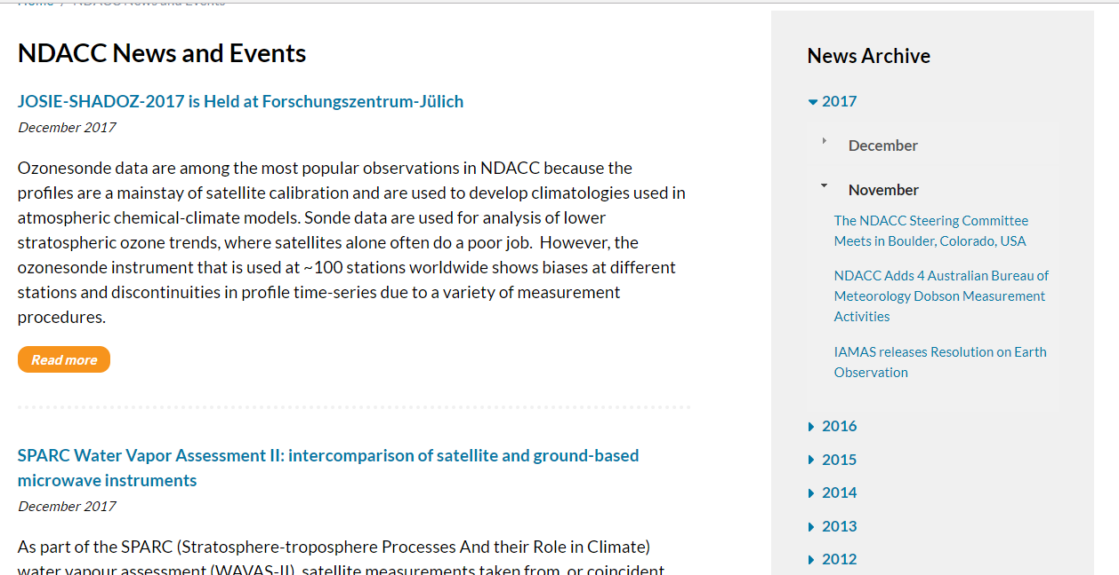
NDACC Hot News
We have had several new articles in November and December 2017:
Would LOVE to have something from the Lidar Working Group.
Email a short paragraph or two about results, meetings, publications, etc. to the DHF.
Lidar WG meeting – May 2018

