Slide 1
Stratospheric Sulfur and its Role in Climate (SSiRC)
SSiRC first meeting 31 Oct to 02 November 2012
at the
International Space Science Institute
Bern, Switzerland

Slide 2
SSiRC Team Members (partial list) Larry Thomason USA, space measurements, SAGE III ISS John Barnes USA, lidar aerosol measurements Terry Deshler USA, OPC aerosol measurements Markus Hermann Germany, CARIBIC, UT/LS in situ measurements Stefanie Kremser New Zealand, sulfur source gases Graham Mann UK, global aerosol modelling, climate Fred Prata Norway, tropospheric volcanic effects Markus Rex Germany, StratoClim, Lagrangian modelling Alan Robock USA, climate modelling Claudia Timmreck Germany, ISA-MIP, global aerosol modelling, climate Jean-Paul Vernier USA, UT/LS aerosol Marc von Hobe Germany, UT/LS in situ measurements

Slide 3
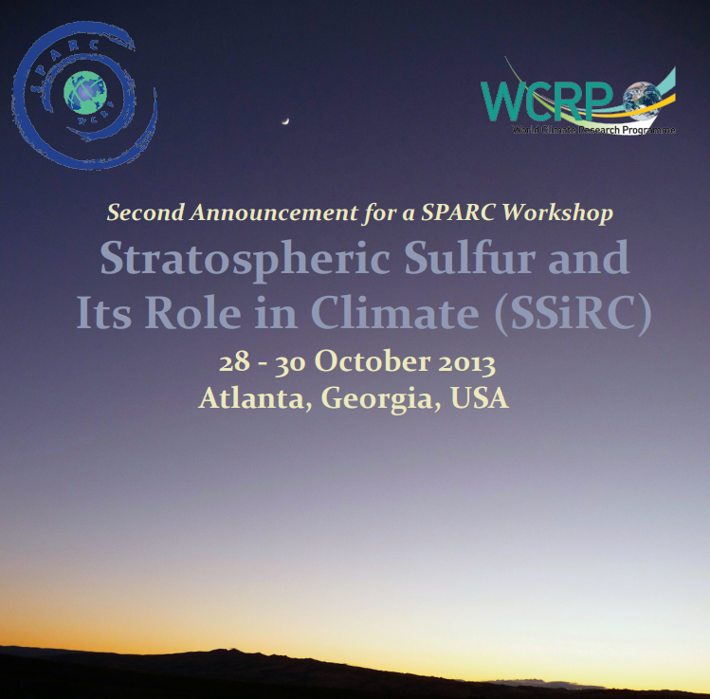

Slide 4
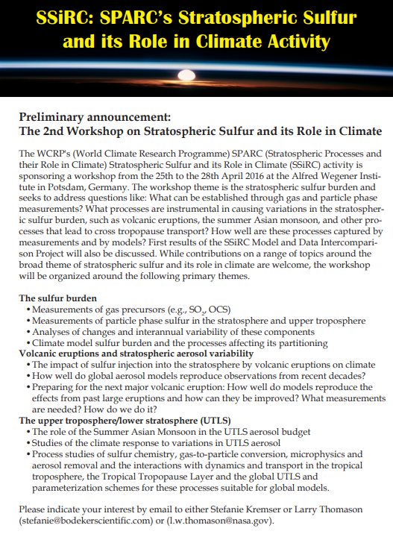
2nd Workshop
Potsdam, Germany
April, 2016

Slide 5
Review Paper: Stefanie Kremser, Larry W. Thomason, Marc von Hobe, Markus Hermann, Terry Deshler, Claudia Timmreck, Matthew Toohey, Andrea Stenke, Joshua P. Schwarz, Ralf Weigel, Stephan Fueglistaler, Fred J. Prata, Jean-Paul Vernier, Hans Schlager, John E. Barnes, Juan-Carlos Antuña-Marrero, Duncan Fairlie, Mathias Palm, Emmanuel Mahieu, Justus Notholt, Markus Rex, Christine Bingen, Filip Vanhellemont, Adam Bourassa, John M. C. Plane, Daniel Klocke, Simon A. Carn, Lieven Clarisse, Thomas Trickl, Ryan Neely, Alexander D. James, Landon Rieger, James C. Wilson, and Brian Meland, Stratospheric aerosol-observations processes, and impact on climate (2016), Rev. Geophysics, 54,10.1002/2015RG000511. Stratospheric Aerosol Workshop 6–8 September, 2017 Laboratory for Atmospheric and Space Physics Boulder, Colorado

Slide 6
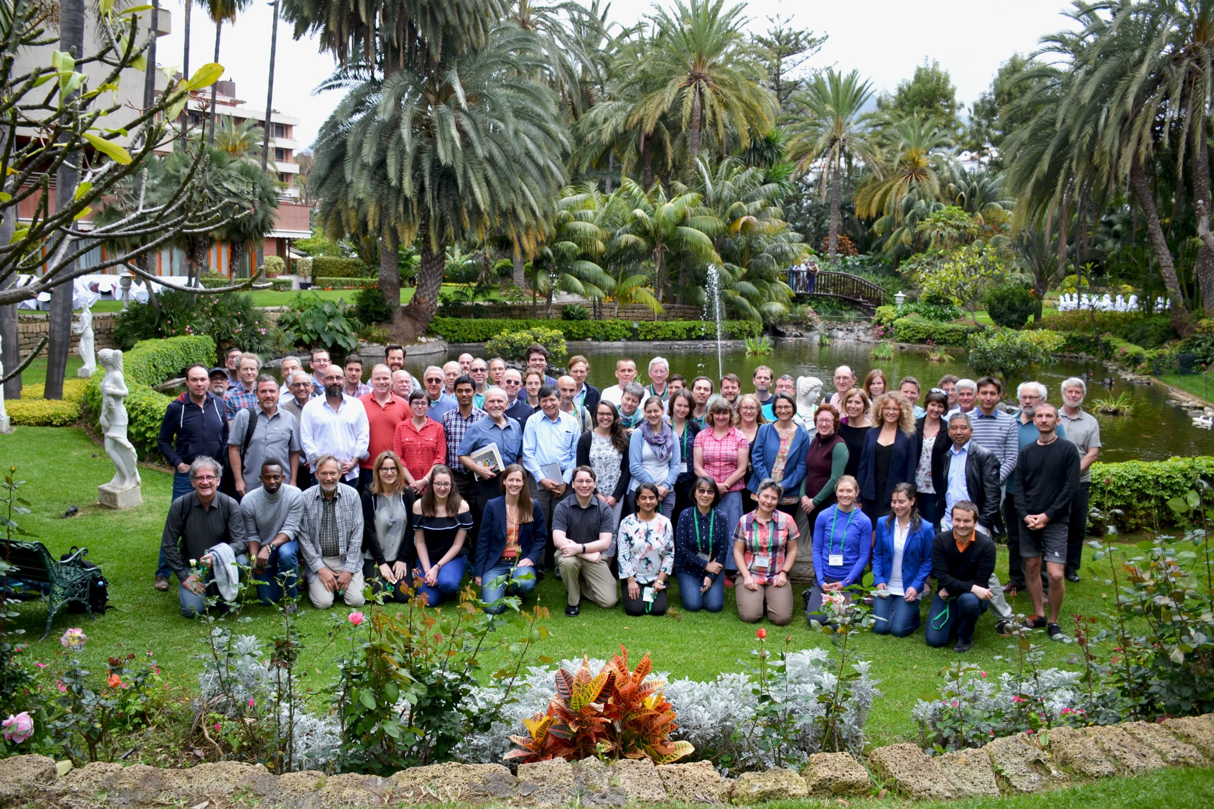
2018 Chapman Conference, Tenerife, Canary Islands

Slide 7
Ongoing SSiRC Activities Team Meeting, Bern, May, 2018 Volcanic Response Plan (VolRes) Model Intercomparison Project on the Climatic Response to Volcanic Forcing (VolMIP)

