Slide 1
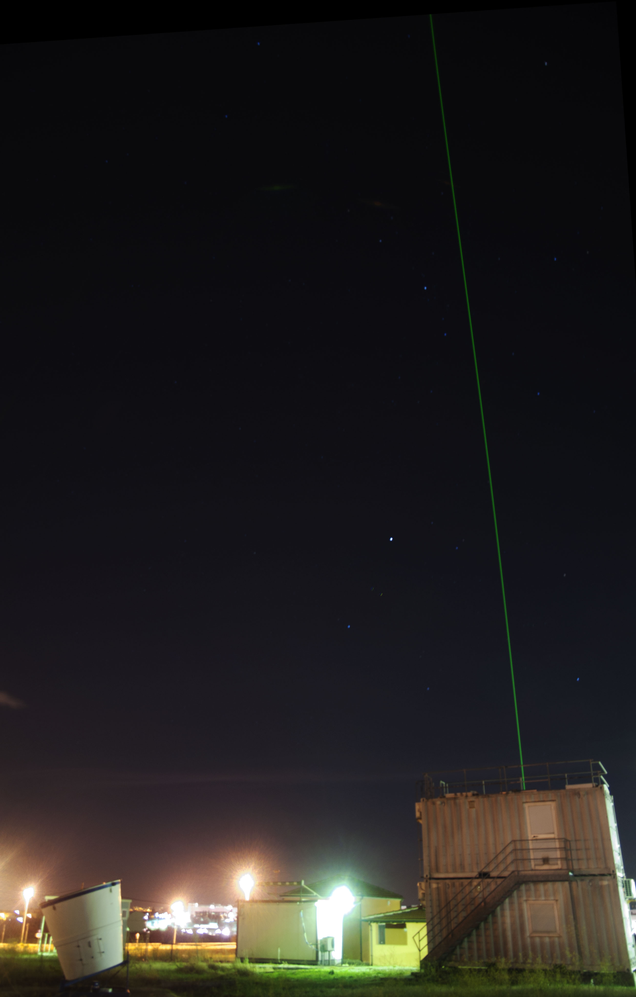
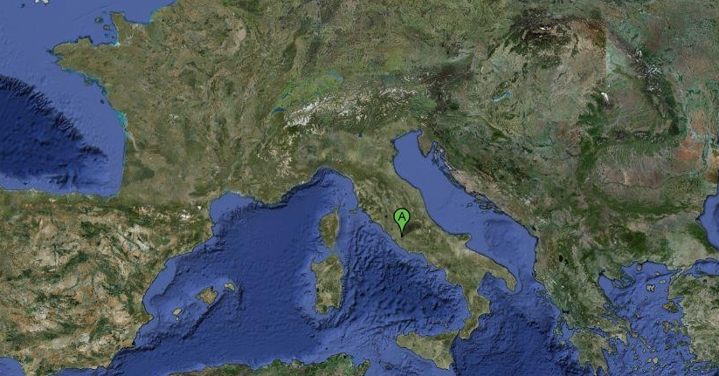
RMR Rome – Tor Vergata NDACC station
G.L. Liberti¹, D. Dionisi¹, F. Congeduti^{1*}, F. Cardillo^{1*}
¹Institute of atmospheric science and climate (ISAC-CNR)
*Retired
Instrument operation update (NO science)
Rome-Tor Vergata
41.8°N 12.6°E . 106 aslm
10 MAY 2018, NDACC Lidar Working Group, Huntsville

Slide 2
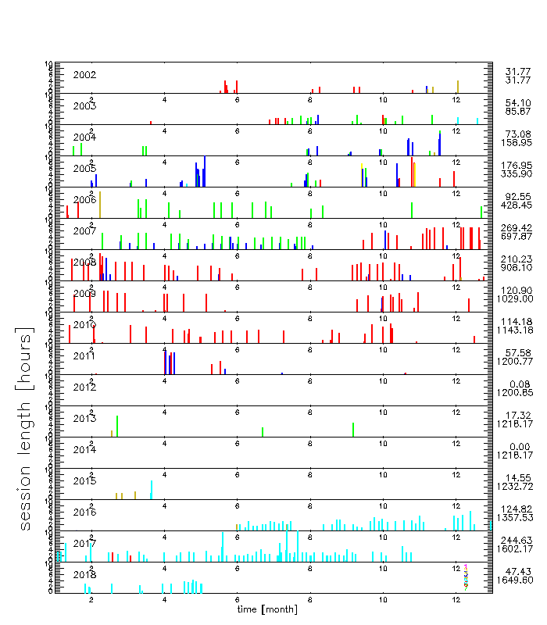
Rome Tor vergata Instrument operation update
NDACC-configuration/protocol
Measurement activities:
NDACC:
measurement in stand-by due to lack of human and financial resources!
- Aerosol profiles ( 0.2 - 25 km)
- Water vapor profiles (0.5 - 15 km)
- Temperature profiles (25 - 80 km)
EARLINET (since 2016/06)
180’ acquisitions twice a week (Monday, Thursday) at sunset,
120’ acquisitions per week at local noon (Monday).
- Aerosol profiles ( 0.2 - 8 km)
- Water vapor profiles (0.5 - 5 km)
Earlinet-configuration/protocol
10 MAY 2018, NDACC Lidar Working Group, Huntsville

Slide 3
Rome Tor vergata Instrument operation update
On-going activities:
-Laser maintenance (done in October 2017)
- Upload the HDF and ASCII water vapor measurements (2003-2010) to the NDACC archive
- Upgrade of the RMR system hardware:
1) addition of cross and co-polarized tropospheric channels at 532 nm;
2) addition of tropospheric channel at 1064 nm
- Upgrade of the RMR system software:
1) Remote control of the laser
2) Remote control of the sliding roof
3) Development of an automated alignment procedure
4) Development of WV+aerosol all at once inversion procedure
Networking & Projects:
- EMERGE (Effect of Megacities on the transport and transformation of pollutants on the Regional and Global scales) measurement campaigns
- Submitted H2020 proposal (FILIA project, P.I. T. Trickl)
- June 2016: EARLINET/ACTRIS affiliation for the tropospheric aerosol product
- Accepted ESA proposal (ID 3881) as an EARTHCARE CAL/VAL site
- Submitted ESA proposal as a SENTINEL 5-p CAL/VAL site
Objective
2019/01: return to normal NDACC activity
300’-500’ night-time acquisitions once a week
10 MAY 2018, NDACC Lidar Working Group, Huntsville

Slide 4
Rome Tor vergata Instrument operation update
Scientific Production:
Liberti, G.L., D. Dionisi, F. Congeduti, A. Di Monte, 2018. Dead-Time Variables Estimation and Correction. ELC2018, 2 pp.
Liberti G.L., D. Dionisi, F. Cheruy, C.Risi. 2018. Feasibility study to measure HDO/H2O atmospheric profiles through a Raman lidar. ILRC28 EPJ Web of Conferences 176, 05032. 4 pp
Dionisi, D., A.M.Iannarelli, A.Scoccione, G.L.Liberti, M.Cacciani, S.Argentini, L.Baldini, F.Barnaba, M.Campanelli, G.Casasanta, H.Diémoz, L.Di Liberto, G.P.Gobbi, I.Petenko, A.M.Siani, J.Von Bismarck, S.Casadio, 2018. Water vapor and aerosol lidar measurements within an Atmospheric instrumental super site to study the aerosols and the tropospheric trace gases in Rome. ILRC28 EPJ Web of Conferences 176, 05050 4 pp https://doi.org/10.1051/epjconf/201817605050
Proestakis,E. V.Amiridis, M.Kottas, E.Marinou, I.Binietoglou, A.Ansmann, U.Wandinger, J.Yorks, E. Nowottnick, A.Papayannis, A.Pietruczuk, A.Apituley, C.Muñoz-Porcar, D.Bortoli, D.Dionisi, D.Mamali, D.Balis, D.Nicolae, G.L.Liberti, H.Baars, K-A.Voudouri, L.Mona, M.Mylonaki, M.R.Perrone, M.J.Costa, M.Sicard, N.Papagiannopoulos, N.Siomos, P.Burlizzi, R.Engelmann, J.Hofer, G. Pappalardo, 2018. EARLINET Validation of CATS L2 Product. ILRC28 EPJ Web of Conferences 176, 02005 5 pp https://doi.org/10.1051/epjconf/201817602005
Liberti,G.L., D.Dionisi, S.Federico, F.Congeduti, 2016. Multiwavelength lidar observation of the atmospheric response to the 20th March 2015 partial solar eclipse in Rome Tor Vergata: preliminary results. ILRC27. EPJ Web of Conferences 119 15003 4 pp., https://doi.org/10.1051/epjconf/201611915003.
10 MAY 2018, NDACC Lidar Working Group, Huntsville

Slide 5
Rome Tor vergata Instrument operation update
Thank you for your attention
10 MAY 2018, NDACC Lidar Working Group, Huntsville

Slide 6
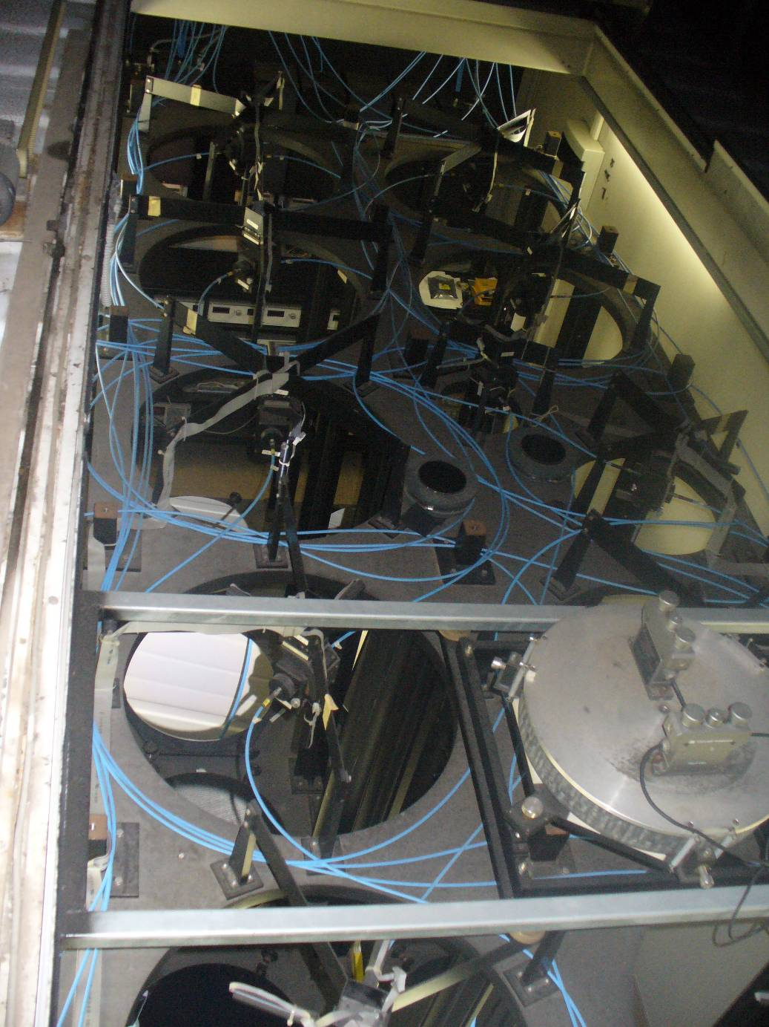
Rome Tor vergata Instrument CONFIGURATION
Instrumental characteristics
TRANSMITTER
Laser Nd:YAG Continuum Powerlite 8010
2 beams: 532 nm, 355 nm
Energy: 200 mJ, 400 mJ
Pulse repetition rate: 10 Hz
Pulse duration: 7 ns
Beam diameter: 45 mm
Beam divergence: 0.1 mrad
RECEIVER
Collector 1
newtonian array
Diameter: 9*500 mm
F-number: F3
FOV : 0.6 mrad
Collector 2
single newtonian
Diameter:300mm
F-number: F3
FOV : 0.9 mrad
Collector 3
single newtonian
Diameter: 150 mm
F-number: F3
FOV: 1.8 mrad
SAMPLING
Range: ~100 m÷75 km
Δt: Standard 1’ (600 profiles)
Δz: Standard 75 m - 7.5 m
DATA ACQUISITION
Raman UT 387 nm
channels: 407 nm
Elastic (T): 532 nm
Raman LT 387 nm
channels: 407 nm
Elastic 355 nm
(UTLS): 532 nm
Elastic: 532 nm
(PBL, LT)
NDACC WV DATASET
-Archived hours of measurements: 690/1232
- More than 90% of the WV night-time sessions have been calibrated (68% of the total dataset)
For each photo-detection channel
Photon-counting: 200 MHz Bandwidth
500 ns max. resolution
ADC: 12 bit, 20 Msample/s
10 MAY 2018, NDACC Lidar Working Group, Huntsville

