Slide 1
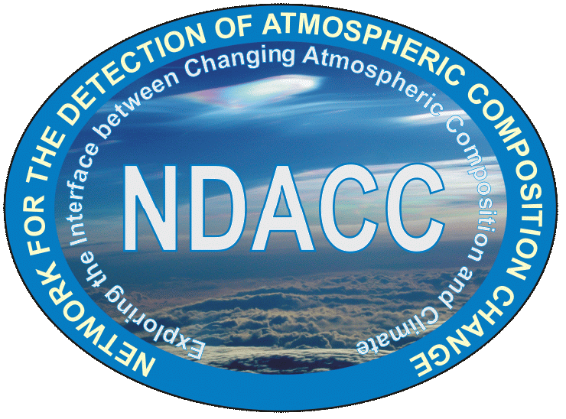
Payerne station operations
2018 NDACC LWG Meeting
G. Martucci¹, L. Renaud¹ and A. Haefele^{1,2}
¹ Office Fédérale de Météorologie et Climatologie, MeteoSuisse, Payerne, Suisse
² Department of Physics and Astronomy, The University of Western Ontario, London, Canada

Slide 2
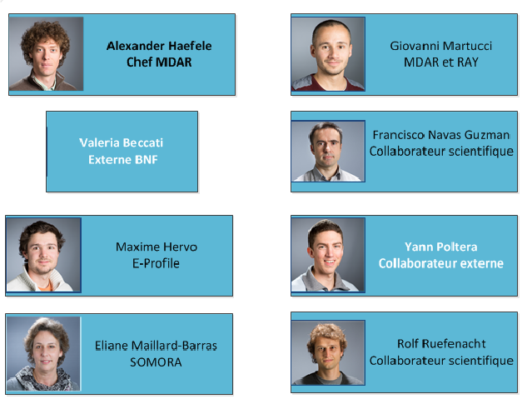
Remote Sensing group at Payerne
LWG NDACC-devoted
Remote sensing group leader
T,q,AOD
Raman LIDAR + sunphotometer
Radiation measurement
Aerosol hygroscopicity
(LIDAR+radiometer)
E-PROFILE
Windprofiler+ceilometers
Ice cloud formation
LIDAR+radiosounding
Ozone measurements
O₃ radiometer
EUMETNET/EUNADICS
Widprofiler+ceilometer

Slide 3
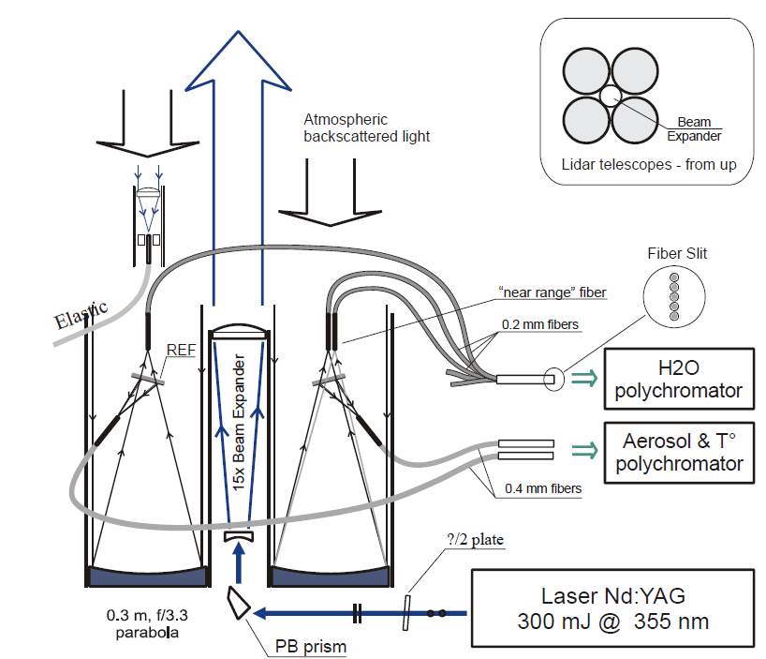
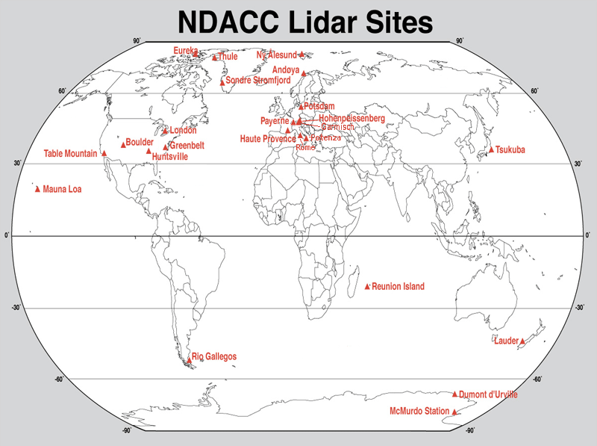
The RAman Lidar for Meteorological Observations - RALMO
Operated in Payerne, Switzerland
Since 2008
Fully automatic Raman lidar
Day and nighttime operation
Narrow FOV and bandwidth
High laser-pulse energy, 450 mJ
Laser Nd:YAG
450 mJ @ 355 nm

Slide 4
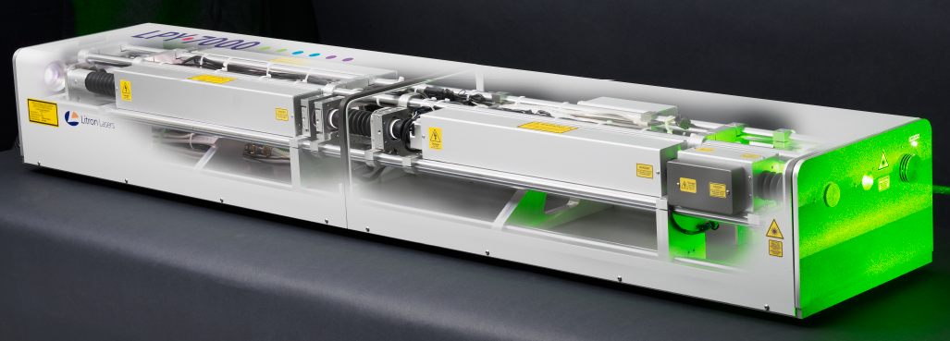
Automatic Operations 24/7
Weekly | Monthly | 6 Monthly | Yearly
Cleaning | Flash lamp exchange after 40 M shots | Litron maintenance | Air conditioning
Raw data archiving | telescopes alignment |  | Cooling system
Energy measurement (before beam expander) | Energy measurement (after beam expander) |  | Cleaning of telescopes
Change in 2018: Litron LPY7000 Nd:YAG laser systems
Wavelength | 355 nm
Rep. Frequency | 30 Hz
Energy @355 nm | 450 mJ
Pumping | flashlamps
Operational | yes

Slide 5
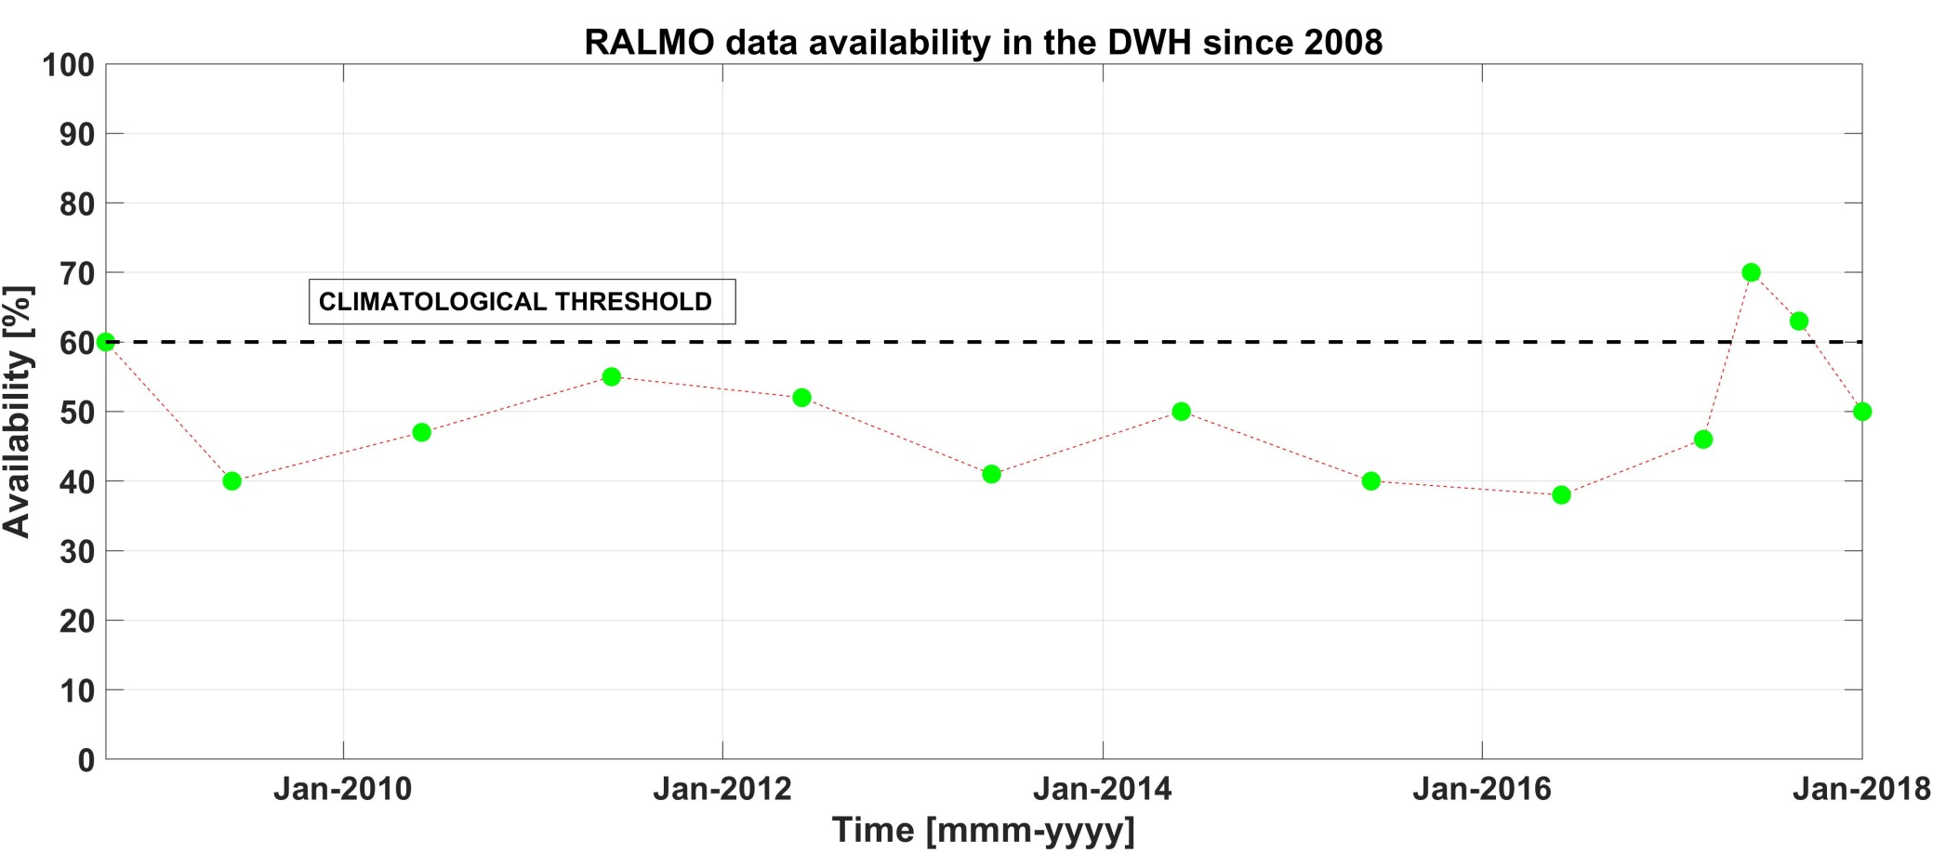
RALMO data availability
last 4 points Q1-Q4 2017.

Slide 6
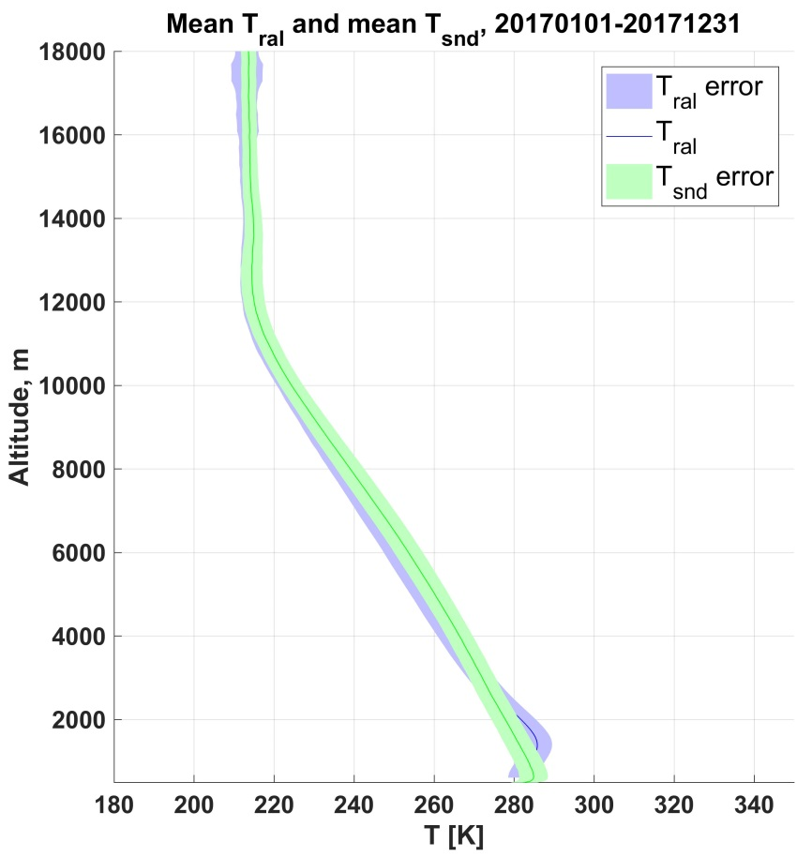
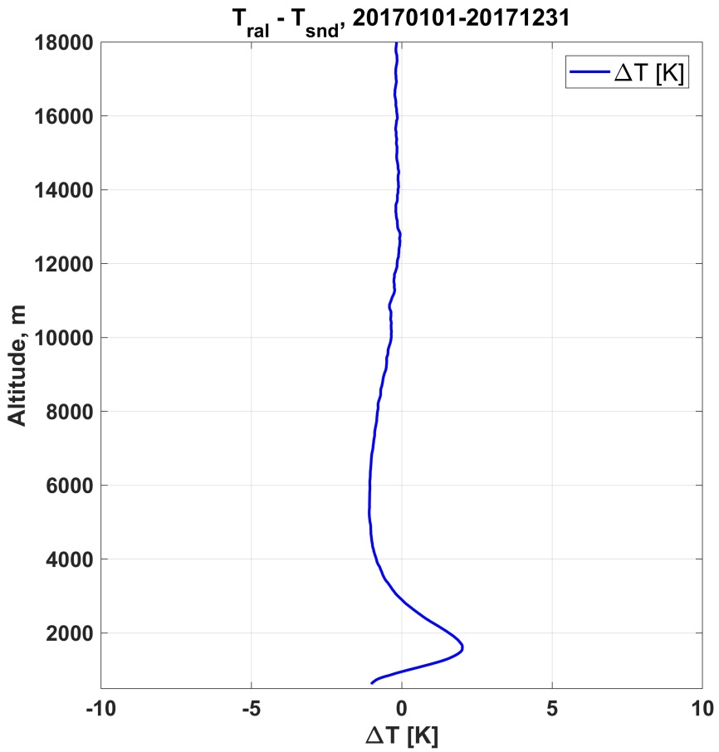
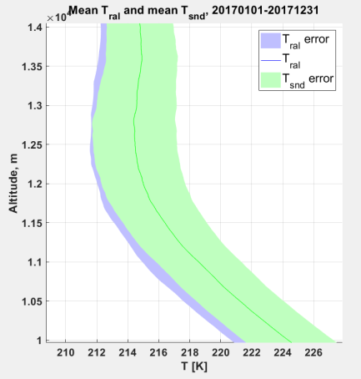
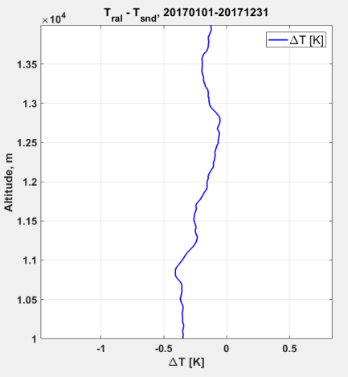
2017 PRR Temperature statistics RAL vs SRS-C50
2017
-0.25 K

Slide 7
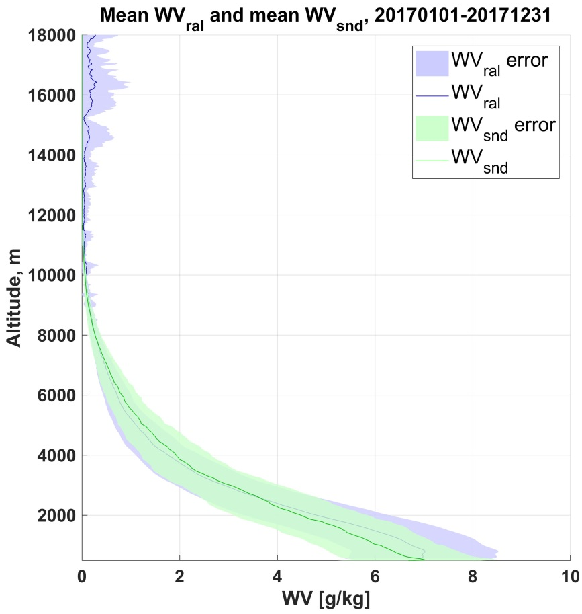
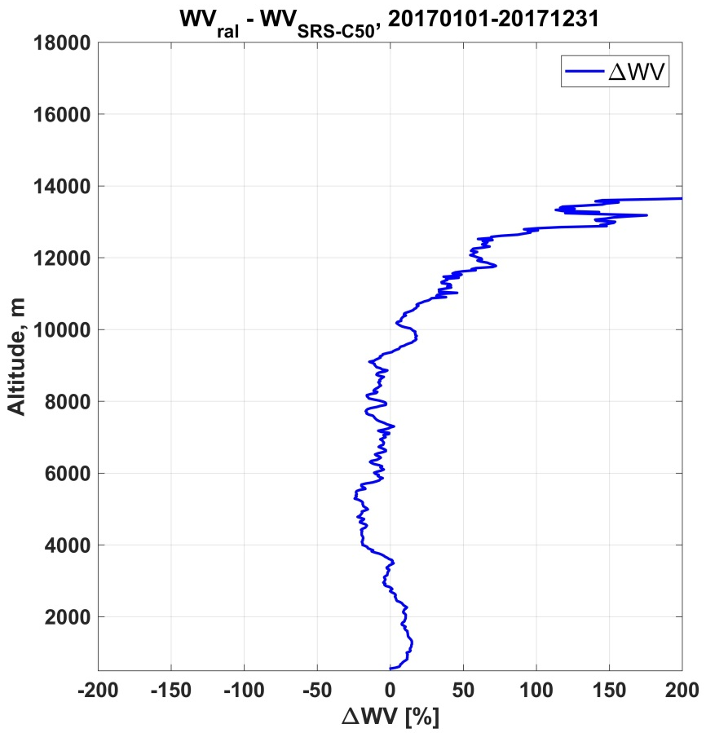
2017 Water Vapor statistics RAL vs SRS-C50
For UTLS validation RS92/RS41 need to be used
Δω≈|10%|

Slide 8
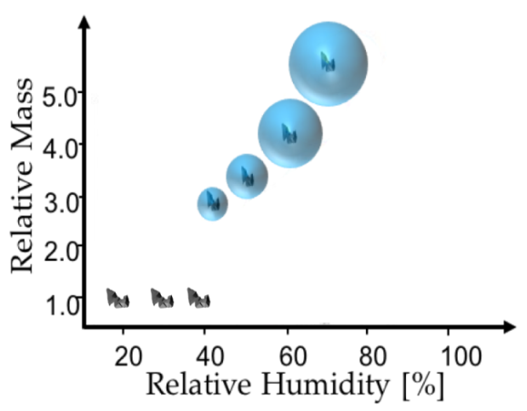

Hygroscopicity
Hygroscopic growth:
Particle size and chemical composition change as function of RH due to water uptake
It affects the scattering of the radiation (direct effect) and the cloud microphysics (indirect effect)
Hygroscopicity is different for each aerosol type
Enhancement factor:
$$fX\left(RH\right)=\frac{Xλ(RH)}{Xλ\left(RHref\right)}$$

Slide 9
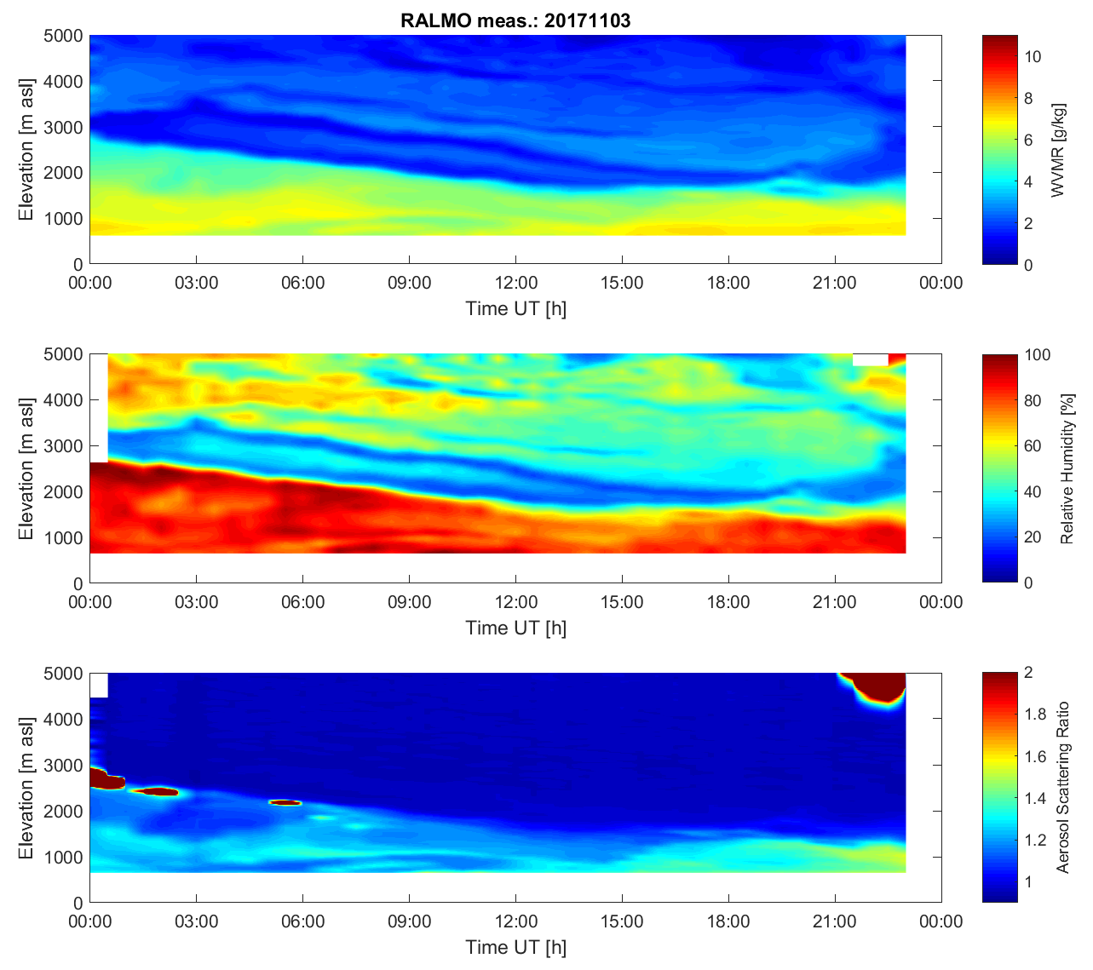
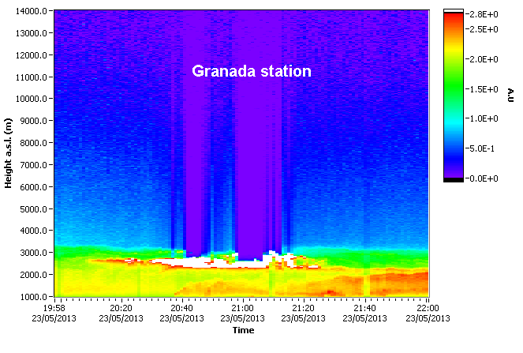
Hygroscopicity
LIDAR measurements of backscatter and RH
Homogeneous aerosol layer with enhanced RH
Air mass origin is the same at all altitudes.
Well mixed layer, i.e. constant profiles of potential temperature (θ) and water vapor mixing ratio (r)

Slide 10
RALMO operations/activities of interest to NDACC in 2017
Continuous real-time measurements, every 30 minutes, of H2O, T
Clear-sky nighttime integrated offline measurements of H2O and T
New RH real-time measurements troposphere and UTLS
Trip to TMF to validate RALMO H2O profiles with GLASS and LidarRun_Client.
On-going publications to be submitted summer/fall 2018:
PRR Temperature validation since FastCOM
OEM PRR Temperature climatology (MeteoSwiss + Western)
OEM H2O (MeteoSwiss + Western)
2018: create the HDF matlab routine based on WV template and submit 2008-2018 data to the NDACC server

