Slide 1
Ozone Monitoring in Río Gallegos NDACC Station, Argentina
Instrument Operation and Data Status
CEILAP (CITEDEF-CONICET), UMI-IFAECI-CNRS 3351,
Río Gallegos Santa Cruz, Argentina
Jacobo Salvador
Jonathan Quiroga
Eduardo Quel

Slide 2
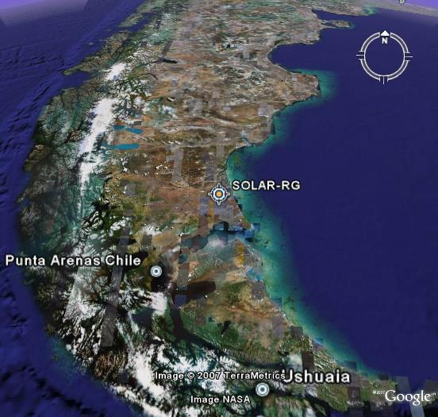
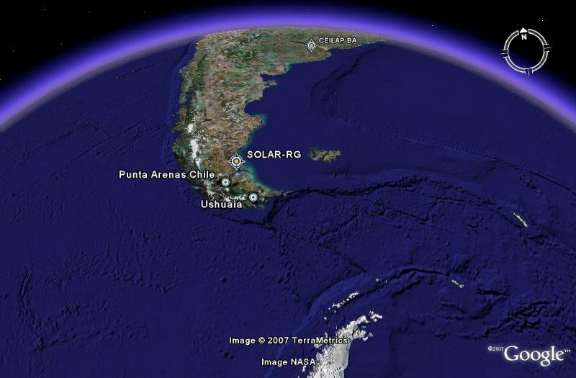
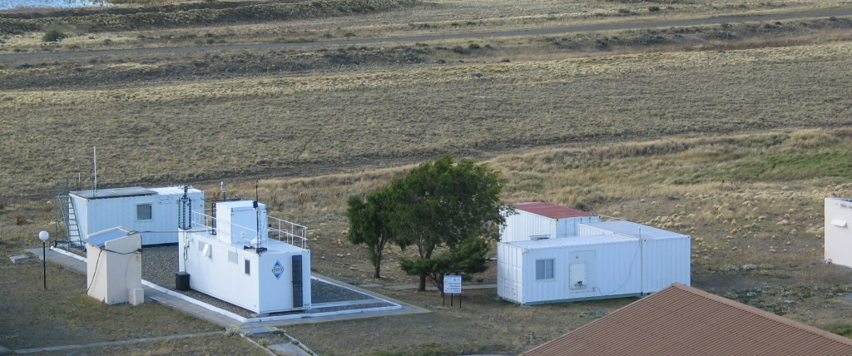
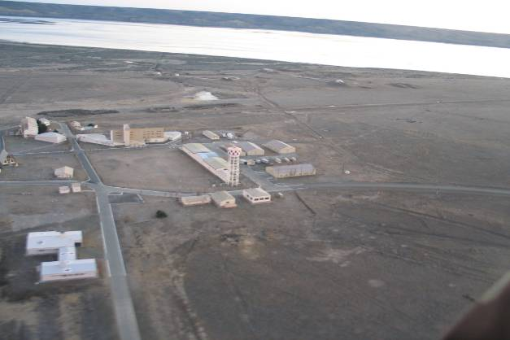
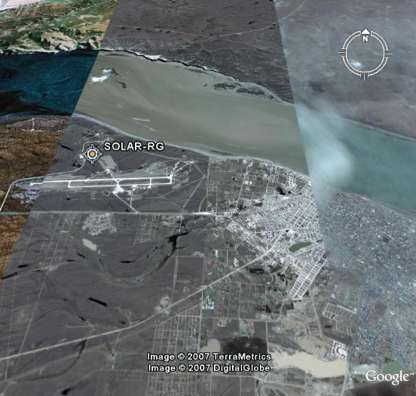
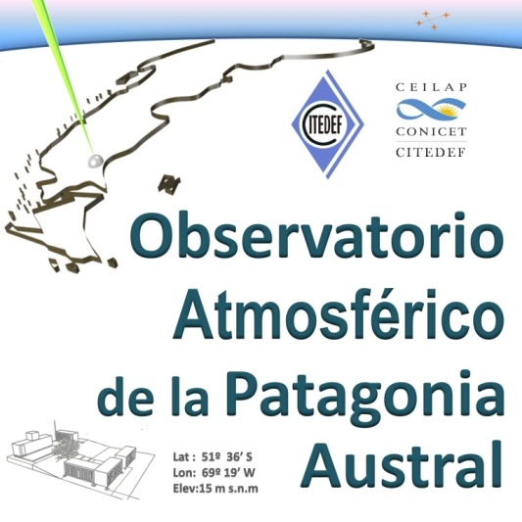
Atmospheric Observatory of Southern Patagonia
Province of Santa Cruz, Argentine Patagonia.
Lat: 51º 36’ S, Lon: 69º 19’ W.
Military Air Force Base, Río Gallegos - Fuerza Aérea Argentina (FFAA)

Slide 3
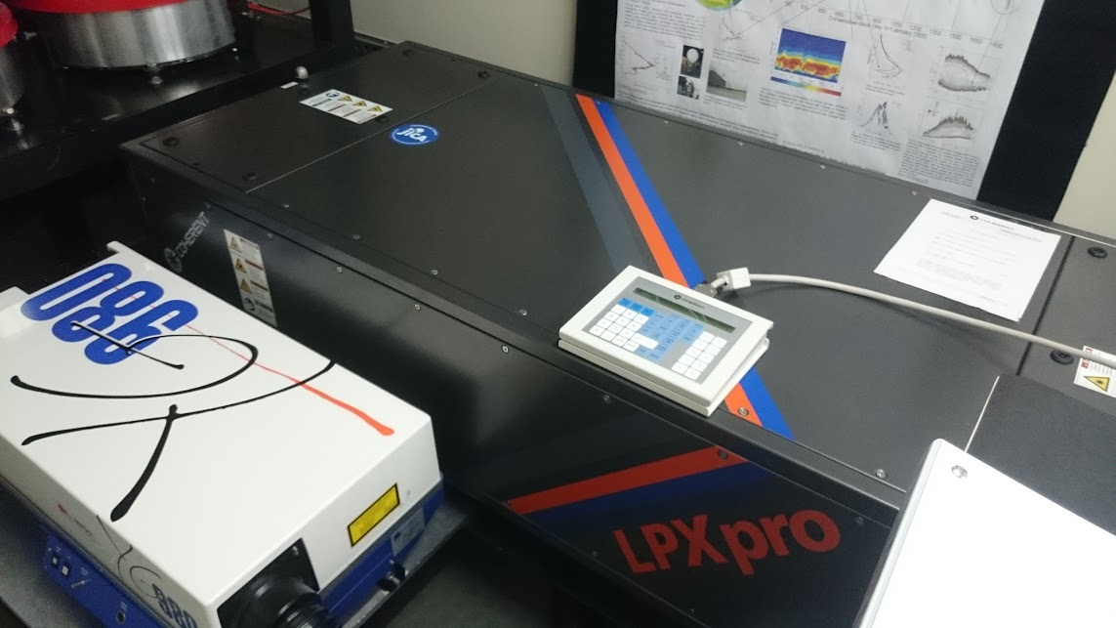
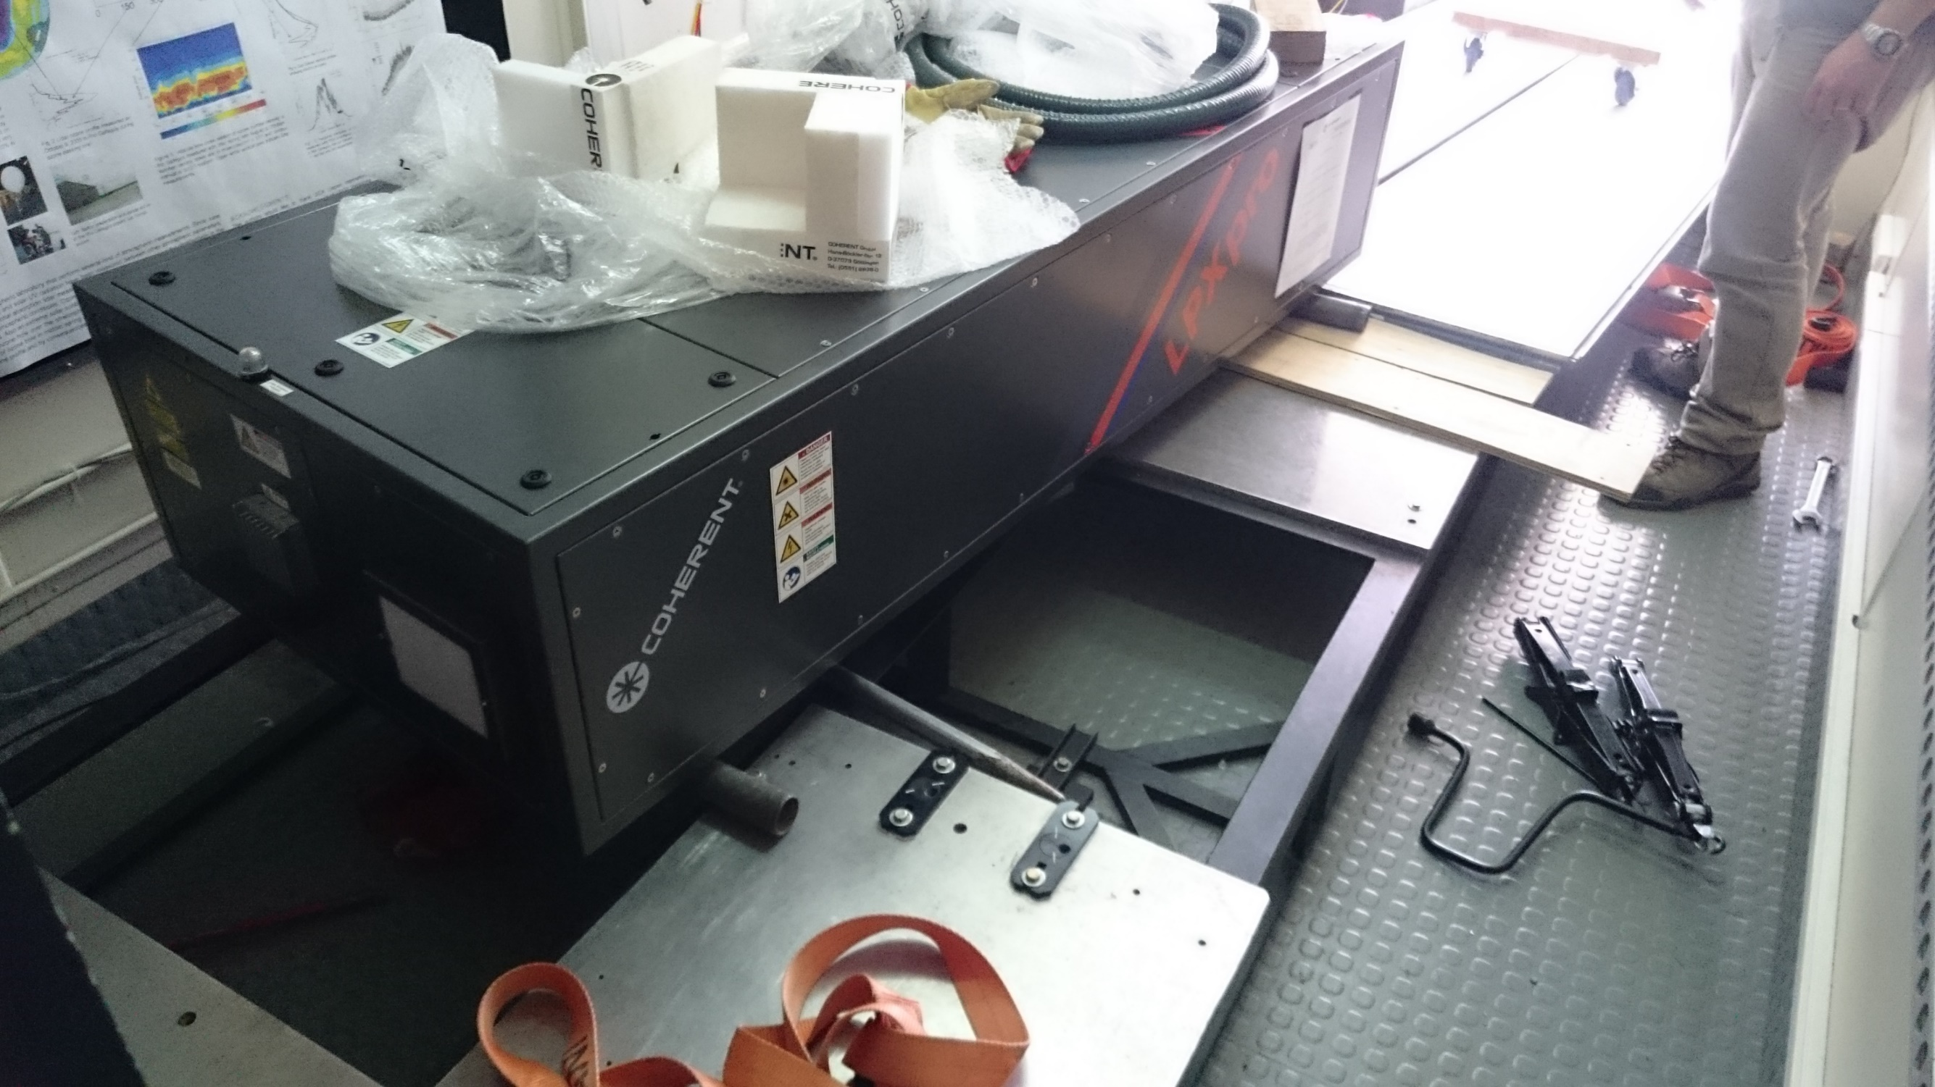
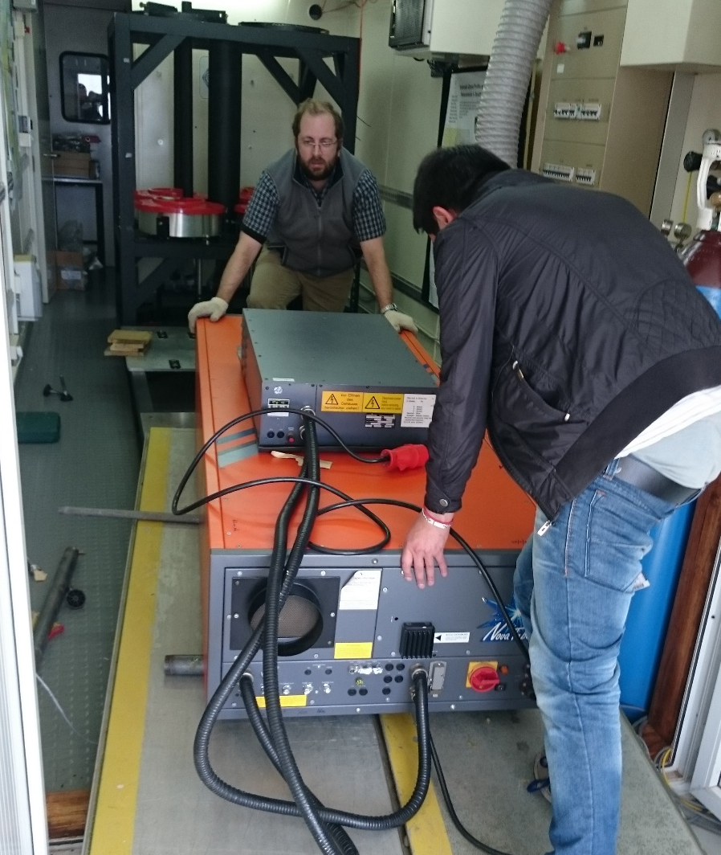
New Eximer LPX-Pro220 Laser Replacement

Slide 4
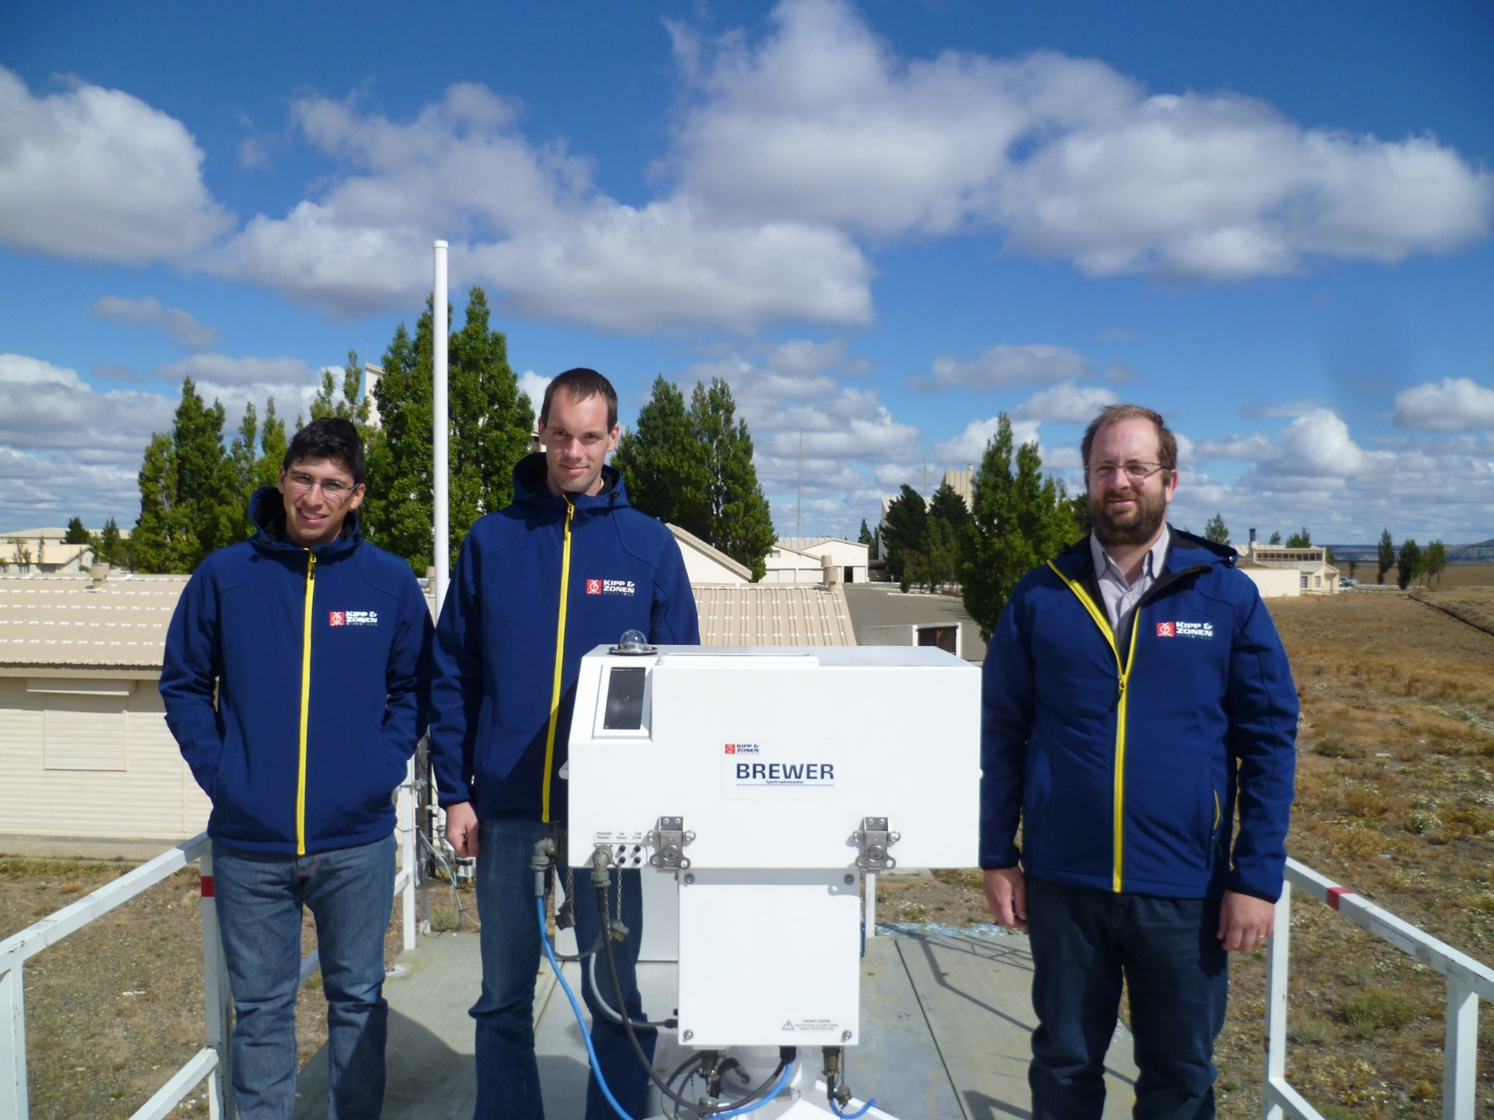
New Brewer MKIII #299 Installed on February 2016
Installed on February 2016 as part of framework SAVER-Net (Argentina-Chile-Japan)

Slide 5
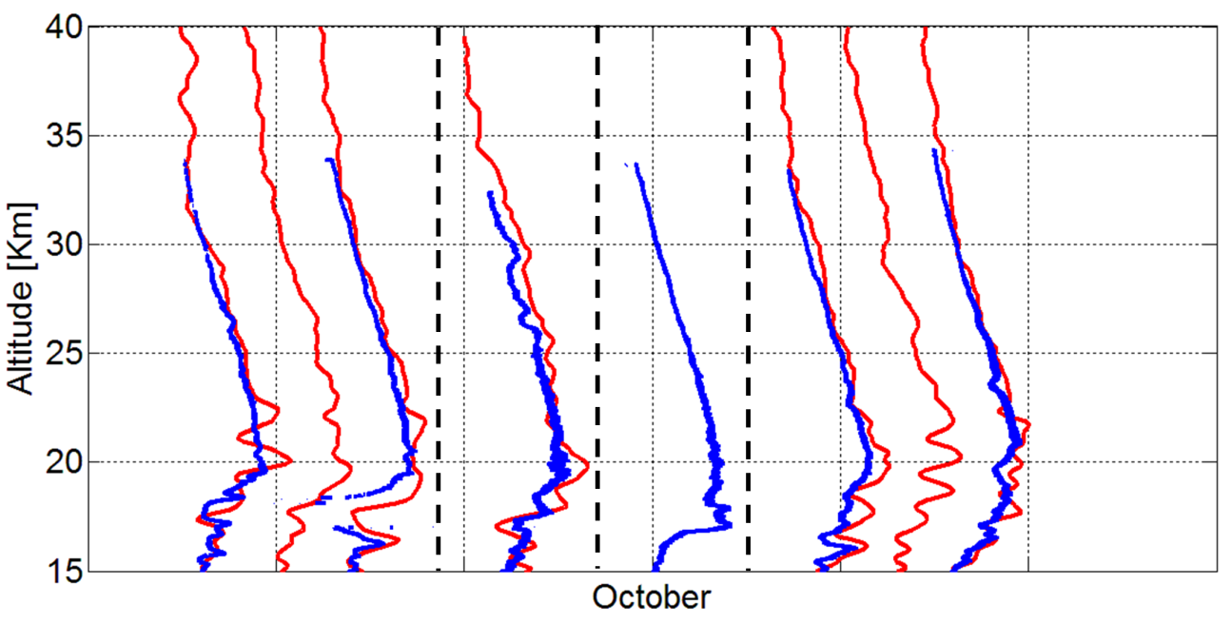
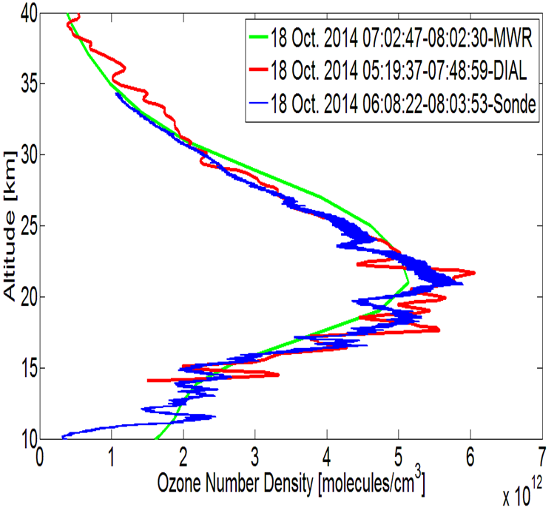
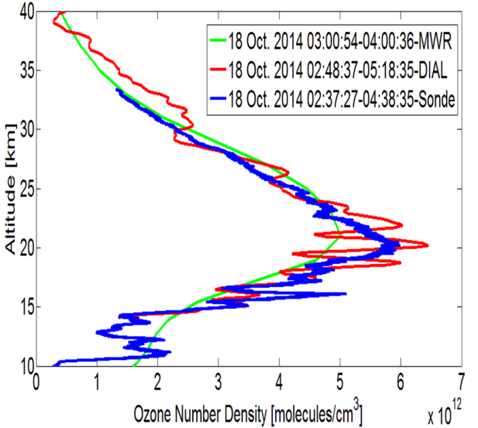
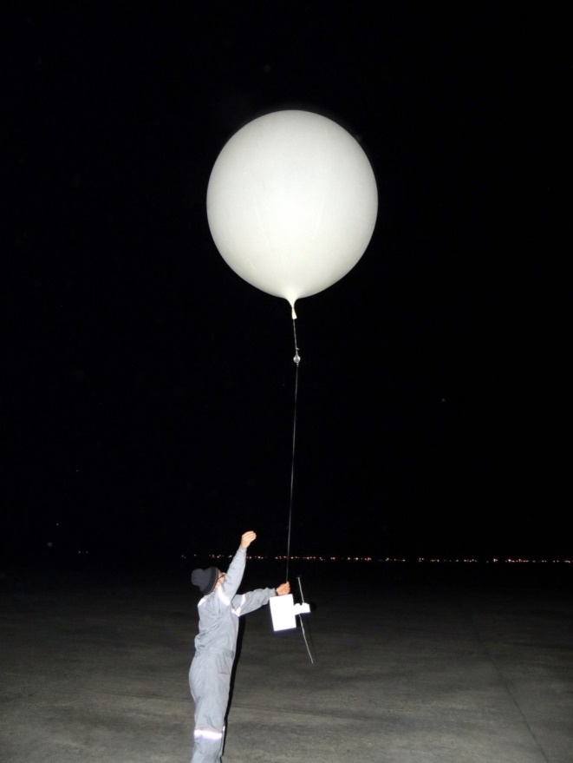
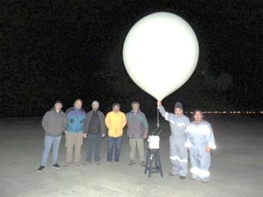
OZITOS+ Campaign:OZone profIle aT rio gallegOS DIAL+Ozone Sondes + mm wave radiometer
Inter-comparison between stratospheric ozone profile measured by DIAL instrument at OAPA Site (red) and the sonde (blue) launched from the local Airport by the personal LICA Lab. Magallanes Univ.(Chile).For Oct 15 and 18 two sondes were launched during the same night. The correlation between both instruments show more observations provided by DIAL instrument, this is due the large integration time during the night which might be separate at independent observations.

Slide 6
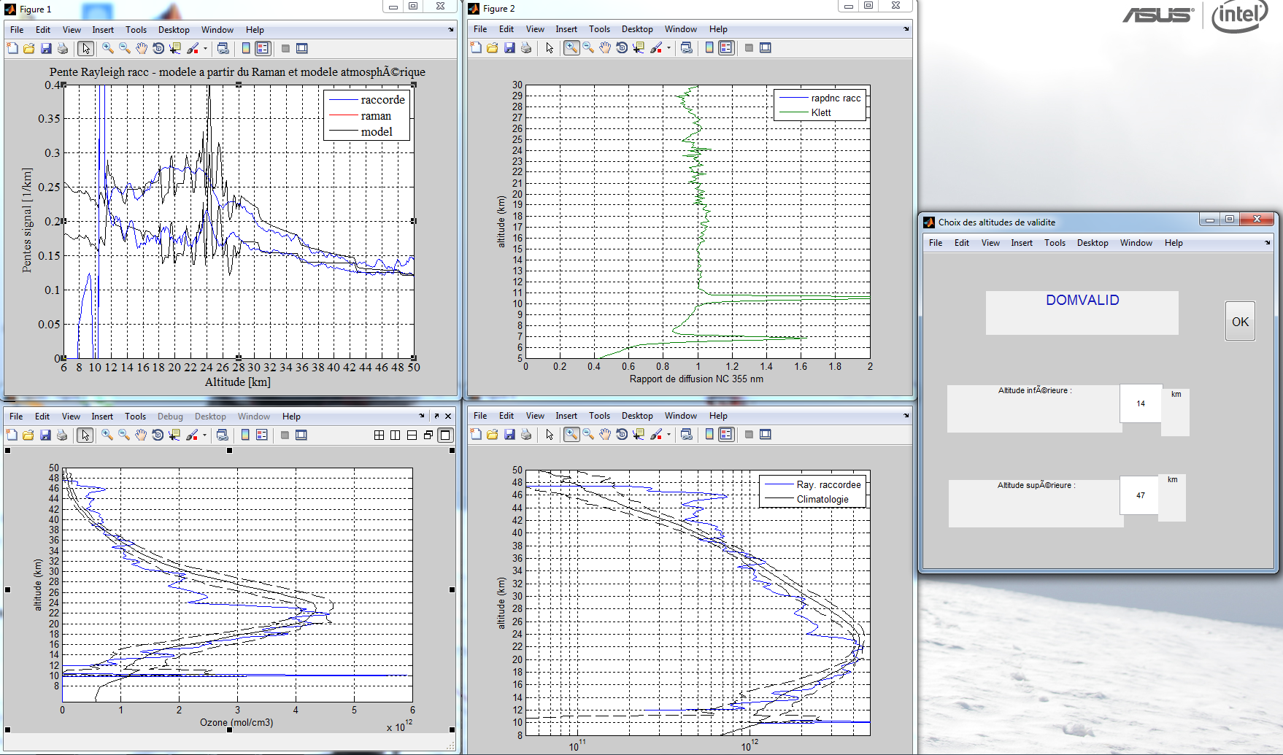
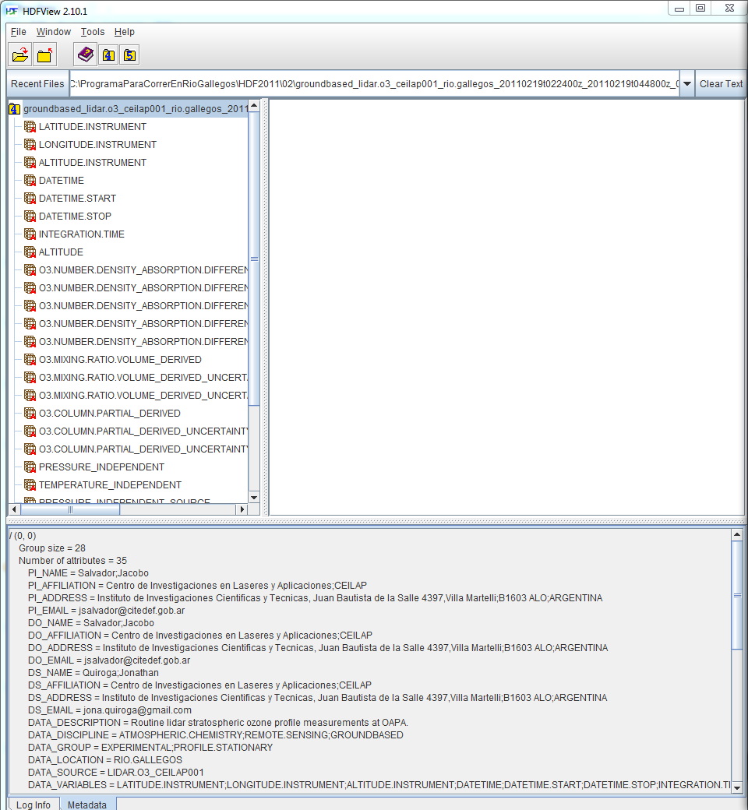
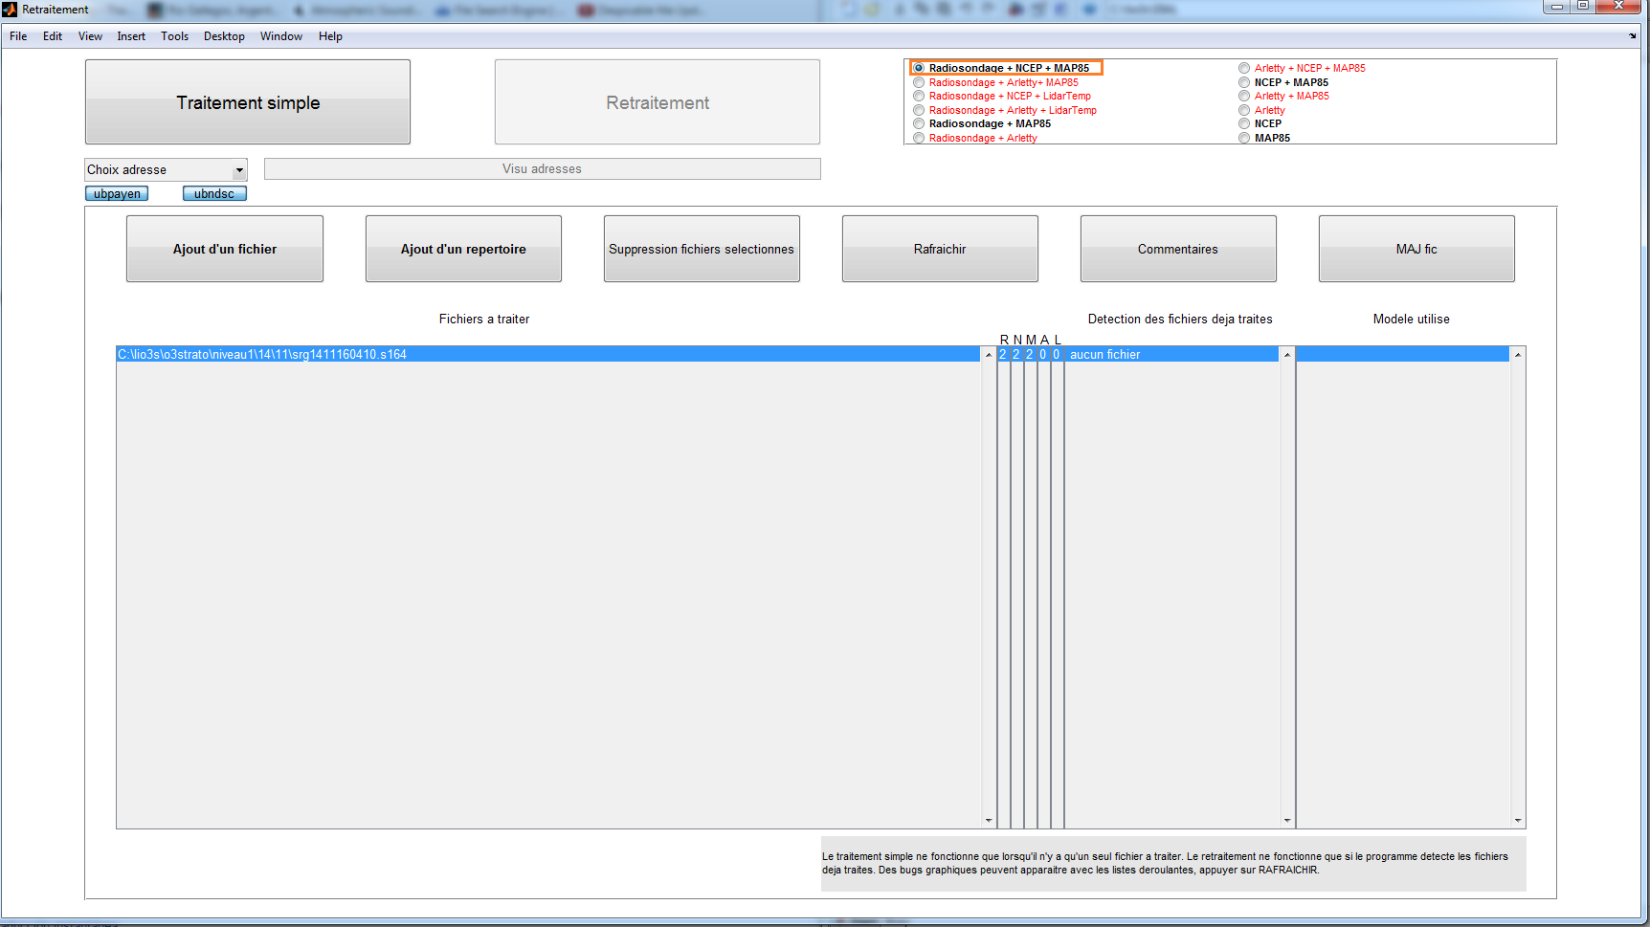
Measurements = DIAL V6 + HDF

Slide 7
Outline
We are working in the adaptation of new ozone algorithm inversion
used to generate HDF files directly.
Actually data to NDACC are submitted using AMES format but also we have facilities to upload using GEOMS routines, (HDF Format - CAMS27)
We are working in the validation of Rayleigh Lidar temperature
profiles measured in the OAPA satellites platform. A possible collaboration with international campaign at Río Grande, Argentina is starting with DLR.
New Excimer Laser (LPX Pro 220) and Brewer Spectrometer MKIII #229 installed on February 2016

Slide 8
Perspectives
We plan to continue with routing measurements rate during 2018 after no financial support at the moment to adquire gases for Eximer laser.
Troubles
Permanent troubles with gas supply due to financial support, unstable observation
Xenon Xe | Buffer Ne
Purity 99.995% Qty 120 lts. | Pureza: 99.995% Presión 2000 psi Qty 4500 lts
Halogen Hydrogen Chloride (HCl, H₂ in He)
Tipo de gas: 4.5% HCl y 0.9% H2 en He Helium Balance Purity 99.995% Qty 120 lts.
Funding:
New international project in collaboration with the Japan Science and Technologies (JST) started 2013 and have finished on March 2018. No international funding for 2018. Additional funding support minor activities at OAPA

