Slide 1


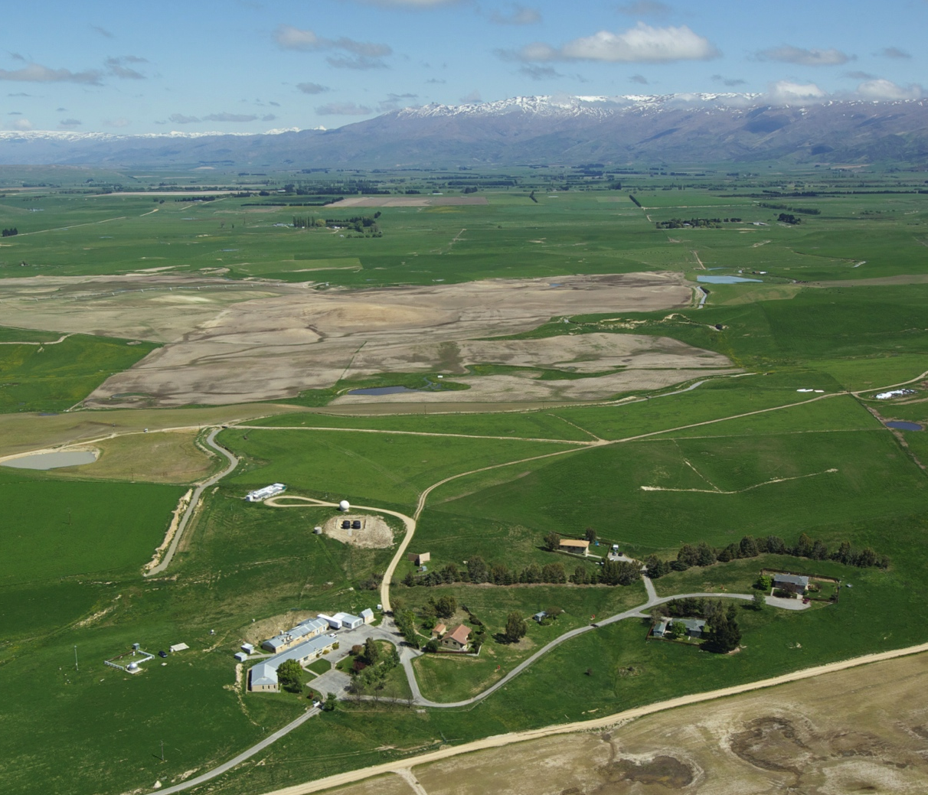
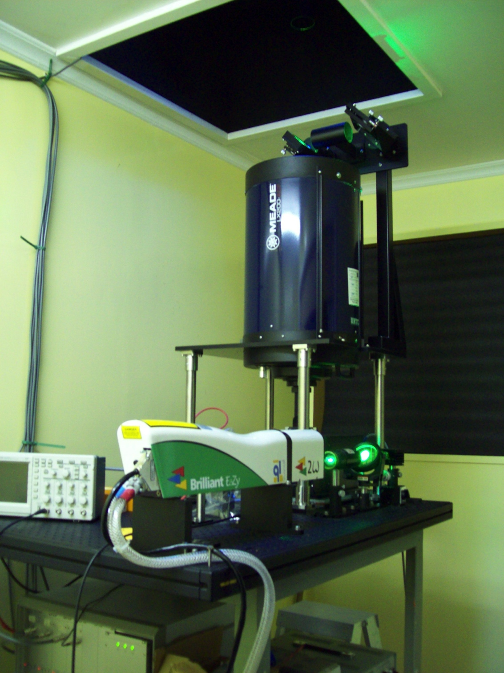

Lauder Aerosol Lidar
2018 report
Ben Liley – NIWA, New Zealand
Osamu Uchino – NIES, Japan
Tetsu Sakai – MRI, Japan
5th TOLNet / 2018 NDACC LWG Meeting, 7-11 May, University of Alabama, Huntsville

Slide 2
Instrumentation
NDACC Technique PIs Lauder staff Dates
Stratospheric aerosol NdYAG 532 nm, sequential PC Liley/Nagai 0.5 1992-2009
Stratospheric aerosol Nd:YAG 532 & 1064 nm, Liley/Uchino/Sakai 0.3 2009-present
PC & analogue, 532 polarisation
TCCON (Total Column Carbon Observing Network)
Trop. aerosol & cloud Nd:YAG 532 & 1064 nm, Uchino/Morino/Sakai 0.3 2009-present
PC & analogue, 532 polarisation
Supporting measurements
Ozone- & frost-sondes Lauder, weekly & monthly 1985-present
PTU radiosondes Invercargill (186 km SW), twice daily 1956-present
BSRN GFR radiometry, AOD (4-ch.) Liley/Aust. BoM 1999-present
SkyNet Prede Skyradiometer, AOD (11-ch.) 2011-present
Associated NDACC
Ozone Sondes, Lidar, Dobson, Microwave Querel/Swart
Trace gases Mid-IR FTS, UV-vis DOAS Smale
UV Spectroradiometer Liley/Geddes
Associated TCCON & GRUAN
Greenhouse gases TCCON - Near-IR FTS Pollard
Climate data profiles GRUAN - Balloon-borne Querel
5th TOLNet / 2018 NDACC LWG Meeting, 7-11 May, University of Alabama, Huntsville

Slide 3
Status of Operations
NDACC
Stratospheric aerosol measurements simultaneous with RIVM ozone lidar operation, four times per month.
Ozonesonde release within 24 hours if weather permits.
TCCON
Tropospheric aerosol & cloud measurements during overpass by GOSAT (Greenhouse gas Observing Satellite).
Overpasses occur every three days, but observations are Mon-Fri and require clear skies.
Observations for OCO-2 overpass, SAGE III (ISS), and quarterly ATom overflights.
DEEPWAVE, Volcanic eruptions
The lidar is operated continuously during periods of particular interest, including daytime operation.
In 2014, operated on all clear nights in June and July, in support of the DEEPWAVE study of gravity wave propagation into the mesosphere. Temperature profiles by DLR mobile lidar from late June to early November 2014.
Frequent measurements from May 2015 to October 2015 to characterise Calbuco plume.
Analysis
Analysis of both TCCON and NDACC data is regularly completed by Tetsu Sakai.
Conversion to NDACC format yet to be implemented, by Ben Liley.
5th TOLNet / 2018 NDACC LWG Meeting, 7-11 May, University of Alabama, Huntsville

Slide 4
Observations and Archiving
NDACC
Stratospheric aerosol measurements are mostly simultaneous with RIVM ozone lidar operation, approximately four times per month.
The NDACC archive contains MRI aerosol data up to 2008, after which the lidar was upgraded.
Ben Liley had been working to analyse the new stratospheric data in a manner consistent with the old, but now Tetsu Sakai has developed his analysis to cover all past data.
Ben is comparing the data series, with a view to submitting a combined series from 1992 to the present.
The new data include:
 | 2009 | 2010 | 2011 | 2012 | 2013 | 2014 | 2015 | 2016 | 2017 | 2018
Nights | 58 | 56 | 70 | 36 | 37 | 64 | 112 | 46 | 38 | 42
 |  |  | Puyehue-Cordón Caulle |  |  | DEEPWAVE | Calbuco |  |  | (to date)
5th TOLNet / 2018 NDACC LWG Meeting, 7-11 May, University of Alabama, Huntsville

Slide 5
Publications and Funding
Publications and Presentations since 2013
Nakamae, K., et al. (2014), Lidar observation of the 2011 Puyehue-Cordón Caulle volcanic aerosols at Lauder, New Zealand, Atmos. Chem. Phys., 14, 12099-12108, doi:10.5194/acp-14-12099-2014.
Sakai, T., et al. (2016), Long-term variation of stratospheric aerosols observed with lidars over Tsukuba, Japan from 1982 and Lauder, New Zealand from 1992 to 2015, Journal of Geophysical Research: Atmospheres, 121, 10283-10293, doi:10.1002/2016JD025132.
Ehard, B., et al. (2017), Horizontal propagation of large-amplitude mountain waves into the polar night jet, J. Geophys. Res., 122, 1423-1436.
Kaifler, N., et al. (2017), Observational indications of downward-propagating gravity waves in middle atmosphere lidar data, J. Atmos. Solar-Terr. Phys., 162, 16-27, doi:10.1016/j.jastp.2017.03.003.
Liley, J. B., et al. (2014), Stratospheric aerosol over Lauder, New Zealand, in SPARC, Queenstown, New Zealand.
Sakai, T., et al. (2015), Long-term variation of stratospheric aerosols observed with lidars from 1982 to 2014 over northern and southern midlatitudes, in 27th International Laser Radar Conference, edited, New York.
Uchino, O., et al. (2016), Lidar observations at prioritized sites for GOSAT validation, in AGU Fall Meeting, edited, San Francisco.
Staff and Funding
After a contraction five years ago, Lauder is back to reasonable strength with four scientists and four technicians.
They operate a wide range of instruments, contributing data to four major international networks:
NDACC, BSRN, TCCON, and GRUAN.
Facility funding is static.
NIES fund lidar operation during GOSAT overpass, determined biennially.
5th TOLNet / 2018 NDACC LWG Meeting, 7-11 May, University of Alabama, Huntsville

