Slide 1

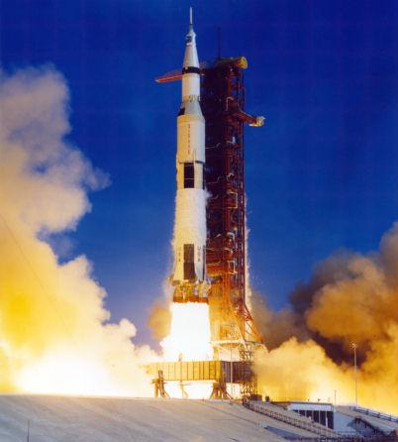
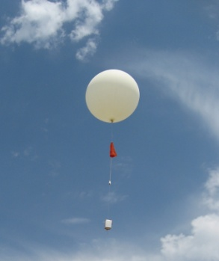
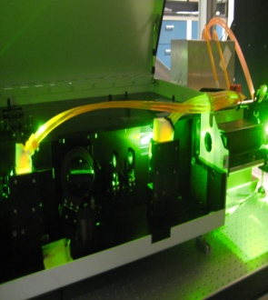


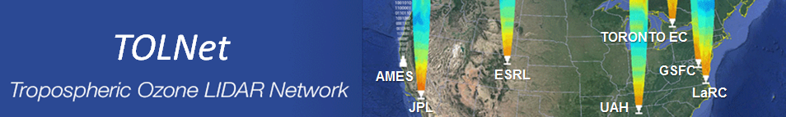
Huntsville Station Report
NDACC Lidar Working Group Meeting
Huntsville, AL, U.S.A.
May 10, 2018
Shi Kuang, Mike Newchurch, David Bowdle, Bo Wang, Paula Tucker, Kristen Pozsonyi, Ankur Shah, David Mercier
University of Alabama in Huntsville
http://nsstc.uah.edu/atmchem/

Slide 2
Outline
Data status
Hardware development
Software changes
Scientific studies
Future plan

Slide 3
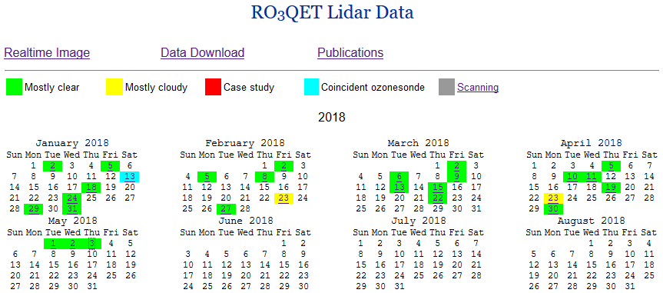
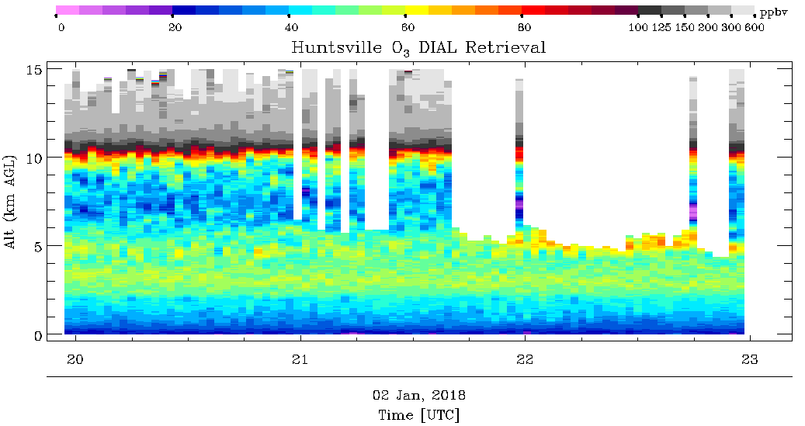
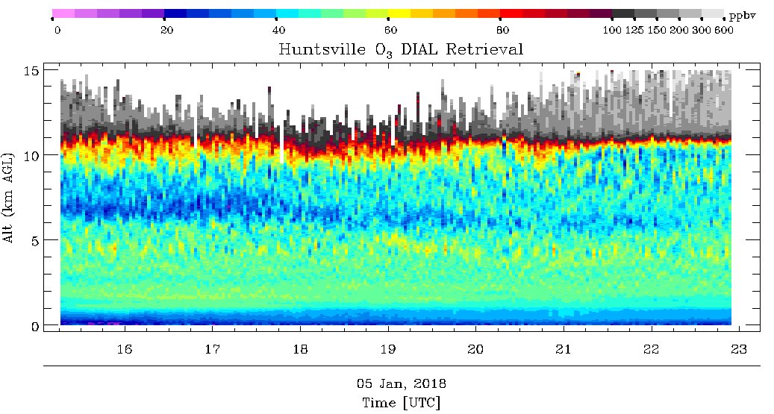
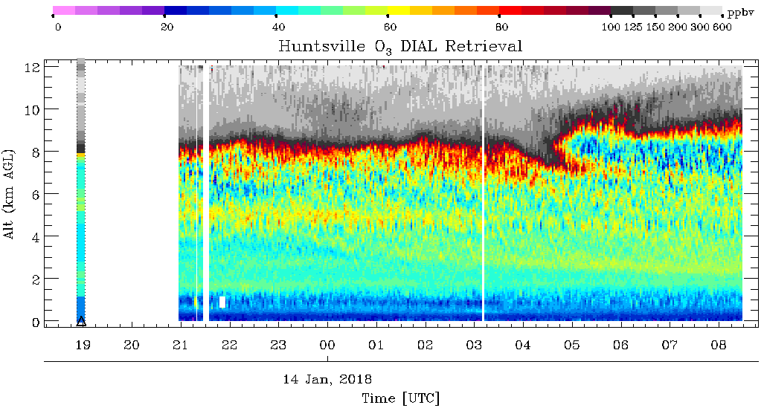
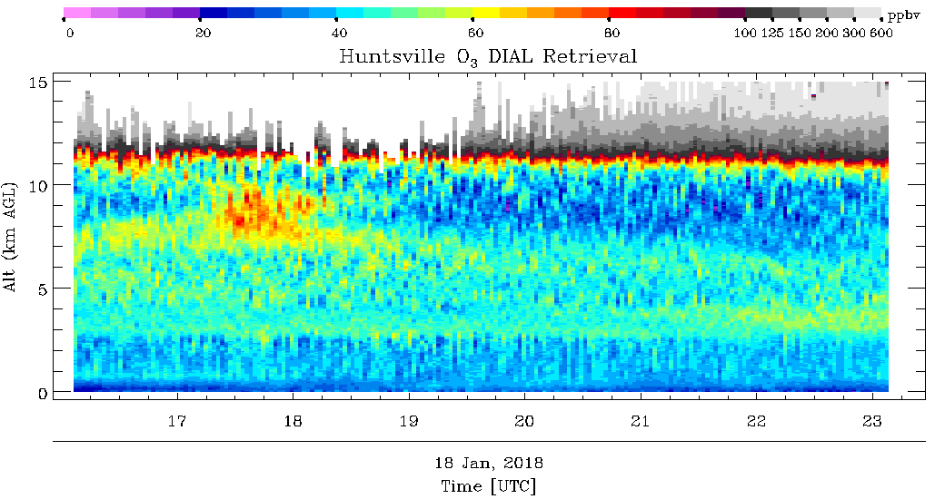
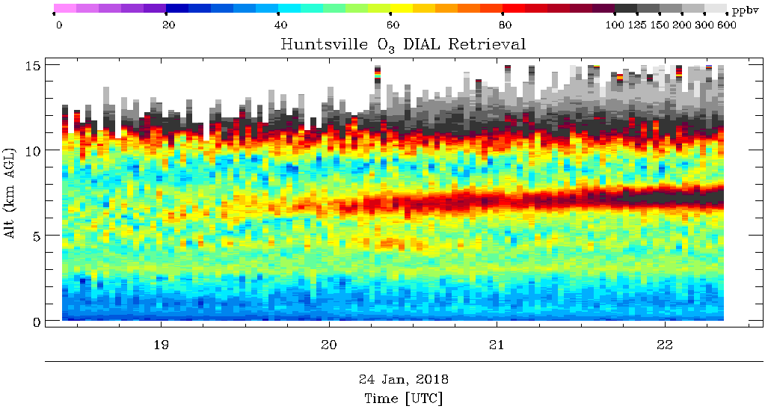
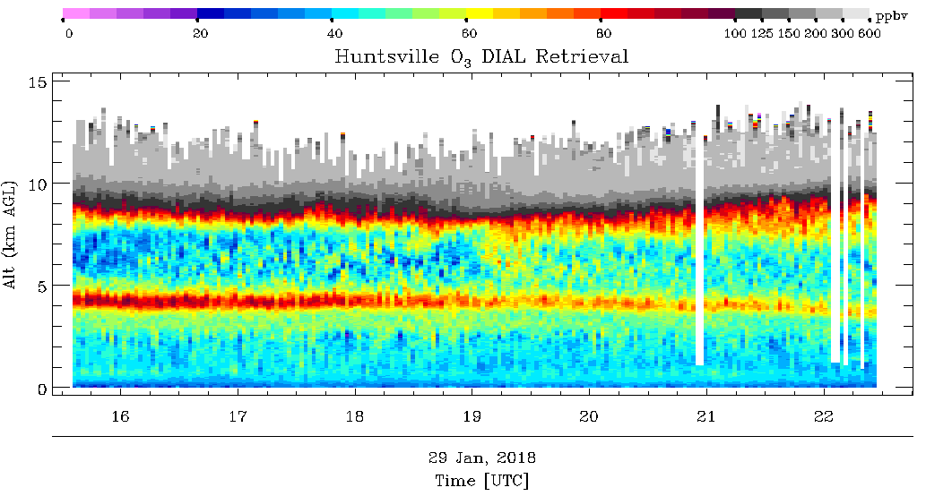
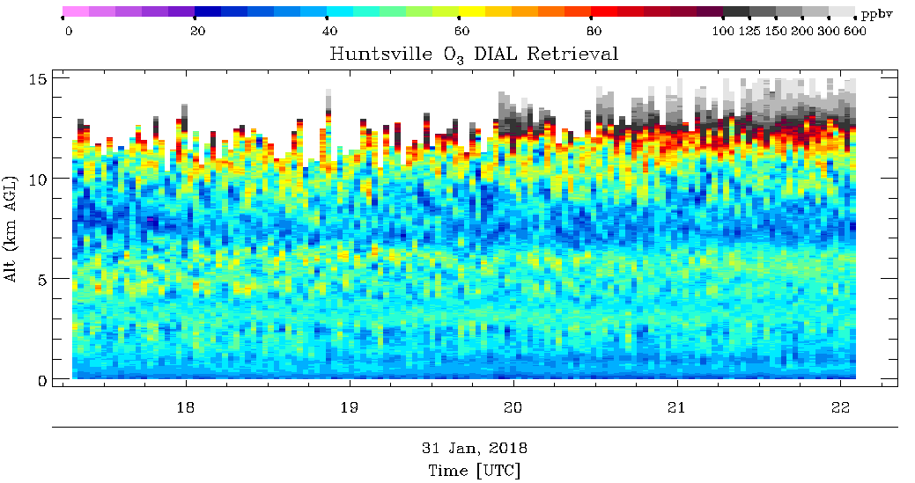
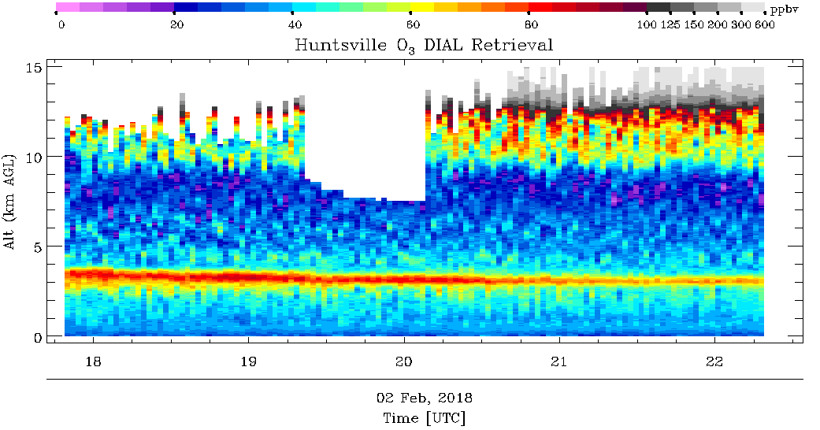
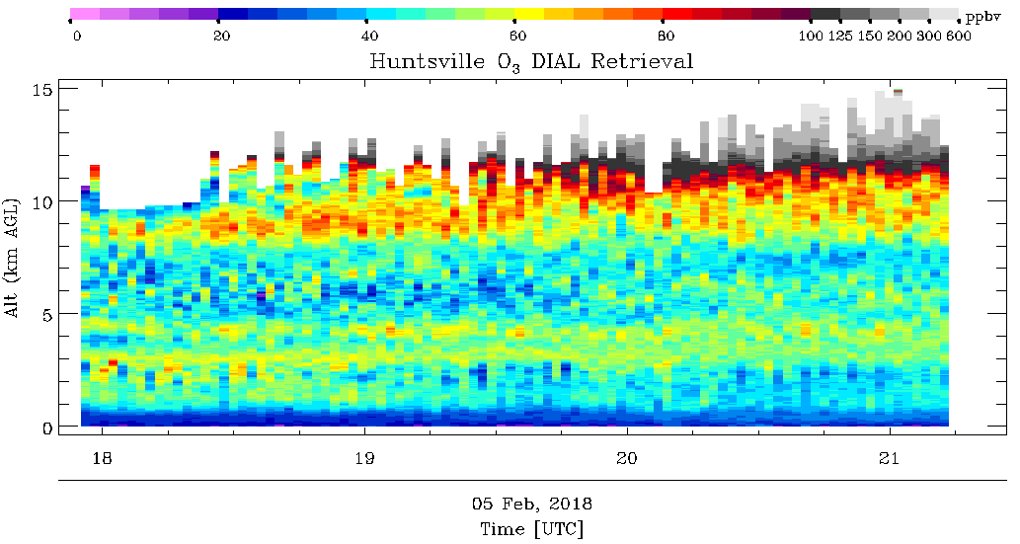
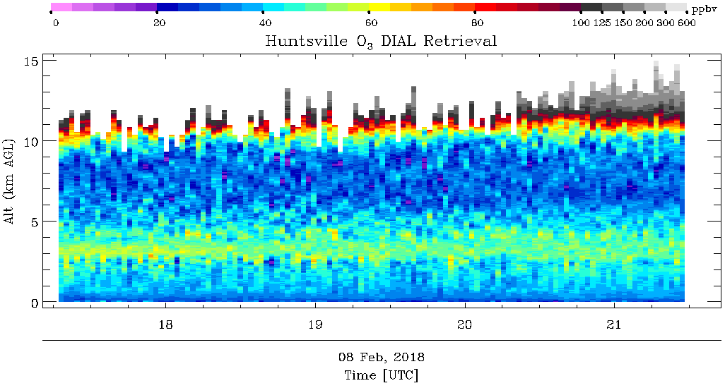
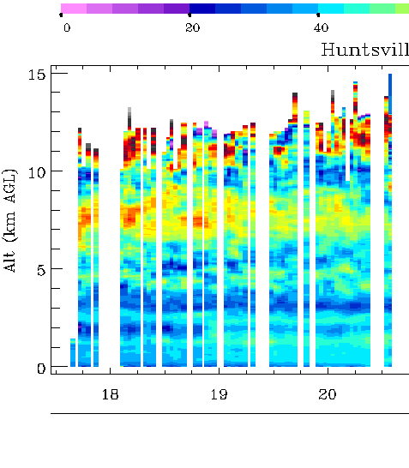
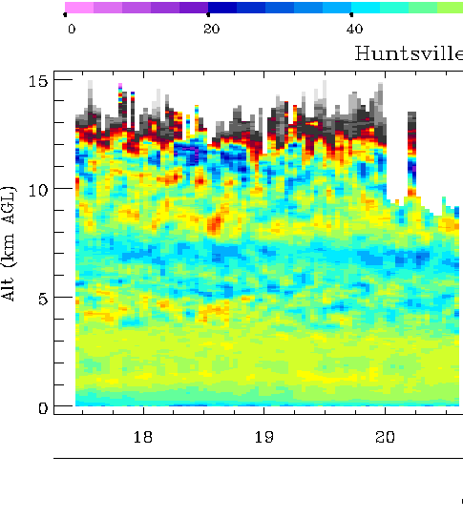
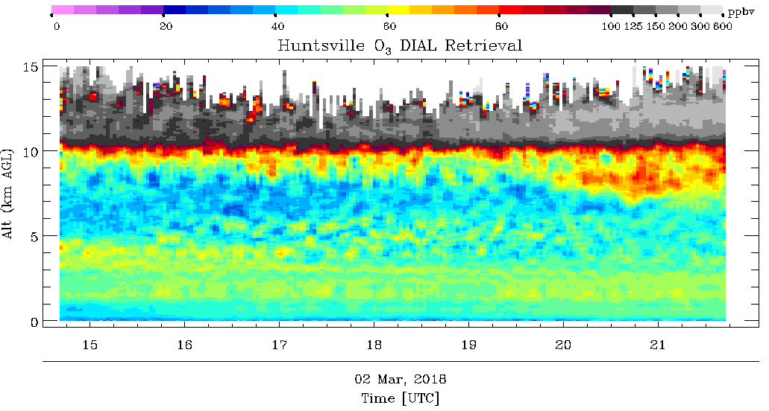
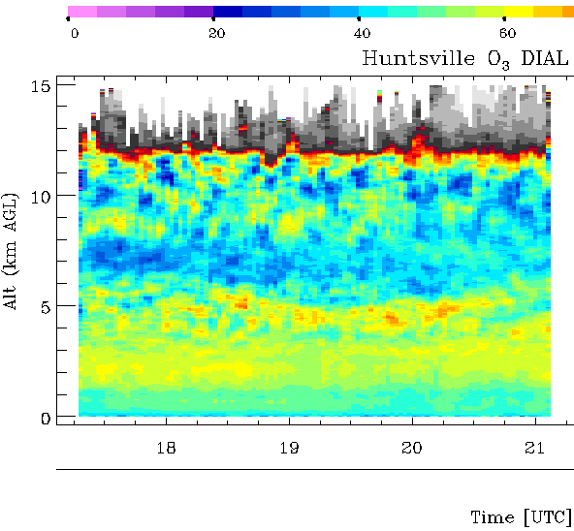
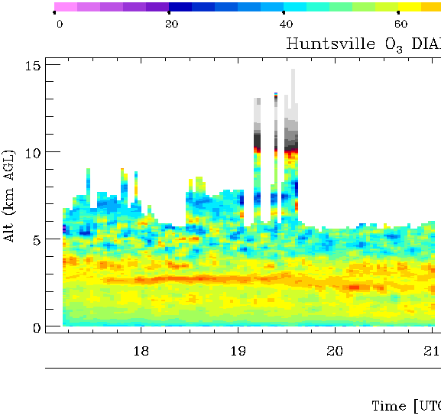
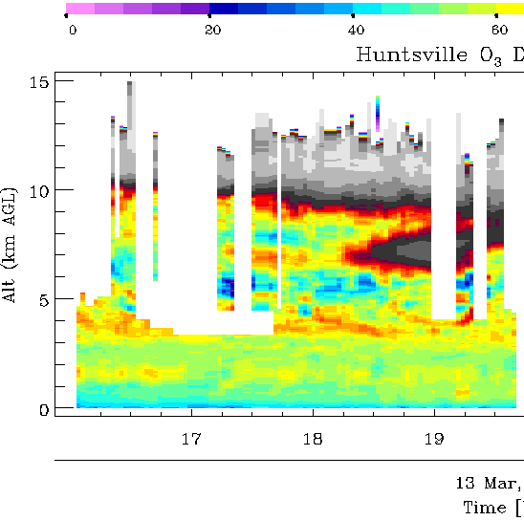
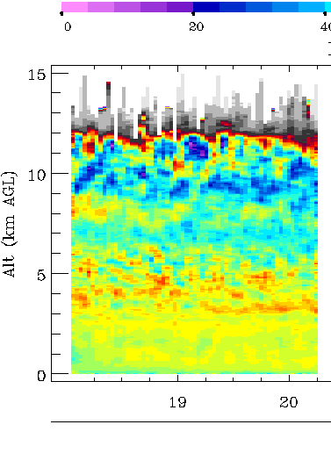
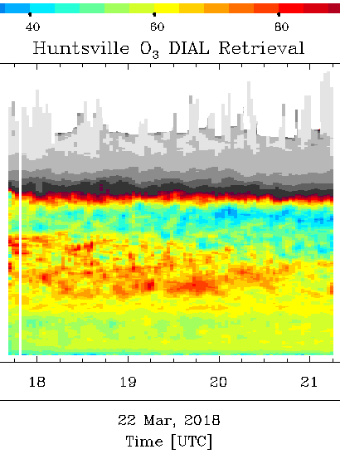
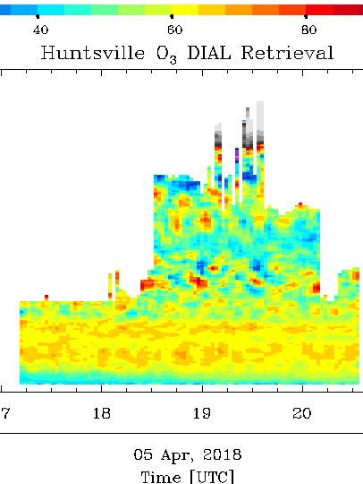
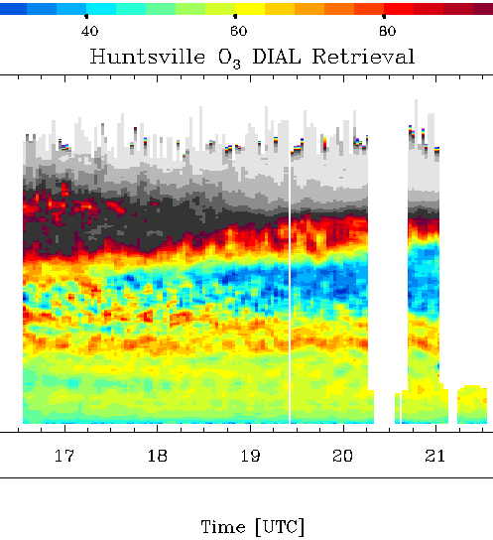
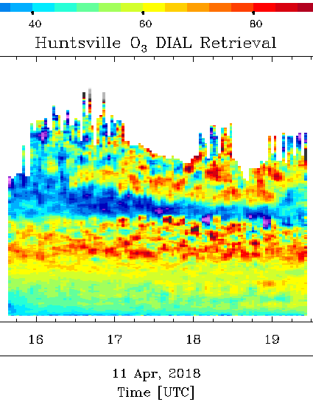
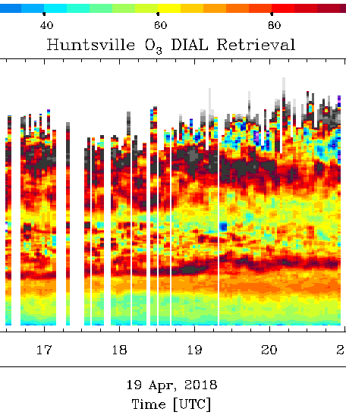
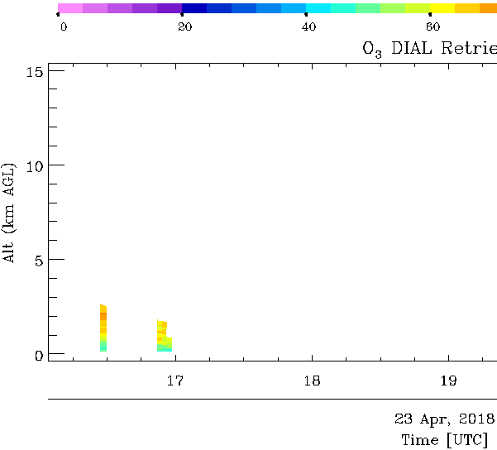
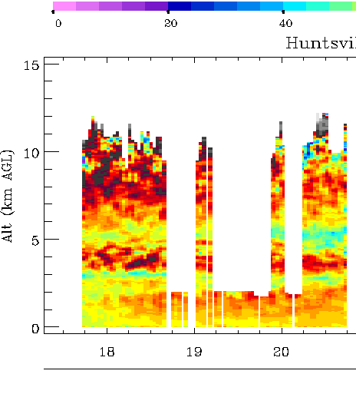
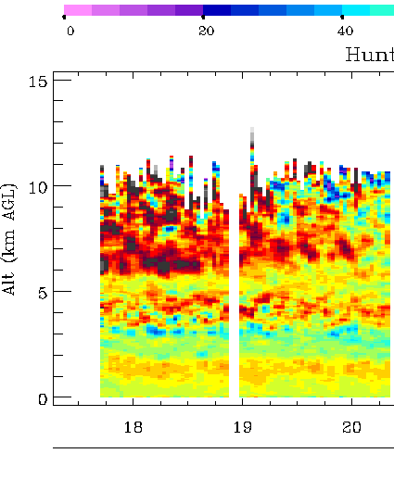
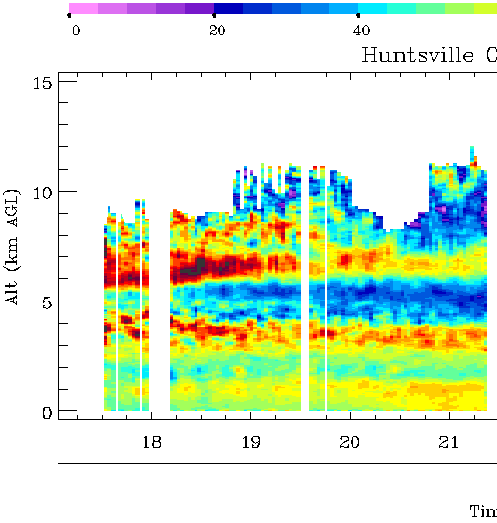
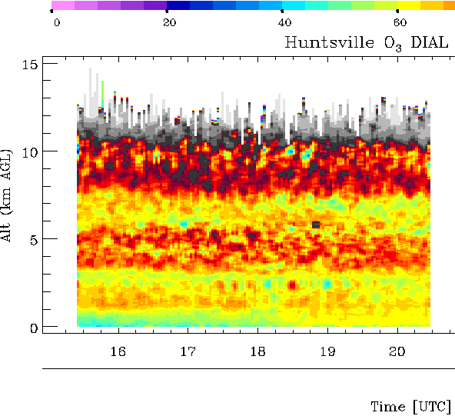
Data
 | Days | Hours
2017 | 34 | 204
2018 (until May 5) | 27 | 119
Expect more data in 2018
1/2
1/5
1/13-14
1/18
1/24
1/29
1/31
2/2
2/5
2/8
2/23
2/27
3/2
3/6
3/9
3/13
3/15
3/22
4/5
4/19
4/11
4/19
4/23
4/30
5/1
5/2
5/3

Slide 4
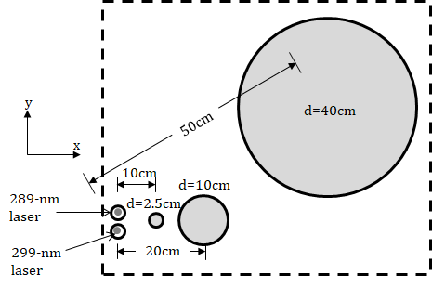
RO₃QET lidar
Rocket-city Ozone (O3) Quality Evaluation in the Troposphere
30Hz, 5-7 mJ/pulse
z
40cm Telescope
1,2,3,4,5 PMT
x
10cm
5
Solar & ND filters
2.5cm
4
10%
299
2
289
Pin hole or iris
90%
1
3
289/299
289/299
289/299
Beamsplitter
289/299 laser
Licel TR
Pulse
generator
Trigger
Photodiode
Gate
Function
generator
Gate
Trigger

Slide 5
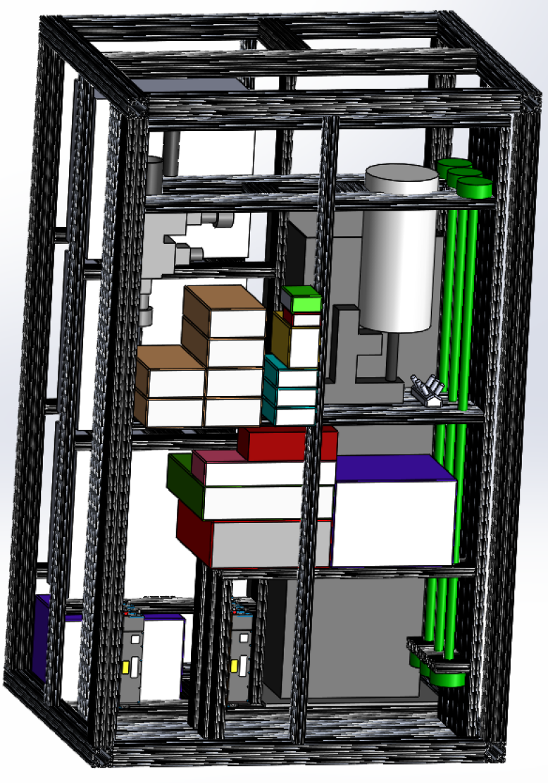
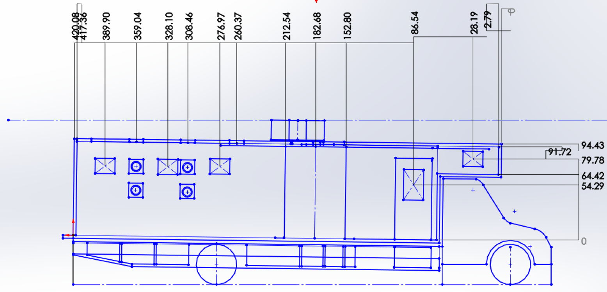
Hardware Development
Truck purchased.
Box in development by contractor.
Truss design finished and in the process of ordering material.
One laser head repaired due to doubler crystal coating damage.

Slide 6
Software Changes
Standardize the uncertainty and resolution according to the NDACC recommendation (Leblanc et al. 2016 a b)
Added five variables (Random uncertainty for # density and mr, systematic uncertainty for # density and mr, impulse response FWHM resolution) in the NDACC hdf files.

Slide 7
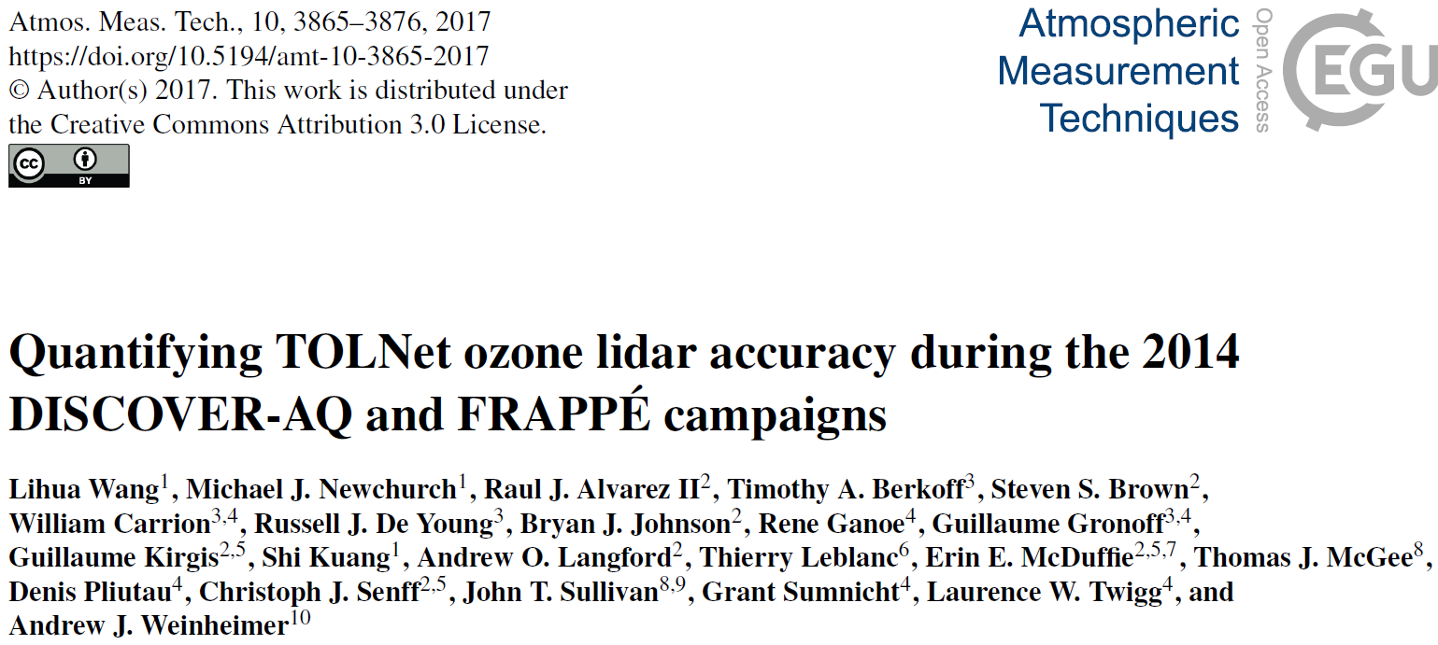
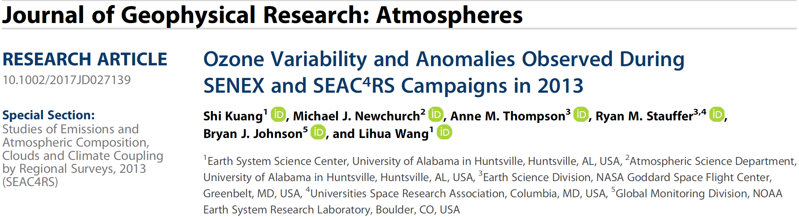
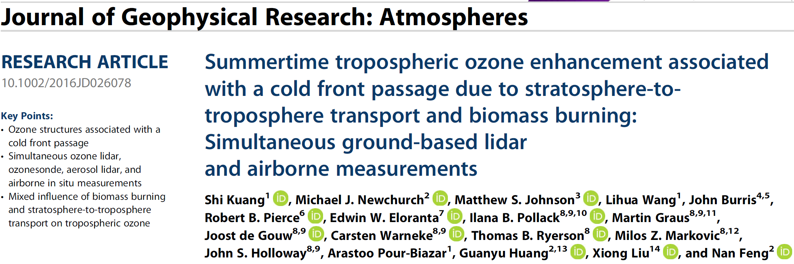
Studies
1st -author papers
Notes:
This study presents the analysis of the intercomparison between the TROPOZ, TOPAZ, and LMOL lidars, along with comparisons between the lidars and other in situ ozone instruments including ozonesondes and a P-3B airborne chemiluminescence sensor. The TOLNet lidars measured vertical ozone structures with an accuracy generally better than ±15% within the troposphere. Larger differences occur at some individual altitudes in both the near-field and far-field range of the lidar systems, largely as expected. In terms of column average, the TOLNet lidars measured ozone with an accuracy better than ±5% for both the intercomparison between the lidars and between the lidars and other instruments.
The SEAC4RS sonde paper analyzed the relationship between ozone anomaly and met variable anomaly in troposphere, and identified the regression slopes, investigated the STT influence in the troposphere, found STT still significant in early summer.
The SEAC4RS lidar paper presents the ozone structure associated with certain weather process.

Slide 8
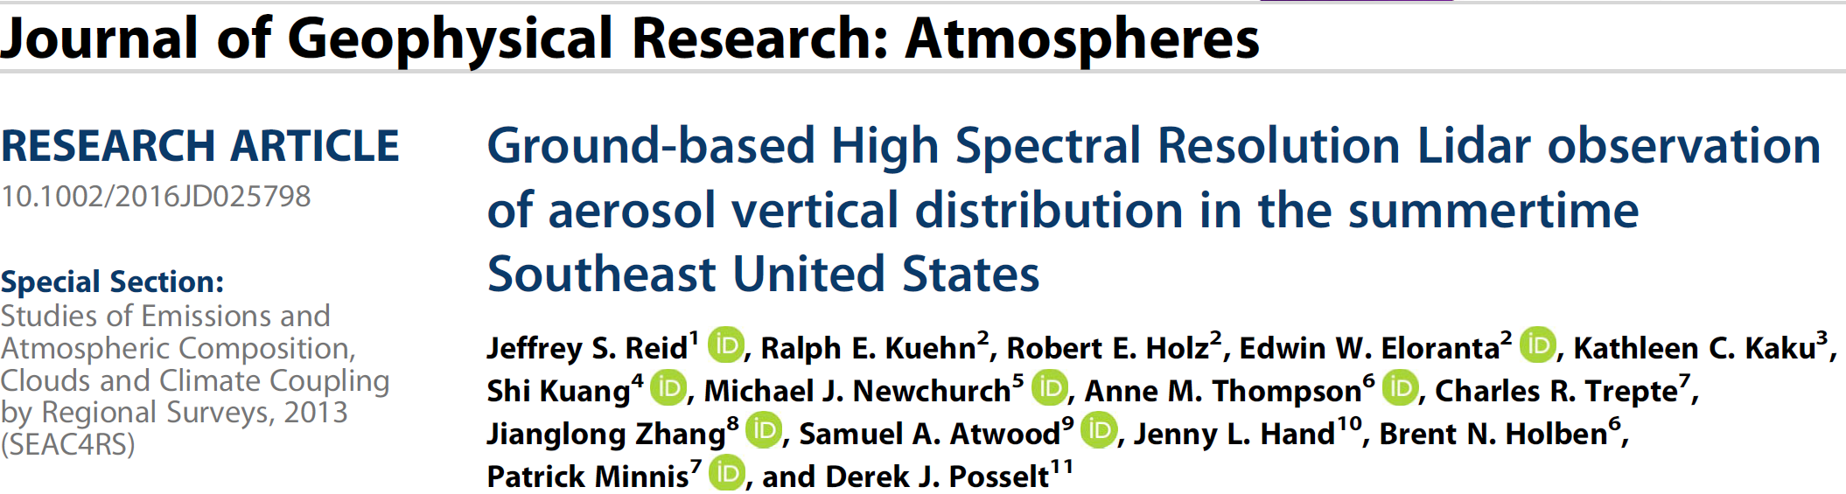
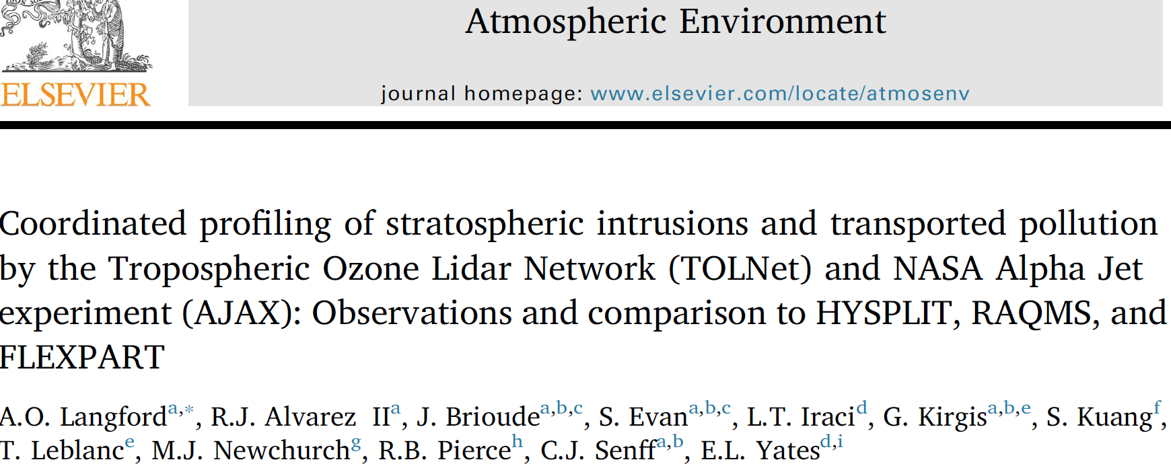
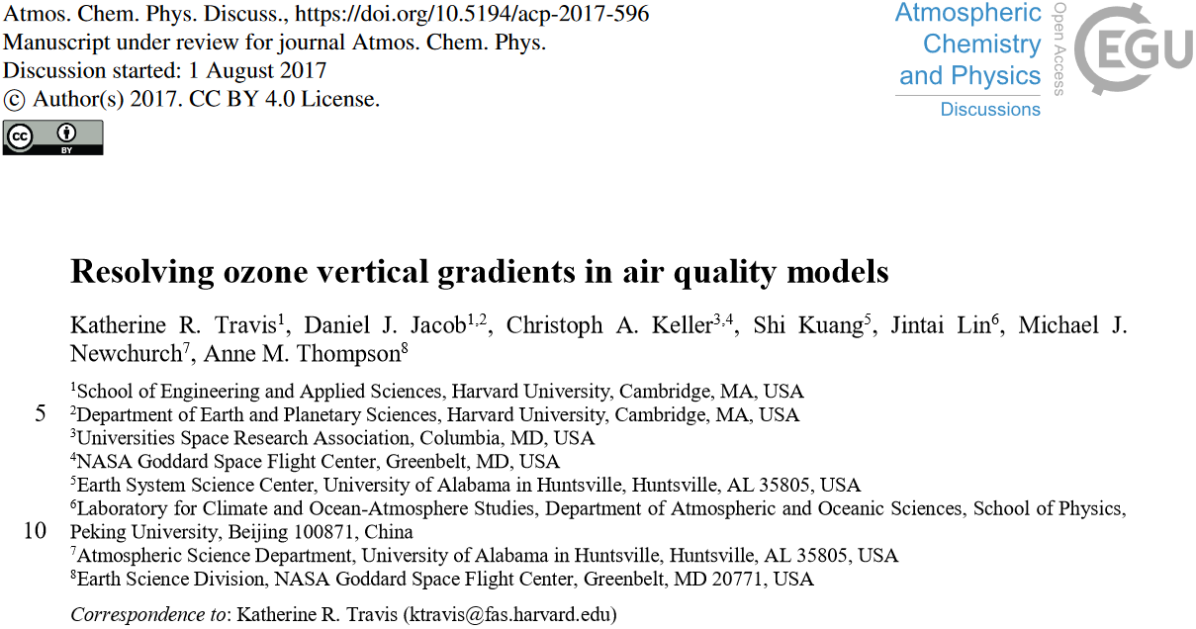
Studies
Co-author papers
Notes:
Reid et al. paper provides an overview on the aerosol properties observed by UW IN 2013 summer at Huntsville. We provided ozone lidar data as an example of ozone production in wild fire smoke long-range transport.
Langford et al provides very detailed analysis on the ozone structures affected by a STT process, and comparison between observations and model outputs.
Ozone gradients exists in 1pm ozonesondes. Katie Travis et al. tries to improve the chemical model simulation at surface and near surface using the SEAC4RS data taken at Huntsville, primarily the mixing scheme in PBL.

Slide 9
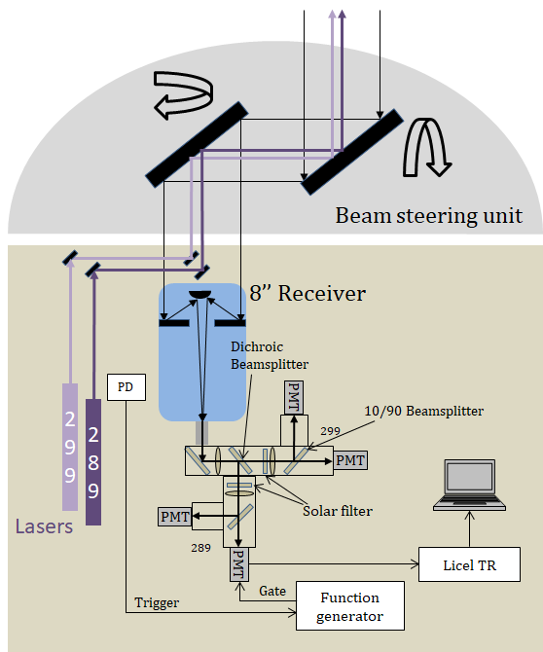
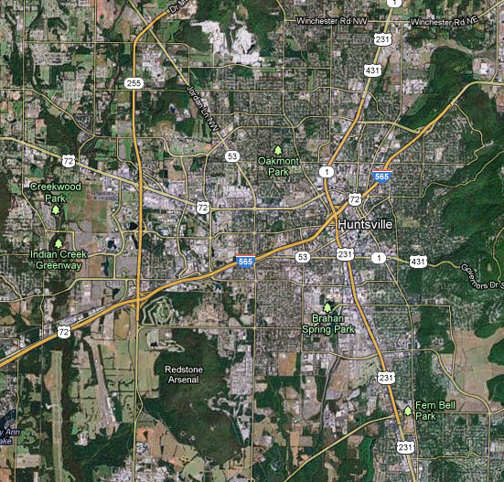
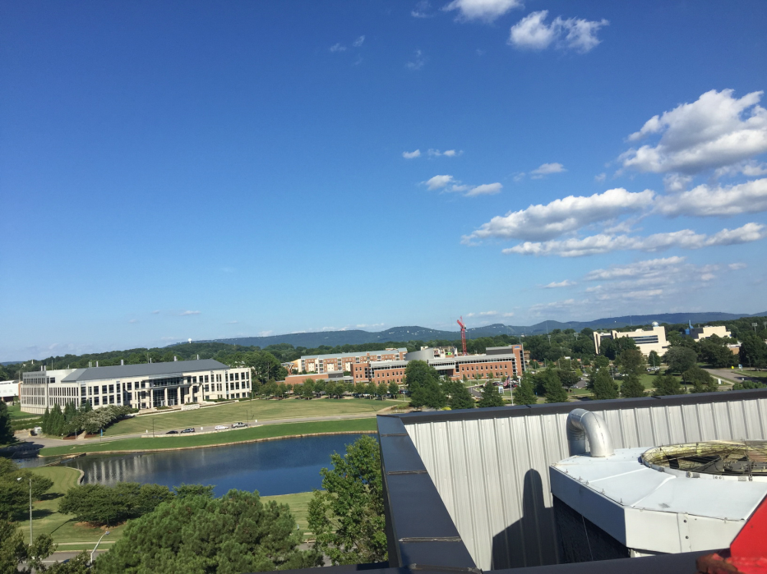
Horizontal Lidar Measurement of Near-surface O3
7km
5km
LIDAR
Mountain

Slide 10
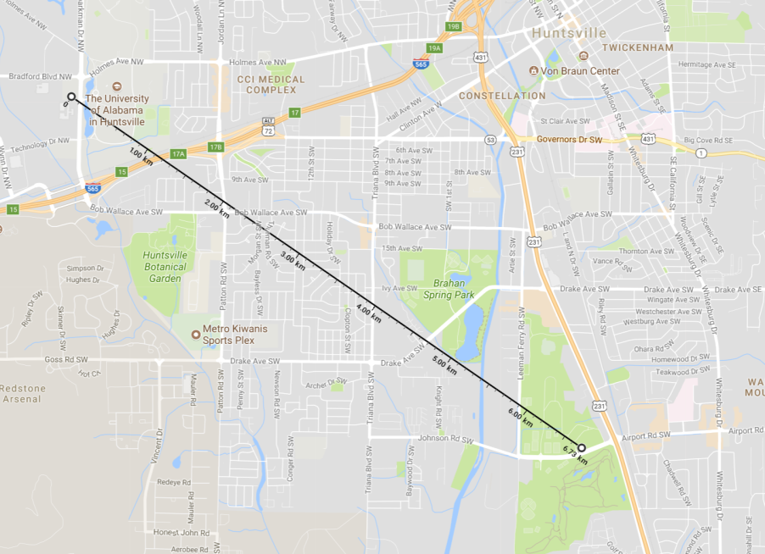
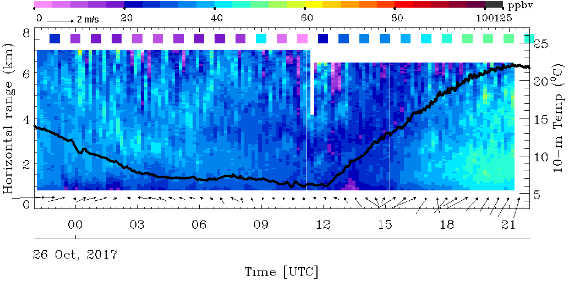
10/26/2017, point to SE
SNRs further than 6km are not very good and also decay with time.
The daytime O3 gradients are smaller than 8/21.
Nighttime ozone is higher than EPA, likely because the lidar measured upper-air.
Averagely, ozone gradients = 0.8±1.8 ppbv/km.
UAH 10-m T from Prof. Kevin Knupp

Slide 11
Funding Sources
Most from NASA HD TOLNet program
The mobile lab hardware mostly from UAH

Slide 12
Future Plan
Transition from the zenith lidar system to the mobile system.
Continue to provide data for TROPOMI validation.
Scanning lidar validation.
Continue studying the small-scale ozone gradients.
Study the chemical influence of the SEUS agriculture fire (smoke).
Study the health effect of air pollution.
We thank the NDACC lidar community for their support and help!

Slide 13
Backup

Slide 14
Schematic of the Scanning Lidar
Share the transmitter with the vertical system
Wide-band solar filter for 289 and 283 and narrow band filter for 299
Beam steering unit
8’’ Receiver
Dichroic Beamsplitter
299
PD
289
PMT
10/90 Beamsplitter
299
PMT
Lasers
PMT
Solar filter
289
Licel TR
PMT
Trigger
Gate
Function generator

Slide 15
Characteristics of the Huntsville Ozone Lidar
 | Specification
Transmitter
Pump lasers | Nd:YAG, 30-Hz repetition rate, 25-30mJ·pulse⁻¹ at 266 nm
Raman cells | D2 and He for 289, H2 and Ar for 299, 1.8m long, 2m FL
Emitted UV lasers | 7 mJ·pulse⁻¹; 0.6-cm near-field beam diameter, 7-ns pulse length and divergence<1 mrad for both lasers
Receiver | Channel 1 | Channel 2 | Channel 3 | Channel 4
Diameter (cm) | 2.5 | 10 | 10 | 40
Focal length (m) | 0.1 | 2.3 | 2.3 | 4.5
Separation from the laser beams (cm) | 10 | 20 | 20 | 50
FOV (mrad) | 10 | 4.3 | 4.3 | 1.5
Full overlap height (m above the laboratory) | 20 | 90 | 90 | 1200
Light split percentage (%) | 100 | 10 | 90 | 100
Solar blind filter | Edge filter @ 300nm |  |  | NB filter at 289 and 299 (BW=1nm)
PMT type | Hamamatsu R9880U | Hamamatsu R7400U | Hamamatsu R7400U | Hamamatsu R9880U
Gated PMT delay (μs) | 0 | 0 | 1 | >10
Measurable height range (km) | 0.1-1 | 0.4-1.5 | 1-4 | 3-12
Signal Processing | Channel 1 | Channel 2 | Channel 3 | Channel 4
Photoncounting | 250-MHz maximum counting rate
Analog | 12-bit and 40-MHz analog-to-digital converter
Fundamental range resolution (m) | 3.75 | 3.75 | 3.75 | 3.75
Degraded range resolution due to average (m)* | 22.5 | 45 | 75 | 150

Slide 16
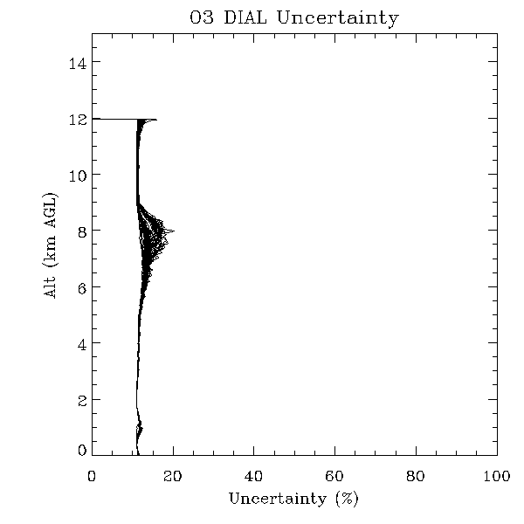
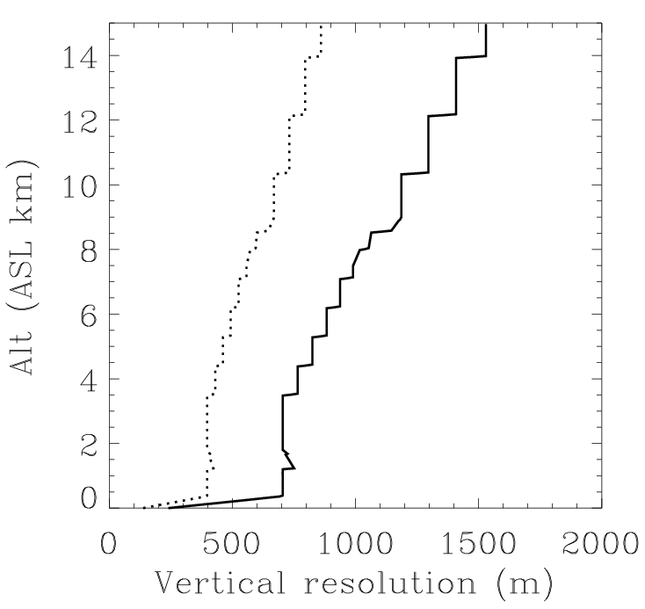
Retrieval Uncertainty And Vertical Resolution of the UAH Ozone Lidar
Uncertainties are related to the choice of the vertical resolutions and integration time.
NDACC-standardized impulse response (FWHM) definition
Channel 5 and 2 are merged in this region.
NDACC-standardized cutoff freq. definition
Channel 2 and 1 are merged here.
10-min integration time

Slide 17
Quantifying TOLNet Ozone Lidar Accuracy during the 2014 DISCOVER-AQ and FRAPPÉ Campaigns [Wang et al., 2017 AMT]
The TOLNet O₃ lidars measure better than ±15% of vertical O₃ profile and ±5% of column average.

Slide 18
Ozone Variability and Anomalies Observed at SEUS in 2013
Kuang et al. 2017 JGR
10-ppbv (about 17%) lower than the climatology in the PBL associated with unusually wet and cool weather;
40-ppbv (about 25%) higher than in the UT due to stronger STT.
PV provided by Ryan Stauffer

Slide 19
Correlation between Tropospheric O₃, Water Vapor and Temperature
The regression slopes between ozone and T anomalies for surface, PBL, and mid-troposphere are similar, 3.0-4.1 ppbv·K⁻¹ consistent with previous studies using surface air-quality data.
The ozone/RH regression slopes are -1.0, -0.6, -0.5 and -3.6 ppbv·%⁻¹ for surface, PBL, mid-troposphere, and upper-troposphere, respectively.

Slide 20
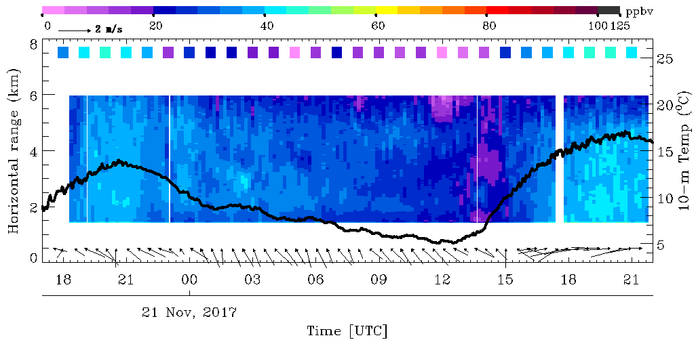
Nov. 21-22, Toward west, 10-min integration
Laser intensity decays with time, far range retrievals have larger uncertainty. 5-6km gradients at the end of the time window probably are not real.
Diurnal variations make sense, consistent with EPA. (1) Transition in the morning, (2) peak daytime O3, higher on 11/21.
Lidar-O3 is consistently higher than EPA during nighttime. Lidar-O3 low occurs at 8,9LT, same as other data, interesting, likely correct.
Averagely, ozone gradients = -2.9±1.5 ppbv/km.
EPA, Airport rd.
UAH 10-m T from Prof. Kevin Knupp
Notes:
1-5km gradients

Slide 21
Publication since 2016
De Young, R., W. Carrion, R. Ganoe, D. Pliutau, G. Gronoff, T. Berkoff and S. Kuang (2017), Langley mobile ozone lidar: ozone and aerosol atmospheric profiling for air quality research. Appl. Opt., 56(3), 721-730.
Huang G., X. Liu, K. Chance, K. Yang, P. K. Bhartia, Z. Cai, M. Allaart, B. Calpini,G. J. R. Coetzee, E. Cuevas-Agullo, M. Cupeiro, ..., M. J. Newchurch, etc.,(2017), Validation of 10-year SAO OMI Ozone Profile (PROFOZ) Product Using Ozonesonde Observations. Atmospheric Measurement Techniques, 10(7), 2455.
Kuang, S., Newchurch, M. J., Thompson, A. M., Stauffer, R. M., Johnson, B. J., & Wang, L. (2017). Ozone variability and anomalies observed during SENEX and SEAC4RS campaigns in 2013. Journal of Geophysical Research: Atmospheres, 122, 11,227-11,241, doi.org/10.1002/2017JD027139.
Kuang, S., M.J. Newchurch, M. S. Johnson, L. Wang, J. Burris, R. B. Pierce, E. W. Eloranta, I. B. Pollack, M. Graus, J. de Gouw, C. Warneke, T. B. Ryerson, M. Z. Markovic, J. S. Holloway, A. Pour-Biazar, G. Huang, X. Liu, and N. Feng (2017), Summertime tropospheric ozone enhancement associated with a cold front passage due to stratosphere-to-troposphere transport and biomass burning: Simultaneous ground-based lidar and airborne measurements, J. Geophys. Res. Atmos., 122(2), 1293-1311, doi:10.1002/2016JD026078.
Johnson, M., S. Kuang, L. Wang, and M.J. Newchurch (2016), Evaluating Summer-Time Ozone Enhancement Events in the Southeast United States, Atmosphere, 7(8), 108, doi:10.2290/atmos7080108.
Johnson, M. S. , X. Liu, P. Zoogman, J. Sullivan, M. J. Newchurch, S. Kuang, T. Leblanc, T. McGee, Potential sources of a priori ozone profiles for TEMPO tropospheric ozone retrievals, submitted to Atmospheric Measurement Techniques.
Langford, A. O., Alvarez II, R. J., Brioude, J., Evan, S., Iraci, L. T., Kirgis, G., ... & Senff, C. J. (2018). Coordinated profiling of stratospheric intrusions and transported pollution by the Tropospheric Ozone Lidar Network (TOLNet) and NASA Alpha Jet experiment (AJAX): Observations and comparison to HYSPLIT, RAQMS, and FLEXPART. Atmospheric Environment, 174, 1-14.
Reid, J. S., R. E. Kuehn, R. E. Holz, E. W. Eloranta, K. C. Kaku, S. Kuang, M.J. Newchurch, A. M. Thompson, C. R. Trepte, J. Zhang, S. A. Atwood, J. L. Hand, B. N. Holben, P. Minnis, D. J. Posselt (2017), Ground based high spectral resolution lidar observation of aerosol vertical distribution in the summertime Southeast United States, J. Geophys. Res. Atmos., 122, doi:10.1002/2016JD025798.
Wang, L., Newchurch, M. J., Alvarez II, R. J., Berkoff, T. A., Brown, S. S., Carrion, W., DeYoung R. J., Johnson, B. J., Ganoe, R., Gronoff, G., Kirgis G., Kuang, S., Langford, A. O., Leblanc T., McDuffie E. E., McGee, T. J., Pliutau, D., Senff, C. J., Sullivan, J. T., Sumnicht, G., Twigg, L. W., & Weinheimer, A. J. (2017). Quantifying TOLNet ozone lidar accuracy during the 2014 DISCOVER-AQ and FRAPPE campaigns. Atmospheric Measurement Techniques, 10(10), 3865-3876.
Zoogman P., et al. (2017), Tropospheric emissions: monitoring of pollution (TEMPO), Journal of Quantitative Spectroscopy and Radiative Transfer, 186, 17-39.

