Slide 1
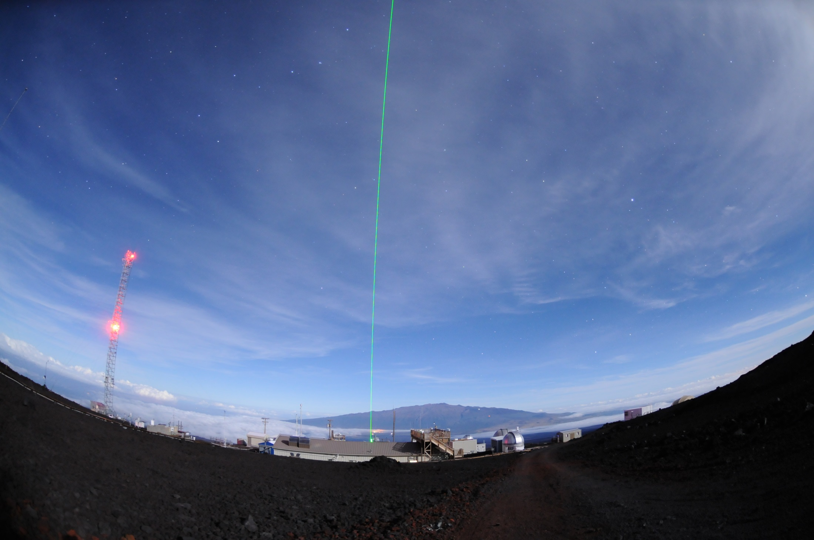
NDACC Lidar Working Group, 2018
Photo by Joe Shaw, Montana State Univ.

Slide 2
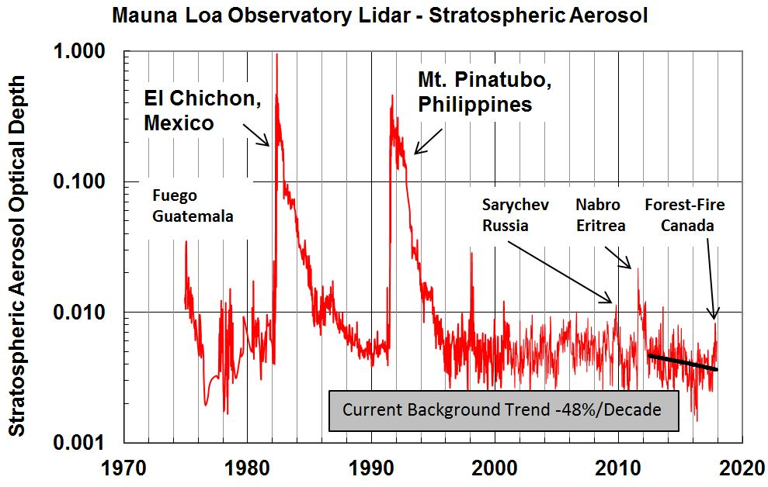

Slide 3
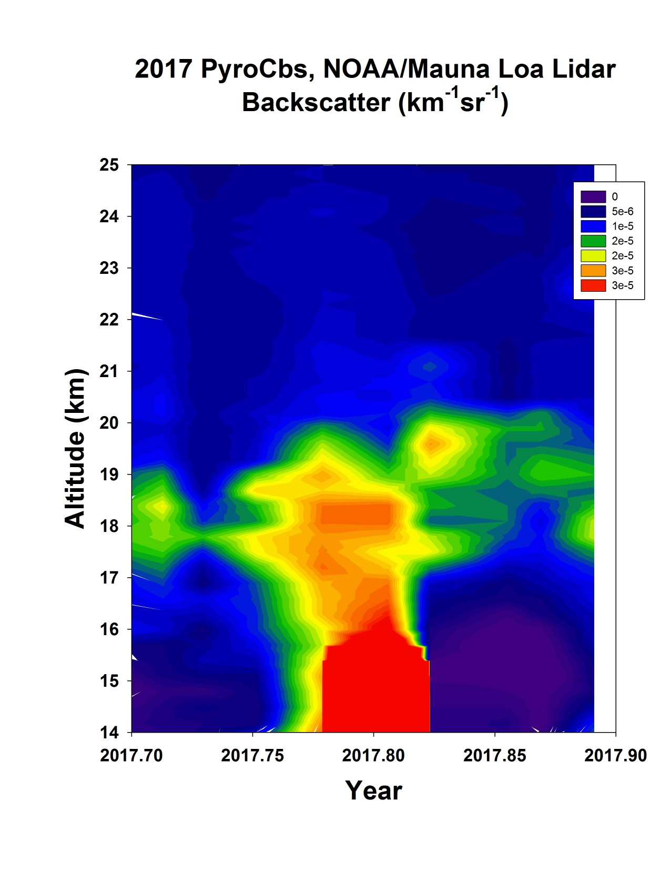

Slide 4
Cirrus Cloud Study, Amit Pandit, John E. Barnes Pandit, A. K., Gadhavi, H. S., Venkat Ratnam, M., Raghunath, K., Rao, S. V. B., and Jayaraman, A.: Long-term trend analysis and climatology of tropical cirrus clouds using 16 years of lidar data set over Southern India, Atmos. Chem. Phys., 15, 13833-13848, doi:10.5194/acp-15-13833-2015, 2015. National Atmospheric Research Laboratory (NARL), Gadanki, India Interested in joining NDACC

Slide 5
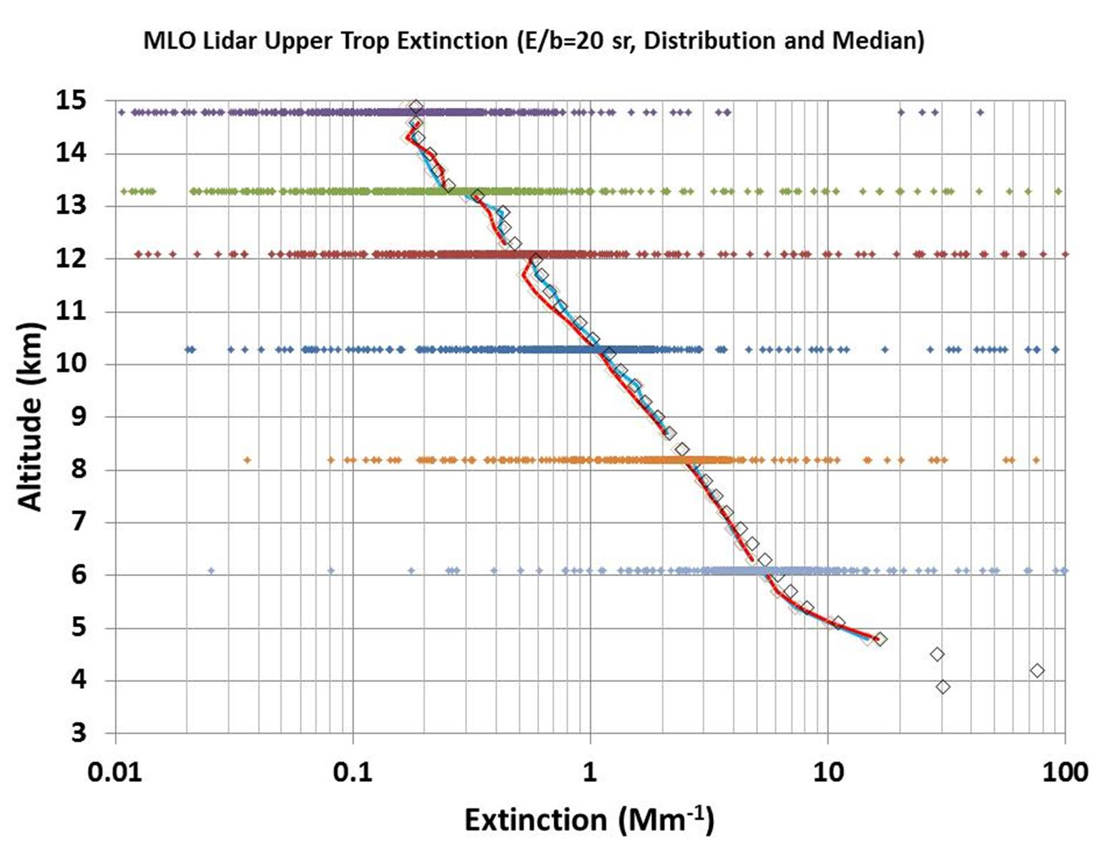
Aerosol Scale Height, 2.5 km

Slide 6
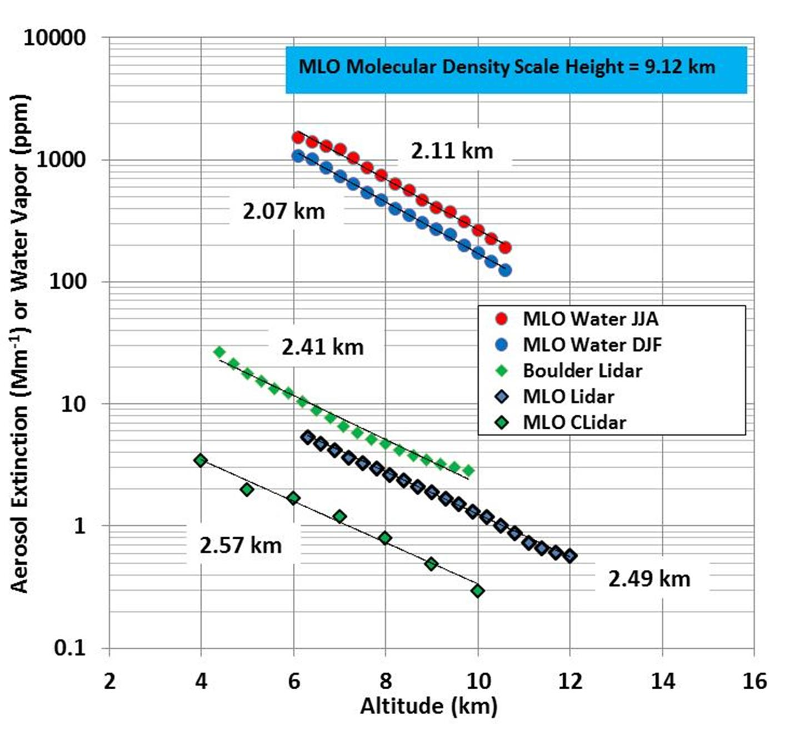
Aerosol Scale Height, 2.5 km

Slide 7
Measurements of the Boundary Layer at Mauna Loa Observatory, Hawaii John Barnes NOAA/ESRL/Global Monitoring Division N. C. Sharma, Central Connecticut State University

Slide 8
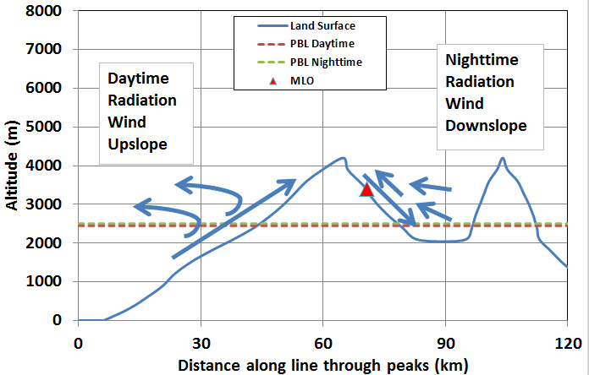

Slide 9
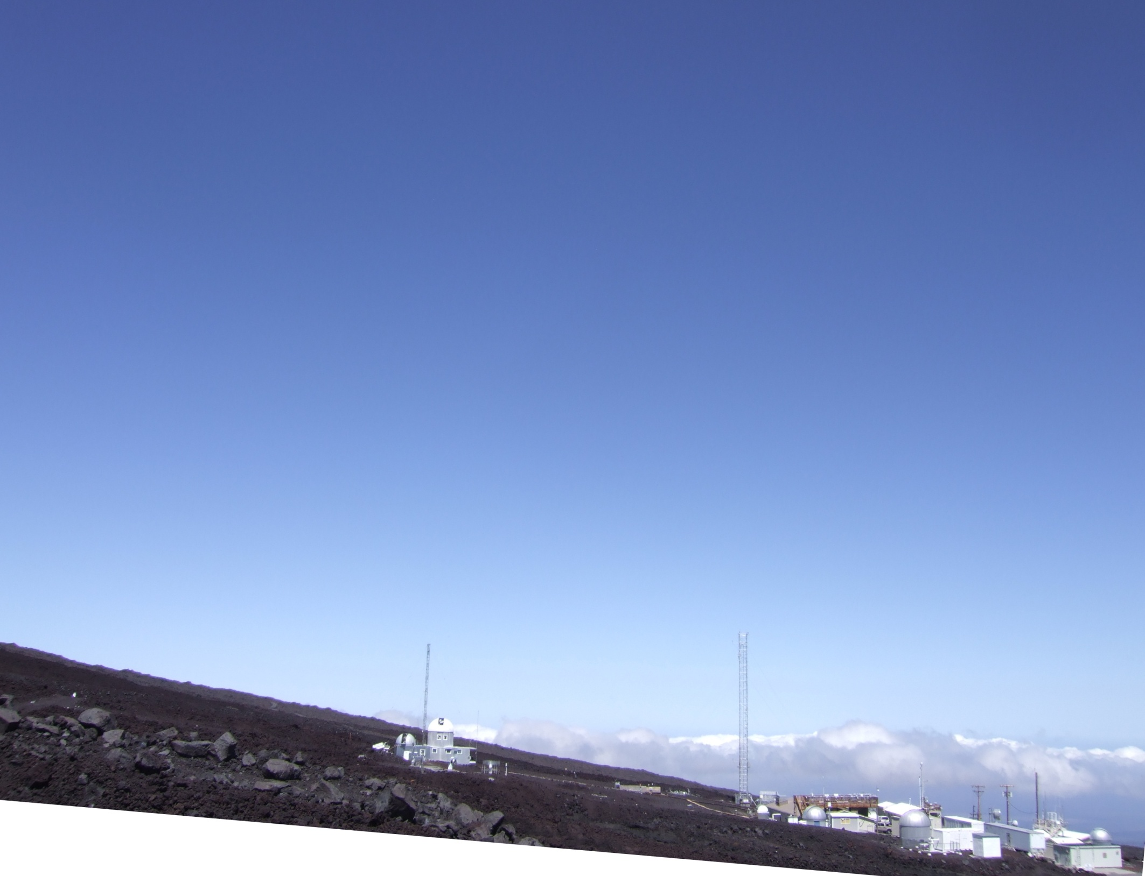
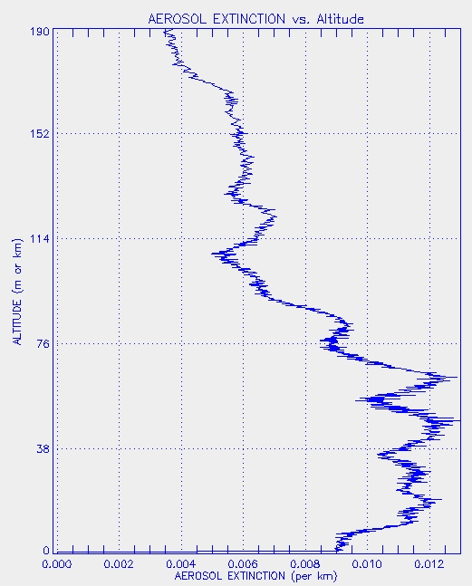
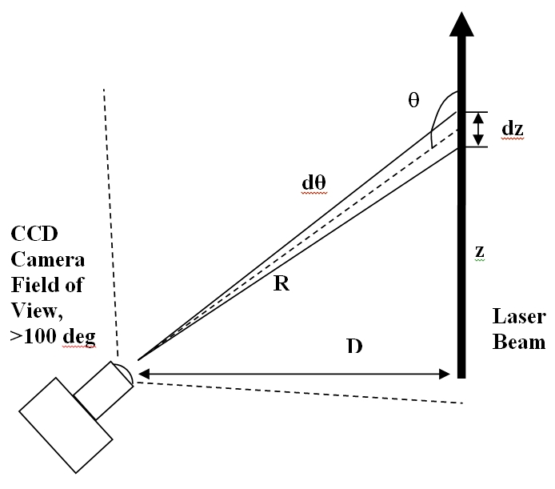
View of MLO Looking West 7 degree slope
190 m
CLidar Camera
38 m Tower
10 m

Slide 10
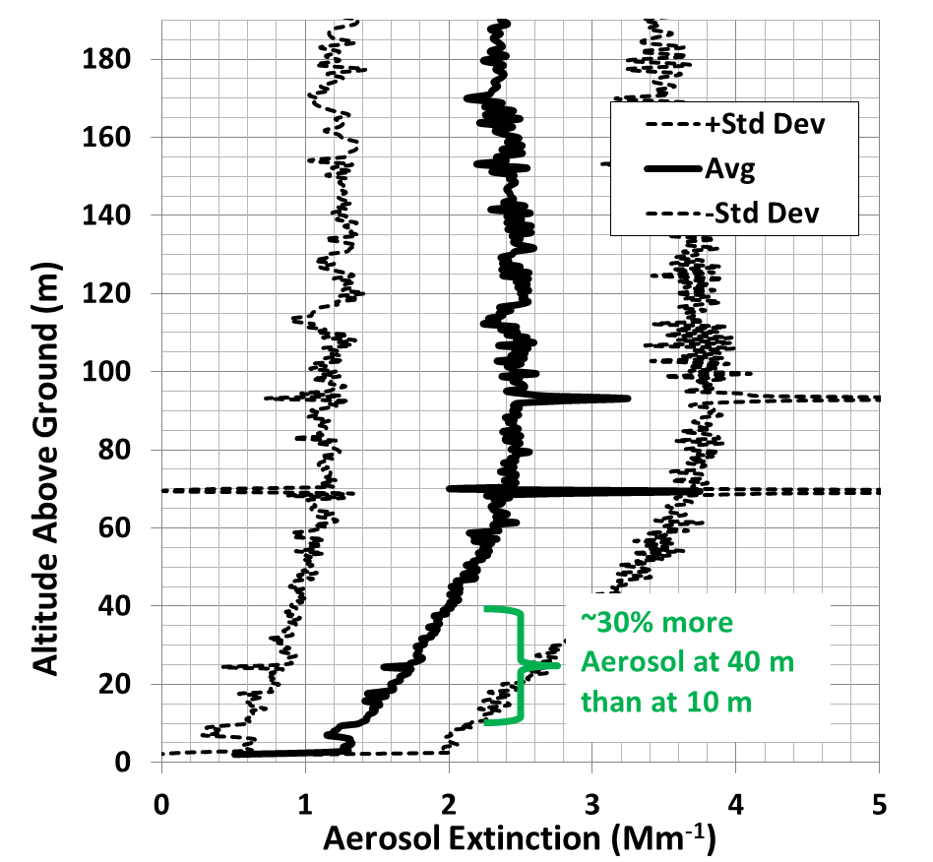
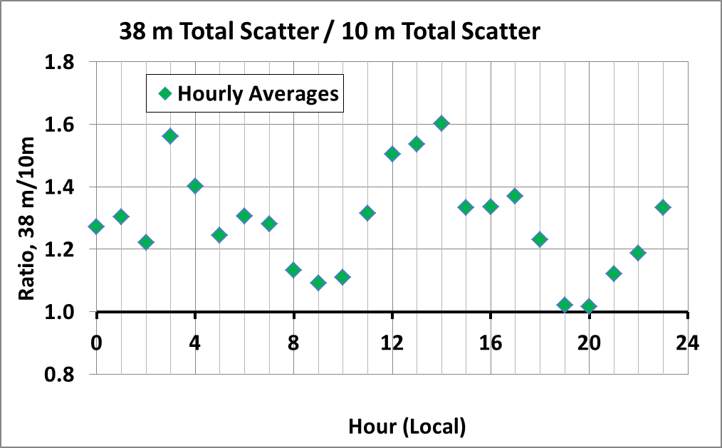
190 m
~30% more Aerosol
38 m Tower
10 m
Aerosol
Intake
Upslope/Downslope Transition
Better mixing
Notes:
Clidar cartoon

Slide 11
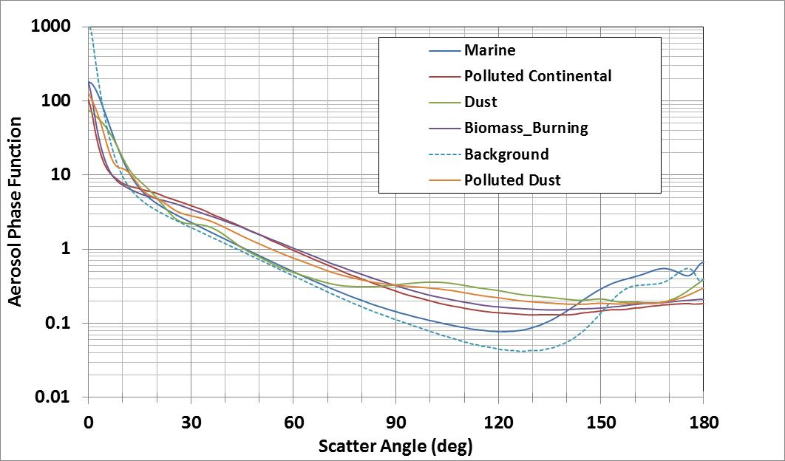
NASA/CALIOP Space Lidar, Aerosol Phase Functions
Vary large range (not known well) to convert single-angle scatter to total scatter.
Which one is “right”?
CLidar and Satellite
Lidar Ratio Ext/Back

Slide 12
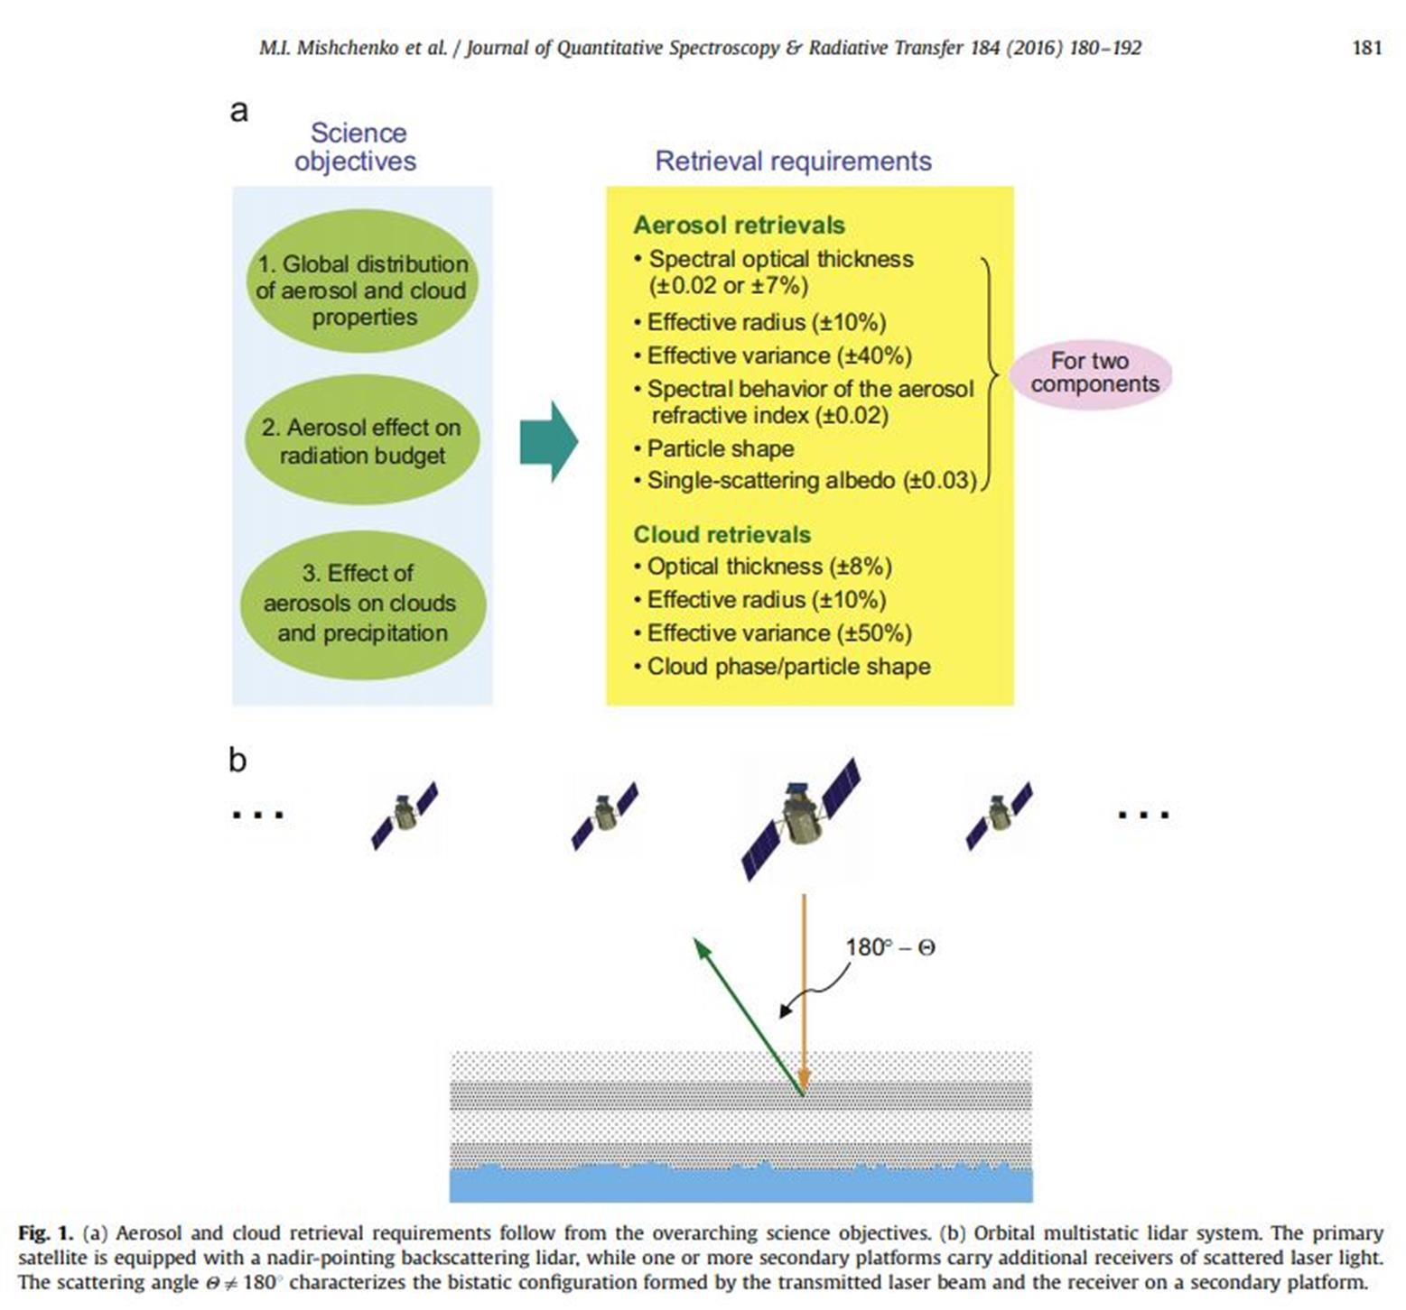
Multistatic Space Lidar,
Mishchenko et al.

Slide 13
