Slide 1





Chemistry and Dynamics in the Lower Stratosphere:
Trends in Ozone and HCl
Susan Strahan
Universities Space Research Association
NASA Goddard Space Flight Center
May 10, 2018
Notes:
The title of this talk is a science result, but this science result is made possible because satellite measurements from the MLS and a chemistry transport model simulation using MERRA2 worked together.

Slide 2
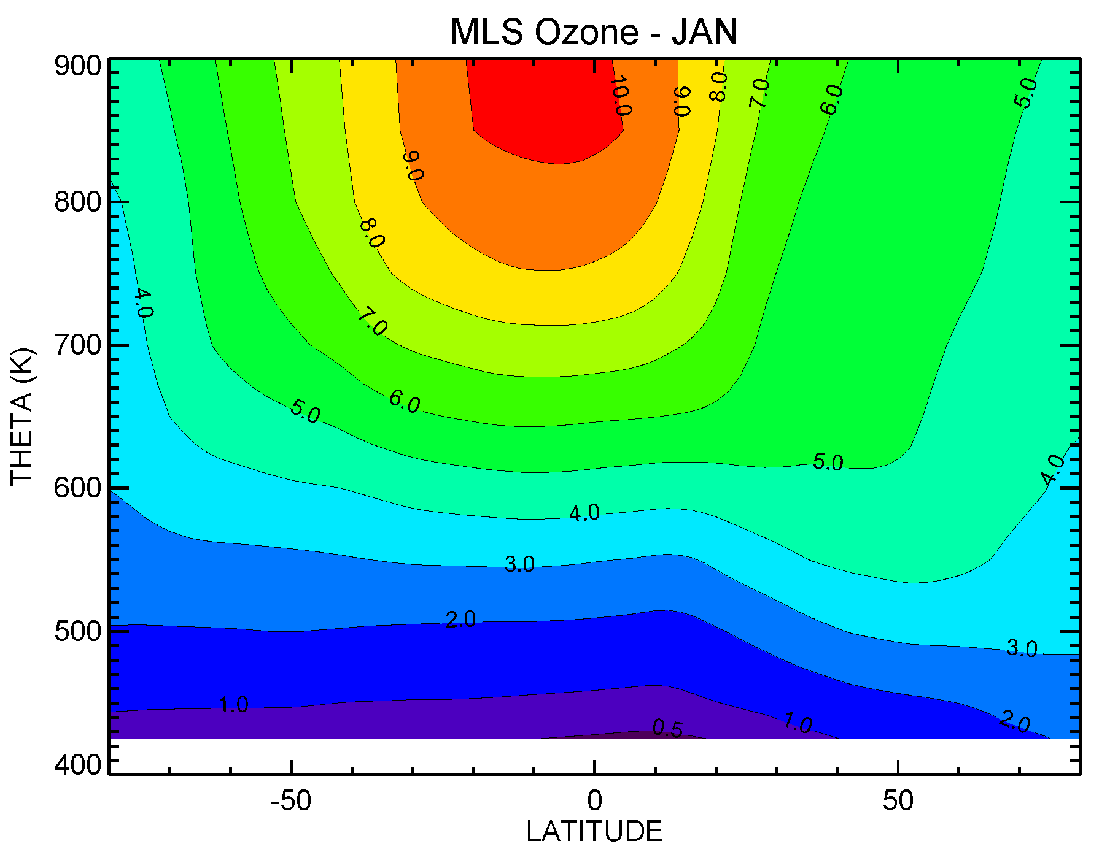
Lower Stratospheric Ozone 101:
Distribution is controlled by chemistry and dynamics
~10 hPa
~100 hPa
Chemical Control
P
P
L
Transport Controlled
Hohen
Summer Winter
The Brewer-Dobson circulation influences the O3 distribution directly by transporting O3 and indirectly by transporting long-lived families, e.g., NO_{y}, Cl_{y}).
These ‘reservoirs’ are sources of radicals involved in O₃ loss cycles.

Slide 3
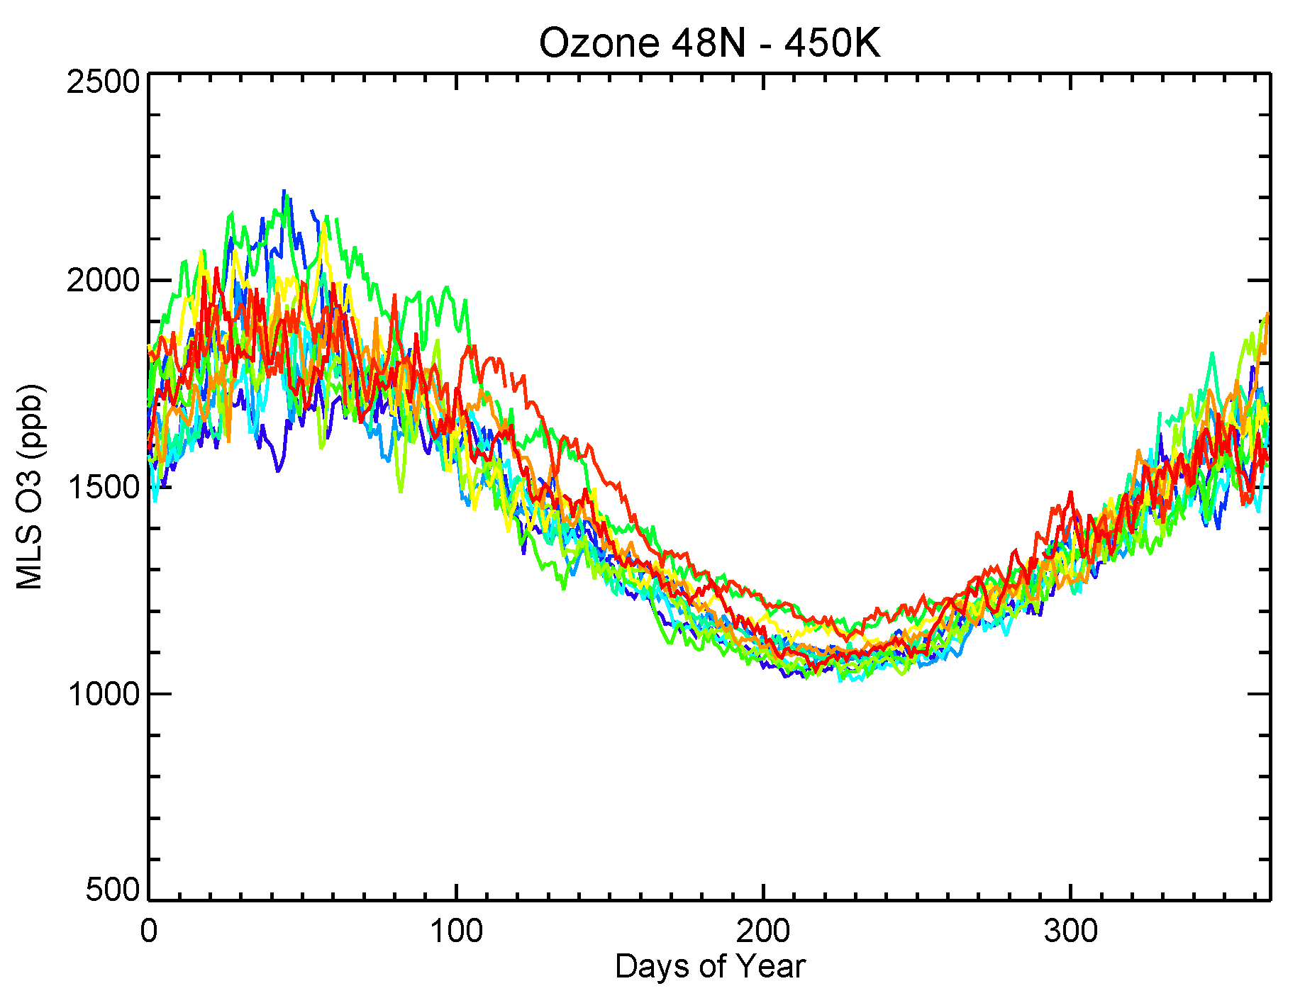
Midlatitude O₃ Seasonal Cycle at 450 K (~70 hPa)
12 years of daily MLS Zonal Mean O₃ at 48N
Photochemical loss, little transport
Gas Phase Loss Cycles: HO_{x}, NO_{x}, ClO_{x}, BrO_{x}, O_{x}
Fall & Winter: transport, ~no chemistry
In the midlatitude lower stratosphere:
  HOx loss ~50%
  ClOx + BrOx ~33%
  NOx Loss ~17%
Winter Spring Summer Fall
The winter O3 max depends on circulation strength, but the summer O3 minimum is about the same each year, regardless of the winter maximum

Slide 4
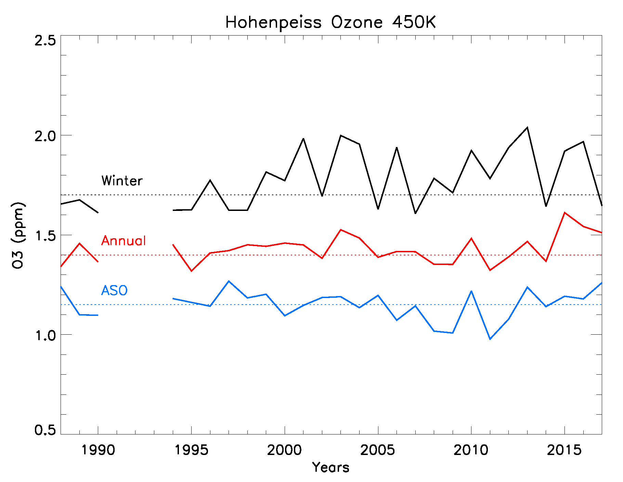
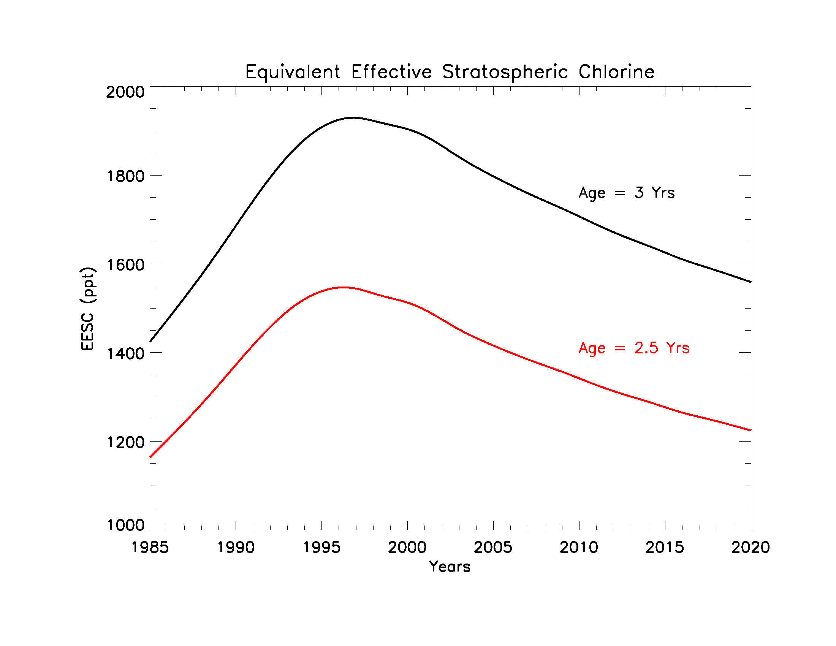
Hohenpeissenberg O₃ Record at 450 K, 1988-2017
Equivalent Effective Stratospheric Chlorine
Winter
Summer
Data averaged by season
In summer (ASO), EESC increase has come and gone by 2017.
Where’s the response in either direction?
Notes:
Theta levels were calculated for each measurement. All measurements between 440 and 460 K were included in each 450 K mean. Means were calculated for each season, then averaged into annual. Winter was calculated as 1 Jan-10 Mar; ASO is Aug-Sep-Oct.

Slide 5
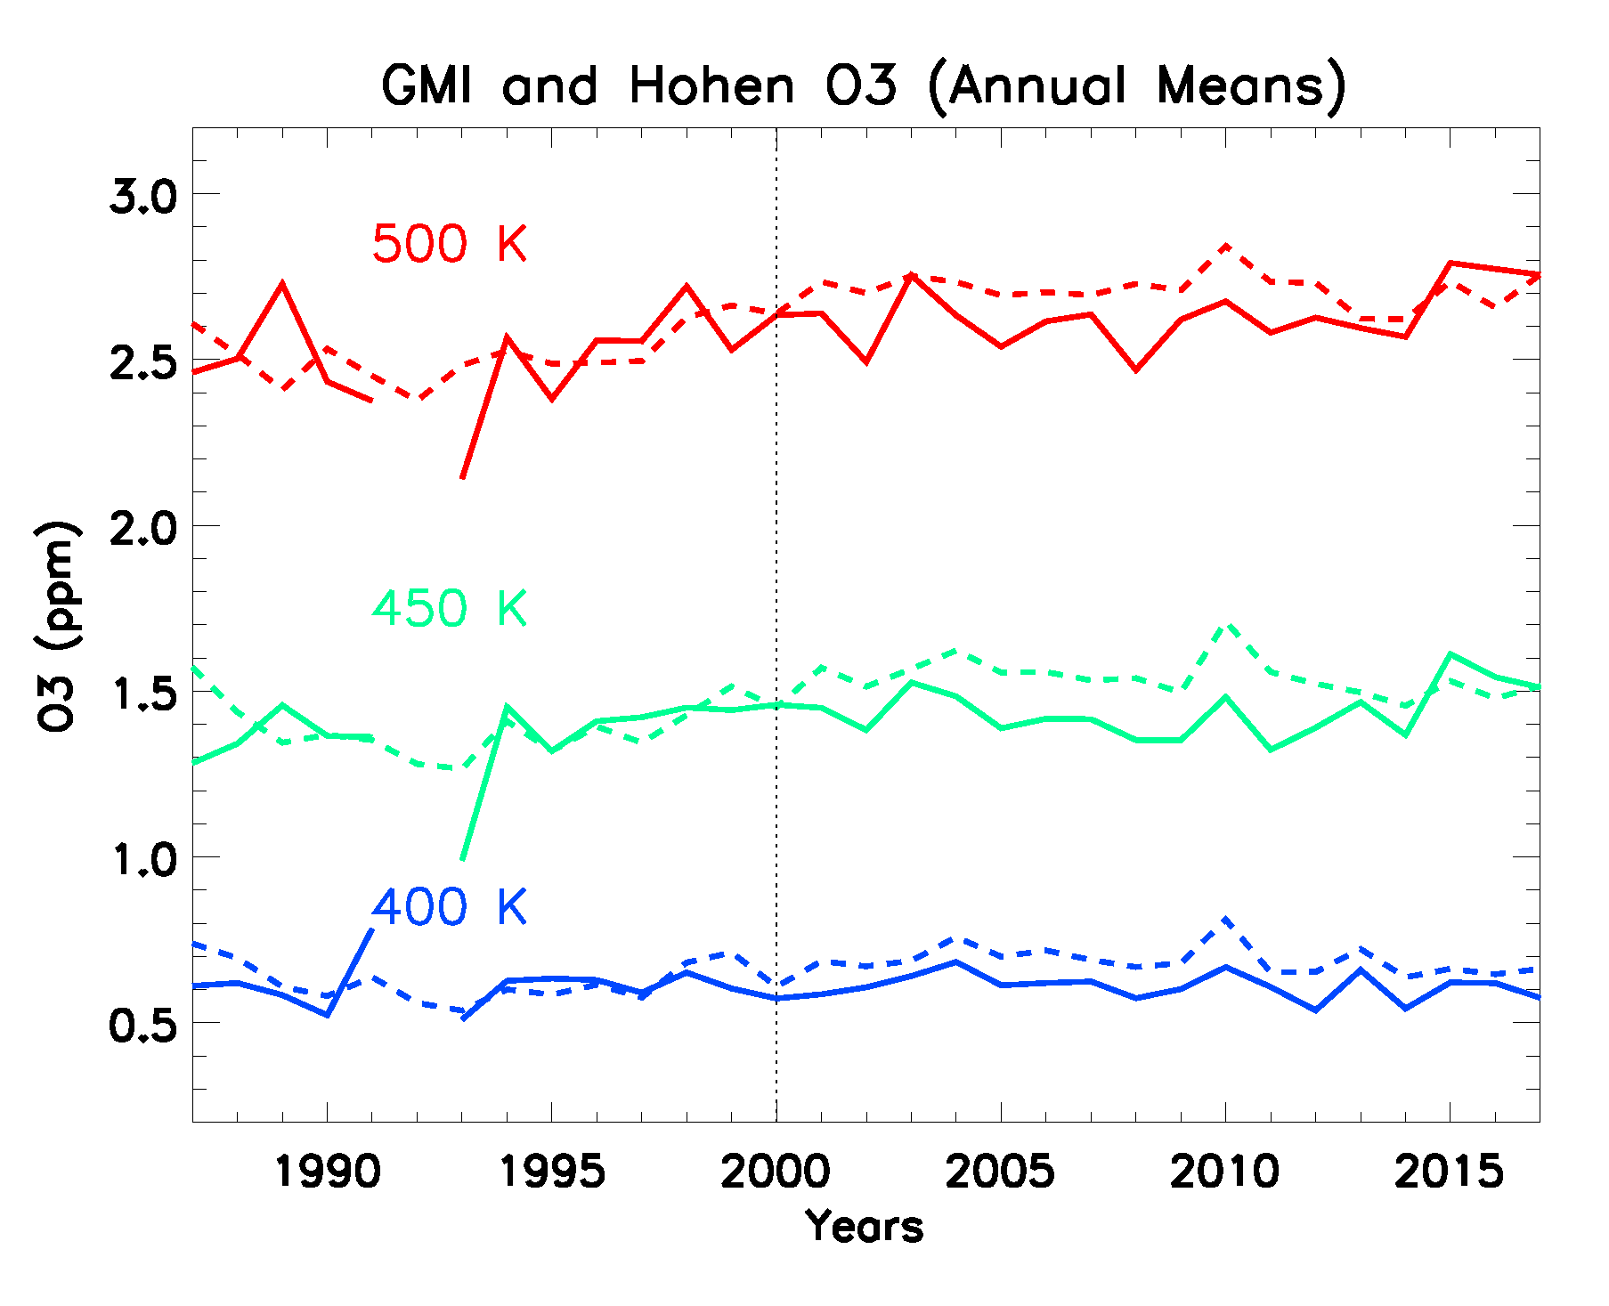
GMI-MERRA2 Simulation shows same EESC response as does the Hohenpeissenberg O₃ Record
(3 LS Levels, ~100-50 hPa)
The simulation (dashed) has realistic time-dependent CFC and other ODS surface mixing ratios.
This simulation is telling us what we expect the observations (solid lines) to do.
And they agree!!
Caveat – I have made no attempt to sample the model with the same frequency as the obs. This impacts the comparison (somewhat).
The Hohenpeissenberg record is consistent with our expectations.
It would be nice to know whether lower stratospheric chlorine is declining.

Slide 6
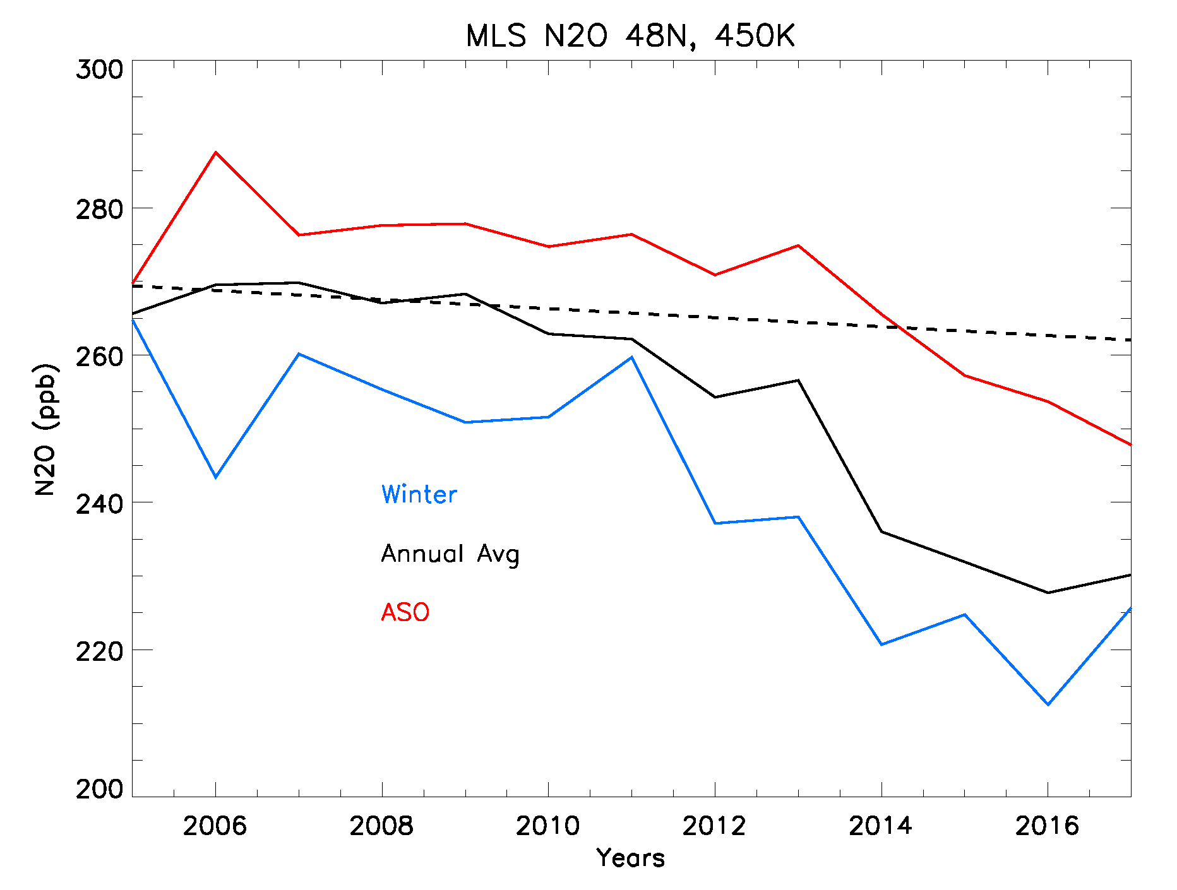
What’s Cl_{y} doing in the Lower Stratosphere?
N₂O tells us about changes in mean age (i.e., composition)
N₂O is a long-lived trace gas with sources at the surface and loss in the middle and upper stratosphere.
Lower N₂O means older mean age.
The dashed line is the N₂O change we expect based on N₂O’s surface growth rate (2.6%/decade) and the MLS N₂O drift rate (-5.1%/decade)
Expected N2O change
This N2O time series suggests the mean age of the northern midlatitude lower stratosphere has increased since ~2012.

Slide 7
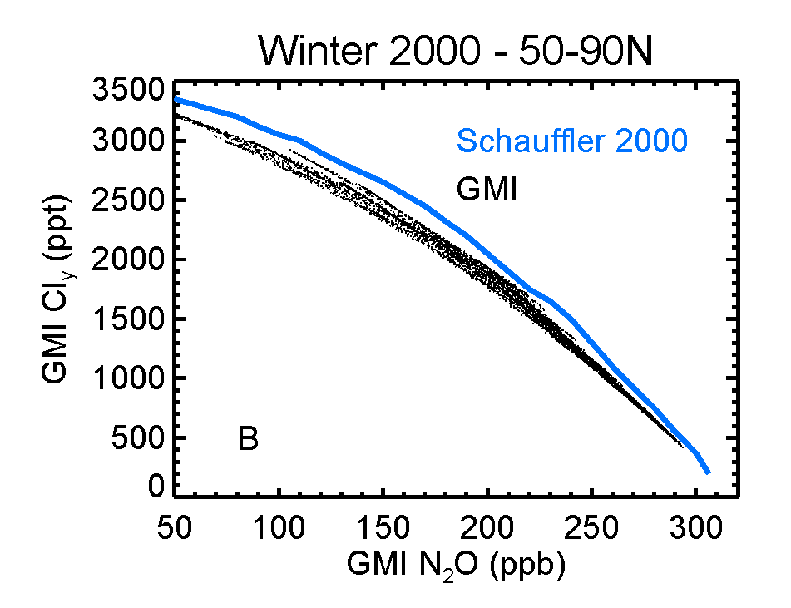
Increasing mean age means local chlorine is going up – in spite of reduced stratospheric chlorine loading!
N₂O and Cl_{y} (total inorganic chlorine) are both long-lived tracers in the lower stratosphere. They are anti-correlated.
An N₂O change from 265 to 230 ppb (MLS 450K annual mean) translates to 400-500 ppt increase in Cl_{y}
(No need to invoke fears of unregulated short-lived halogens – this is dynamical variability.)
230 ppb
265 ppb

Slide 8
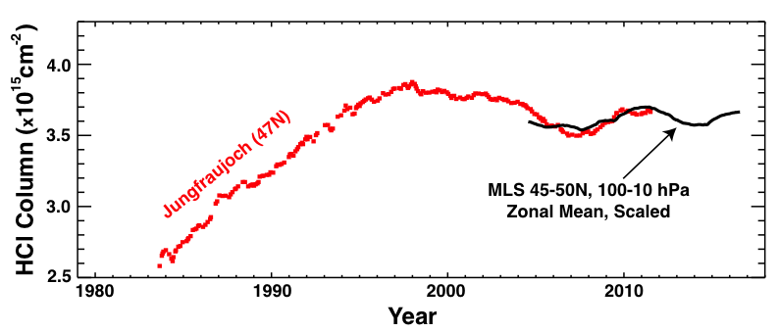
Observations suggest increasing HCl (in spite of the Montreal Protocol)?
NDACC Jungfrau FTIR Column HCl (Mahieu et al., 2014)
HCl is ~80% of Cly in the lower stratosphere.
We’ve just seen that decreasing N₂O means older air
This means Cl_{y} (and HCl) will increase.
Is there a way to remove this dynamical variability to see the real trend in chlorine loading?

Slide 9
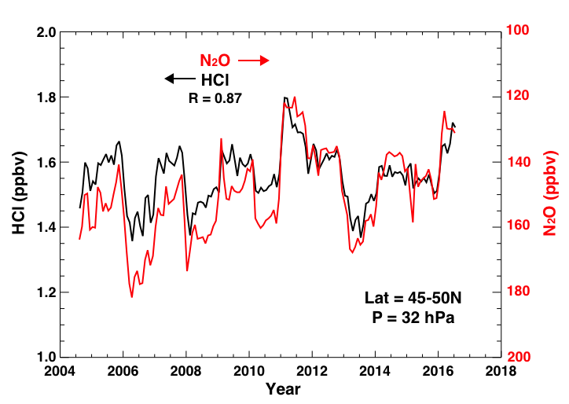
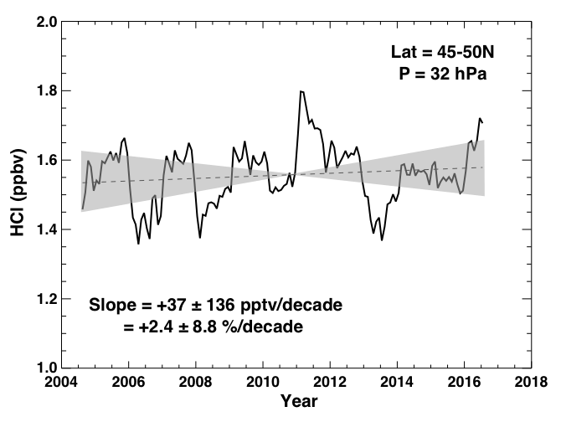
N₂O and HCl co-vary – this gives up a way to take the dynamical variability out of the MLS HCl data
In the lower stratosphere, both N₂O and HCl are long-lived and respond to dynamical variability.
Here’s how, from Stolarski et al. ACP 2018:
Deseasonalized MLS data
MLS HCl 2004-2016 has an increasing trend! (but considerable uncertainty)
Clearly a lot of this variability is matched by N₂O (note N₂O axis in red). Correlation = -0.87
Stolarski, R. S., Douglass, A. R., and Strahan, S. E. (2018), Using satellite measurements of N₂O to remove dynamical variability from HCl measurements, Atmos. Chem. Phys., 18, 5691-5697.

Slide 10
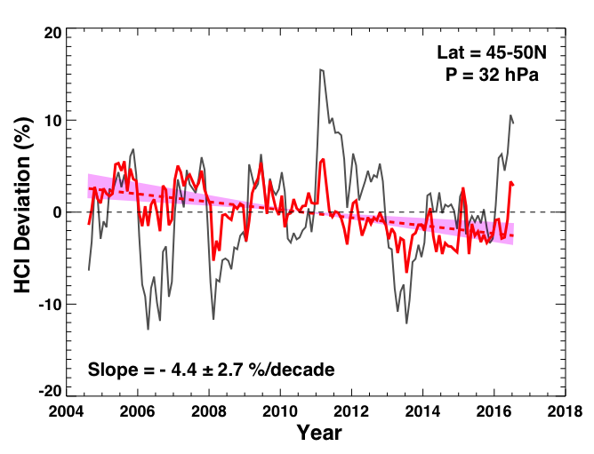
With HCl regressed with N₂O time series… a trend free of dynamical variability emerges
HCl was fit to N₂O from 70-10 hPa. It has a huge impact on the HCl trend – now negative at all levels.
Uncertainty is reduced too.
Now the HCl trend is about what we expect due to the decline of CFCs at the surface and mean age in the LS.

Slide 11
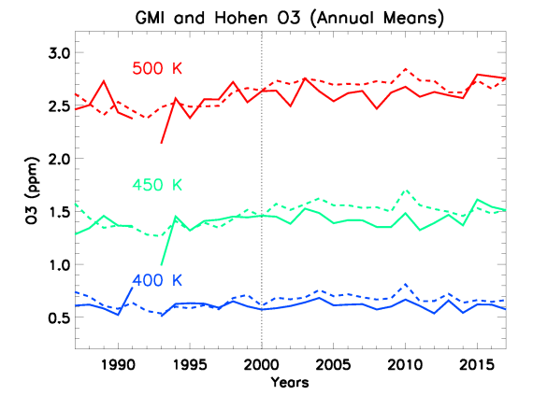
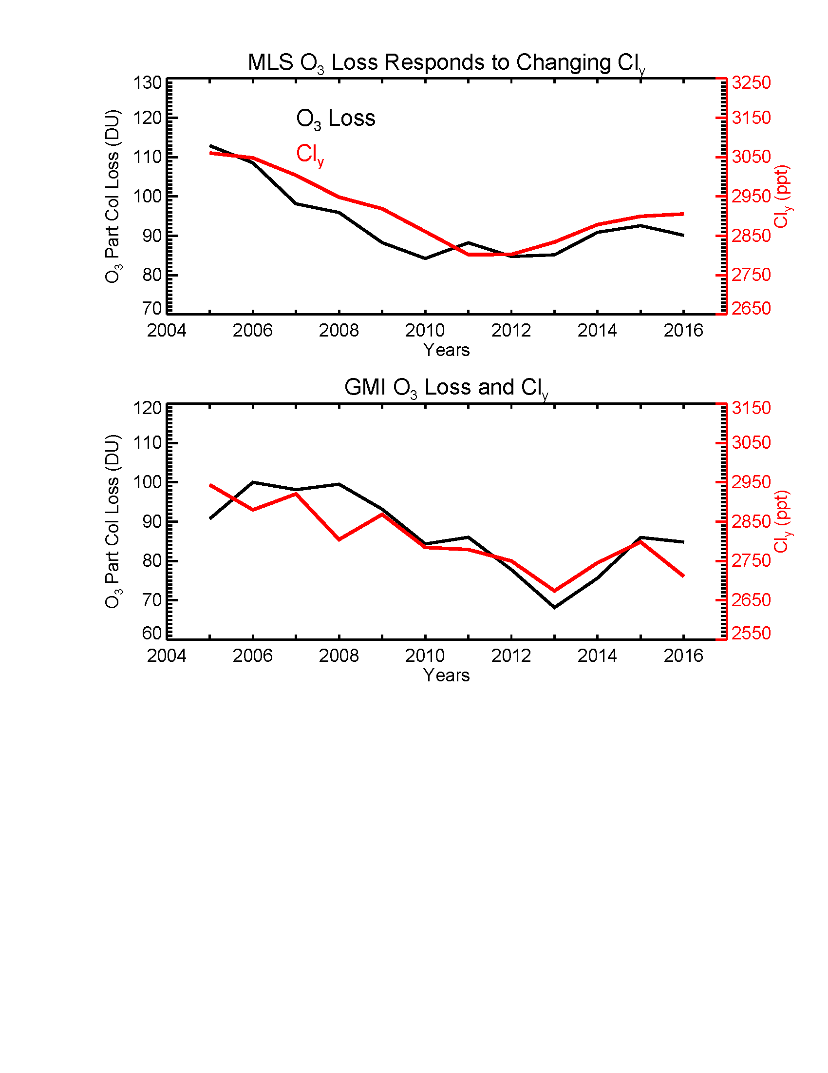
All’s Well that Ends Well?
Midlatitude lower stratospheric O₃ doesn’t appear to be increasing…but it is behaving as expected!
Stratospheric chlorine IS going down as expected! (Thanks, MP!)
Changes in Antarctic ozone depletion are attributable to changing chlorine

Slide 12

And Now for Something Completely Different

Slide 13
Why GMI-MERRA2 simulations are useful for NDACC and maybe TOLNet too?
The GMI chemistry transport model integrated with MERRA2 reanalysis met fields (1980-present) produces realistic simulations of the atmospheric composition of the recent past.
GMI output at stations has been curated for LIDAR, FTIR, Dobson, and sonde instrumental teams for use in retrievals and analyses.
NDACC Lidar Station Files: Hourly O₃, NO₂, H₂O, T, P, and PV profiles, 1 km resolution from 0-60 or 0-75 km geometric altitude.
With these hourly simulated outputs, you can investigate sampling biases. E.g., effect of nighttime-only sampling, of weekly sampling, of sampling only during clear skies (high pressure systems), etc.
Ideas for inclusion in future GMI files: mean age, stratospheric ozone tracer, cloud optical depth, surface pressure
Notes:
Merra has realistic spatial and temporal (daily, seasonal) that make it good at ‘filling in the blanks’. MERRA2 looks just as good.

Slide 14
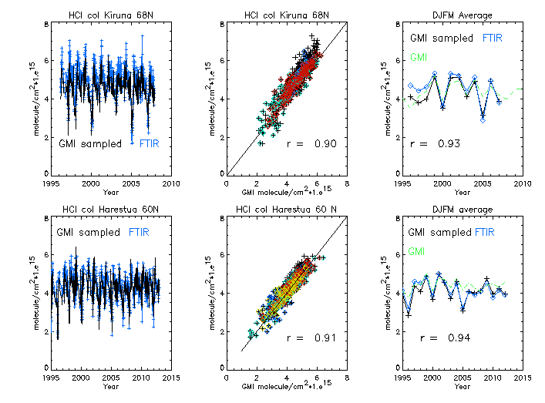
GMI-MERRA2 has realistic temporal variability
Multi-decadal Column HCl Record (blue) and GMI (black) – sampled on FTIR dates
Applications:
Identify sampling issues (bias) in NDACC/Tolnet Data sets
Determine ‘true’ monthly or seasonal means using GMI-MERRA2 variability to fill in on missing days

Slide 15
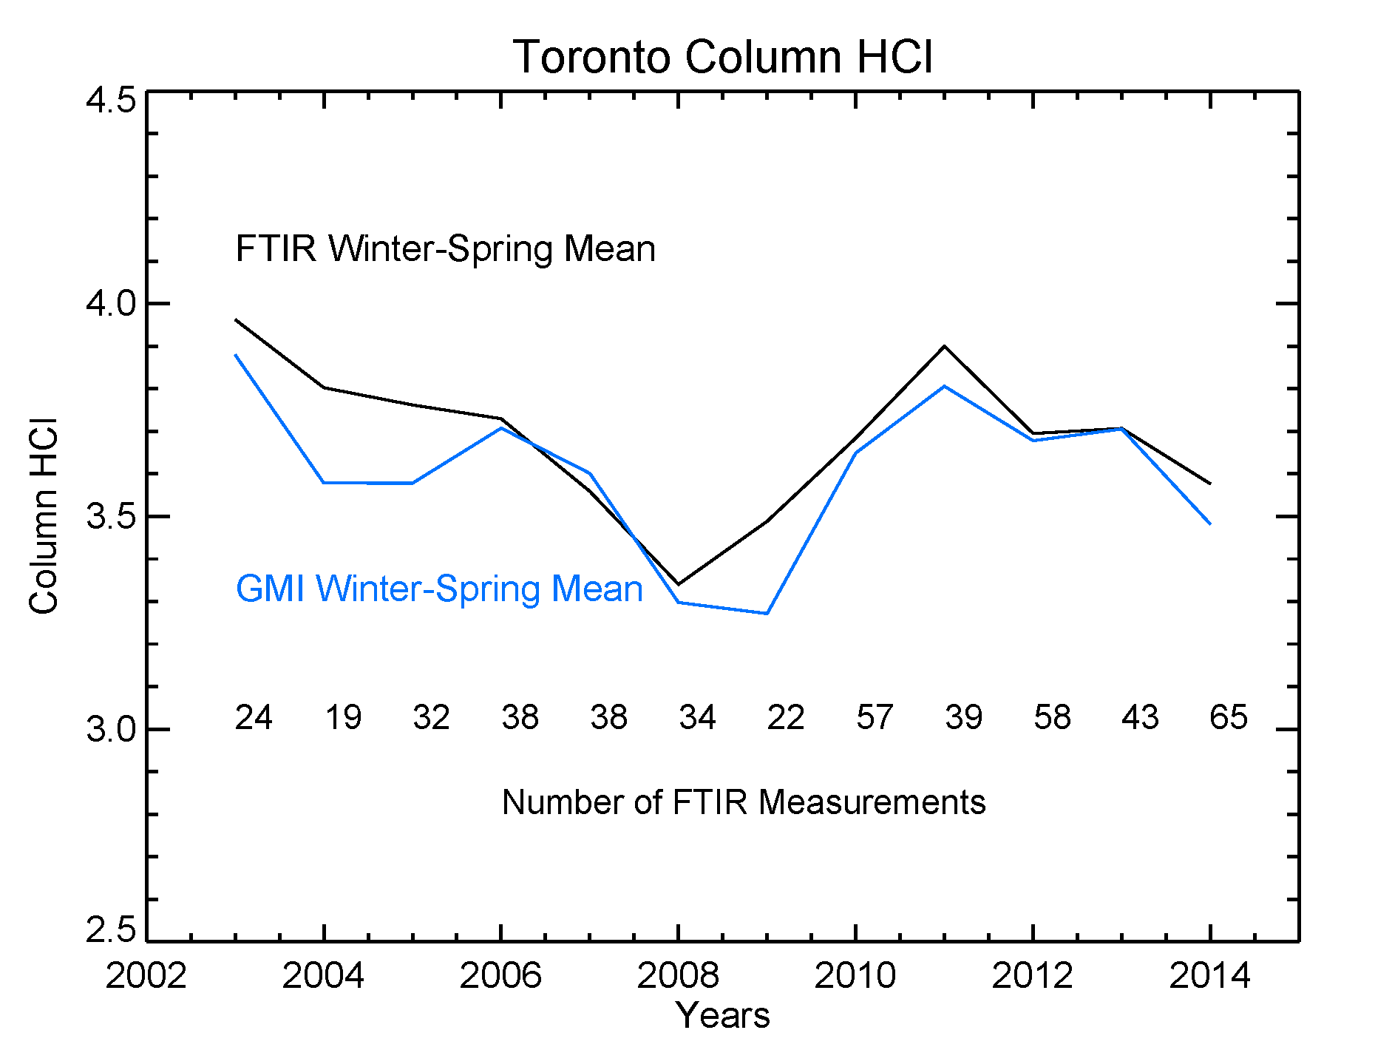
The GMI-MERRA2 simulation identifies periods where sampling frequency biases the mean
The Toronto FTIR HCl observations were averaged during winter/spring (black).
The simulated column HCl was averaged over all days in winter/spring at the station location (blue).
The differences between the simulated and observed seasonal means are greatest when there are the fewest measurements.
Notes:
The idea is to take the FTIR observations, which are sparsely sampled in time, and turn them into a true monthly or seasonal mean.

Slide 16
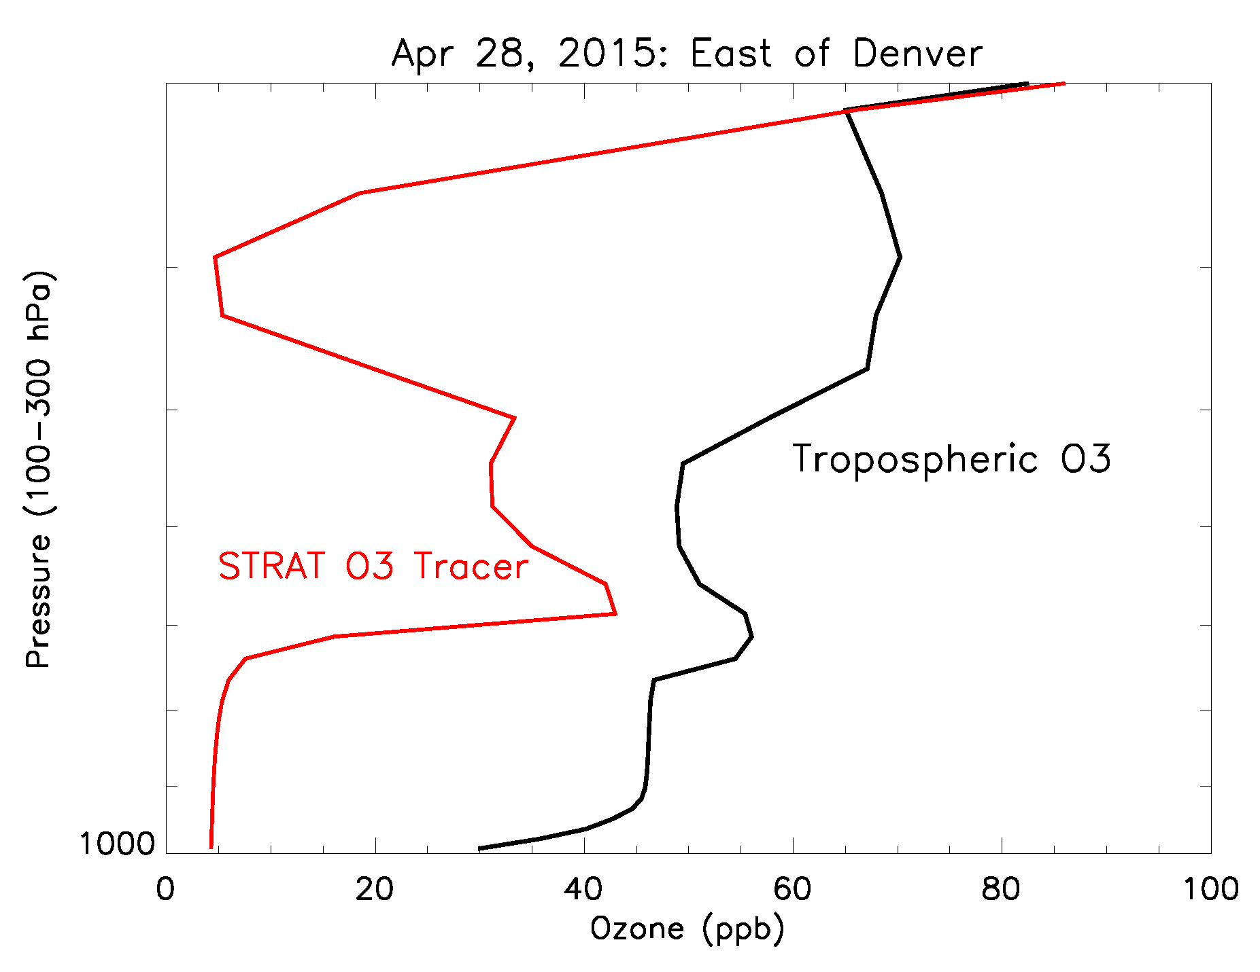
GMI Stratospheric O₃ Tracer:
Something to add to the GMI/NDACC netcdf files?
GMI Strat O₃ Tracer and ‘full chemistry’ O₃ Profiles
Stratospheric O3 Intrusion ~500-700 hPa, east of the Rockies in Spring
How it works: The StratO3 tracer is set equal to O3 in the stratosphere. Once in the troposphere, it is removed using the loss frequency (chemistry and deposition) archived from output from a Hindcast simulation.

Slide 17
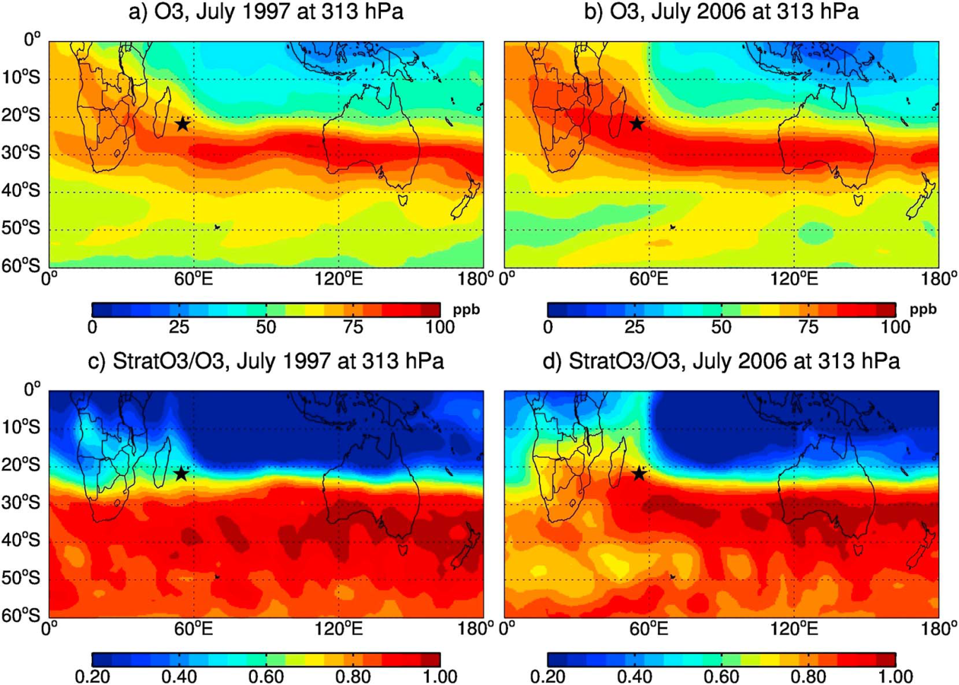
Strat O₃ Tracer was used to attribute STE as cause of an upper tropospheric O₃ trend at La Reunion
“…the large interannual variation (IAV) of
upper tropospheric ozone over Réunion is driven by the large IAV of the stratospheric influence.”
Simulations with constant 1992 emissions showed this change was NOT due to emissions.
From J. Liu et al., Origins of tropospheric ozone interannual variation over Réunion: A model investigation, J. Geophys. Res. Atmos., 121, 521–537, doi:10.1002/2015JD023981.

Slide 18
Websites for GMI Output or Simulation Information
ftp://ftp.cpc.ncep.noaa.gov/ndacc/gmi_model_data/
To download GMI-MERRA2 support files for Lidar stations.
Or go to the NDACC website and follow links to getting data.
https://gmi.gsfc.nasa.gov The source for information on the GMI model, recent Hindcast simulations, and publications.
If you are interested in model output/support that differs from what I’ve produced, please contact me! susan.strahan@nasa.gov

Slide 19
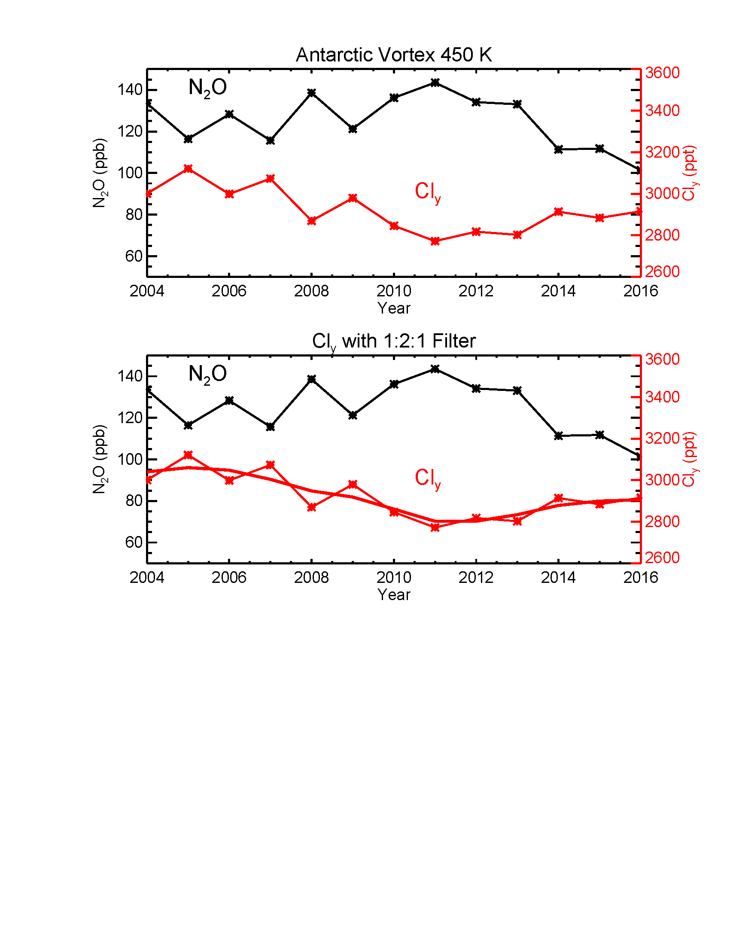
Mean Antarctic Cl_{y} decline is 25 ppt/yr, but vortex-averaged Cl_{y} varies due to transport
Vortex-averaged Cl_{y} (red) is inferred from MLS N₂O
Over 12 years, vortex N2O first got higher (younger) but recently it’s been getting quite low (old).
The QBO meridional circulation has everything to do with this (in the Antarctic) .
The recent increase in mean age is so large that it overwhelms the 25 ppt/yr Cl_{y} decline in chlorine-loading – giving the impression of a Cl_{y} increase in recent years.
From Strahan and Douglass (2018), Geophys. Res. Lett.
Notes:
The northern midlatitudes isn’t the only place with mean age variability – here’s an example in the Antarctic. This paper showed how older air gives the appearance of an increase in Cly.

Slide 20
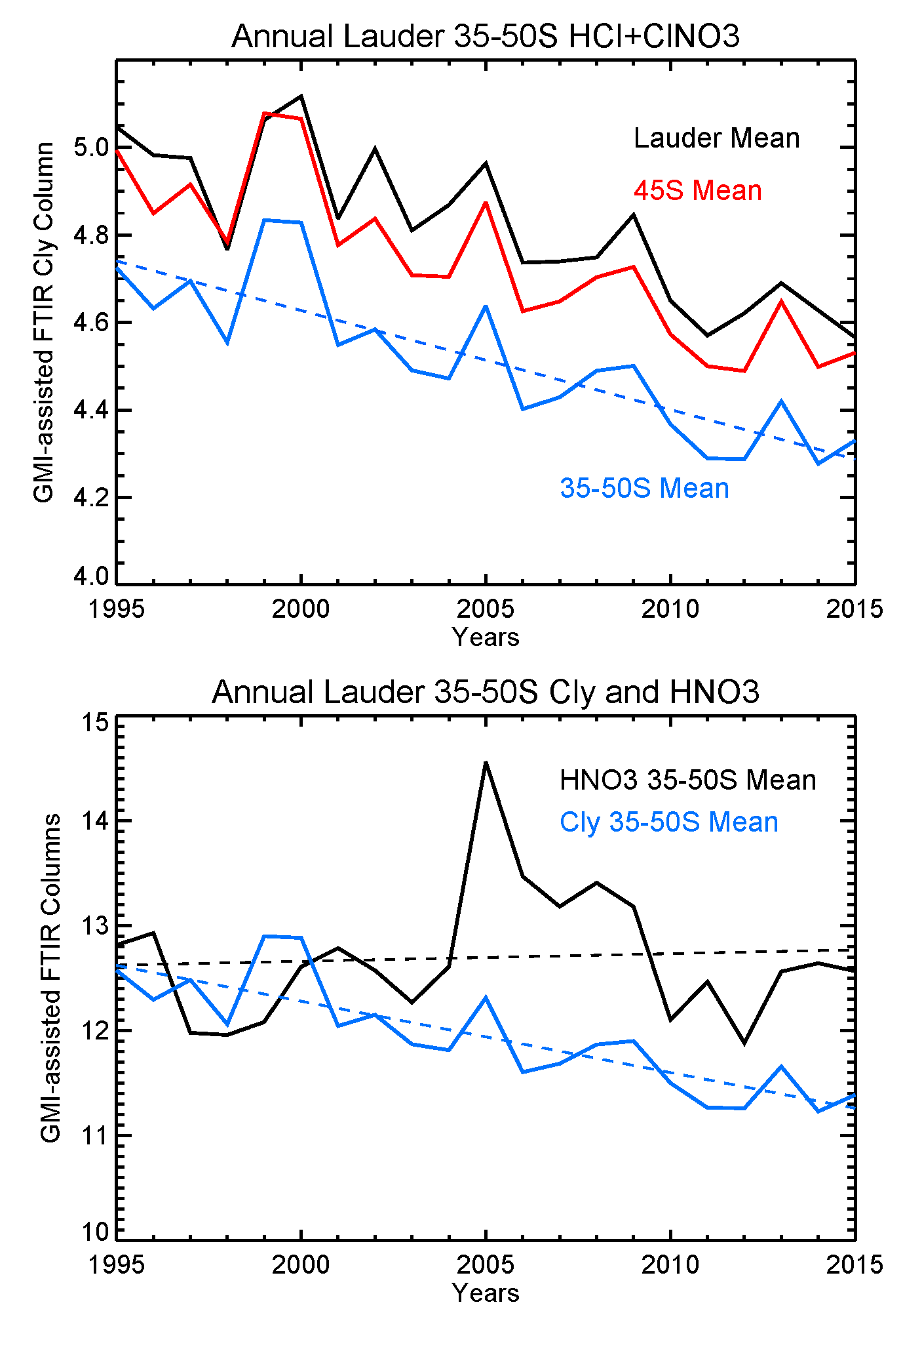
Example: ‘GMI-assisted’ FTIR columns and long-term trends
GMI variability was used to determine Lauder HCl and ClONO₂ column seasonal means. The annual average of their sum (Cl_{y}) is shown here. Means are shown for the Lauder station, 45ºS zonal mean, and for the southern midlatitudes.
The midlatitude Cl_{y} (blue) shows large interannual variability and a slow decline.
The HNO₃ southern midlatitude trend is +0.06%.yr. The growth rate of its source gas is +0.25%.yr. No evidence of circulation change.
The HCl southern midlatitude trend is -0.5%.yr. Cl-containing sources gases have declined at a similar rate during this period.
Notes:
Here’s an example of what one can do with the GMI-assisted FTIR means.
HCl columns on lower plot are scaled.
HNO3 shows large interannual dynamical variability (some old air from 2005-2009 and young are from 2010-2013), but it’s overall trend is consistent with the surface growth rate of its source gas, N2O.

