Slide 1
Tropospheric Ozone Assessment Report (TOAR)
A community-wide effort to quantify tropospheric ozone in a rapidly changing world
NDACC TOLNet workshop May 9, 2018
Notes:
The mission of TOAR is to provide the community with an up-to –date assessment of the global distribution and the trends of ozone from the surface to the tropopause

Slide 2
The report is made of 8 stand alone papers
TOAR-Climate
TOAR-Observations
TOAR-Surface Ozone Database
TOAR-Health
TOAR-Metrics
TOAR-Model Performance
TOAR-Ozone Budget
TOAR-Vegetation

Slide 3
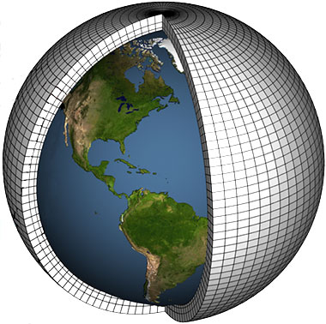
4 of the 8 stand alone papers are already published
TOAR-Climate
TOAR-Observations
TOAR-Surface Ozone Database
TOAR-Health
TOAR-Metrics
https://join.fz-juelich.de
TOAR-Model Performance
TOAR-Ozone Budget
TOAR-Vegetation
http://www.igacproject.org/activities/TOAR

Slide 4
A 5th one has been accepted
TOAR-Climate
TOAR-Observations
TOAR-Surface Ozone Database
TOAR-Health
TOAR-Metrics
https://join.fz-juelich.de
TOAR-Model Performance
TOAR-Ozone Budget
TOAR-Vegetation
http://www.igacproject.org/activities/TOAR

Slide 5
TOAR-Climate is the focus of this talk

Slide 6
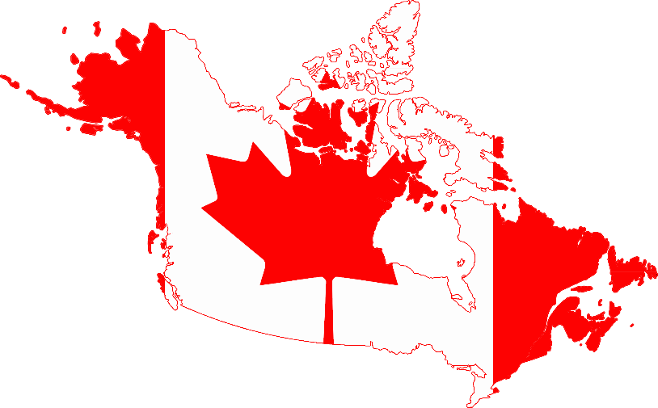
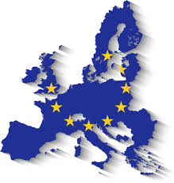
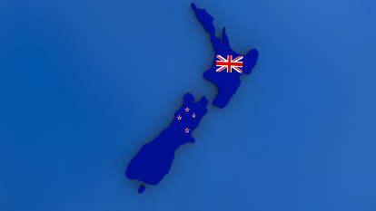
TOAR-Climate counts more than 50 authors
A. Gaudel, O. R. Cooper, G. Ancellet, B. Barret, A. Boynard, J. P. Burrows, C. Clerbaux, P.-F. Coheur, J. Cuesta, E. Cuevas, S. Doniki, G. Dufour, F. Ebojie, G. Foret, O. Garcia, M. J. Granados-Muñoz, J. W. Hannigan, F. Hase, B. Hassler, G. Huang, D. Hurtmans, D. Jaffe, N. Jones, P. Kalabokas, B. Kerridge, S. Kulawik, B. Latter, T. Leblanc, E. Le Flochmoën, W. Lin, J. Liu, X. Liu, E. Mahieu, A. McClure-Begley, J. L. Neu, M. Osman, M. Palm, H. Petetin, I. Petropavlovskikh, R. Querel, N. Rahpoe, A. Rozanov, M. G. Schultz, J. Schwab, R. Siddans, D. Smale, M. Steinbacher, H. Tanimoto, D. W. Tarasick, V. Thouret, A. M. Thompson, T. Trickl, E. Weatherhead, C. Wespes, H. M. Worden, C. Vigouroux, X. Xu, G. Zeng, J. Ziemke

Slide 7
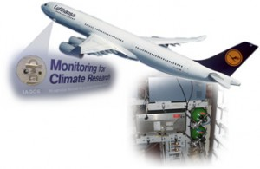
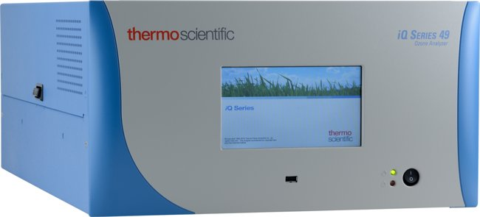
7 types of measurements are used in TOAR-Climate
In situ
Commercial Aircraft IAGOS
Sondes
Ground-based
UV Photometer

Slide 8
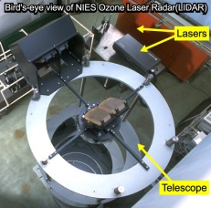
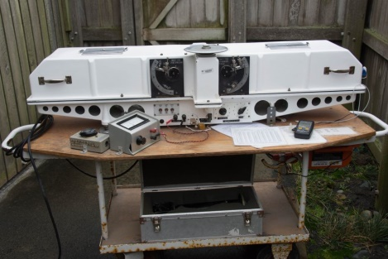
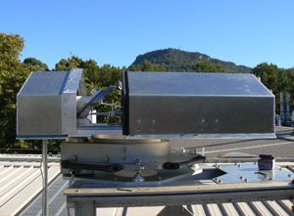
7 types of measurements are used in TOAR-Climate
Ground-based remote sensing
Commercial Aircraft IAGOS
Lidar
Sondes
Dobson
Ground-based
UV Photometer
FTIR

Slide 9
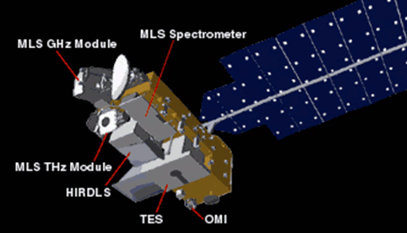
7 types of measurements are used in TOAR-Climate
Remote sensing from Space
Commercial Aircraft IAGOS
Lidar
Dobson
Satellite
Sondes
Ground-based
UV Photometer
FTIR

Slide 10
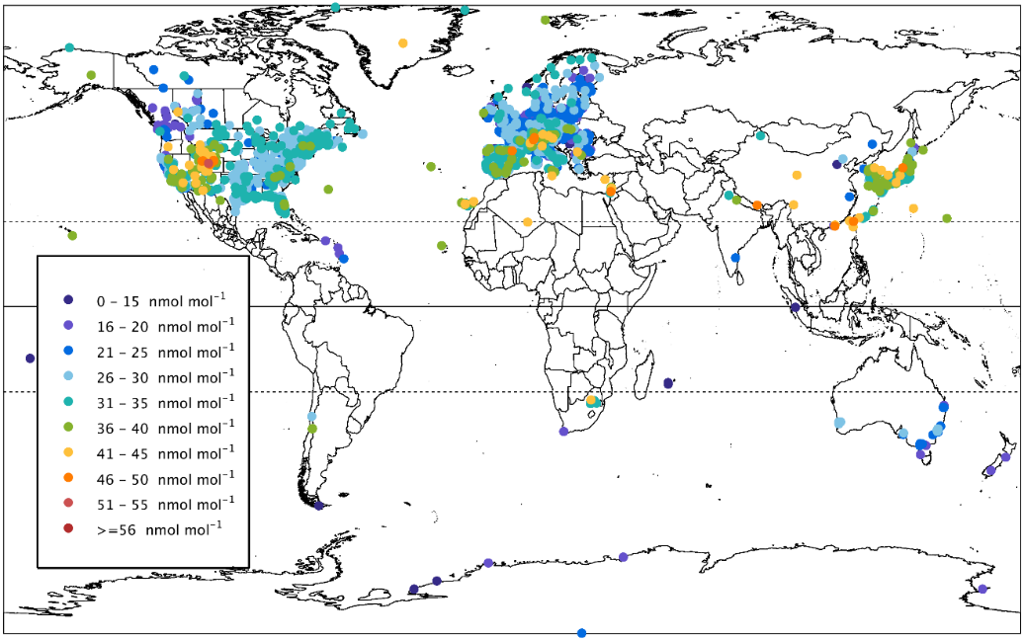
There is a lack of ground-based ozone measurements
in the southern hemisphere - Above oceans - Above Russia
Ground-based
UV Photometer

Slide 11
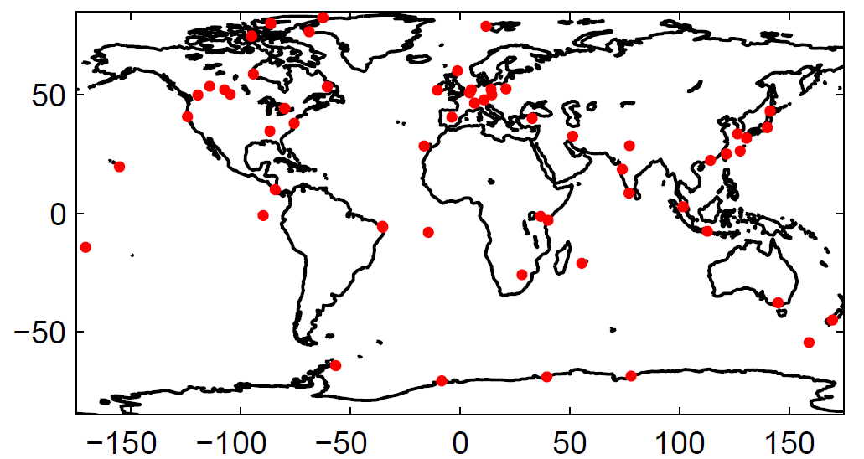
There is a lack of ground-based ozone measurements
in the southern hemisphere - Above oceans - Above Russia
Ground-based
UV Photometer
Sondes

Slide 12
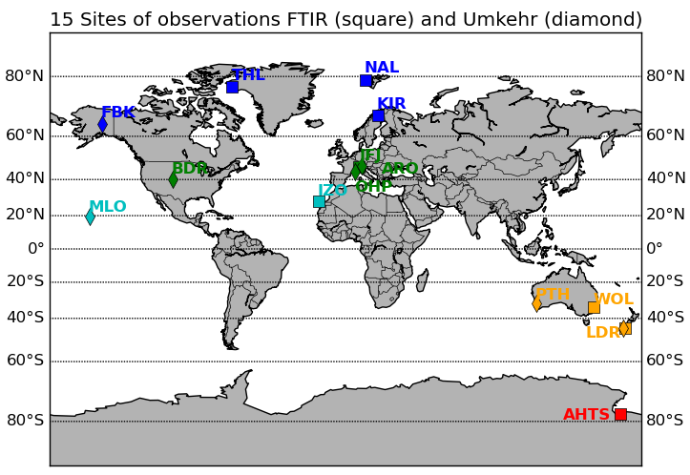
There is a lack of ground-based ozone measurements
in the southern hemisphere - Above oceans - Above Russia
Ground-based
UV Photometer
15 sites of observations FTIR (square), Umkehr (diamond) and lidar (circle)
Sondes
TMF
Dobson
Lidar
FTIR

Slide 13
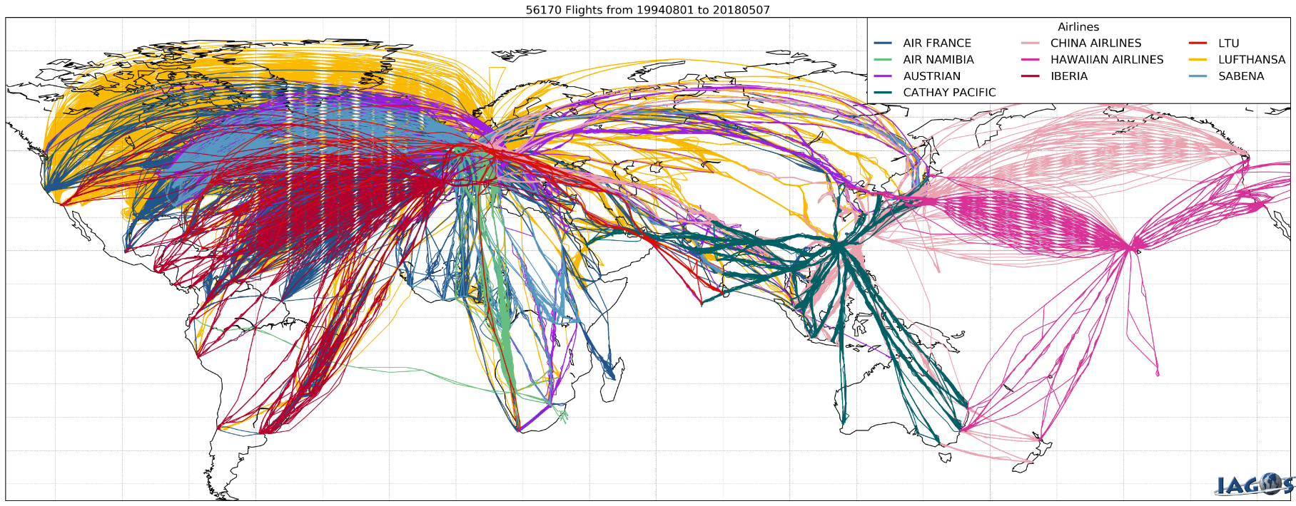
The commercial aircraft program IAGOS has a good coverage but mostly in the upper troposphere (9-12 km)
Commercial Aircraft IAGOS

Slide 14
The satellite measurement give a good coverage but they are less reliable in the poles
Satellite

Slide 15
TOAR-climate focuses on Trends and Present-day global distribution of ozone in the troposphere
1970
1980
1990
2000
2010

Slide 16
1970
1980
1990
2000
2010
Present-day

Slide 17
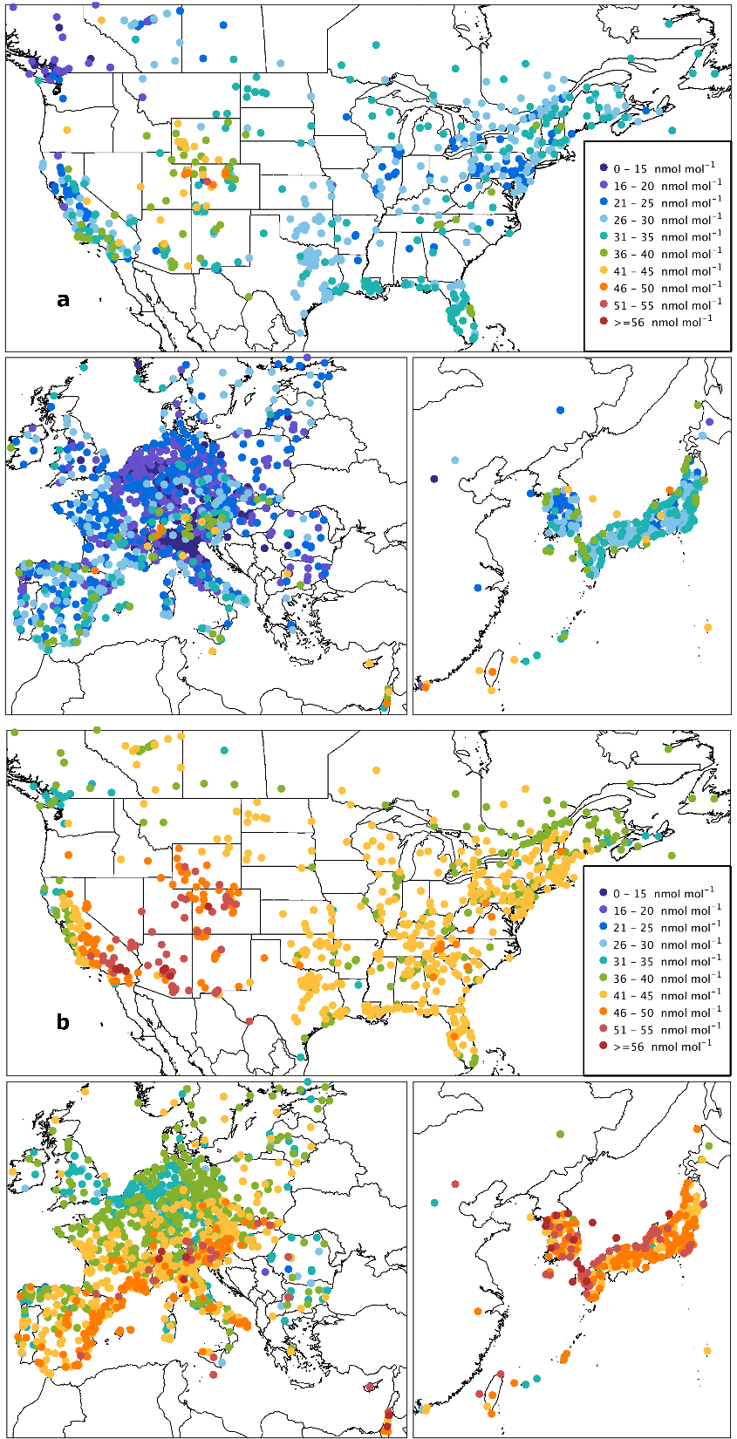
In winter, surface ozone values are maximum in
central US and the Po valley
Daytime average ozone
Present-day ozone: 2010-2014
Ground-based
UV Photometer
DJF

Slide 18
In spring, maximum surface ozone values spread to
southwestern US, southern France and Spain as well as Korea and Japan
Daytime average ozone
Present-day ozone: 2010-2014
Ground-based
UV Photometer
MAM

Slide 19
In summer, maximum surface ozone values are higher in western US, southern Europe and eastern Mediterranean
Daytime average ozone
Present-day ozone: 2010-2014
Ground-based
UV Photometer
JJA

Slide 20
In fall, maximum surface ozone values are found in
western US, southern Europe and eastern Mediterranean
Daytime average ozone
Present-day ozone: 2010-2014
Ground-based
UV Photometer
SON

Slide 21
At 2-3 km, the maximum of ozone is found in
spring and summer northern hemisphere
UT
9
Sondes
DJF
MAM
7
5
JJA
SON
3
2 km

Slide 22
At 5-7 km, the maximum of ozone is spread to the whole northern hemisphere in spring and summer and in the southern tropics in spring
UT
9
Sondes
DJF
MAM
7
5
JJA
SON
3
2 km

Slide 23
At 7-9 km, the maximum of ozone is spread to larger regions in both hemisphere in spring and summer
UT
9
Sondes
DJF
MAM
7
5
JJA
SON
3
2 km

Slide 24
In the upper troposphere, maximum ozone values are found
above Russia in summer
Commercial Aircraft IAGOS
UT
9
7
5
3
2 km

Slide 25
TOST
OMI-MLS
UT
Tropopause
9
OMI-SAO
OMI-RAL
7
Satellite
IASI-FORLI
IASI-SOFRID
5
3
2 km
Surface

Slide 26
TOST
OMI-MLS
UT
Tropopause
Sondes
9
OMI-SOA
OMI-RAL
7
IASI-FORLI
IASI-SOFRID
5
3
2 km
Surface

Slide 27
TOST
OMI-MLS
Satellite
UT
Tropopause
9
OMI-SAO
OMI-RAL
7
IASI-FORLI
IASI-SOFRID
5
3
2 km
Surface

Slide 28
TOST
OMI-MLS
Satellite
UT
Tropopause
9
OMI-SOA
OMI-RAL
7
IASI-FORLI
IASI-SOFRID
5
3
2 km
Surface

Slide 29
TOST 2008-2012
OMI-MLS 2010-2014
UT
Tropopause
9
OMI-SAO 2010-2014
OMI-RAL 2010-2014
7
IASI-FORLI 2010-2014
IASI-SOFRID 2010-2014
5
3
2 km
Surface

Slide 30
1970
1980
1990
2000
2010
Trends
Present-day

Slide 31
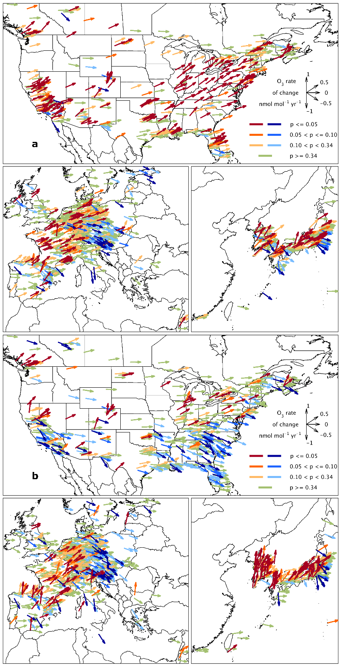
In winter, surface ozone increase at all sites in the 3 main regions
except central and northeast Europe, south and east of Korea and Japan
Daytime average ozone
Trends: 2000-2014
nmol mol⁻¹ yr ⁻¹
Ground-based
UV Photometer
DJF

Slide 32
In spring, surface ozone increase in
the northern part of US, western part of Europe, Korea and Japan
Daytime average ozone
Trends: 2000-2014
nmol mol⁻¹ yr ⁻¹
Ground-based
UV Photometer
MAM

Slide 33
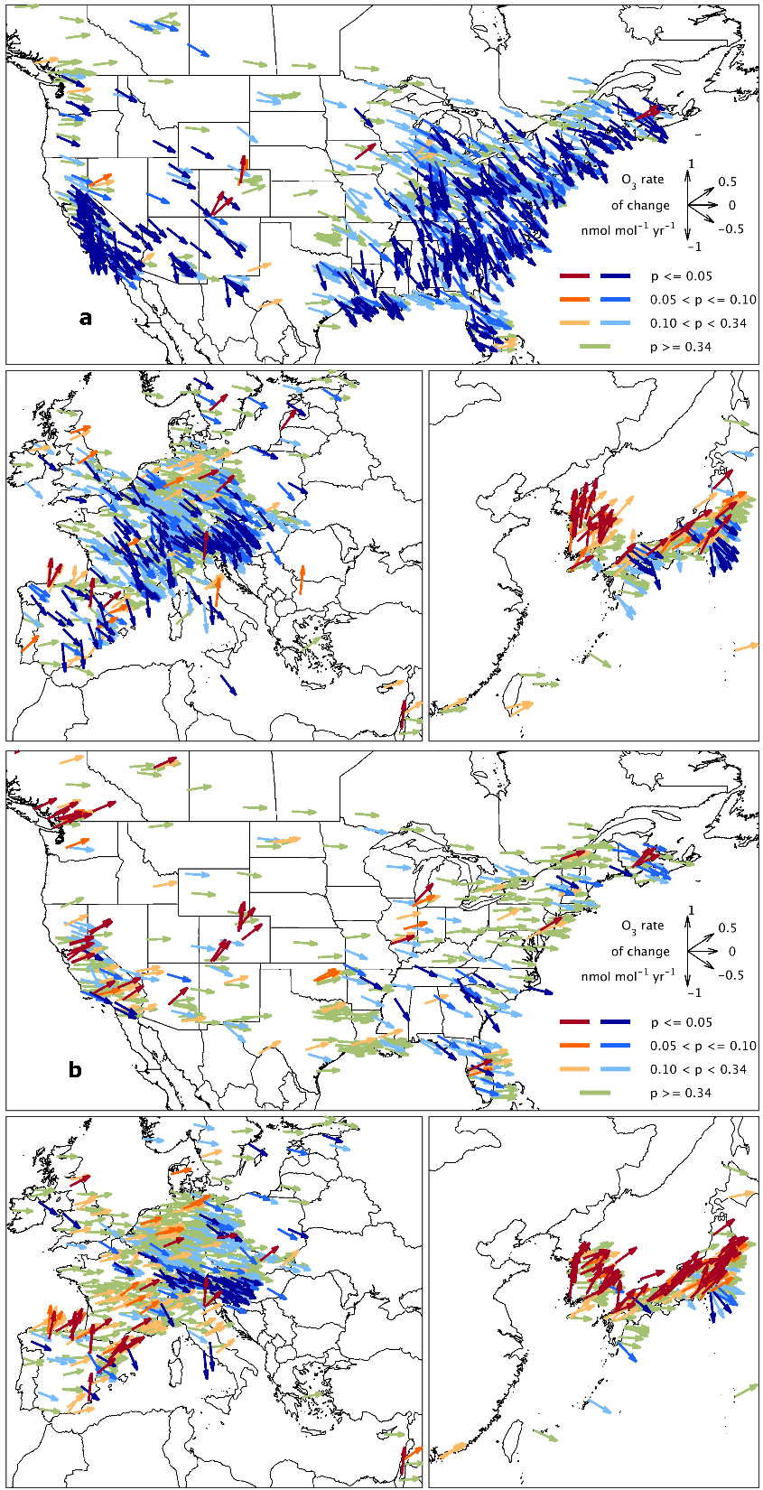
In summer, surface ozone decrease in North America, Europe and some sites in East Asia but increase in Korea and some sites in Japan
Daytime average ozone
Trends: 2000-2014
nmol mol⁻¹ yr ⁻¹
Ground-based
UV Photometer
JJA

Slide 34
In fall, surface ozone increase in Korea and Japan
Daytime average ozone
Trends: 2000-2014
nmol mol⁻¹ yr ⁻¹
Ground-based
UV Photometer
SON

Slide 35
Winter
Spring
Summer
Autumn
Table Mountain (California)
Lidar
ΔO₃=-9%
ΔO₃=0%
ΔO₃=7%
ΔO₃=-5%
- 2000-2007
- 2008-2015

Slide 36
DJF
JJA
Winter
Spring
Summer
Autumn
Table Mountain (California)
Lidar
ΔO₃=-9%
ΔO₃=0%
ΔO₃=7%
ΔO₃=-5%
- 2000-2007
- 2008-2015
North East US (NY, Boston, Philadelphia, Washington)
ΔO₃=7%
ΔO₃=7%
ΔO₃=0%
ΔO₃=3%
Commercial Aircraft IAGOS
- 1994-2004
- 2005-2013
O3 (nmol mol⁻¹)

Slide 37
DJF
JJA
Winter
Spring
Summer
Autumn
OHP (South of France)
Lidar
- 1994-2004
- 2005-2014
ΔO₃=3%
ΔO₃=-3%
ΔO₃=-3%
ΔO₃=-2%
Sondes
Frankfurt (Germany)
ΔO₃=11%
ΔO₃=1%
ΔO₃=-2%
ΔO₃=5%
Commercial Aircraft IAGOS
- 1994-2004
- 2009-2013
O3 (nmol mol⁻¹)

Slide 38
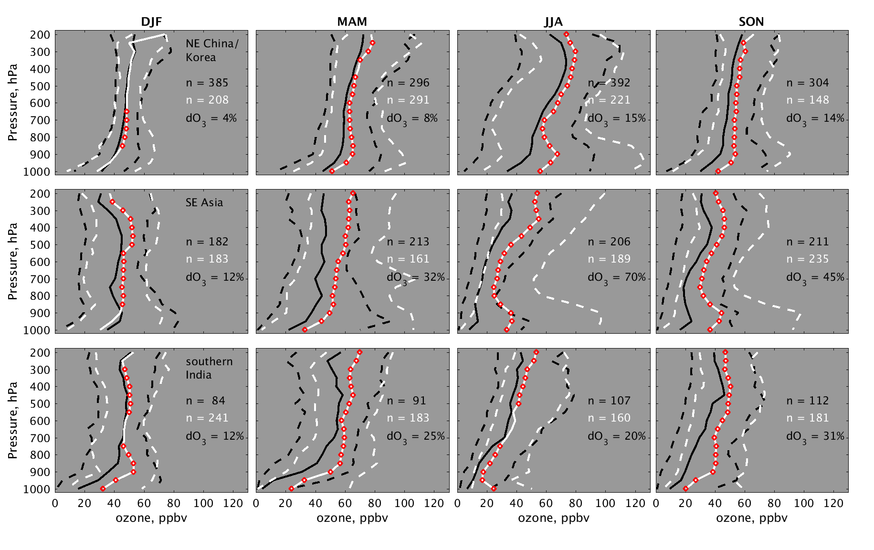
DJF
JJA
Winter
Spring
Summer
Autumn
NE China/Korea
- 1994-2004
- 2005-2014
ΔO₃=4%
ΔO₃=8%
ΔO₃=15%
ΔO₃=14%
SE Asia
Sondes
ΔO₃=12%
ΔO₃=32%
ΔO₃=70%
ΔO₃=45%
Soutern India
Commercial Aircraft IAGOS
ΔO₃=12%
ΔO₃=25%
ΔO₃=20%
ΔO₃=31%
O3 (nmol mol⁻¹)

Slide 39
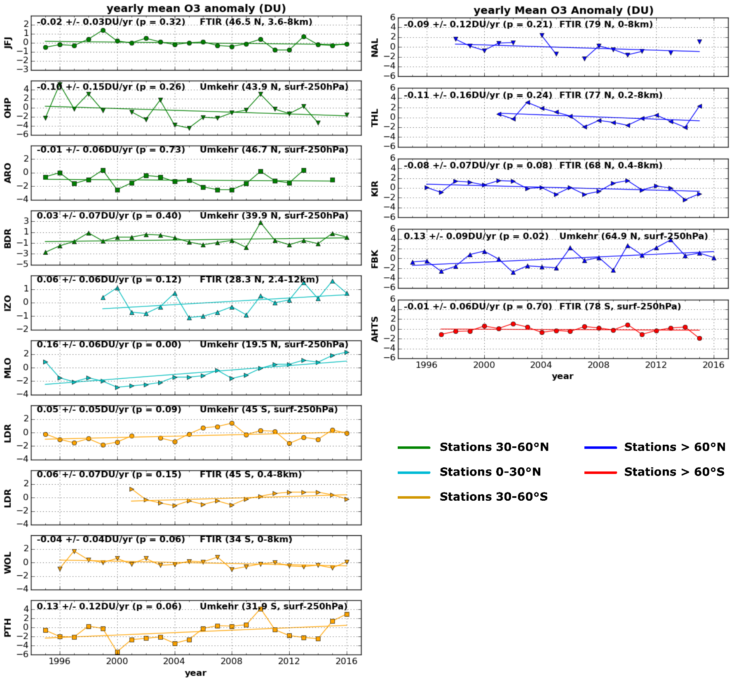
UT
Dobson
250 hPa
or
8 km
9
FTIR
7
5
3
2 km
Surface

Slide 40
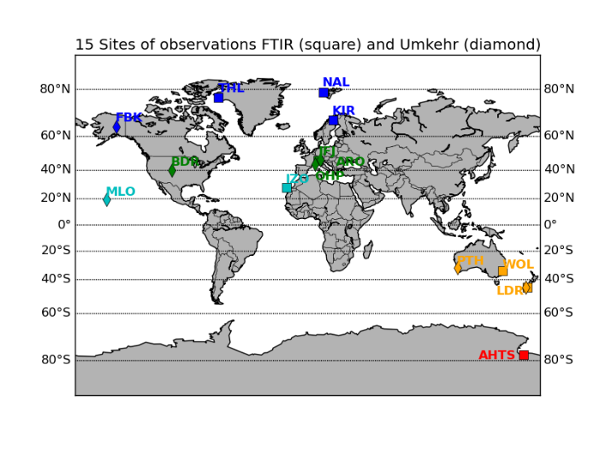
Dobson
FTIR
Increase of tropospheric column ozone (TCO) over Mauna Loa

Slide 41
Dobson
FTIR
Increase of tropospheric column ozone (TCO) above Lauder and Perth

Slide 42
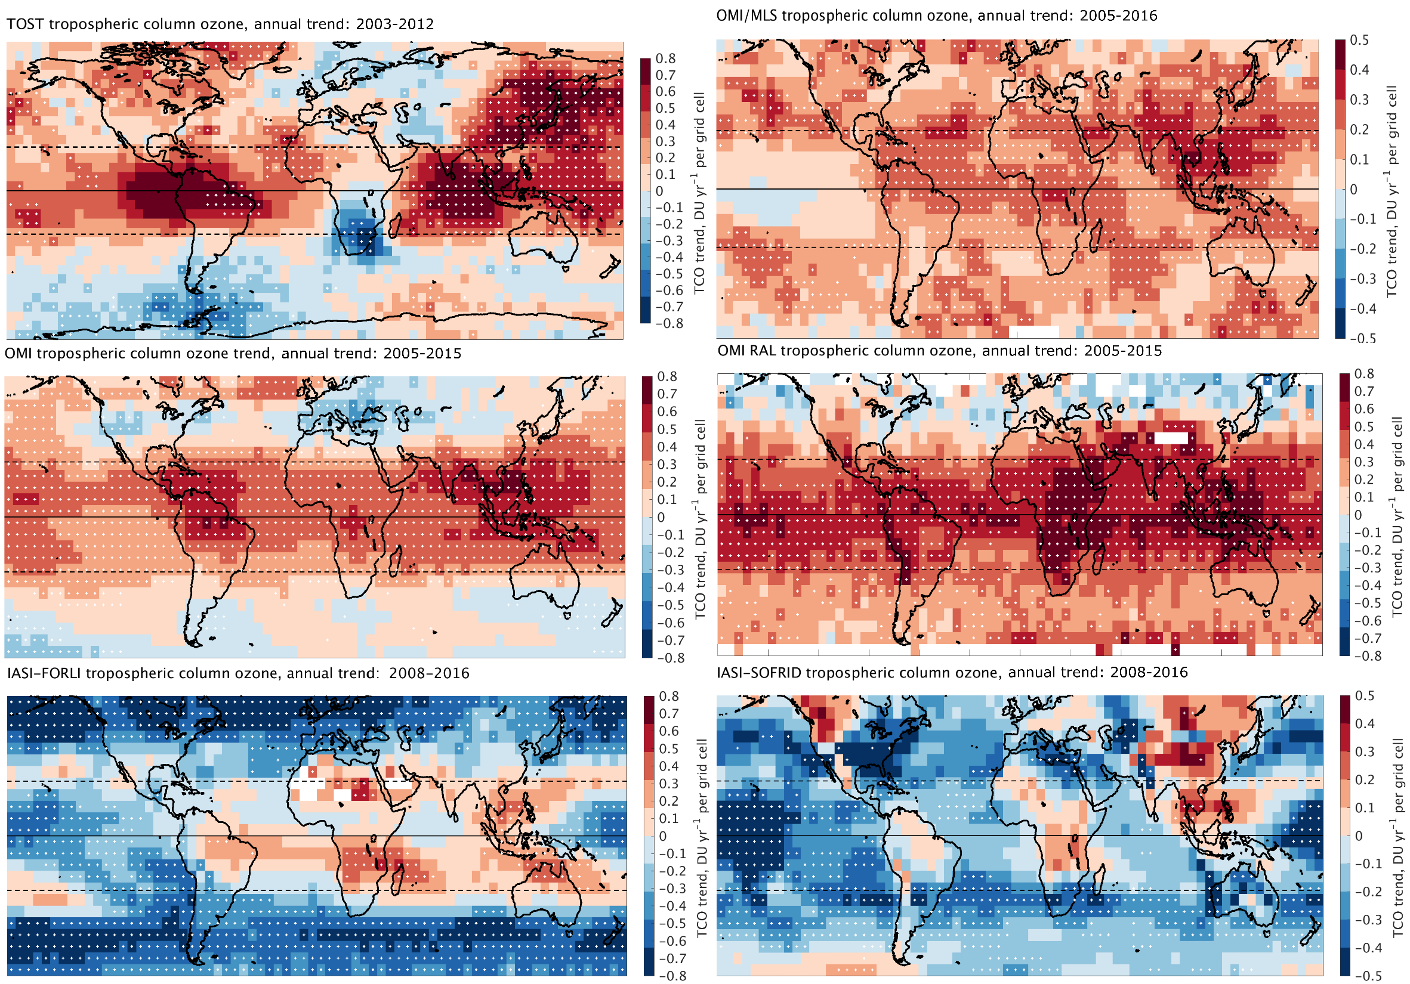
TOST 2003-2012
OMI-MLS 2005-2016
UT
Tropopause
9
OMI-SAO 2005-2015
OMI-RAL 2005-2015
7
Satellite
IASI-FORLI 2008-2014
IASI-SOFRID 2008-2016
5
3
2 km
Surface

Slide 43
TOST 2003-2012
OMI-MLS 2005-2016
UT
Tropopause
9
OMI-SAO 2005-2015
OMI-RAL 2005-2015
7
IASI-FORLI 2008-2014
IASI-SOFRID 2008-2016
5
3
2 km
Surface

Slide 44
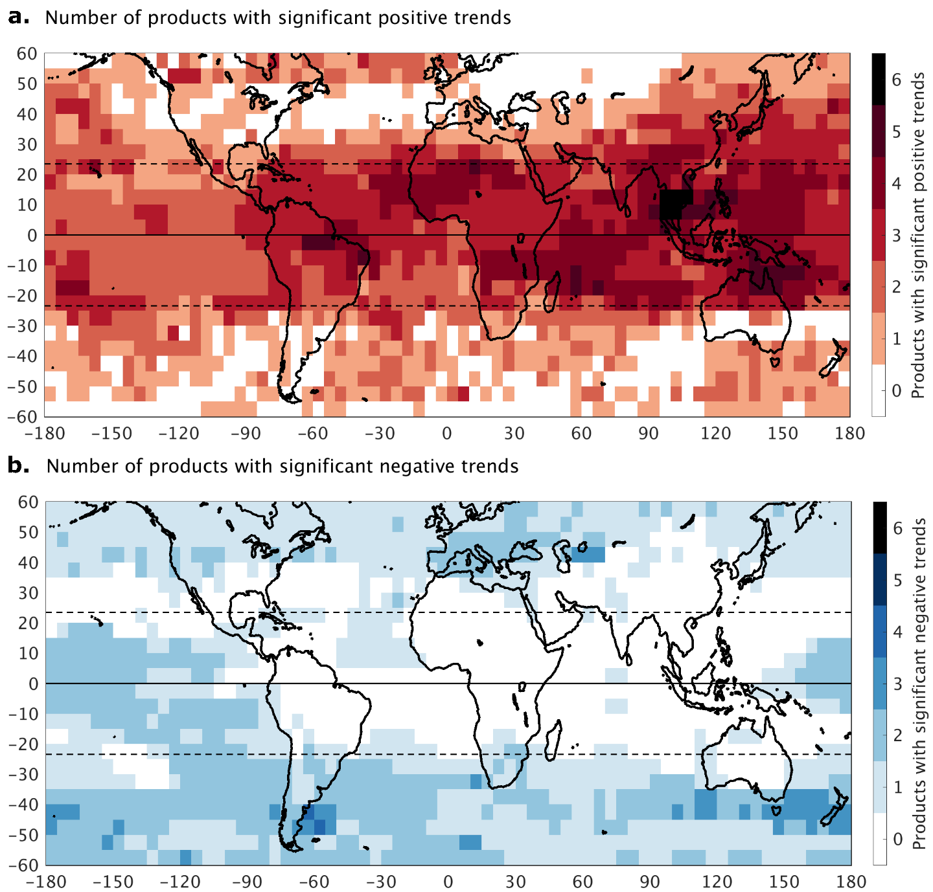
6 products agree there is a significant increase of ozone
above Southeast Asia

Slide 46
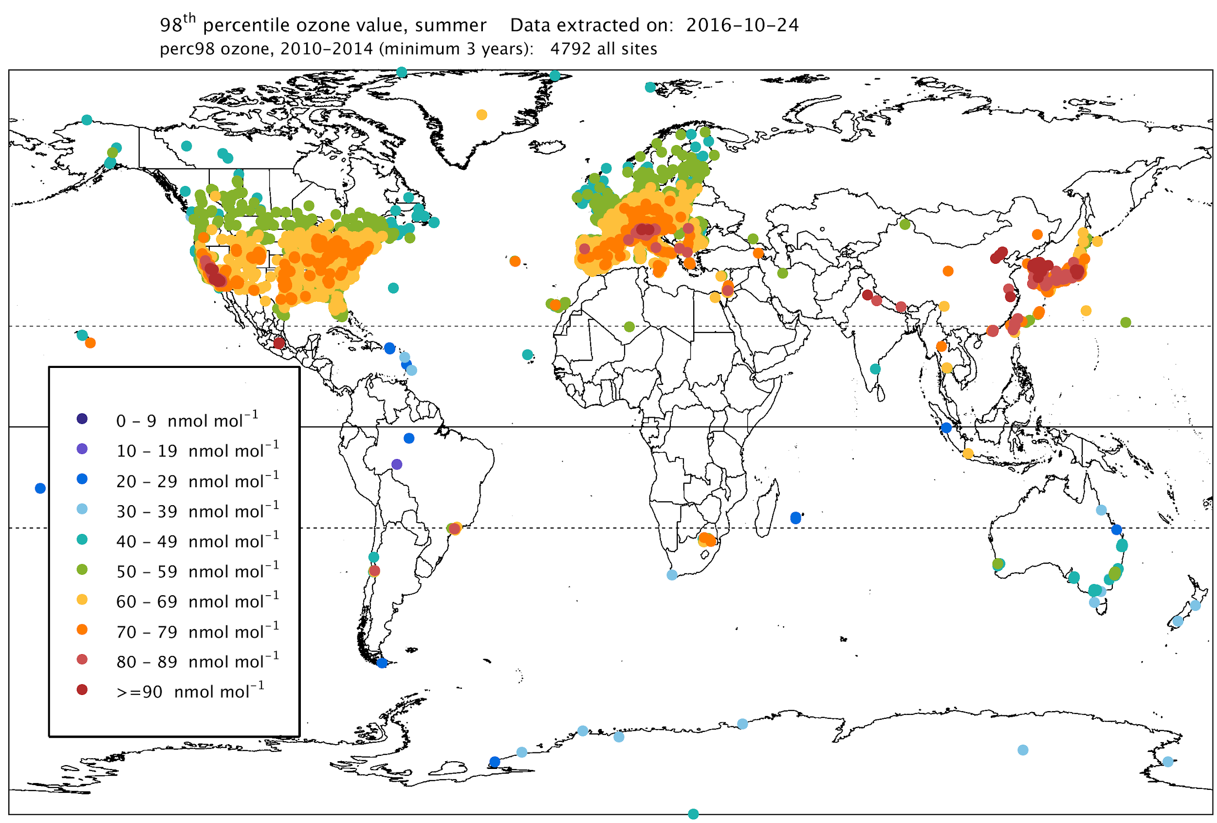
98th percentile ozone for the warm season (April-September in the Northern Hemisphere, and October-March in the Southern Hemisphere) for the present-day period, 2010-2014.

