Slide 1
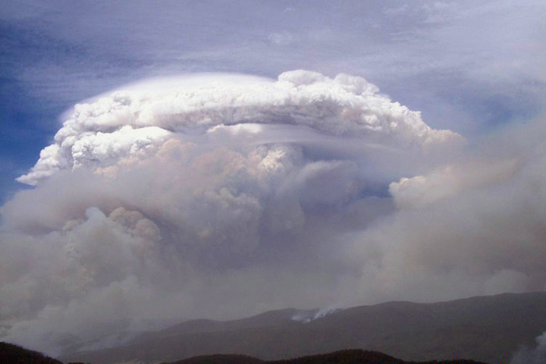

The Mother of All PyroCbs: British Columbia, 12 August 2017
Mike Fromm
Pat Kablick, Dave Peterson, James Campbell, Ed Hyer, Matt Deland
Fake news alert…this is NOT the Mother PyroCb
TOLNet/NDACC Lidar Science Working Group Meeting, 7-11 May 2018
Notes:
Critical points:
We must characterize the source term correctly
Initial plume altitude, mass are essential…and possible with the data at hand
This is a well observed but confounding plume.

Slide 2
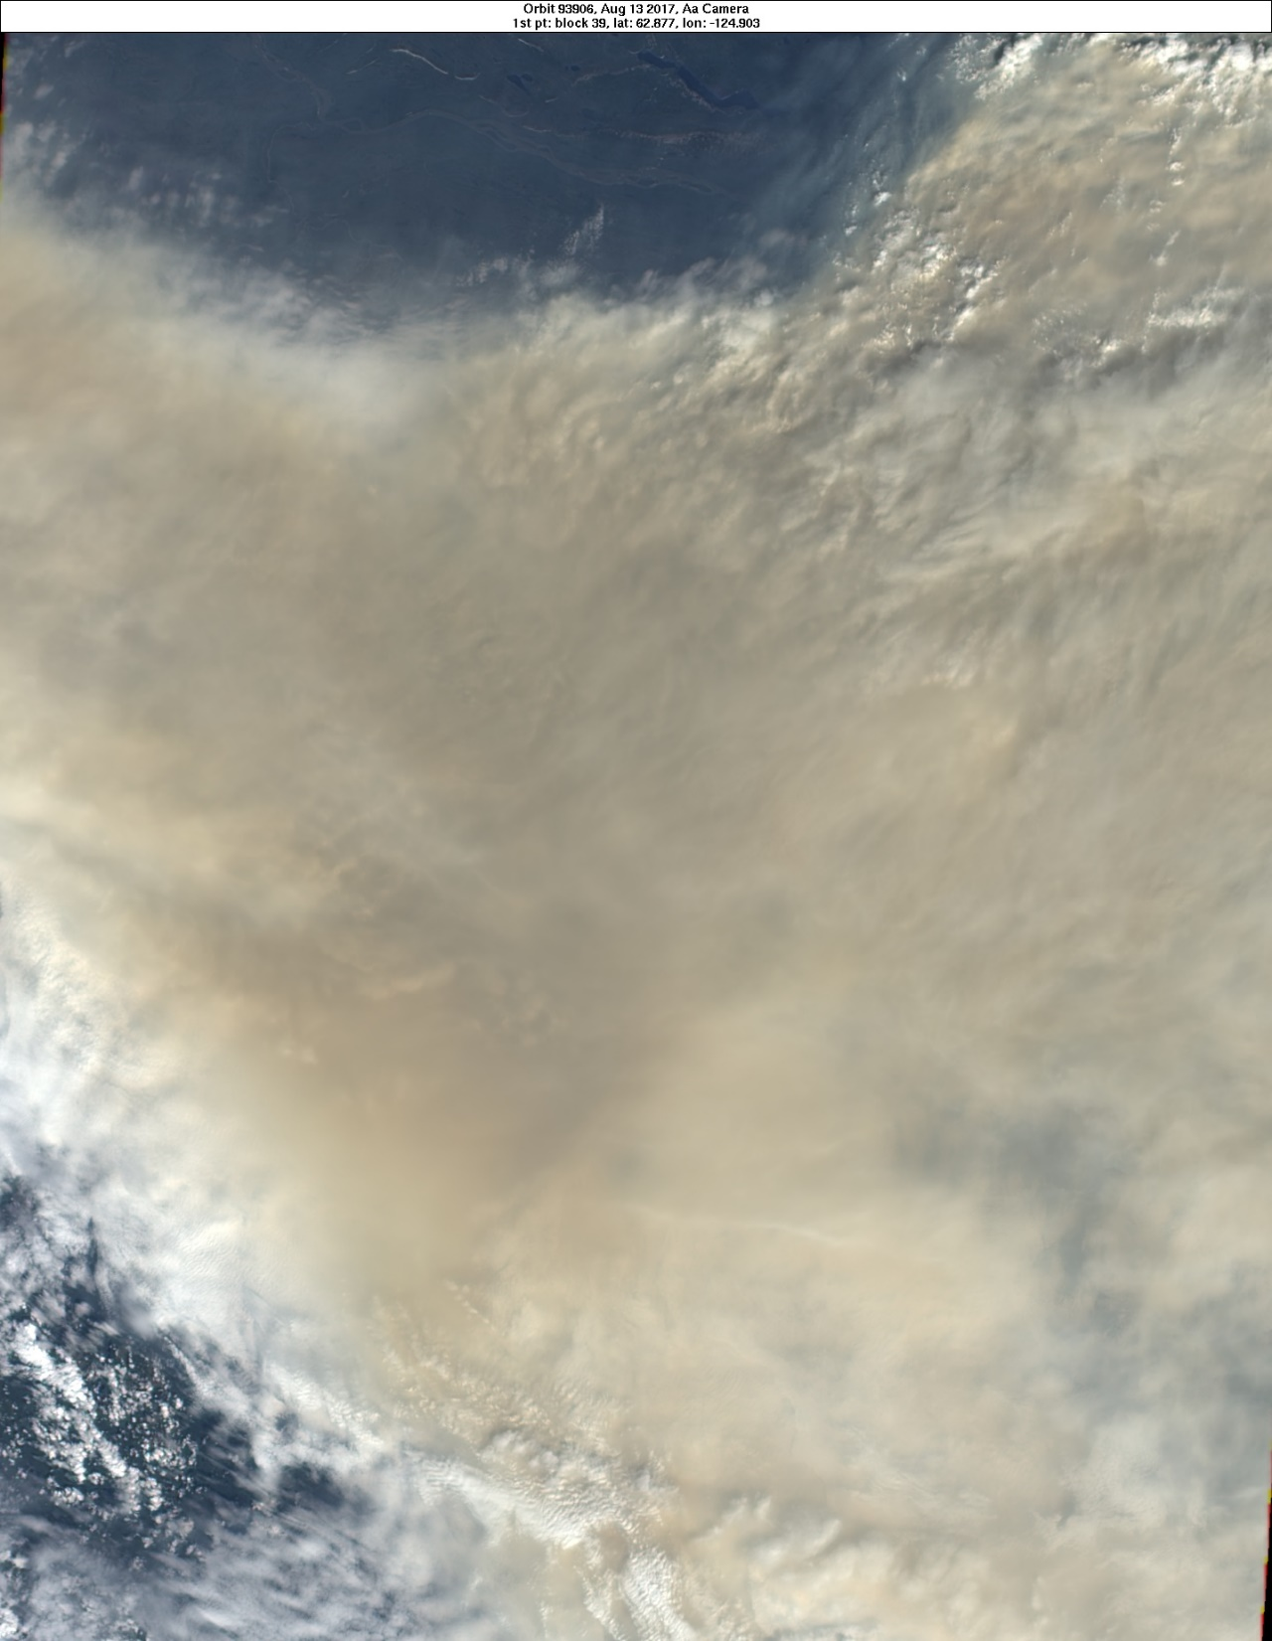
The Mother of all PyroCbs: British Columbia
12 August 2017
Off the charts:
* UV Aerosol Index (think TOMS, OMI, GOME 2)
* Stratospheric…
* plume AOD
* plume CO
* plume altitude
* Diabatic plume ascent from lowermost stratosphere
Warning:
10 data items in the next 20 minutes!
(gulp)

Slide 3
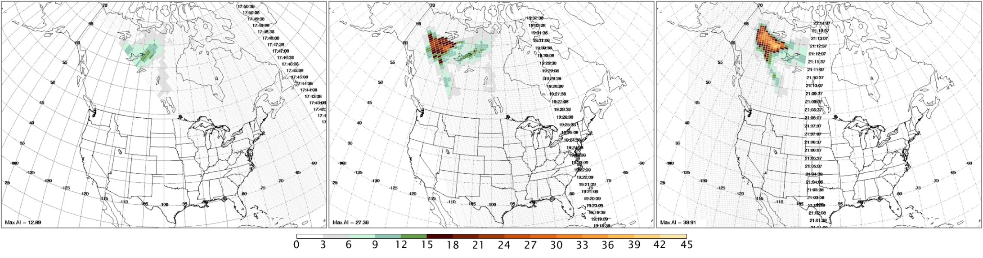
13 August 2017
Colin Seftor (SSAI/NASA):
“I can safely say that I have never used
the Aerosol Index scale that I have on the attached
OMPS AI imagery before.”
…I think this maximum AI value (39.9) is the highest ever seen (including for volcanic ash). It's the highest I can remember.”
8/13 max AI = 39.9. Previous record: 36.7.
8/14 max AI = 49.4. Unprecedented increase.
8/15…49.7. This is the Twilight Zone☺

Slide 4
UV Aerosol Index: GOME 2 & OMPS Together
- 13-17 August 2017
> Level 2 AI
> Rainbow color scale, violet (just above noise) to red (large AAI)
> Red fixed AI=25.

Slide 5
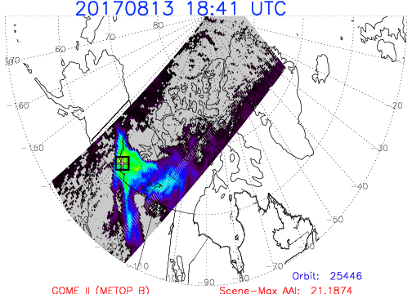

Slide 6
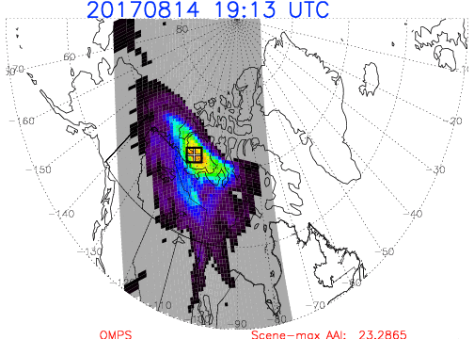

Slide 7
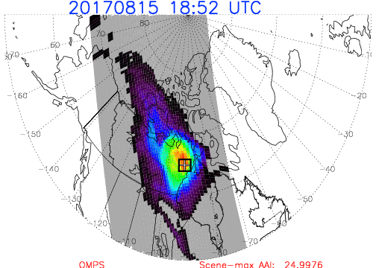

Slide 8
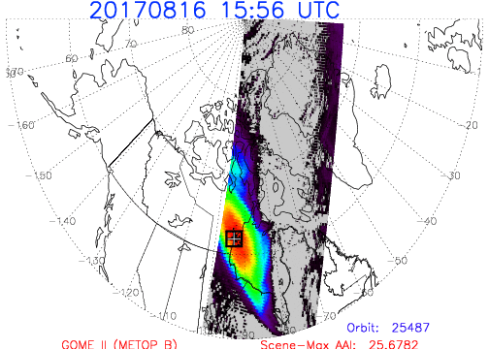

Slide 9
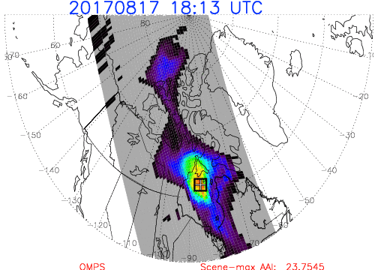

Slide 10
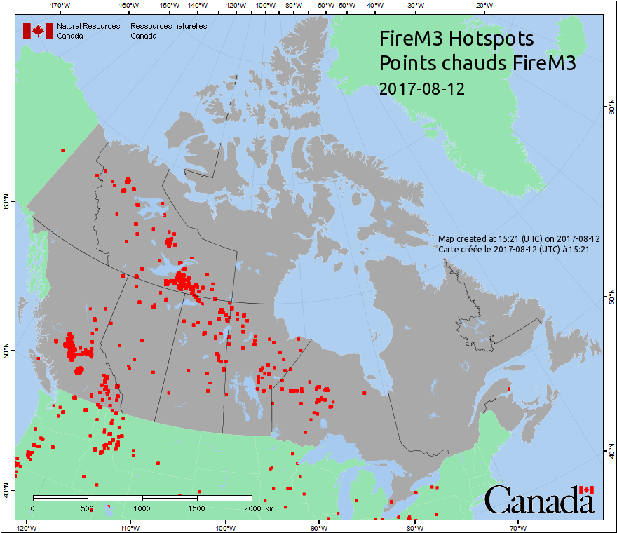
Sniffing out the source…
Mother PyroCbs

Slide 11
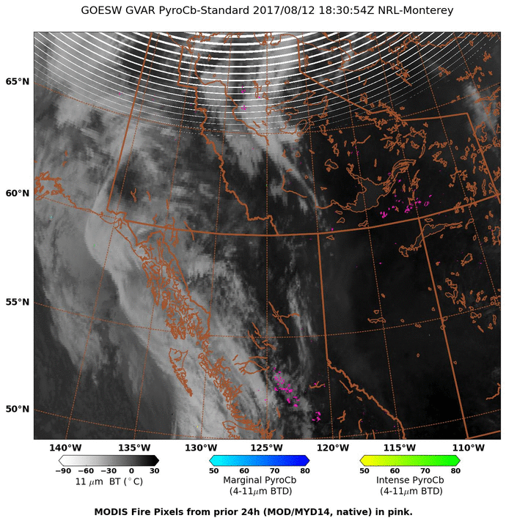
NRL automated, near-real-time pyroCb detection algorithm
PyroCbs in action: dinnertime on 12 August
GOES West Visible

Slide 12
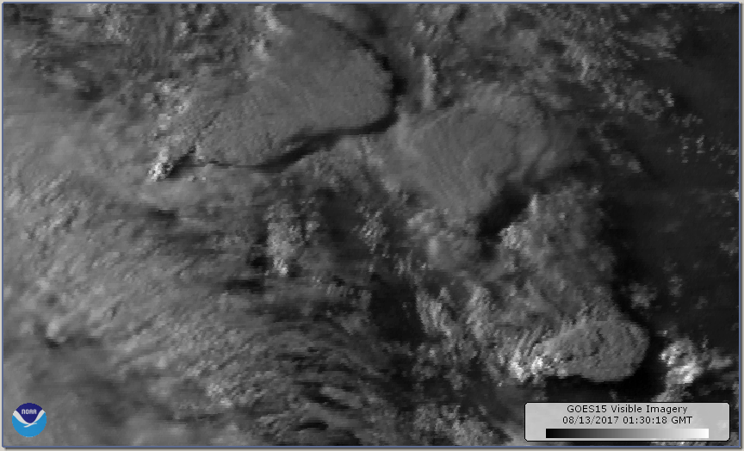
PyroCb cluster: dinnertime on 12 August
GOES West Visible

Slide 13
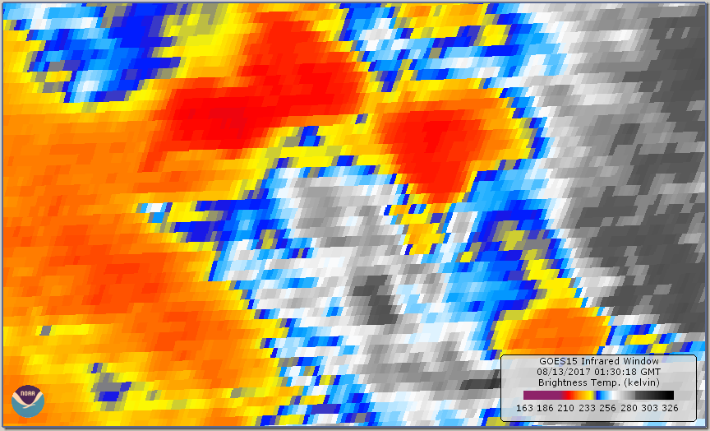
Window IR Brightness Temperature
COLD
Notes:
Btmin -63C

Slide 14
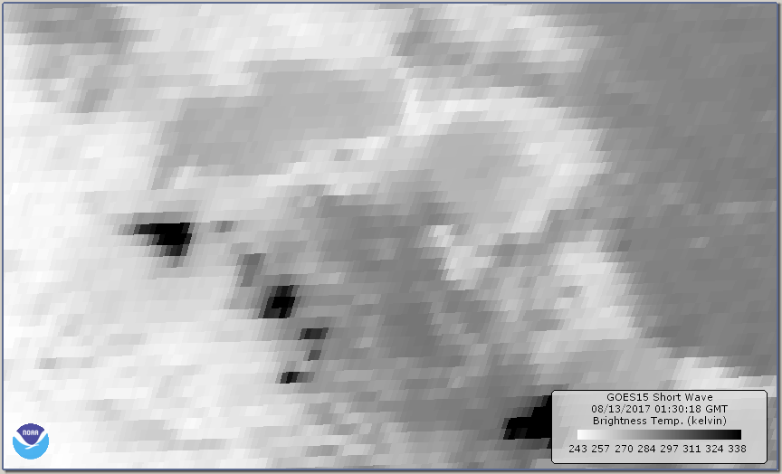
3.9μm Brightness Temperature
Warm!!!
Fires

Slide 15
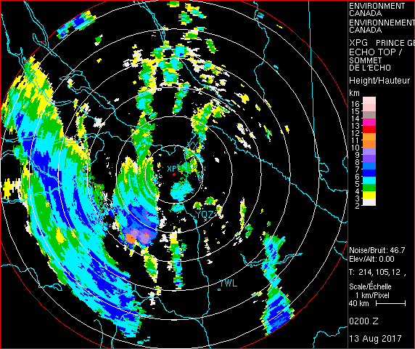
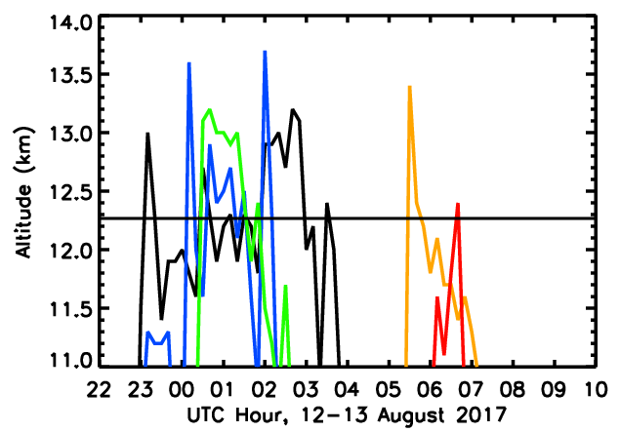
Prince George Radar Echo Tops
12-13 Aug 2017
7 total pyroCbs
~5 stratospheric pyroCbs
~5 hours of strat. injection
~Max echotop: 13.7 km
Tropopause
Notes:
PG RAOB Tmin: 195.0 12268 -60.7
Radar 100 km away from nearest pyroCb.

Slide 16
Now to post-pyroCb: What else do we know?
Notes:
Critical points:
We must characterize the source term correctly
Initial plume altitude, mass are essential…and possible with the data at hand
This is a well observed but confounding plume.

Slide 17
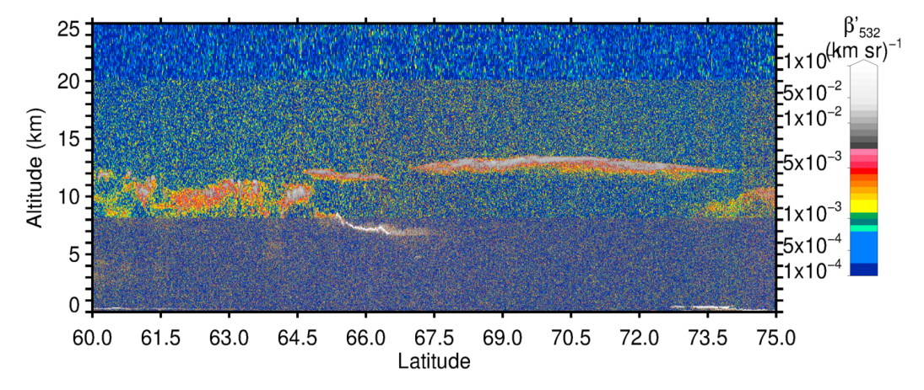
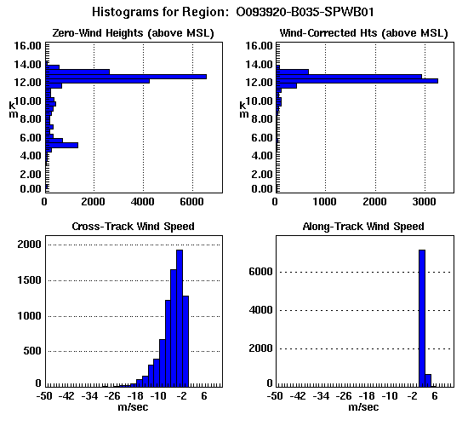
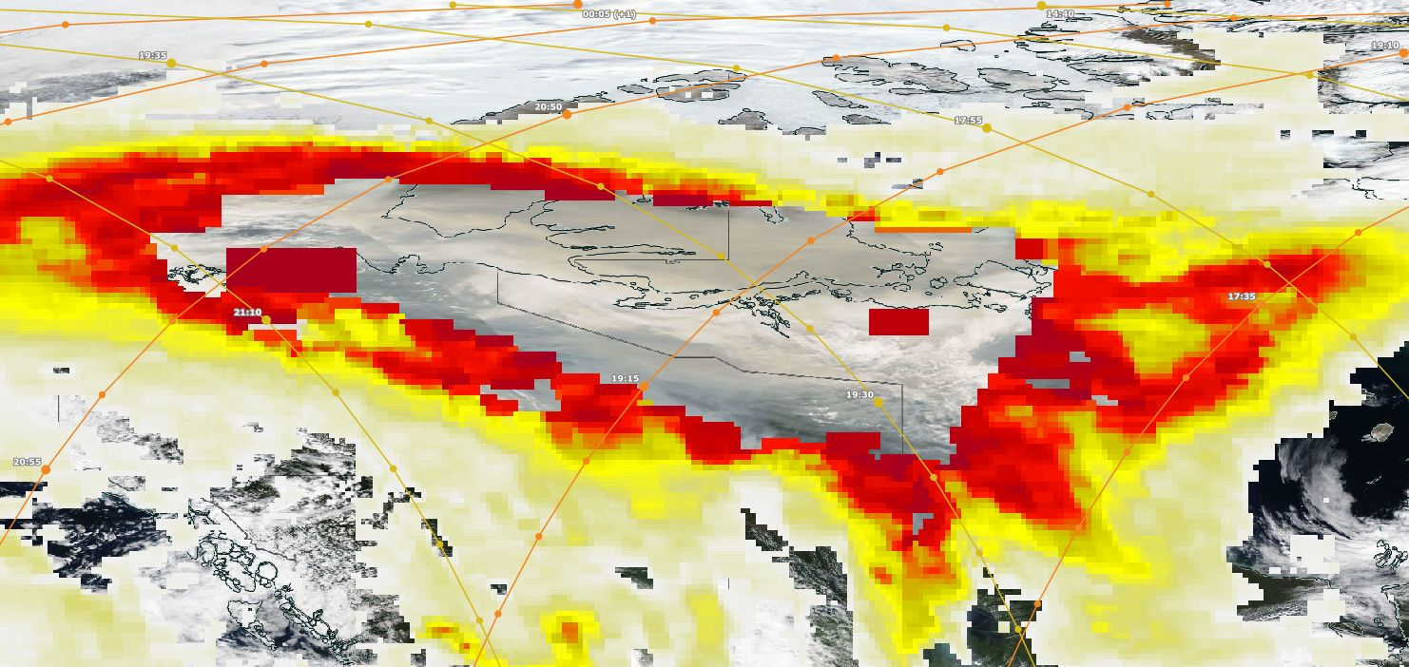
Plume Top: pyroCb + 2 days (14 Aug)
MISR Stereo Hgt.
Credit: Ralph Kahn
CALIPSO 532 nm backscatter
Plume z:
12-14 km
CALIPSO
MISR
AI Max
49.4
Aqua MODIS True Color
OMPS AI
Credit: Worldview
Notes:
Tropopause ~12 km
MISR, CALIPSO give consistent info over large real estate.

Slide 18
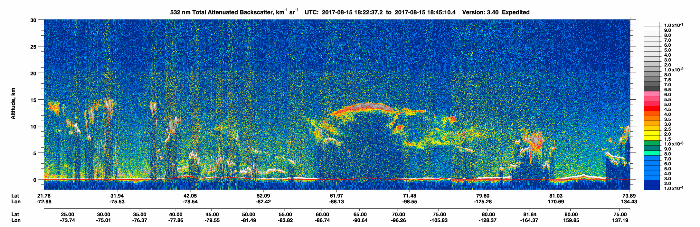
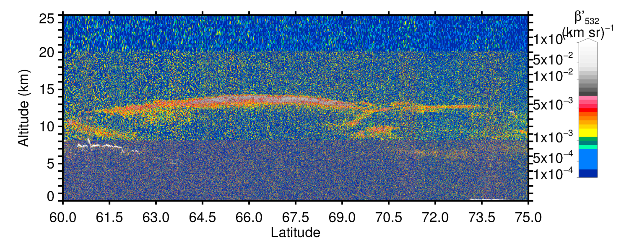
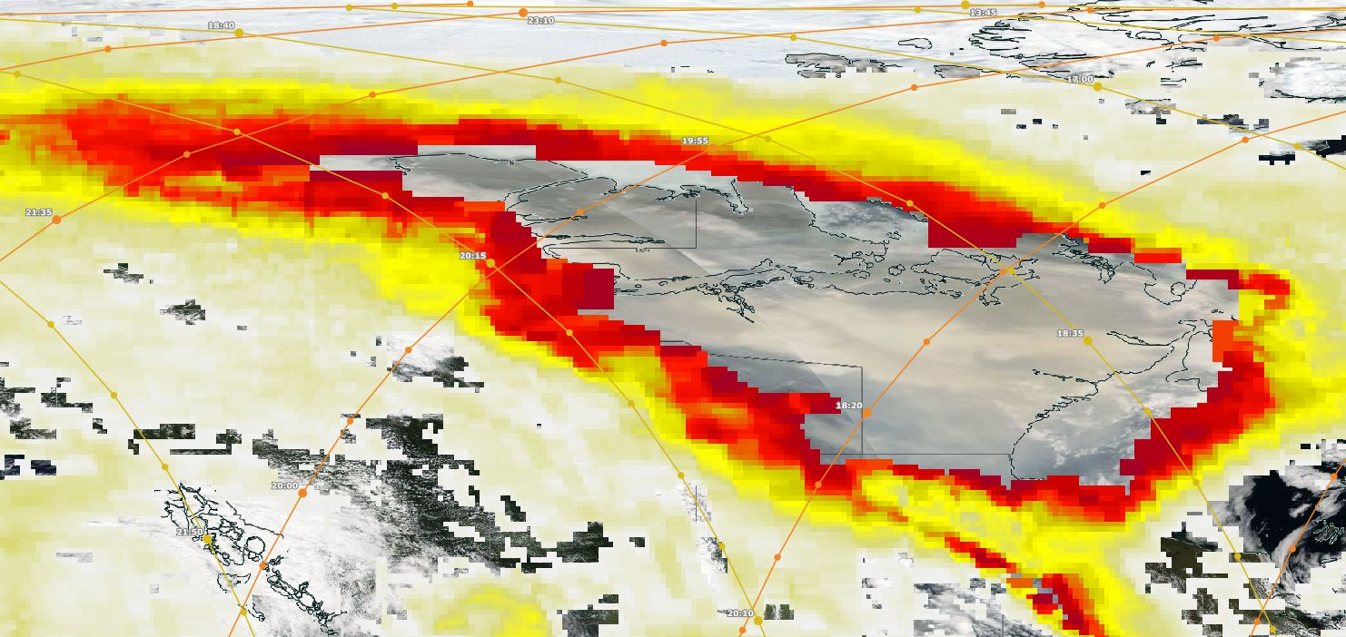
Plume Top: pyroCb + 3 days (15 Aug)
Total
Attenuation
- AOD >3 ?!
Plume z:
12-14 km
CALIPSO
AI Max
49.7

Slide 19
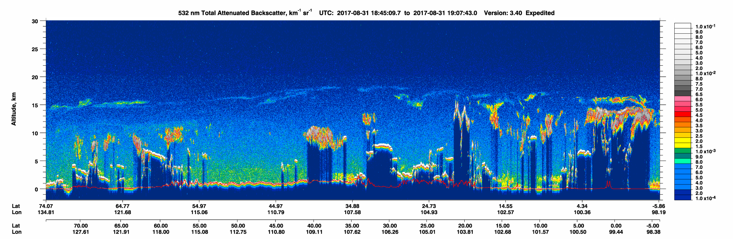
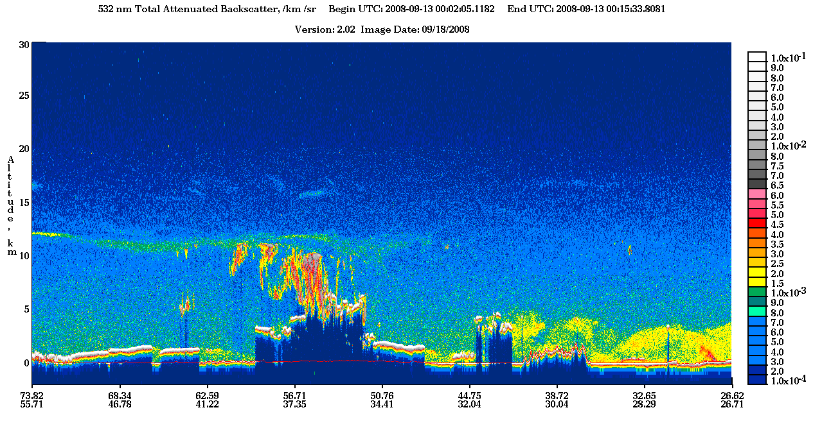
Mother PyroCb Smoke 31 Aug 2017 ~19 Days Old
Kasatochi Sulfate 13 Sep 2008 ~37 Days Old

Slide 20
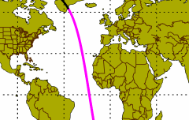
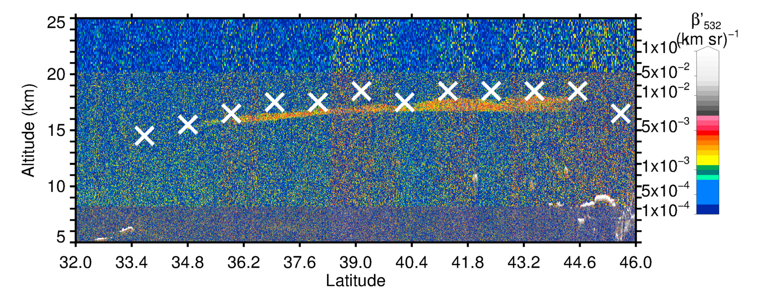
9-day old strat. smoke
22 August 2017
CALIPSO 532 nm
Backscatter
17 km
X OMPS LP Cloud Z

Slide 21
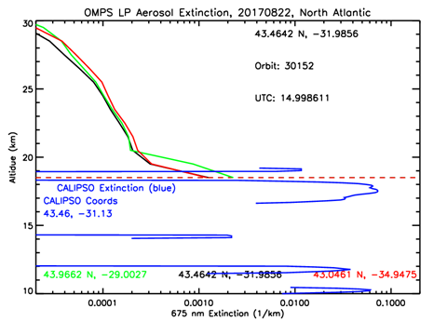

Slide 22
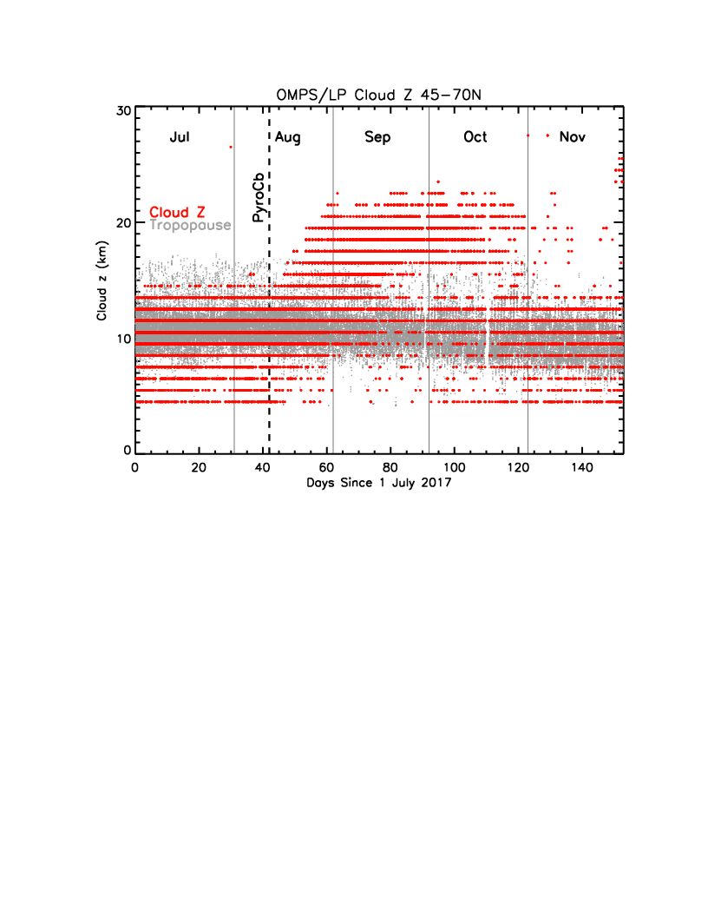
OMPS Limb Profiler Cloud-altitude (“Cloud Z”)
Cloud Z and colocated tropopause Z for latitudes 45-70°N.
Notes:
Cloud Z for each OMPS profile signifies a cloud-like increase in OMPS
radiance (I). dLn(I_{675nm})/dz-dLn(i_{867nm})/dz is evaluated in a downward direction
against a fixed threshold (Chen et al., [2016]*). Cloud Z is set at that altitude.

Slide 23
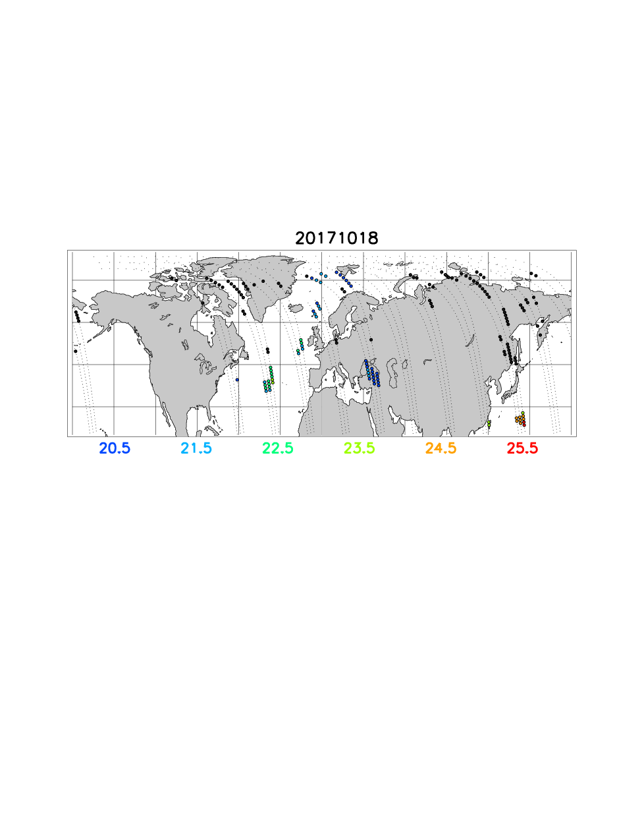
OMPS/LP Cloud Hgt., 18 October 2017
- Cloud Z flag is indicator of strong gradient
in aerosol scattering
- Big, colored dots: Cloud Z Flag set at Z>= 20.5 km
- High “cloud” where CALIPSO shows aerosol layer, south of Japan
- 2 months post-pyroCb, smoke ~24 km and optically dense
enough to trigger cloud flag

Slide 24
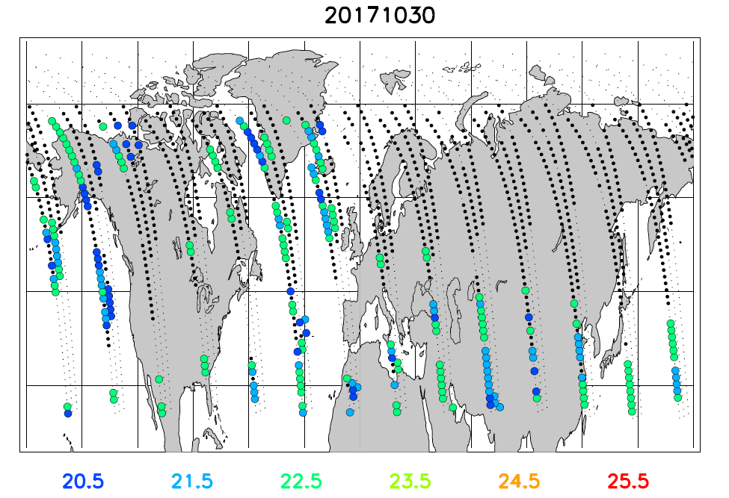
OMPS/LP Aerosol Scattering Index Stratospheric Plume Detection
* Tiny black points: OMPS profile location – no plume
* Black dots: plume-top < 20 km
* Colored, large dots: plume-top > 20 km (see scale above)

Slide 25
And all that came from inside that, which came from that. ☺
13 Aug 2017

Slide 26
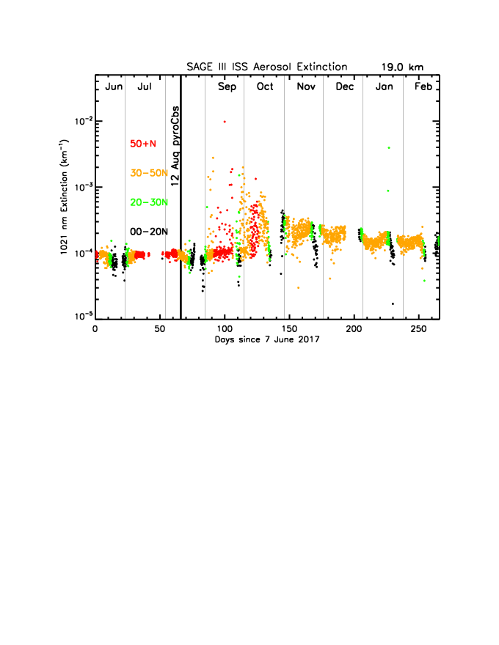
SAGE III ISS 1021 nm extinction, 19 km
* NH latitude bands color coded

Slide 27
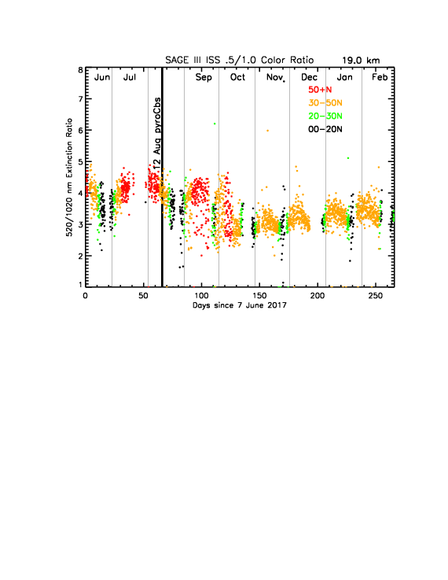
SAGE III ISS 0.5/1.0 micron “Color Ratio”
19 km

Slide 28
Comparison of 3 Top PyroCb Events
? Where does our Mother fit in ?
* All confirmed as pyroCb based on radar echo-top and lightning observations
pyroCb Event Injection z¹ Post-injection z^{2,3} Top z³ Duration ³ (months)
Chisholm (‘01) 14 km 12 km 18 km 3
Black Saturday (‘09) 15 km 17 km 23 km 4
Mother (‘17) 13 km 13-14 km 24 km 6+
1 - Based on radar echo tops
2 - One or two days post-pyroCb
3 - Based on published works (Chisholm and Black Saturday)
Chisholm (Alberta, Canada, 28 May 2001):
Rosenfeld et al. (ACP, 2007)
Fromm et al. (JGR, 2008)
Black Saturday (Victoria, Australia, 7 February 2009):
Siddaway and Petelina, (JGR, 2011)
Pumphrey et al. (ACP, 2011)
Dowdy et al. (JGR, 2017)
Notes:
Chisholm theta = 458K

Slide 29
Mother PyroCb papers are coming out!
Hot off the press (GRL)…
“Stratospheric smoke with unprecedentedly high backscatter observed by lidars above southern France”
S.M. Khaykin, S. Godin-Beekmann, A. Hauchecorne , J. Pelon, F. Ravetta, and P. Keckhut
ACP-D:
“Extreme levels of Canadian wildfire smoke in the stratosphere over central Europe”
Ansmann et al. (Part 1)
Haarig et al. (Part 2)

Slide 30
The Mother of all PyroCbs: British Columbia
12 August 2017
Off the charts:
* UVAI
* Stratospheric…
* plume AOD
* plume CO
* plume altitude
* Diabatic plume ascent from lowermost strat.
*like Chisholm and Black Saturday plumes.

Slide 31
Acknowledgements:
René Servranckx
Colin Seftor
Marloes Penning de Vries
P.K. Bhartia
Ghassan Taha
Omar Torres
Mika Tosca
NASA LANCE
NOAA Weather and Climate Toolkit
Environment Canada

Slide 32
CALIPSO aerosol and Aura MLS Carbon Monoxide together
* 31 August (pyroCb + 19 days)
* Plume height above 20 km!!
* That’s Θ > 500 K
* MLS CO > 330 ppbv!!
Michael Schwartz: “Also, I'd just like to note how
unprecedented these values are in the MLS record at
215 hPa and 147 hPa. At 100 hPa they are rivaled only by
Black Saturday.

Slide 33
31 August 2017
20 km

Slide 34
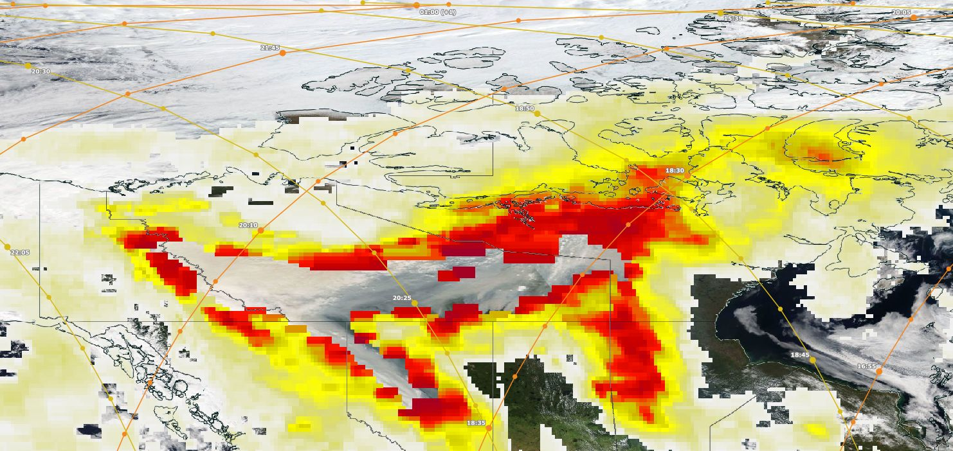
? What about the day after the pyroCbs (13 August)?
* CALIPSO is too far east.
* MISR has an ideal vantage point.
* stereo hgt retrievals fail…plume is too smooth.
CALIPSO
MISR
AI Max
Notes:
OMPS/LP misses it too.

