Slide 1
H2O and Temperature by Raman Lidar in the troposphere and in the UTLS above Payerne
5th TOLNet / 2018 NDACC LWG Meeting
G. Martucci¹, V. Simeonov², L. Renaud¹, , Fran Navas-Guzman¹, Jordan Voirin¹, Shannon Hicks³, Sham Gamage³, Bob Sica³, Bertrand Calpini¹ and A. Haefele^{1,3}
¹ Office Fédérale de Météorologie et Climatologie, MeteoSuisse, Payerne, Suisse
² EPFL, École Polytechnique Fédérale de Lausanne, Suisse
³ Department of Physics and Astronomy, The University of Western Ontario, London, Canada

Slide 2
Outline
LIDAR operational calibrated measurements
Tropospheric PRR temperature
Tropospheric Raman Water Vapour
Ice cloud characterization by balloon-lidar match experiment.
PRR temperature climatology in the UTLS
Raman Water Vapour climatology in the UTLS
Future activities: OEM retrieval

Slide 3
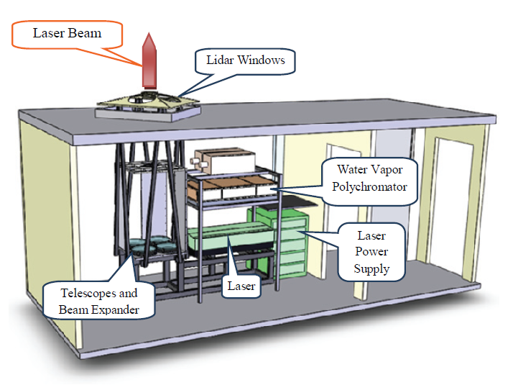
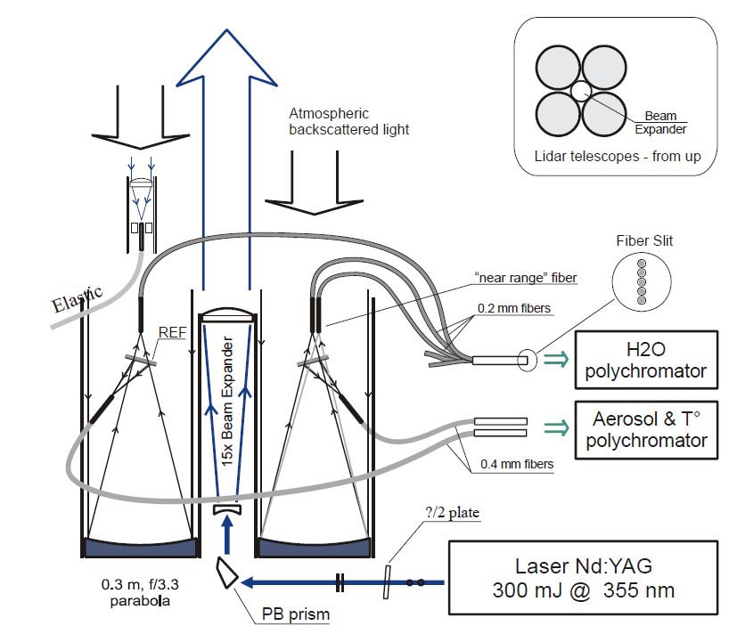
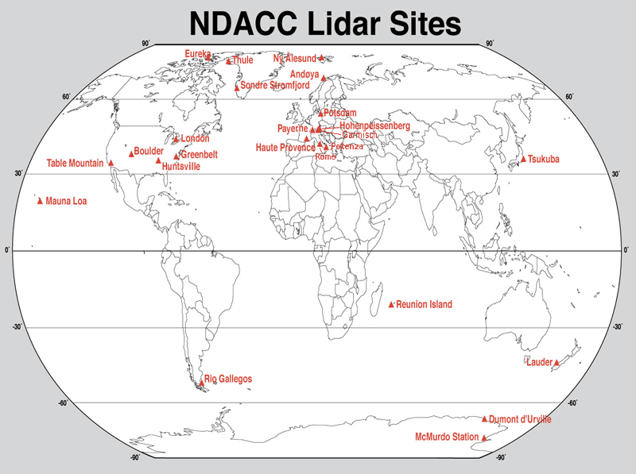
The RAman Lidar for Meteorological Observations - RALMO
Operated in Payerne, Switzerland
Since 2008
Fully automatic Raman lidar
Day and nighttime operation
Narrow FOV and bandwidth
High laser-pulse energy, 450 mJ

Slide 4
Solar background calibration
The procedure to calibrate the RALMO water vapor mixing ratio (ω) consists of the daily automatic correction of the calibration factor C obtained by radiosounding at time t₀.
The correction of C is based on an automatic monitoring of the differential aging of the N₂ and H₂O PMTs using the solar background.
The C(t) factors obtained using the BKG show an excellent agreement with the C(t_{i}) factors within 10% and provide the possibility to characterize RALMO along the entire dataset (9 years) with only one radiosounding calibration (initialization).

Slide 5
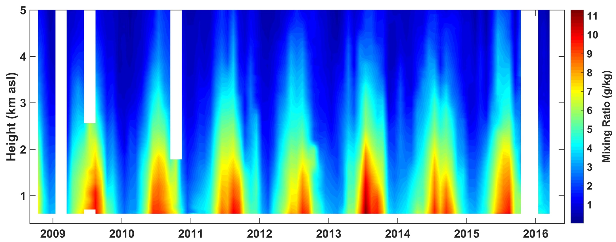
Tropospheric Water Vapour climatology
Since 2008 RALMO has produced on average 1 profile every hour, i.e. 50% availability of tropospheric profiles.

Slide 6
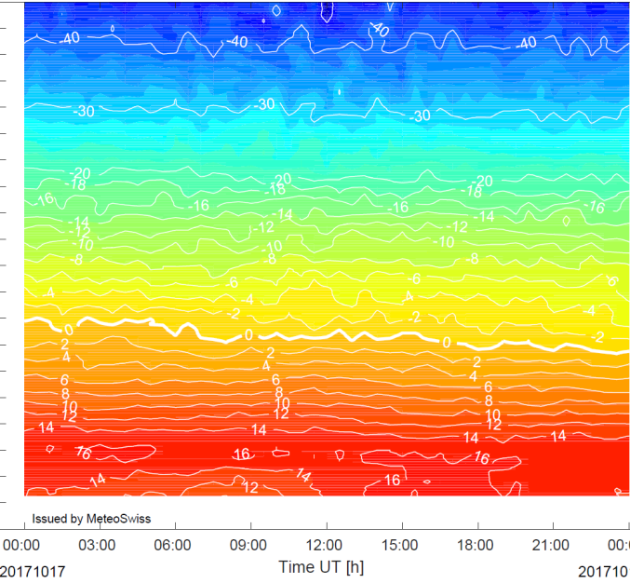
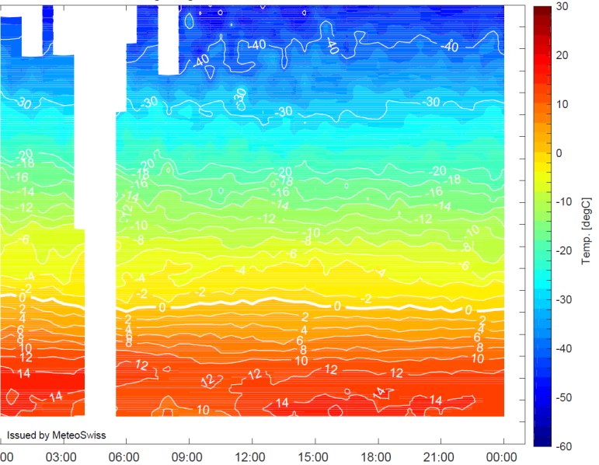
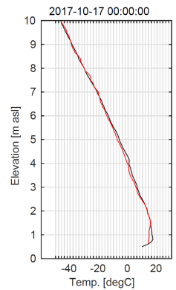
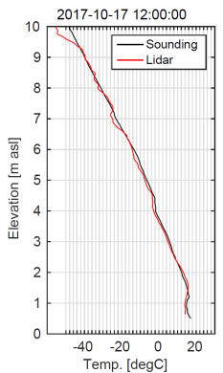
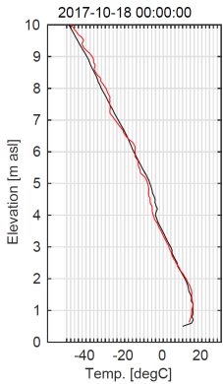
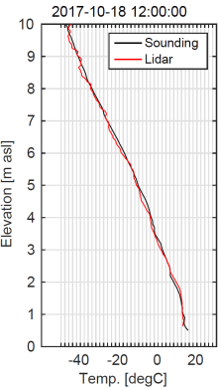
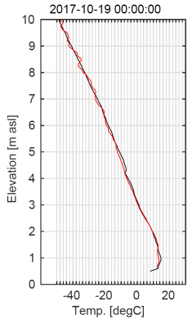
Tropospheric PRR-Temperature
16-11-2017
19-11-2017

Slide 7
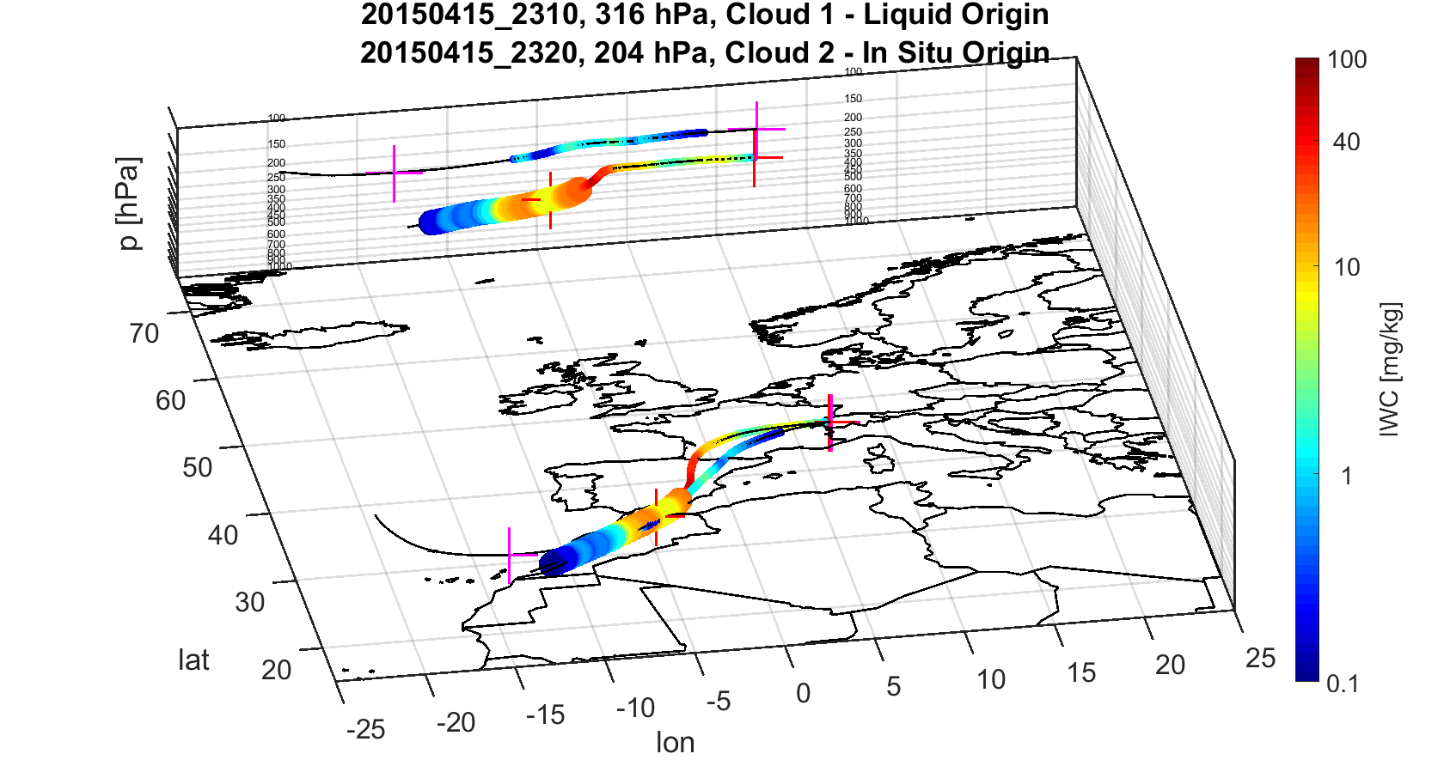
Different cirrus origins over Payerne, night of 15-Apr-2015:
first cirrus layer around 9 km of liquid origin
second thin layer around 11.5 km of in-situ origin
Cloud 1: in-situ
Opt. Depth (lidar): 0.007 (subvis)
IWC: ~0.1 mg/m³
Cloud 2: liquid origin
Opt. Depth (lidar): 0.15
IWC: ~7.4 mg/m³
clear difference in optical and microphysical properties between two clouds with different origins
Backward trajectories using LAGRANTO [Sprenger & Wernli, 2015] on ERA-INTERIM. Large dots indicate presence of LWC.

Slide 8
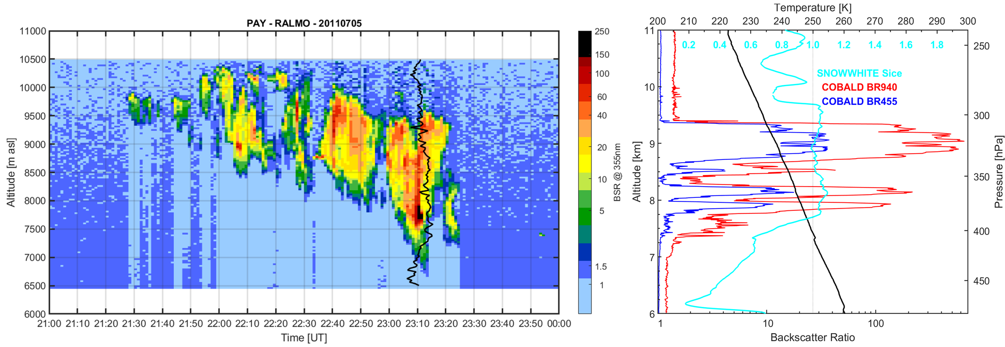
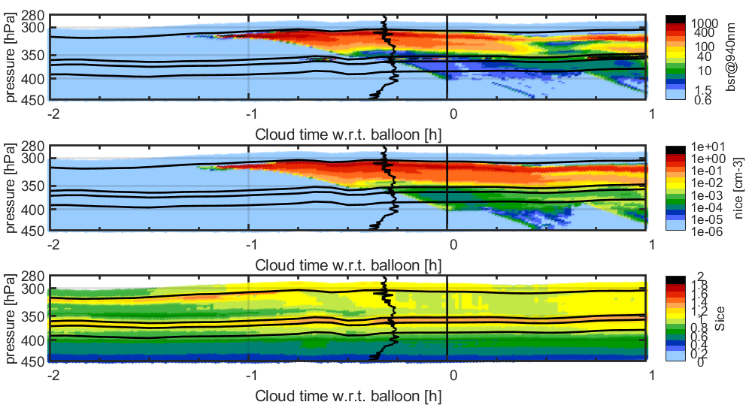
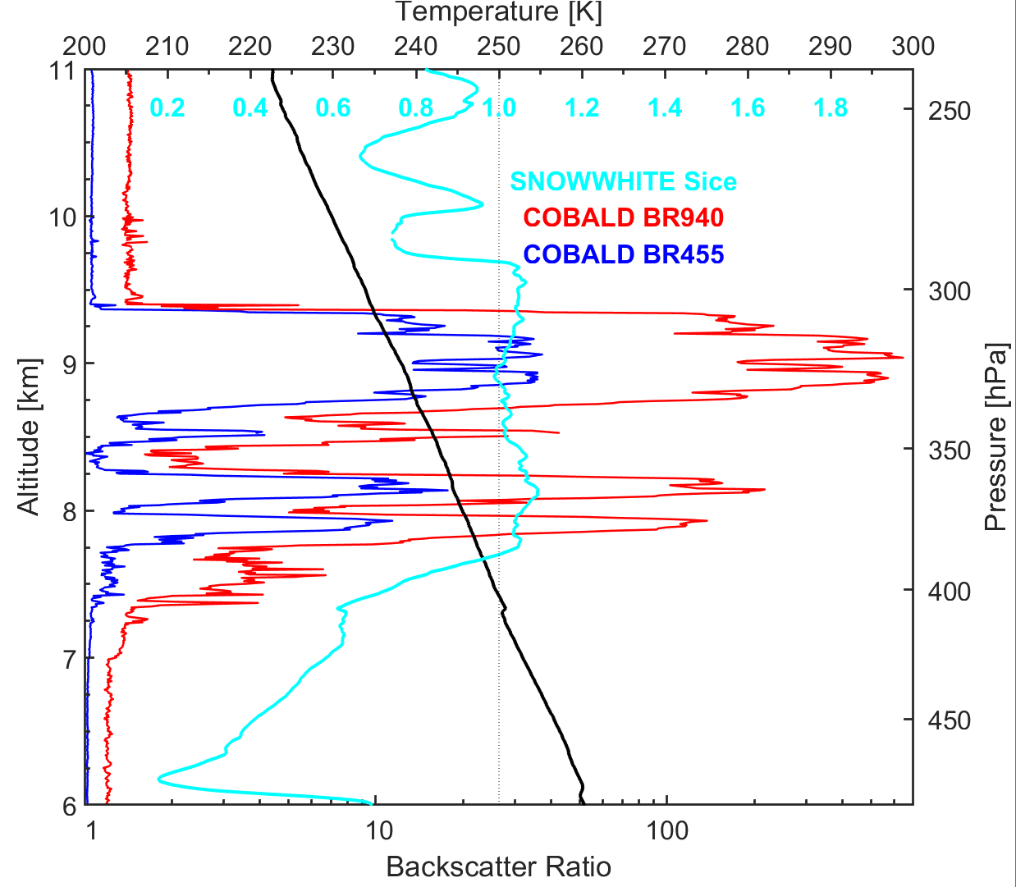
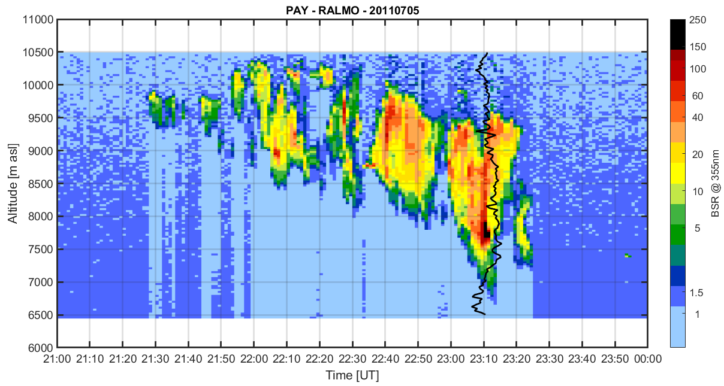
Seeder-feeder effect over Payerne, night of 5-Jul-2011:
1.
2.
Presence of supercooled liquid droplets
indicated by lidar
3.
4.
Homogenously nucleated ‘mother’-cloud (high BR), slowly sedimenting and evaporating in descending air mass
Sedimenting ice particles from the ‘mother’ cloud
Mixed-phase layer (massive BR in lidar), with the water phase being depleted by the falling ice crystals through riming and deposition, thus decreasing the BR over time
Fall streak of ice crystals into subsaturated environment

Slide 9
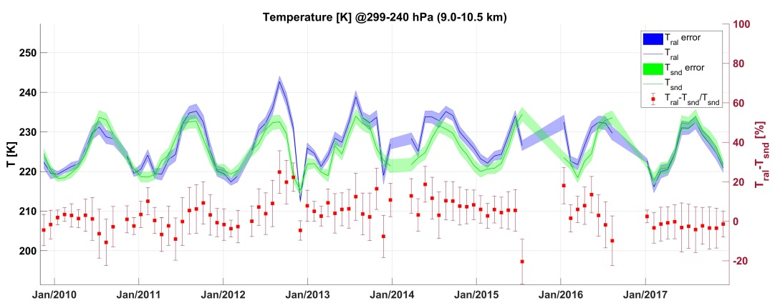
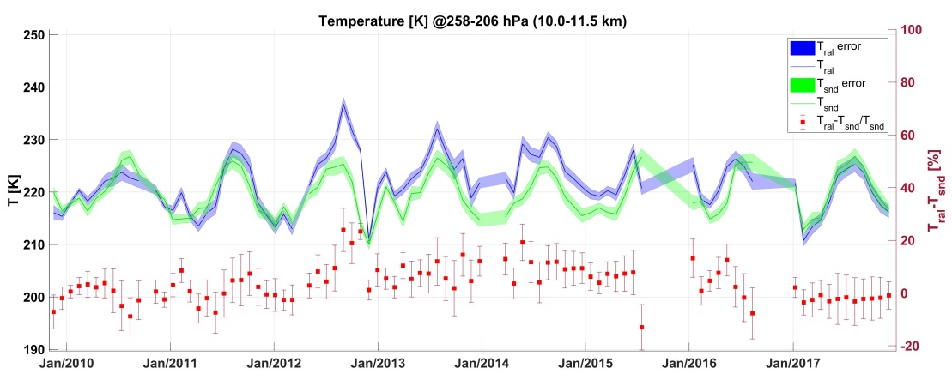
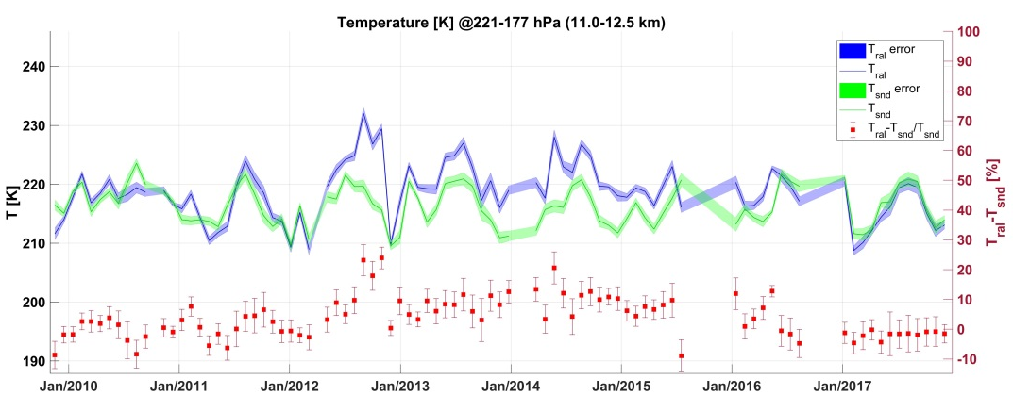
PRR temperature climatology in the UTLS
10 km
11 km
13 km

Slide 10
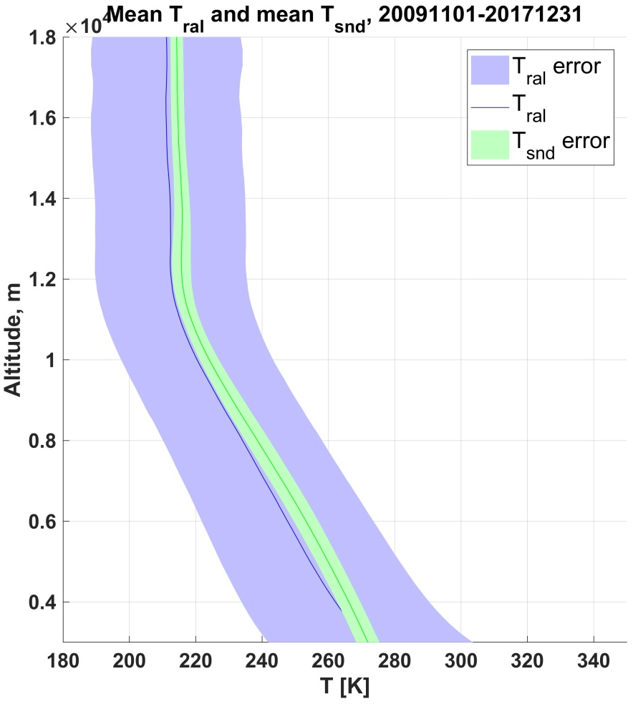
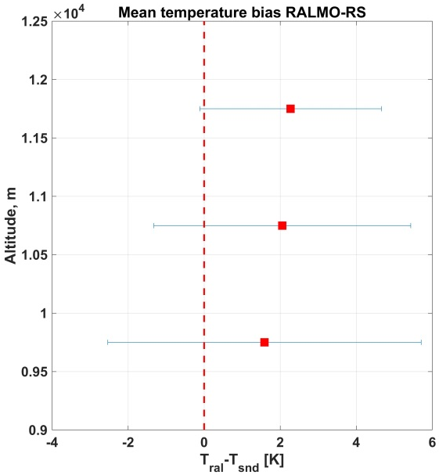
PRR temperature climatology in the UTLS
ΔT = RAL- C34
ΔT within 1.8-2.5 K compared with the operational SRS-C34

Slide 11
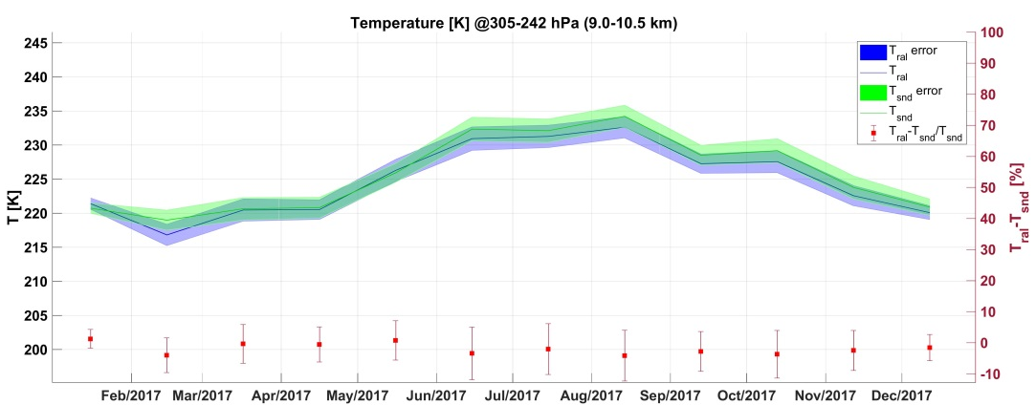
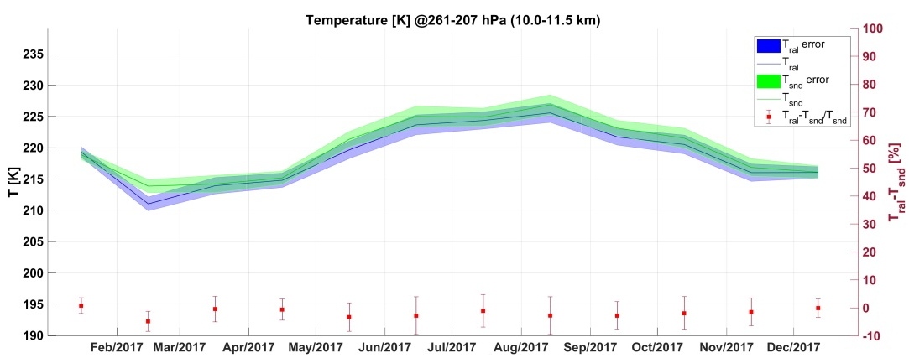
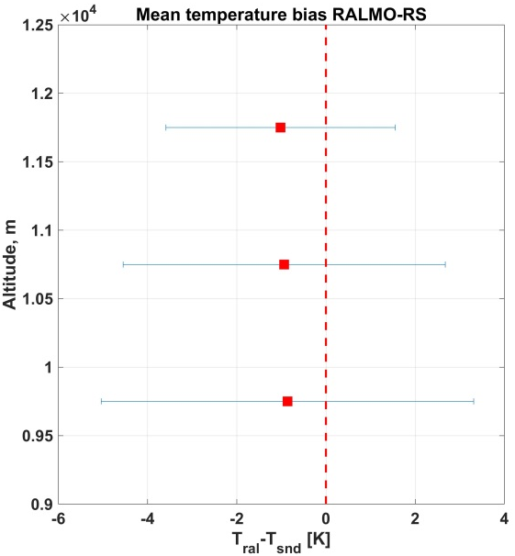
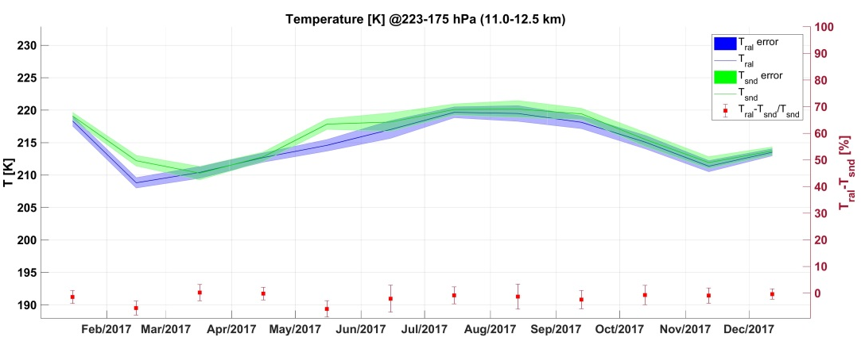
PRR temperature climatology in the UTLS
10 km
11 km
ΔT = RAL- C50
improvement of PRR temperature in 2017
13 km
ΔT within -0.8, -1 K compared with the operational SRS-C50

Slide 12
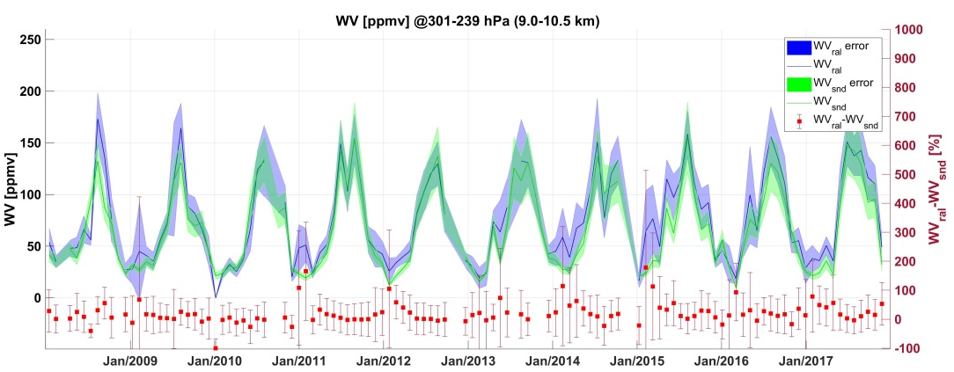
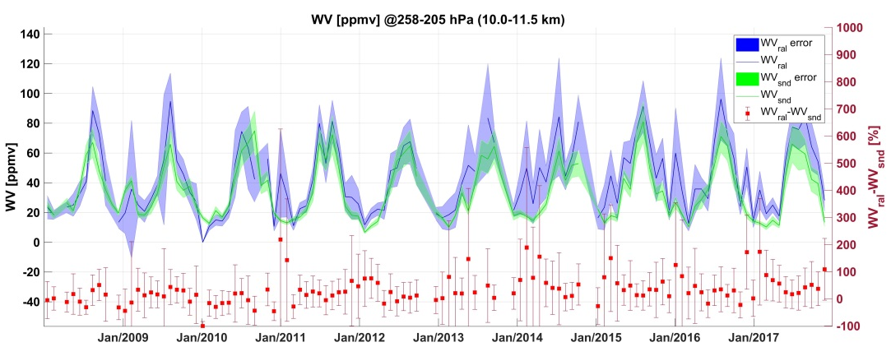
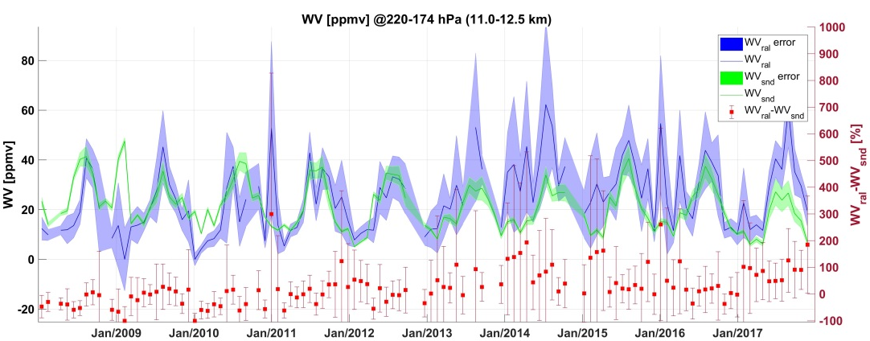
Raman Water Vapour climatology in the UTLS
10 km
11 km
13 km

Slide 13
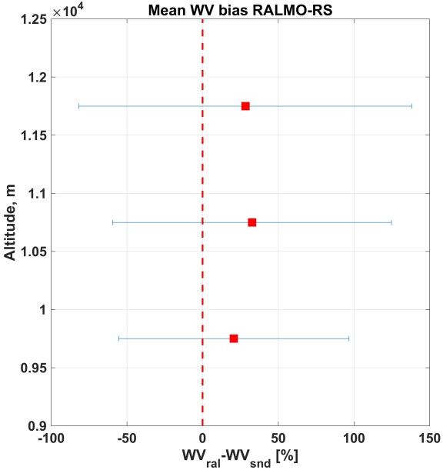
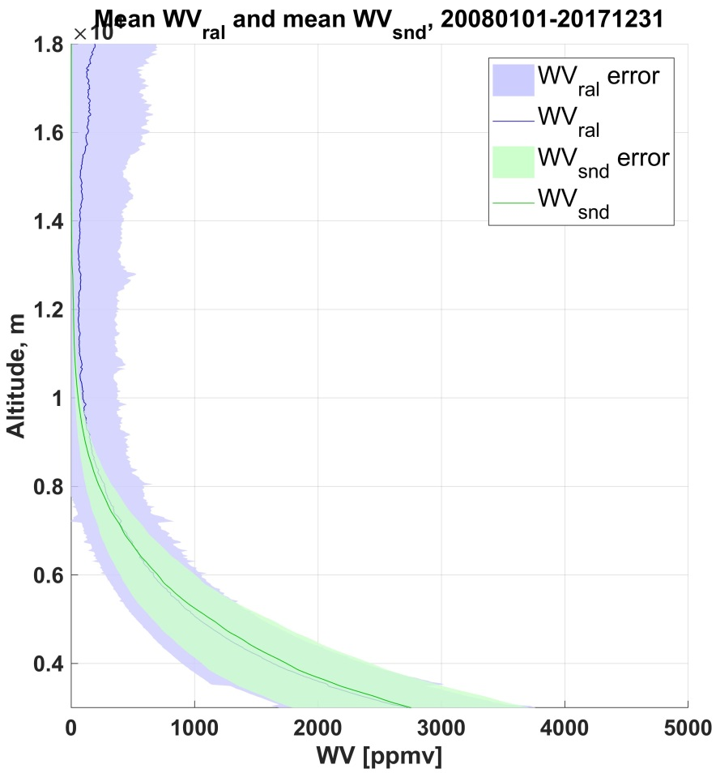
Raman Water Vapour climatology in the UTLS
Δω = RAL- C34
Δω in the 20-30% compared with the operational SRS-C34

Slide 14
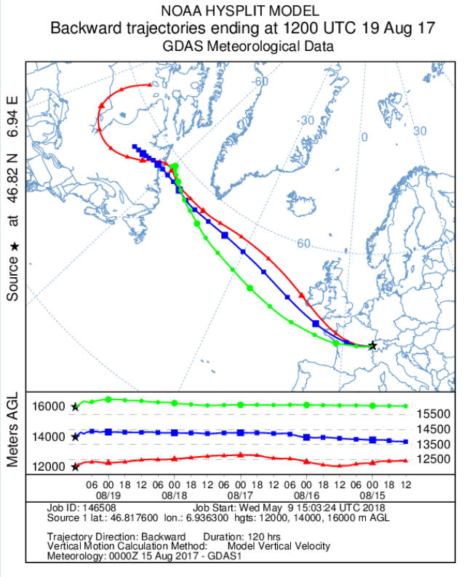
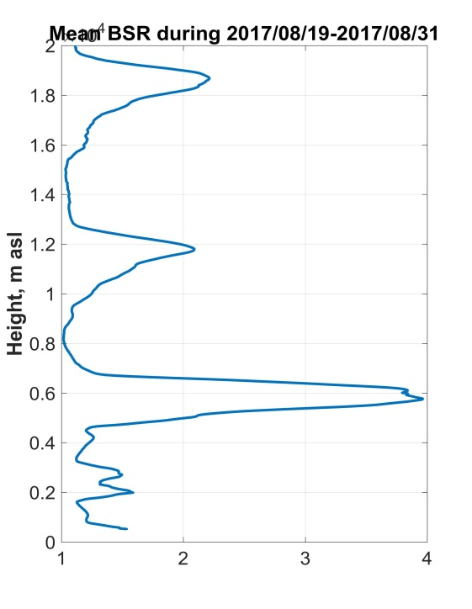
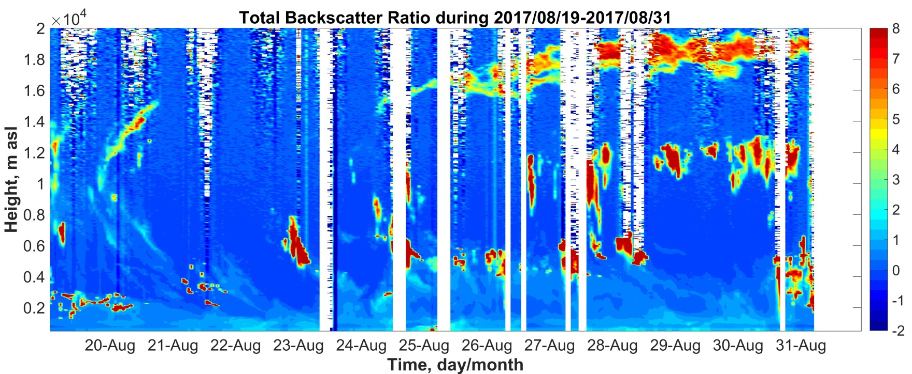
Canadian fires aerosols in the UTLS above PAY

Slide 15
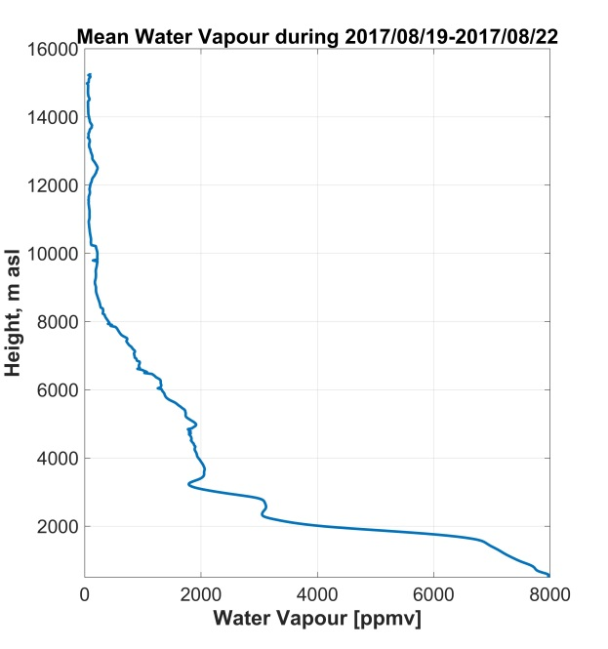
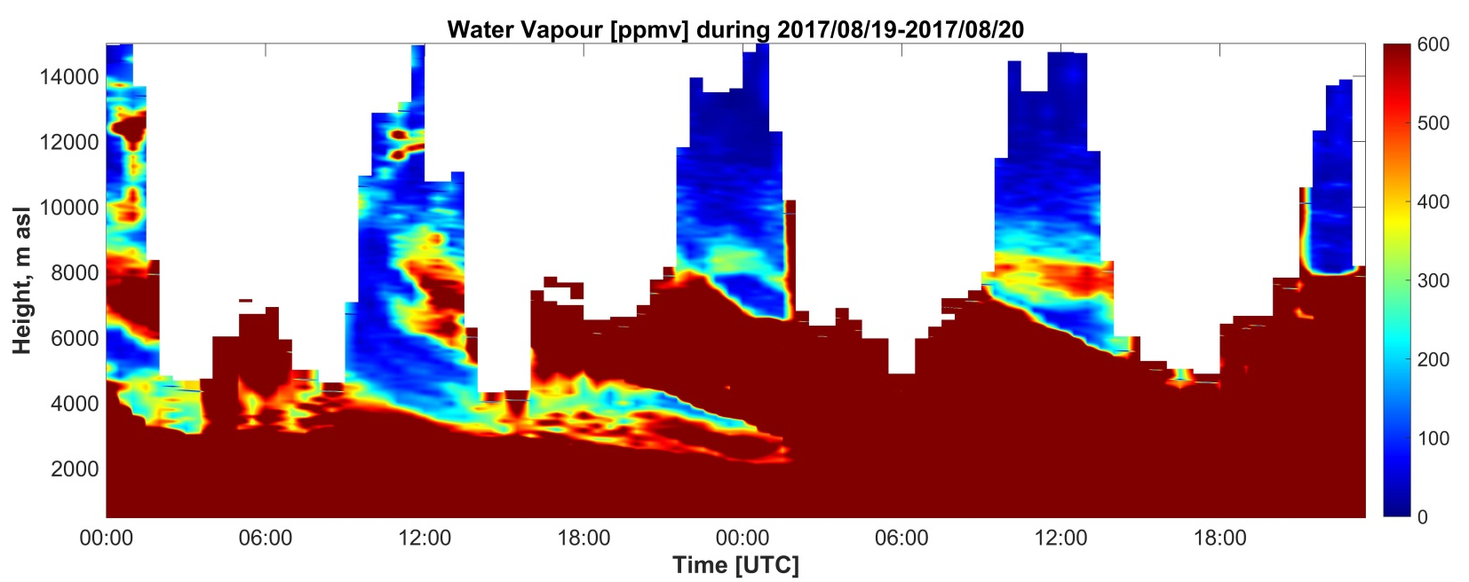
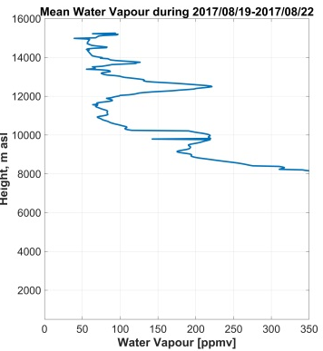
Canadian fires aerosols in the UTLS above PAY
WV = ~200 ppmv @12 km

Slide 16
Optimal Estimation Method
Bayes’ Theorem:
$$P\left(x | y\right)= \frac{P\left(y | x\right)P(x)}{P(y)}$$
The measurement: y
Measurement noise: e
The state vector: x
Auxiliary parameters: b
The forward model: F
The measurement y can be expressed through a forward model:
$$y=F\left(x,b\right)+ε$$
Goal: solve the equation for x

Slide 17
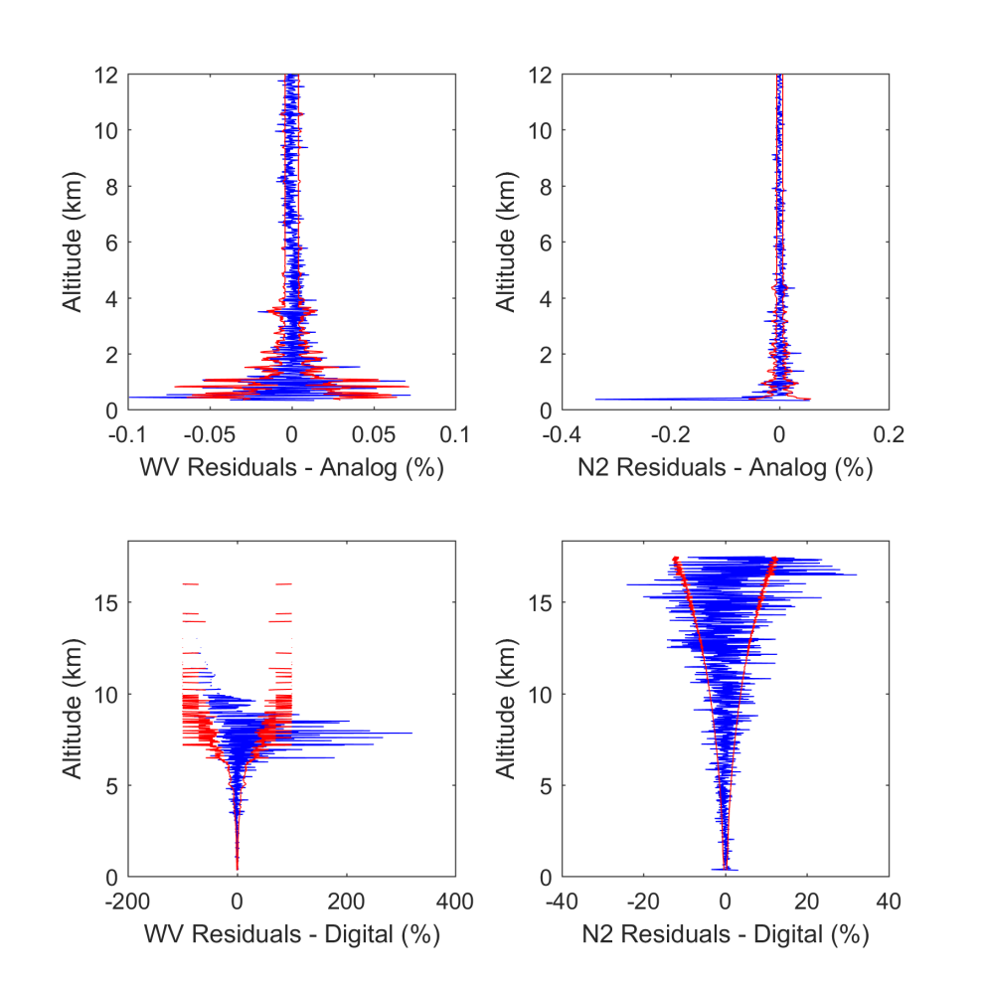
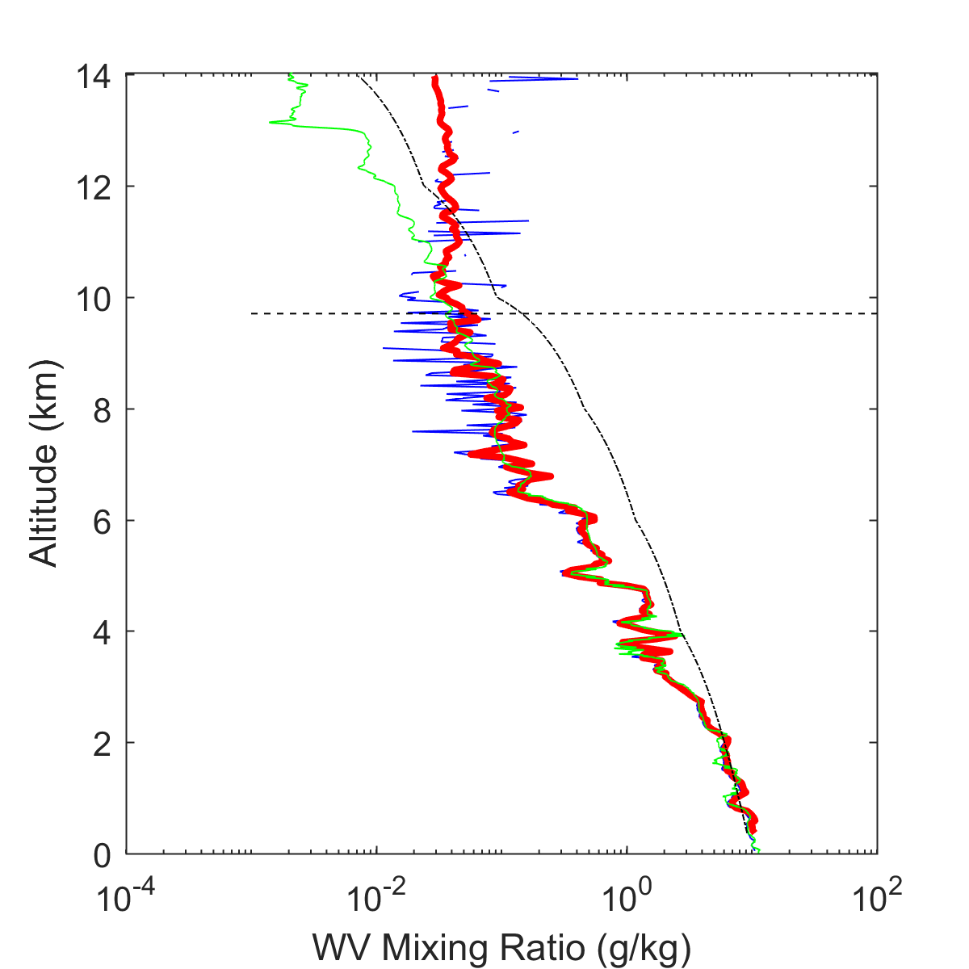
Future activities: Water Vapour operational OEM Retrieval
Residuals
Forward model counts – Measurements
Statistical Uncertainty
2012 – 07 – 26 Night Retrieval
Radiosonde
Traditional
OEM Retrieval

Slide 18
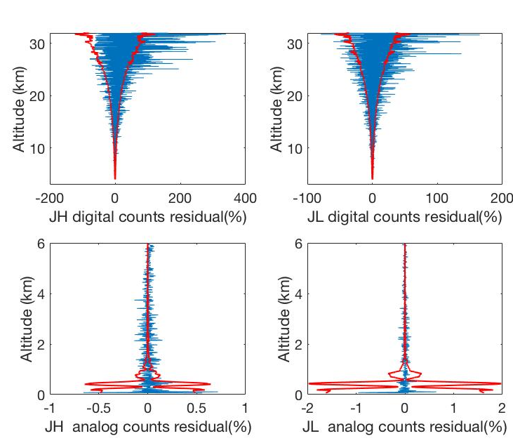
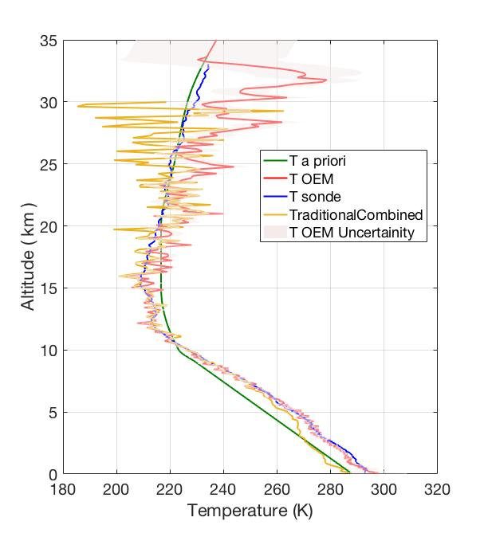
Future activities: PRR temperature operational OEM retrieval
20110909 – Clear Night

Slide 19
Summary
The water vapour mixing ratio is calibrated automatically using the solar background since a year now.
PRR temperature has been affectedly improved since beginning 2017 thanks to software and hardware upgrades.
Cirrus can be characterized by combination of LIDAR and balloon matched-measurements with ice and liquid phase being separated.
RALMO T and WV climatological timeseries well agree with the operational SRS-C34/50 radiosounding in the UTLS.
In 2018/19 the automatic retrieval of T and WV by OEM will be put in place along with the traditional retrievals.

