Slide 1
New automation capability of the NDACC/TOLNet tropospheric
ozone lidar at JPL - Table Mountain Facility
Fernando Chouza¹, Thierry Leblanc¹, Mark Brewer¹, Patrick Wang¹
¹ Jet Propulsion Laboratory, California Institute of Technology, Wrightwood, CA
© 2018 California Institute of Technology. Government sponsorship acknowledged

Slide 2
Contents
Tropospheric ozone lidar automation
  Hardware
  Acquisition software
Very-near-range receiver
  Setup
  Tests/Validation
Summary

Slide 3
Lidar automation: Hardware
Design criteria / Required features
  Modular approach for easy tests and modifications.
  Hardware interlocking for the lidar hatch in case of rain.
  Easy replaceable control PC (i.e. no special interface or acquisition cards installed on the PC).
  Ability to reset every component remotely.
Key implementation features
  Ethernet as the preferred technology for communication with the different peripherals
  Power distribution based on Ethernet controlled power distributions units (PDUs).

Slide 4
Lidar automation: Hardware
Router
Remote access
Control PC
Serial server
Motor controller
Trigger gen
Power distribution
Ethernet connection
Laser
Met station
Interlock
Ethernet I/O
Dome control
Transient recorder
Detectors
PDU
UPS
Chiller

Slide 5


Lidar automation: Acquisition software
Design criteria / Required features
  Modular approach for easy tests and modifications.
  Portable to other lidar systems at TMF.
  HDF5 data storage (1 minute time resolution).
  Easy remote access.
  Email report on acquisition start and end.
  Detailed system status logging
Implementation
  Python + Bokeh (interactive visualization library).
  Free and open source software.
  Code divided in five modules (scheduler, housekeeping, alignment, acquisition, and web interface). Connection between modules is implemented with sockets.
  Interface running on a web browser.

Slide 6
Lidar automation: Software
Web interface
Scheduler
Housekeeping
UPS
HK
PDU
Met station
Laser
Dome
Alignment
Motor controller
Alignment
Acquisition
Transient recorder
HDF5: HK + Alignment + Acquisition

Slide 7
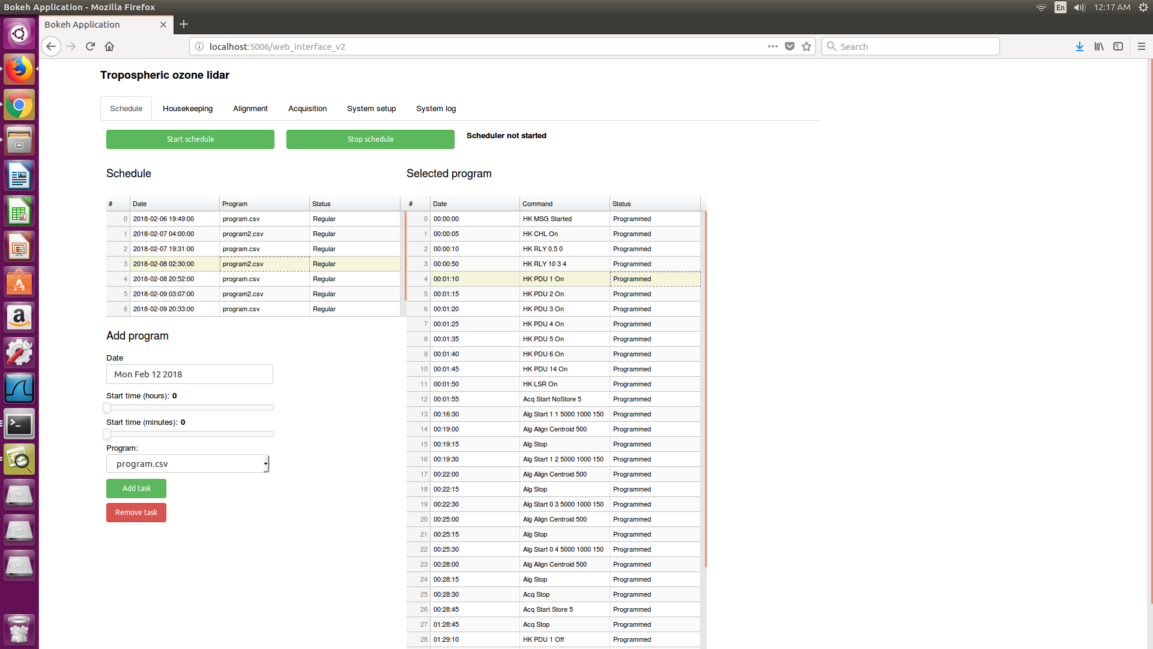
Lidar automation: Software

Slide 8
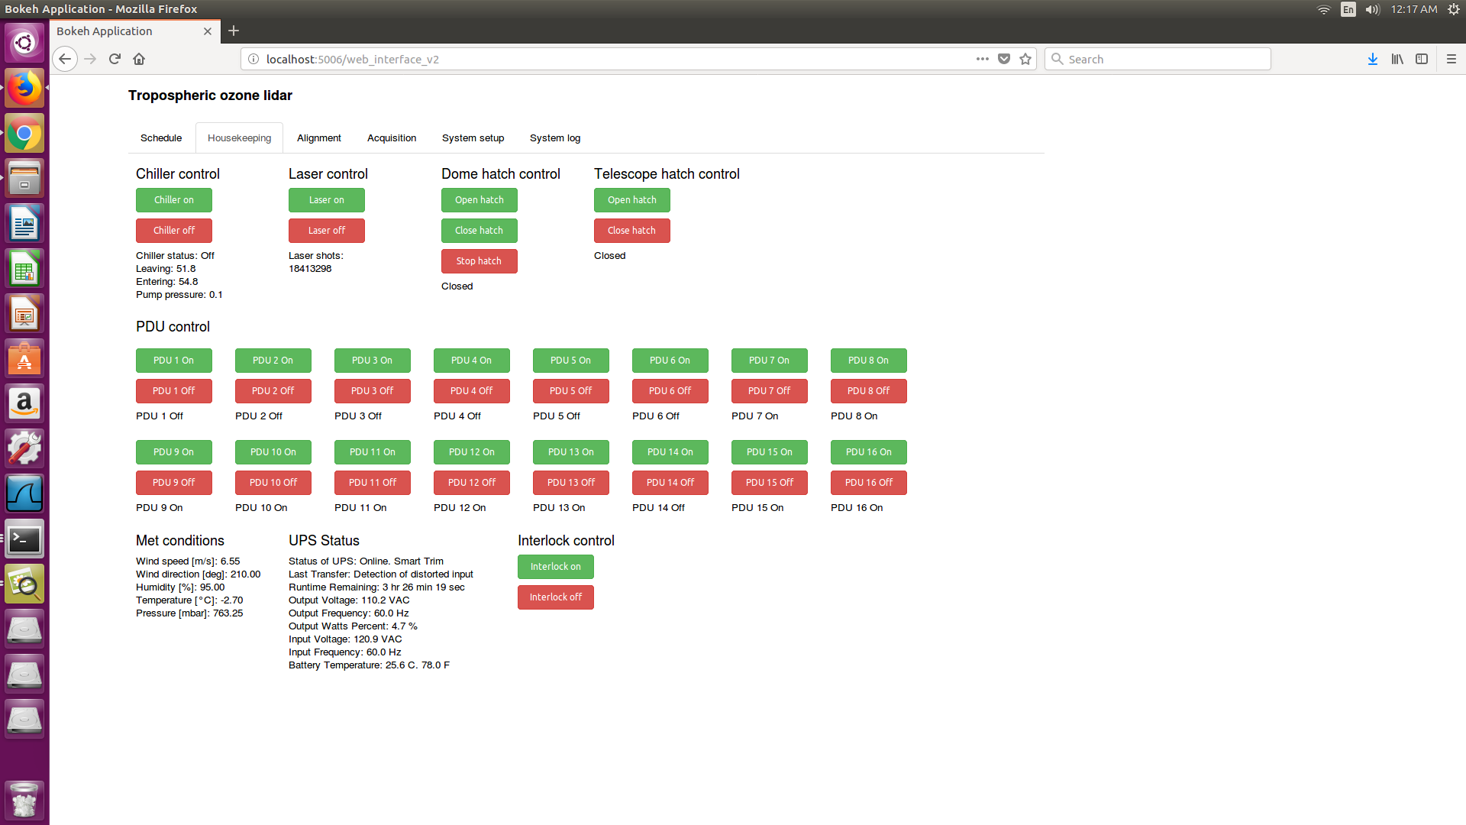
Lidar automation: Software

Slide 9
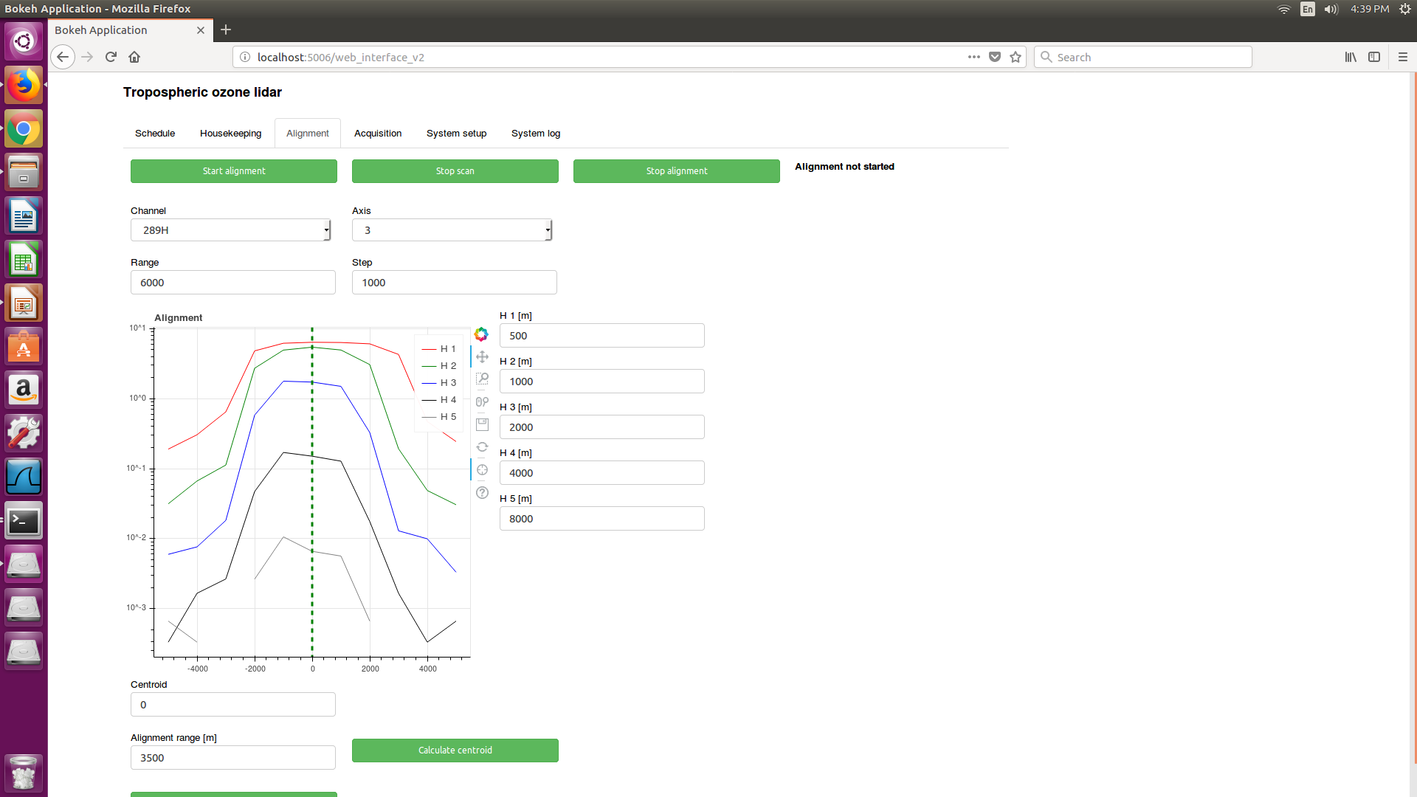
Lidar automation: Software

Slide 10
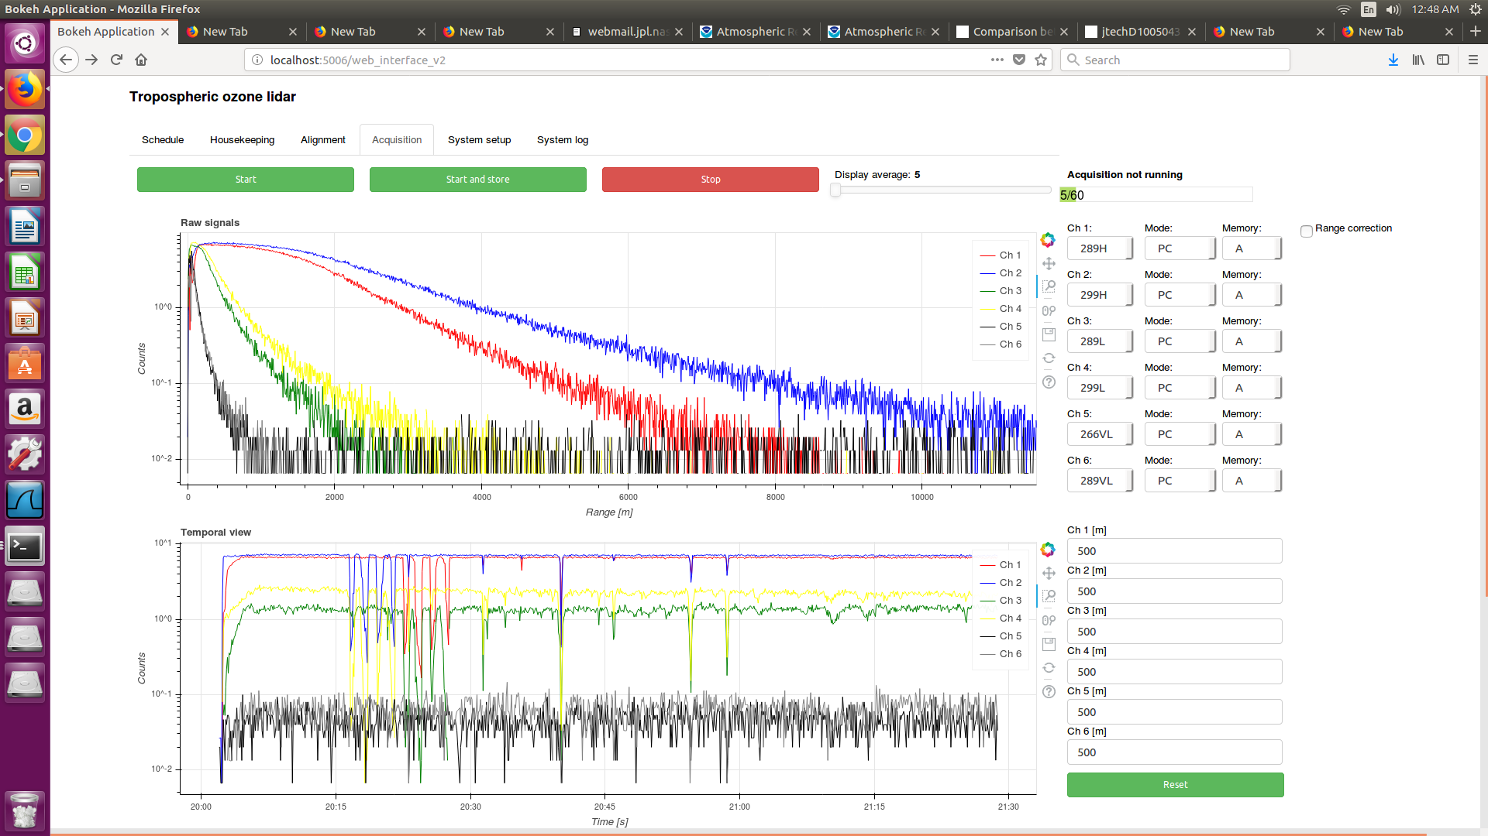
Lidar automation: Software

Slide 11
Very-near-range receiver: Setup
Design criteria / Required features
  Range: 100 - 1000 m
  Signal dynamic range: 3 orders of magnitude (assuming no extinction, only r**2 dependency)
  Originally Raman channels were planned, but the available power is not enough. Around 10 times more power @ 266 nm is needed.
  Alternative: 266 nm / 289 nm wavelength pair
    Available power @ 266 nm: 10 - 20 mW
    Available power @ 289 nm: 200 - 300 mW
Proposed design:
2” – FL 75 mm
IF – 266 nm
1” – FL 25 mm
Iris
Pellicule
beam splitter
50:50
2” – FL 100 mm
2” – FL 75 mm
IF – 289 nm

Slide 12
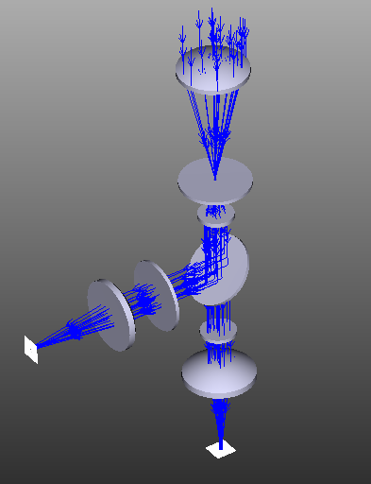
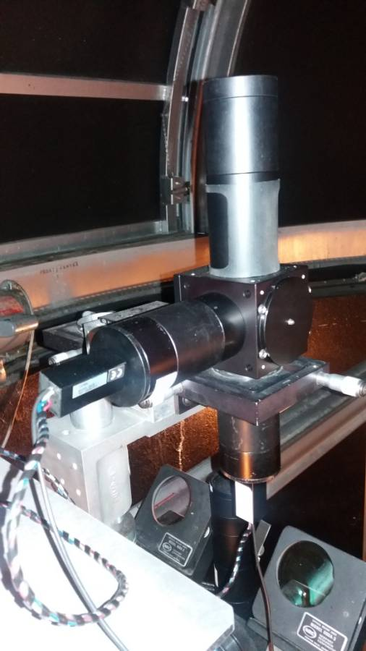
Very-near-range receiver: Setup
ZEMAX Simulation / Construction
  General evaluation of the setup (overlap, AOI on interference filters)
  Analysis of detector surface sensitivity for very near measurements (below 100 m)

Slide 13
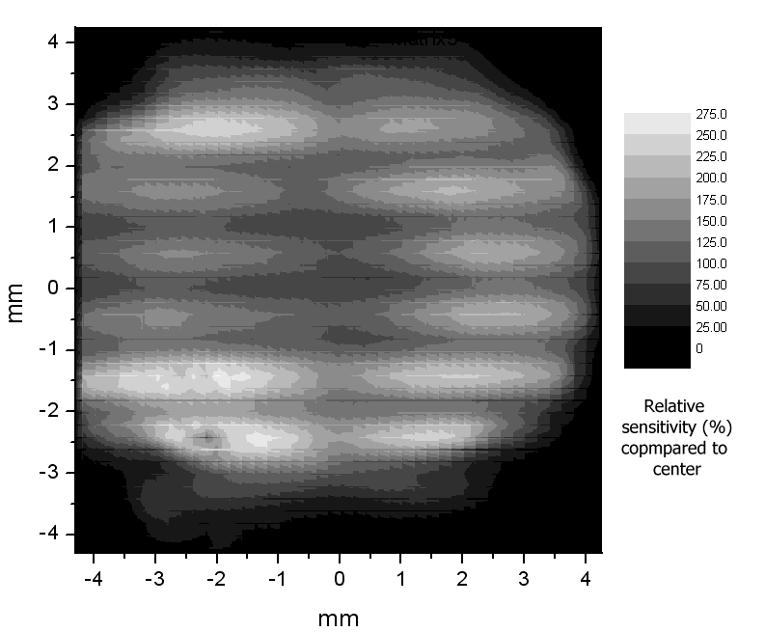
Very-near-range receiver: Setup
PMT Surface
Based on 10 cm separation between receiver and transmitter
Blue -> Inf, 0 mm
Green -> 100 m, 0.15 mm
Red -> 50 m, 0.3 mm -> up to 25% more signal!
V. Simeonov et al., Influence of the Photomultiplier Tube Spatial Uniformity on Lidar Signals, Appl. Opt. 38, 5186-5190 August 1999.
Freudenthaler, V., 2004: Effects of spatially inhomogeneous photomultiplier sensitivity on lidar signals and remedies, Proc. 22. ILRC, Matera, Italy, ESA SP-561, 37-40.

Slide 14
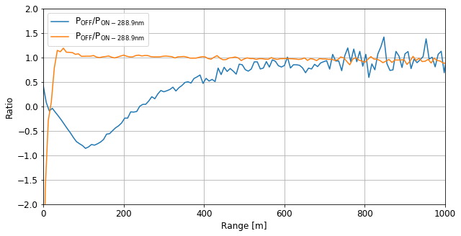
Very-near-range receiver: Tests
Estimation of the differential overlap/gain factor
  Measurement of the differential overlap function/PMT sensitivity between the two receiver arms using two 289 nm IF filters.

Slide 15
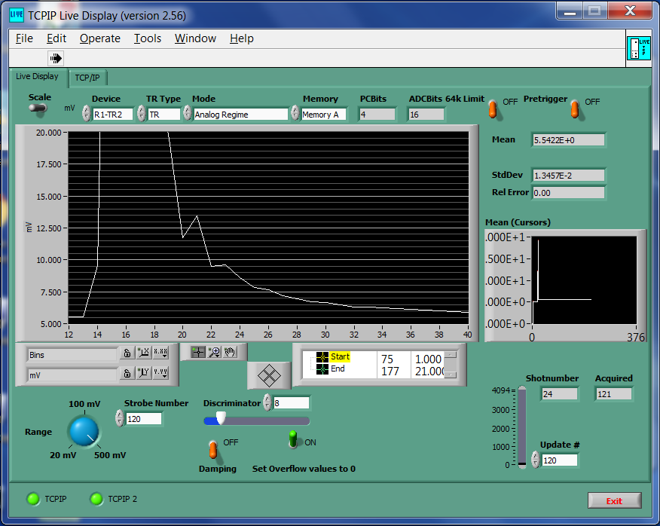
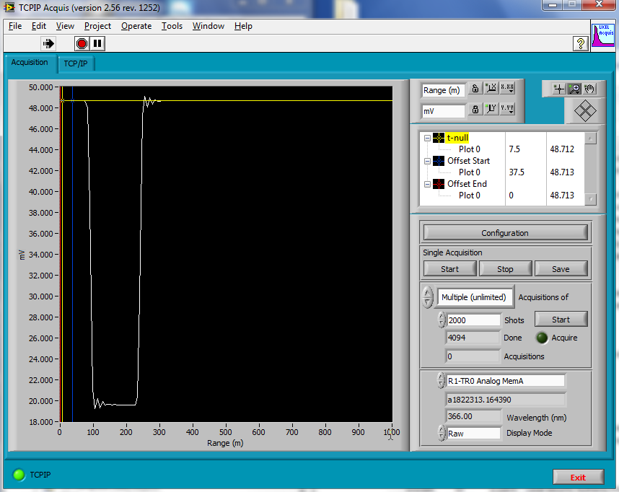
Very-near-range receiver: Tests
Signal issues
  Issues with the analog detection were found on Licel transient recorders (TR20 – 16 bits) when pushed to high frequencies
30 mV square / 40 ns / 100 mV range
BW ≈ 0.35/(40ns) = 8 MHz

Slide 16
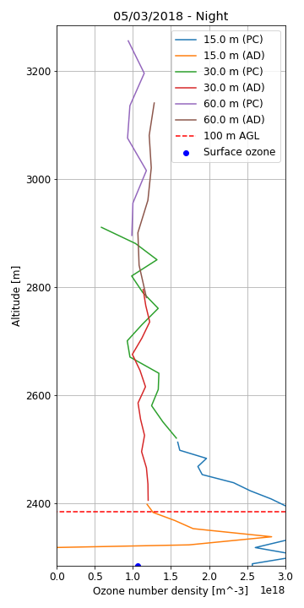
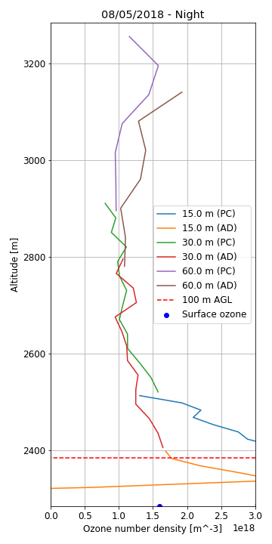
Very-near-range receiver: Tests
Validation
A tethered balloon with an ozone sonde is currently being prepared to validate the measurements of the new very-near-range receiver.
Only measurements on very calm conditions can be carried out with the tethered balloon.
Differences observed between the surface ozone measurement and the lidar might be due to aerosol influence.

Slide 17
Summary
Lidar automation
  The lidar is currently operating twice a day in autonomous mode.
  Some functions, like laser power monitoring and cloud coverage monitoring still have to be implemented.
Very-near-range receiver
  First tests on the receiver overlap were conducted, giving promising results.
  Issues with the analog channels were partially solved.
  We are in the process of getting a UAV-borne ozone sonde. This would allow us to operate not only under very calm wind conditions.
  The range could be further lowered with postprocessing, by applying a correction factor based on the estimation of the differential overlap/gain factor.
Near future work
  Finish writing an AMT paper about lidar automation and very-near-range receiver
  Add aerosol capabilities (UV?+532+1064+Raman). Test RF switches to half the amount of needed TRs (We use two 266 nm lasers interleaved)
  UAV validation

