Slide 1
An Investigation of the Kinematic and Microphysical Control of Lightning Rate, Extent and NO_{X} Production using DC3 Observations and the NASA Lightning Nitrogen Oxides Model (LNOM)
Lawrence Carey¹, William Koshak², Harold Peterson³, Retha Matthee¹ and A. Lamont Bain¹
¹ Department of Atmospheric Science, University of Alabama in Huntsville (UAH), Huntsville, AL
² Earth Science Office, NASA Marshall Space Flight Center (MSFC), Huntsville, AL
³ Universities Space Research Association (USRA), Huntsville, AL

Slide 2
Outline
Deep Convective Clouds and Chemistry (DC3) Experiment - Alabama (AL) aircraft case on 21 May 2012
Environment
Dual-Doppler and dual-polarization radar summary during peak lightning period
Lightning properties (rate, extent) vs. radar-inferred kinematic and microphysical characteristics
NASA Lightning Nitrogen Oxides Model (LNOM)
Lightning Segment Altitude Distribution (SAD)
Lightning NO_{x} (LNOx) Production
LNOM SAD and LNOx Production for 21 May 2o12 case over AL
Comparison to radar

Slide 3
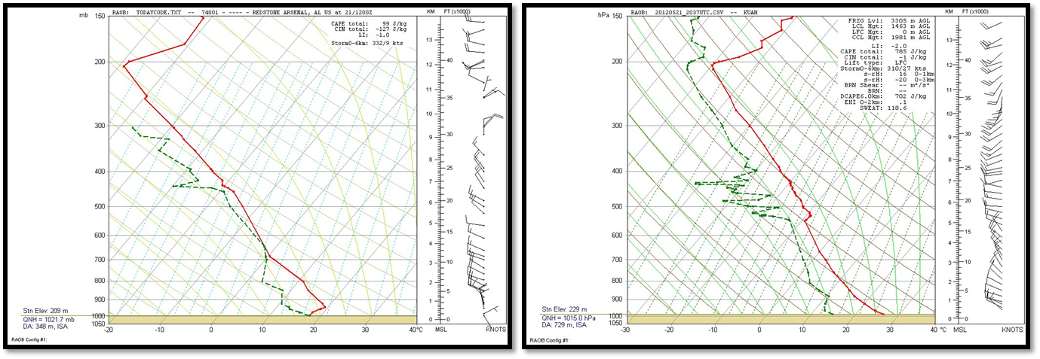
1200 UTC
KQAG
21 May 2012 DC3 AL Sounding
x
x 2037 UTC
UAH RAOB
Convective Parameter | Value
850-700 hPa lapse rate | -3 °C km⁻¹
850-500 hPa lapse rate | -6.2 °C km⁻¹
SFC-3 km lapse rate | -7.3 °C km⁻¹
SBCAPE | 785 J kg⁻¹
SBCIN | -1 J kg⁻¹
DCAPE | 702 J kg⁻¹
Lifted Index | -2 °C
0-6 km shear | 1.2 m s⁻¹
0 °C level | 3.5 km
-10 °C level | 5.5 km
-40 °C level | 9.5 km
Map of DC3 AL Domain
Low-moderate CAPE, low shear → ordinary multicell storms
Environmental Conditions
21 May 2012
DC3 AL Aircraft Case
2037 UTC UAH RAOB

Slide 4
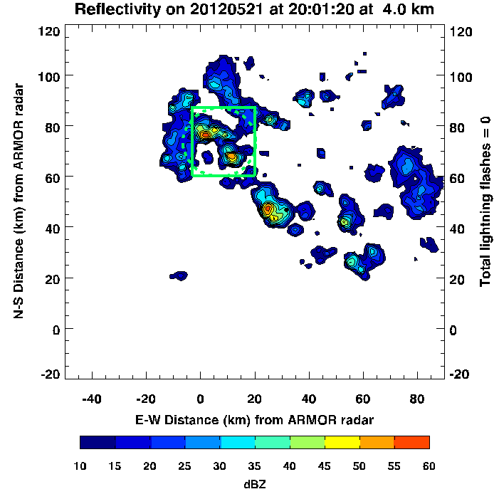
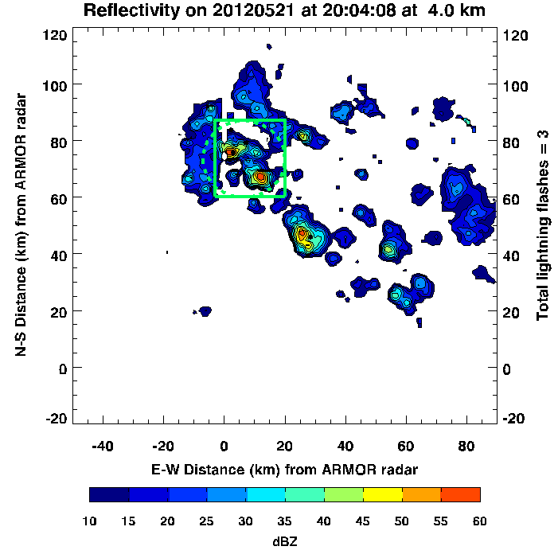
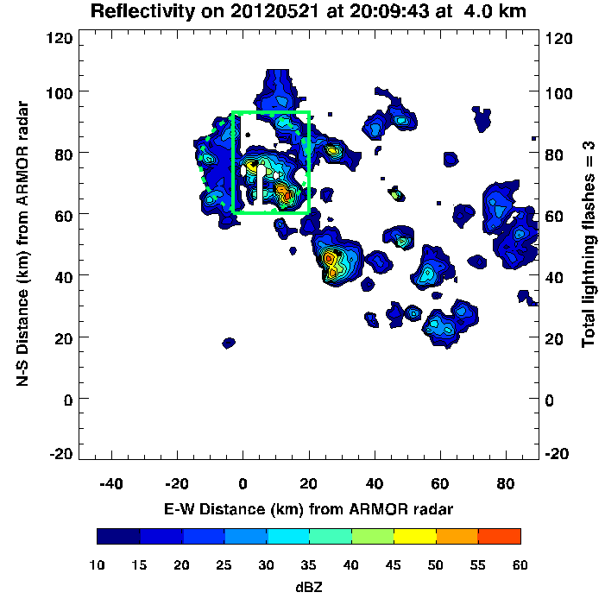
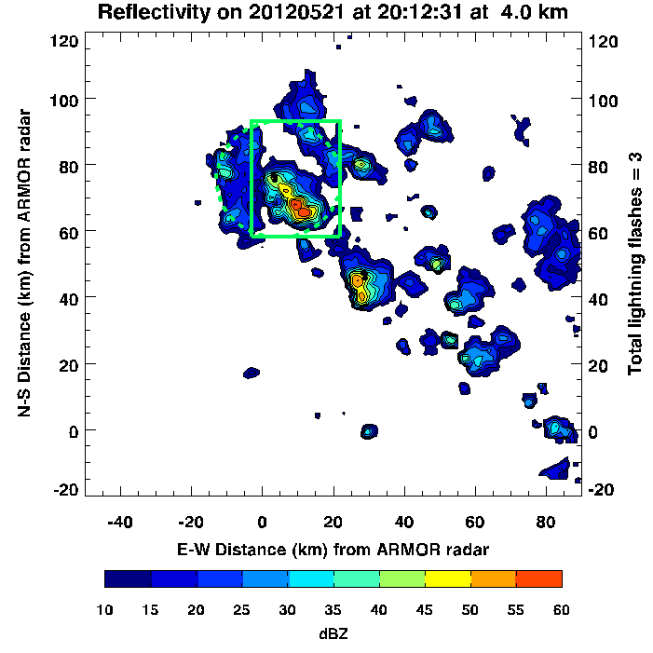
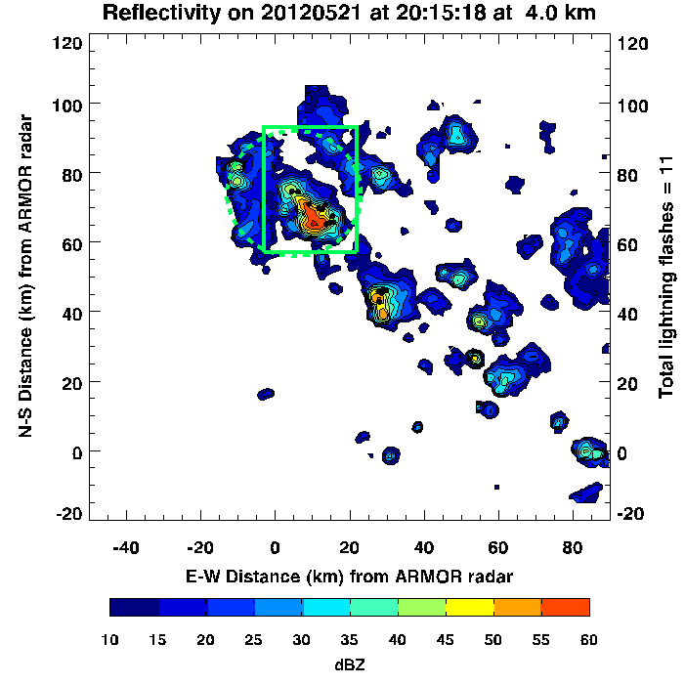
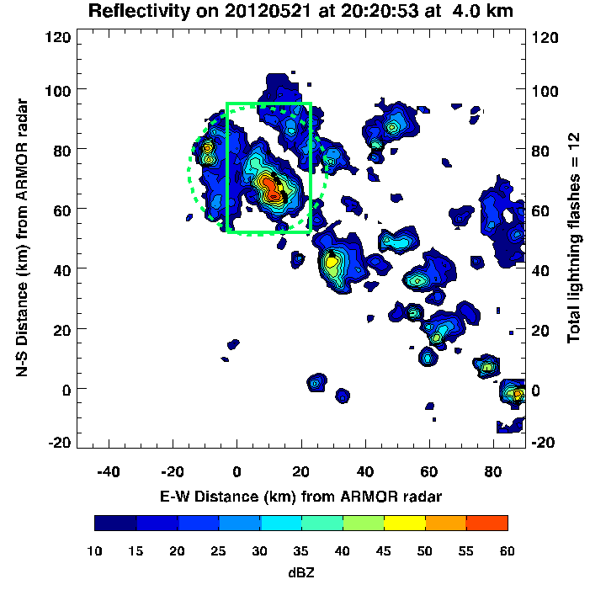
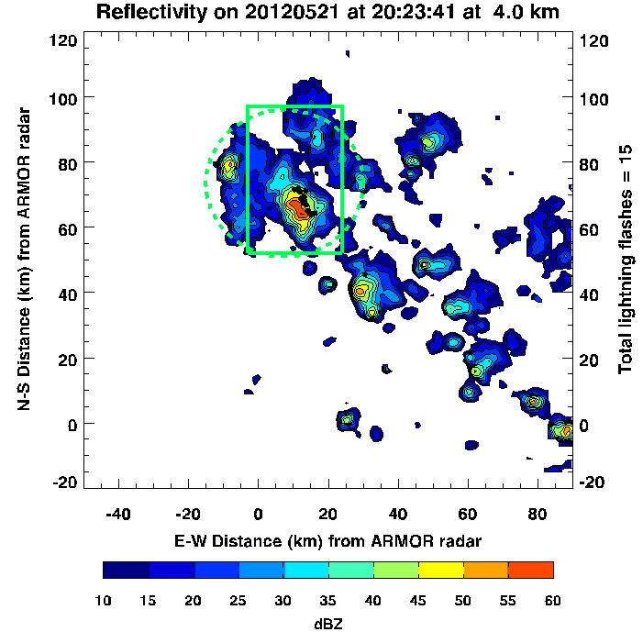
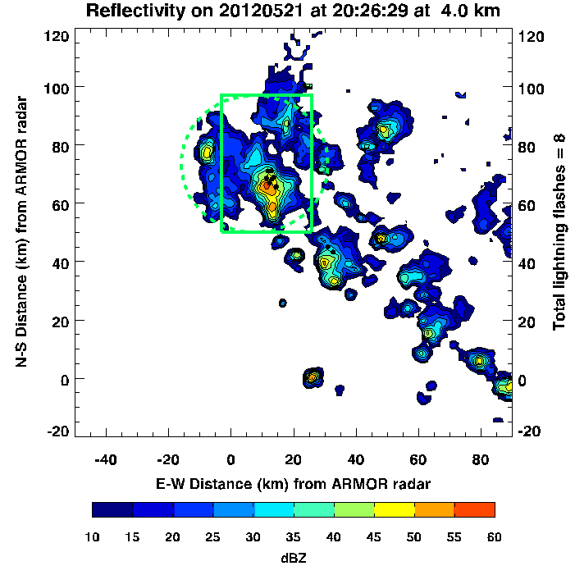
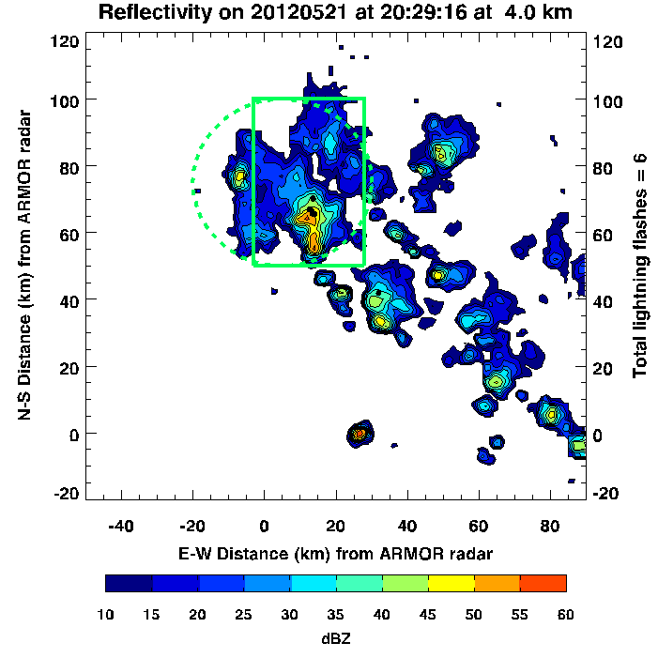
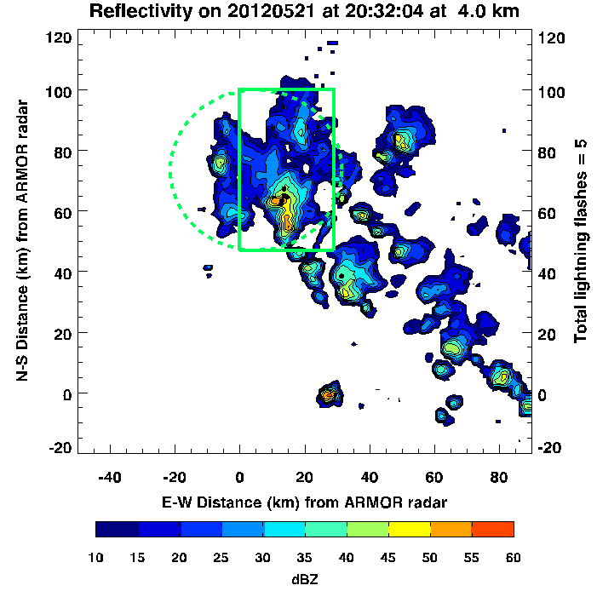
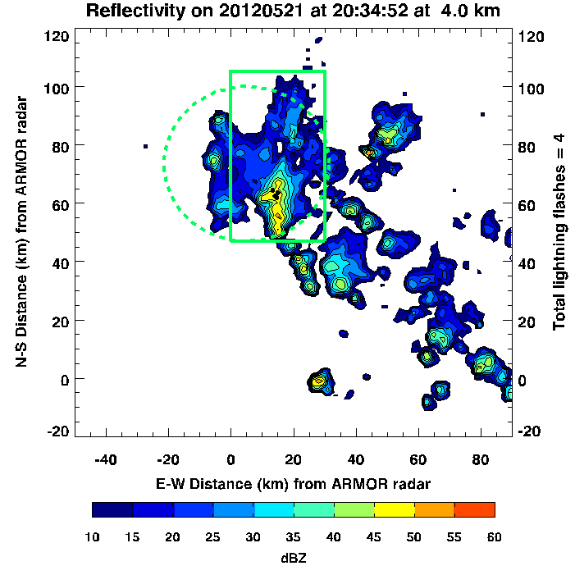
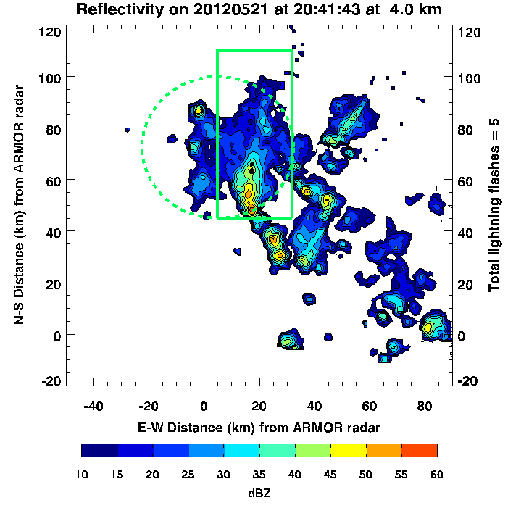
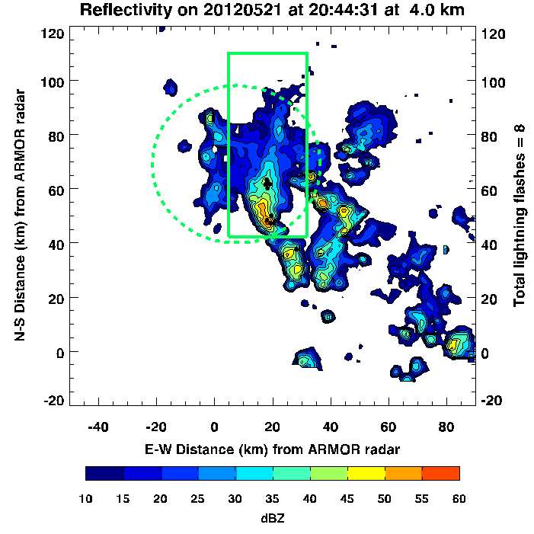
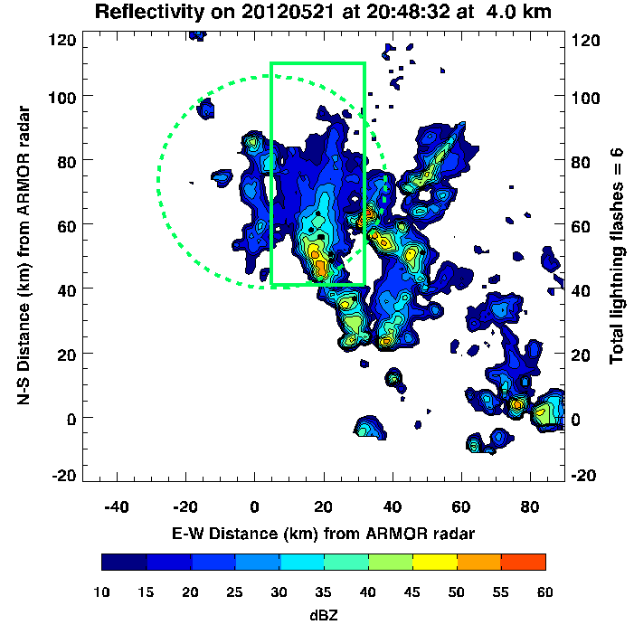
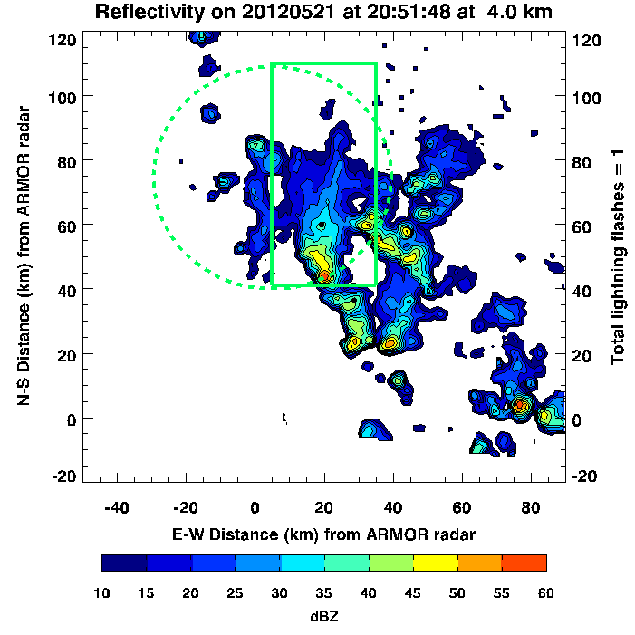
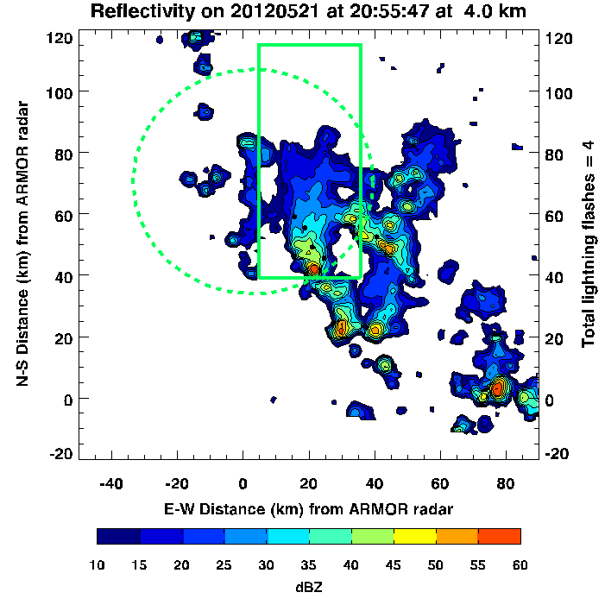
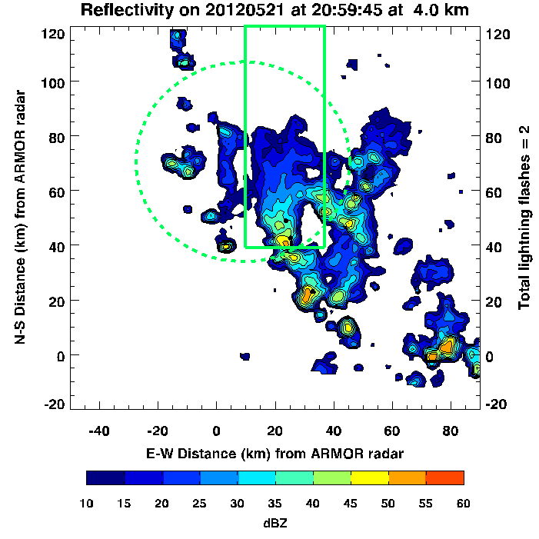
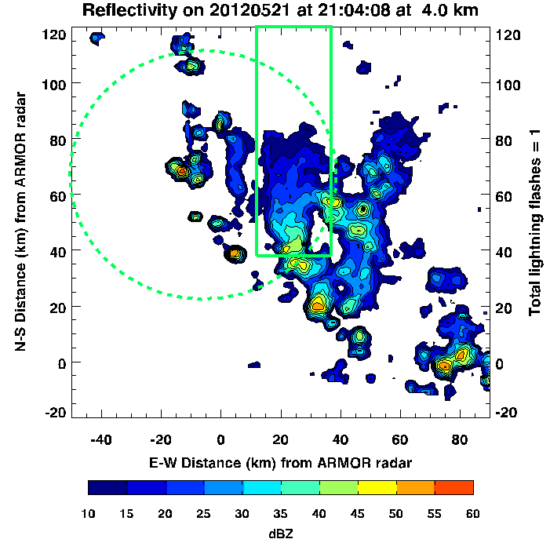
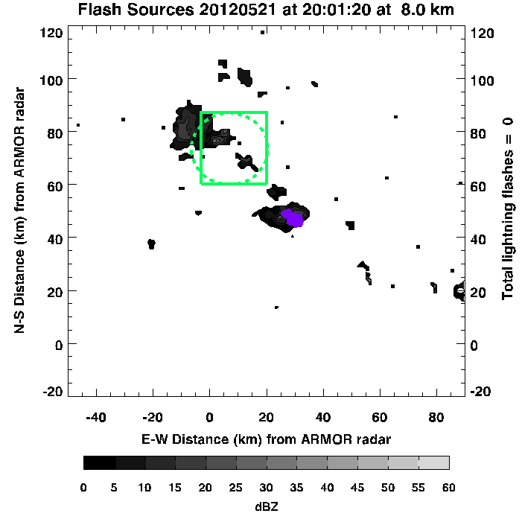
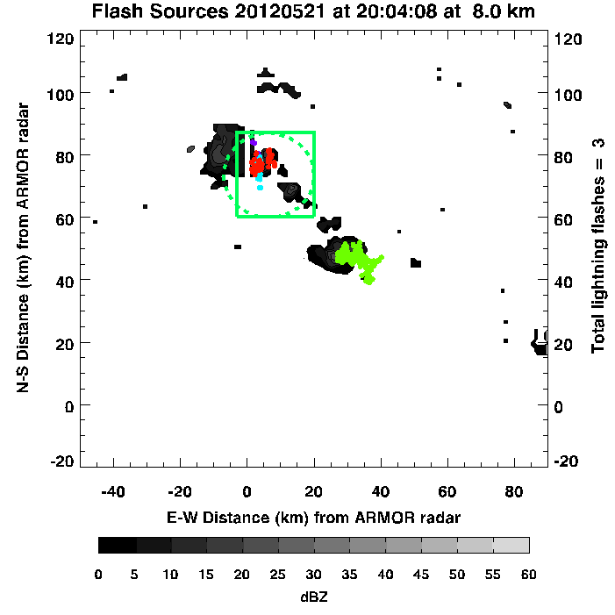
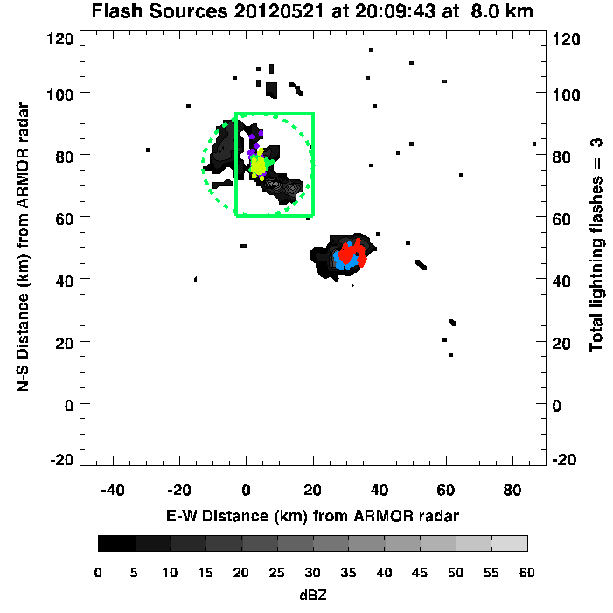
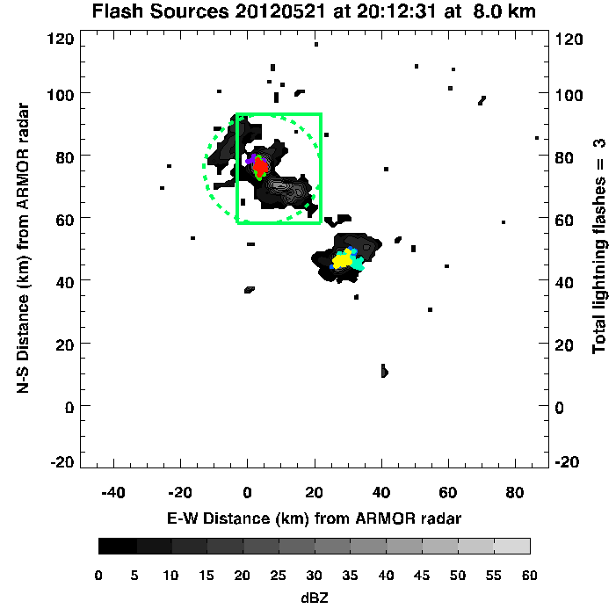
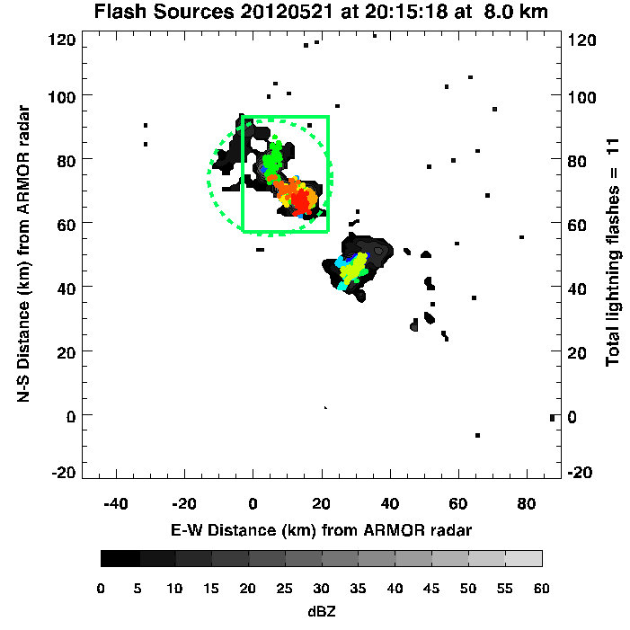
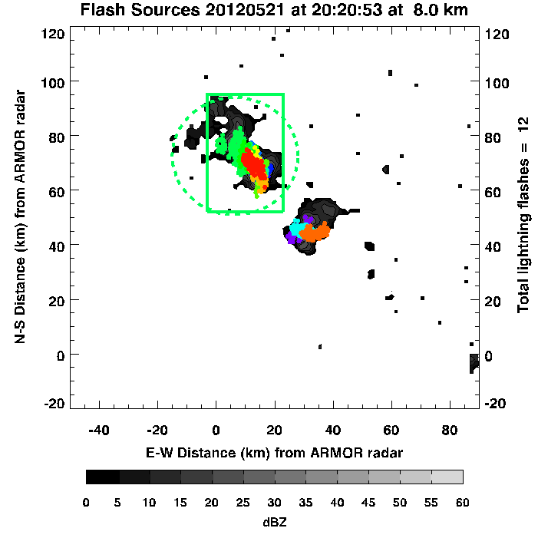
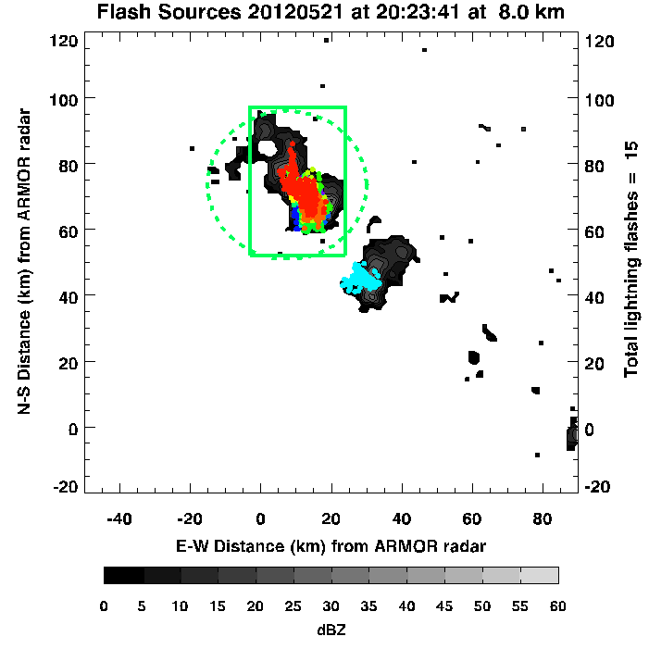
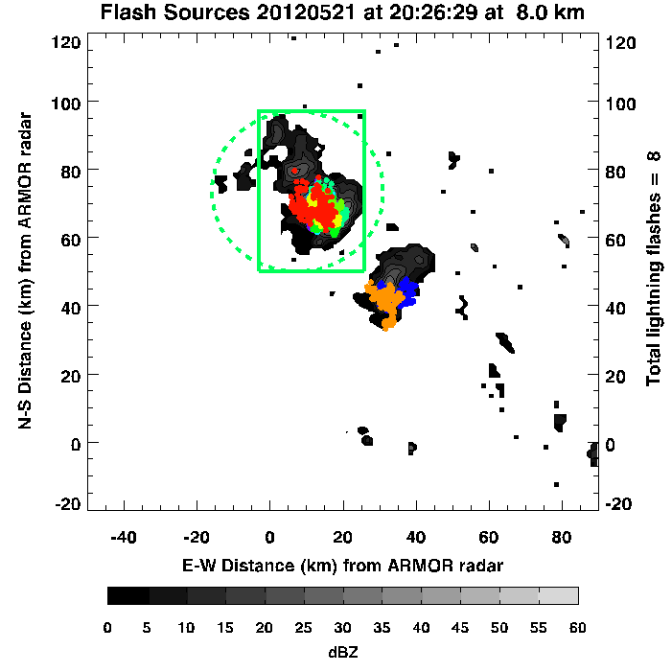
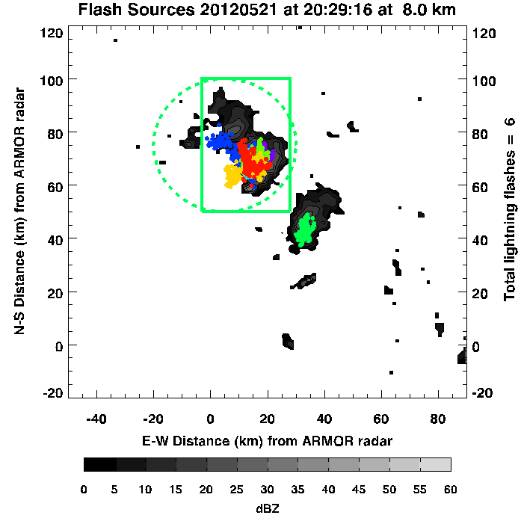
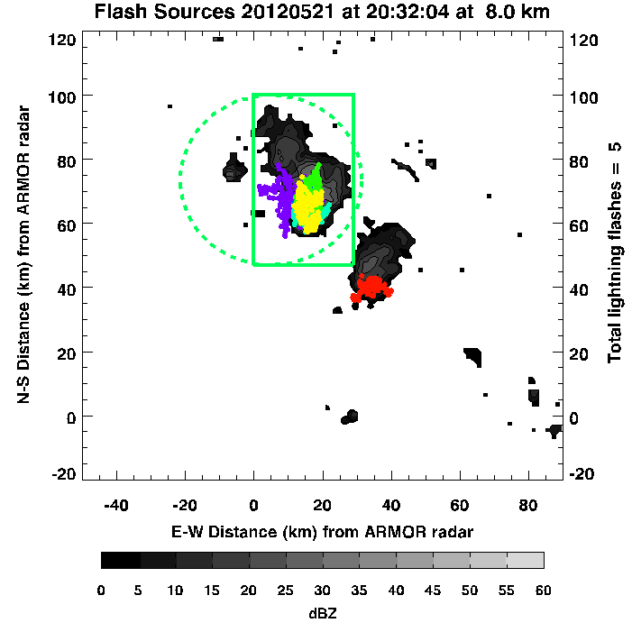
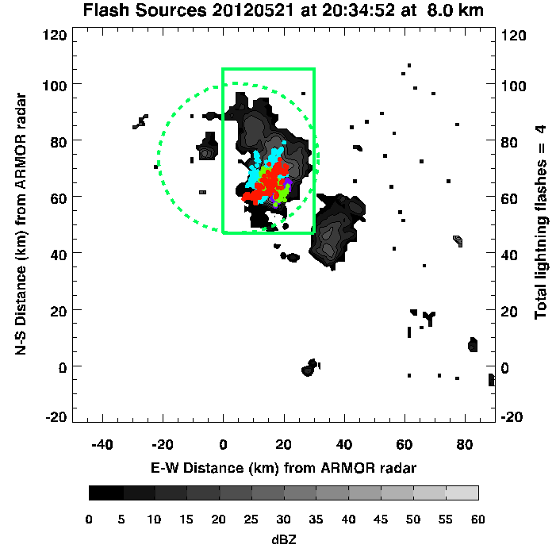
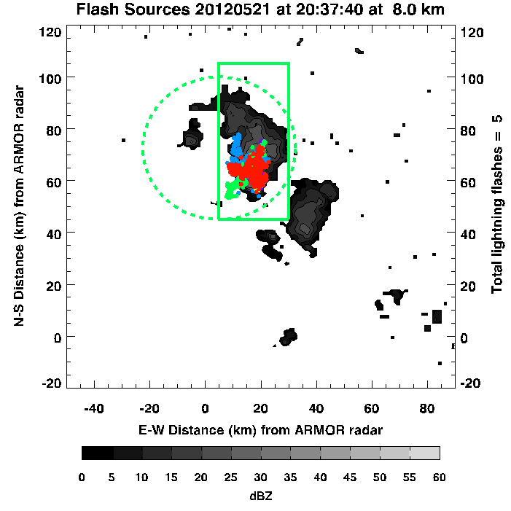
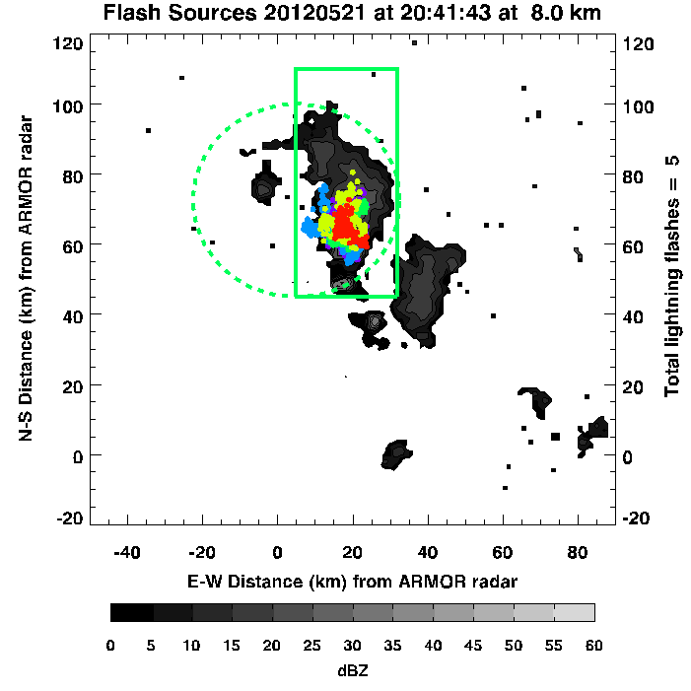
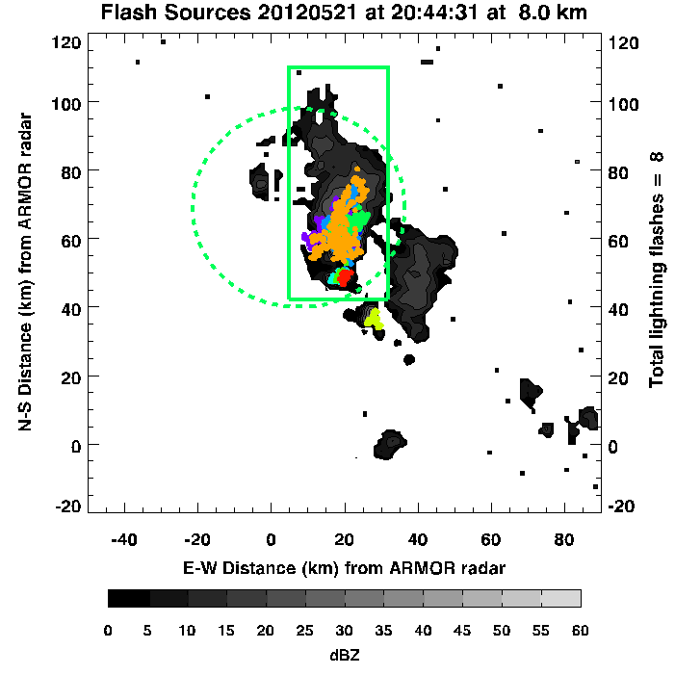
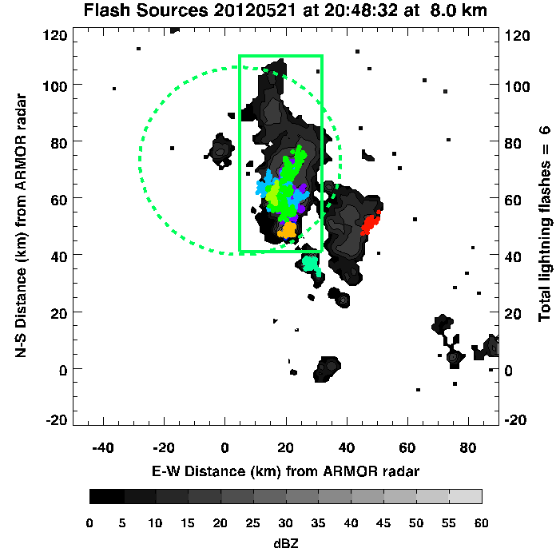
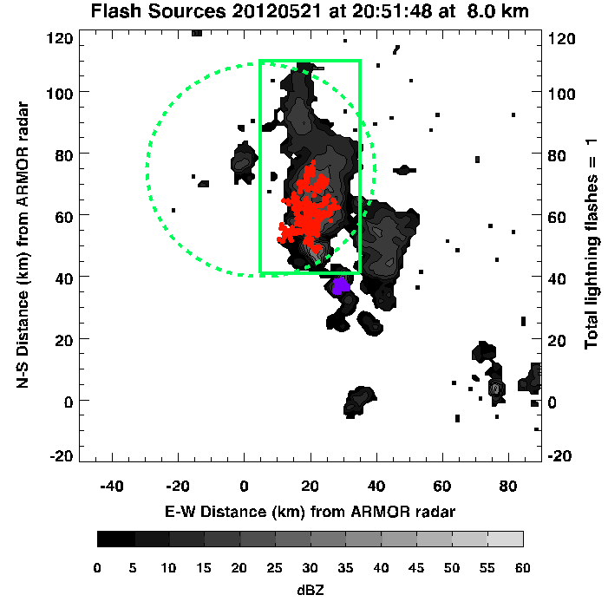
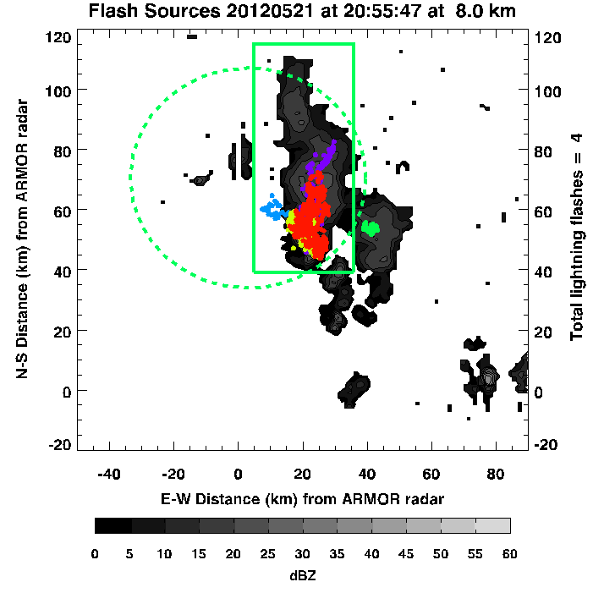
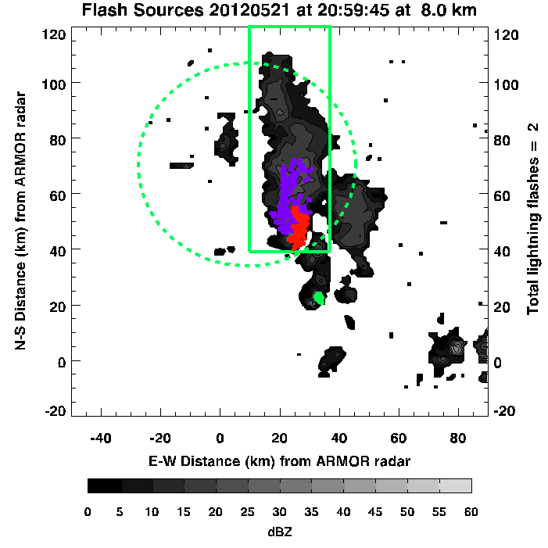
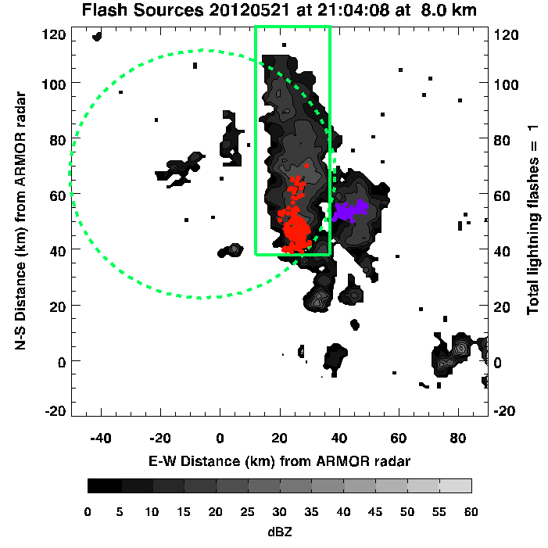
LNOM and Radar Analysis Domains
Initiation approximately around 1940 UTC nearly 80-85 km north of ARMOR
Multicellular with noticeable cell merger around 2015 UTC
Peak NA LMA Total Flash Rate ~ 5 flashes min⁻¹
Peak NLDN CG Flash Rate ~ 1 flash min⁻¹
Peak Vertical Velocity ~ 20 m s⁻¹

Slide 5
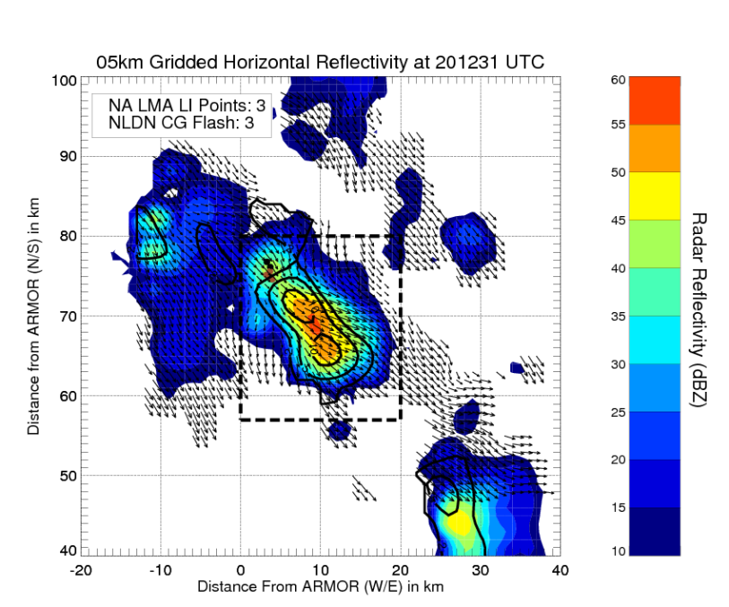
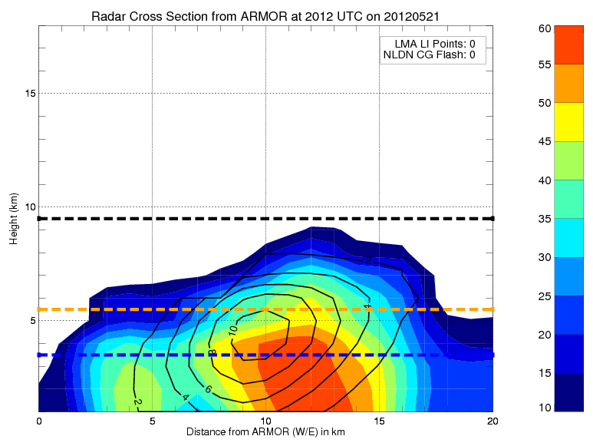
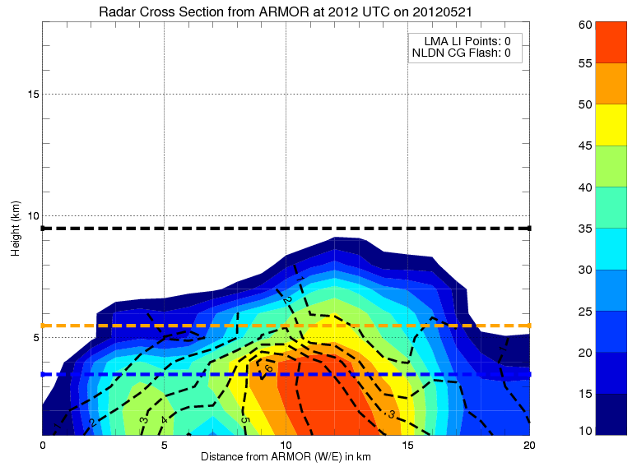
21 May 2012 (Rapid Intensification, Post Merger 2012-2023 UTC)
5 km CAPPI at 2012 UTC
Cell Merger
Northern updraft congeals with southern updraft
Continued increase in w_{max} ~ 10 m s⁻¹
Pronounced Z_{dr} column (5-6 dB)
A. 5 km CAPPI at 2012 UTC
0 °C Level
-10 °C Level
X-Z x-Section at 2012 UTC (y=66 km)
-40 °C Level
W 2, 4, 6, 8, 10 m s⁻¹
X-Z x-Section
at 2012 UTC
(y=66 km)
Z_{dr} > 0 dB
Cell Merger
Strengthening updraft supportive of lofting raindrops upward into MP region for freezing
Gradient in Z_{dr} (Δ Z_{dr} ~ 4 dB < 2 km depth) suggest transition from liquid to frozen particles

Slide 6
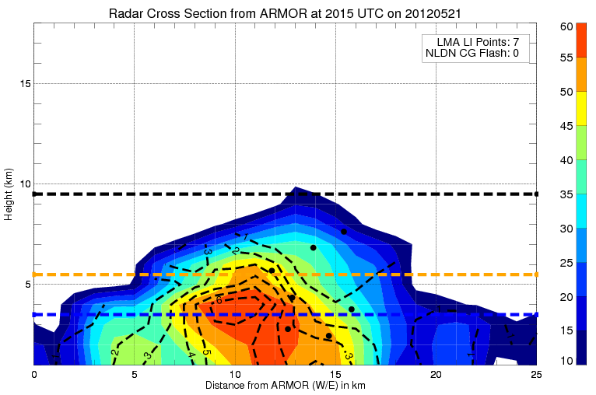
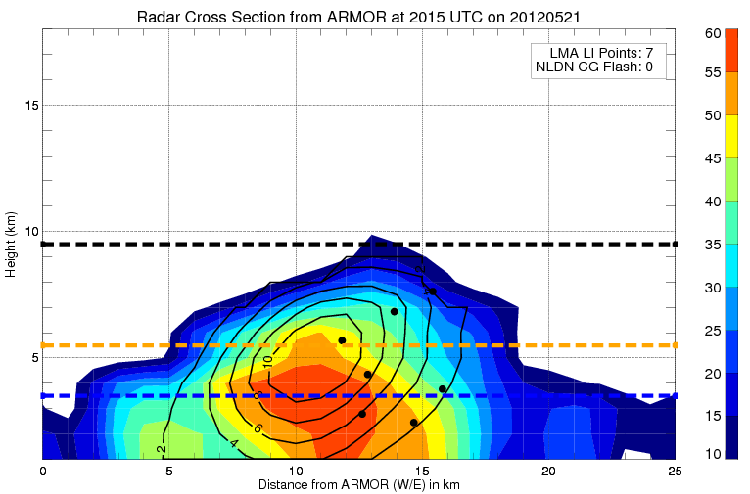
21 May 2012 (Lightning in Southernmost Updraft 2015 UTC)
Initial Lightning in “Merged” Cells
Along gradient of Z_{h} and Z_{dr}
Collocated with w_{max} > 8 m s⁻¹
Storm Scale particle (and thus charge) separation occurred between rimed graupel and ice
Resultant electrification and flashes
X-Z x-Section at 2015 UTC (y=65)
Z_{dr} > 0 dB
X-Z x-Section
at 2015 UTC
(y=65)
Z_{dr} Column
High Z_{h}(55-60 dBZ) and Z_{dr} (> 5 dB) into 0 °C to -10 °C layer
Possible resonance impacts due to high density hail and/or graupel particles
Persistent Z_{dr} column is coincident with strong updraft
LMA flash initiation
0 °C Level
W 2, 4, 6, 8, 10 m s⁻¹
-10 °C Level
-40 °C Level

Slide 7
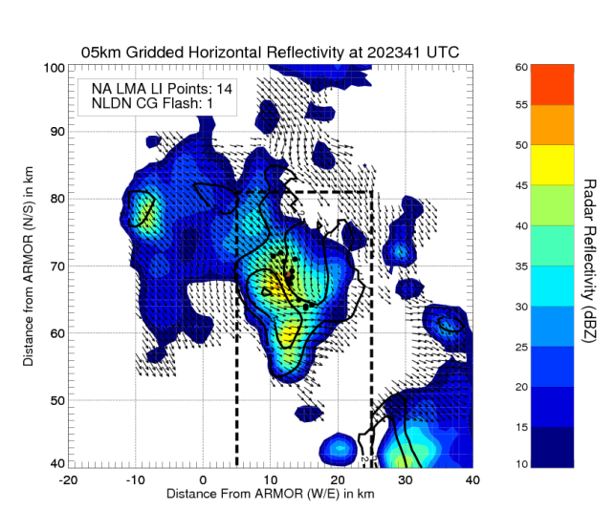
21 May 2012 (Peak Lightning, Post Merger 2023 UTC)
A. 5 km CAPPI at 2023 UTC
0 °C Level
-10 °C Level
Peak Lightning
Peak ~ 5 flashes min⁻¹
Peak likely associated w/ strong ‘w’ observed at 2015 UTC
Max 10 dB echo tops above 10 km
Strong front-to-rear flow (sloped ‘w’ contours). Efficient at transporting precipitation ice mass aloft for NIC
Predominately IC flashes aloft with relatively few CG’s
-40 °C Level
Large quantity of graupel given extension of modest Z_{h} and low Z_{dr} into -10 °C to -40 °C layer
X-Z x-Section
at 2023 UTC (y=65)
X-Z x-Section at
2023 UTC (y=65)
W 2, 4, 6, 8, 10 m s⁻¹
LMA flash initiation
Z_{dr} > 0 dB
4 NLDN CG Flash
(2023-2032 UTC)

Slide 8
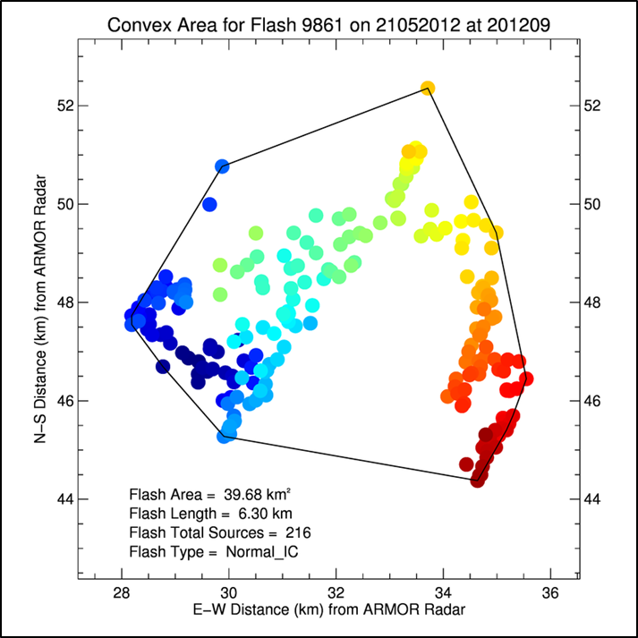
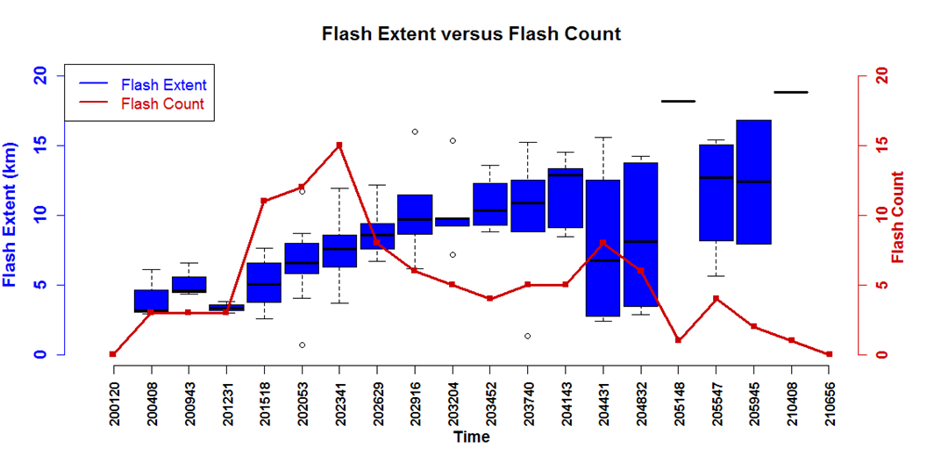
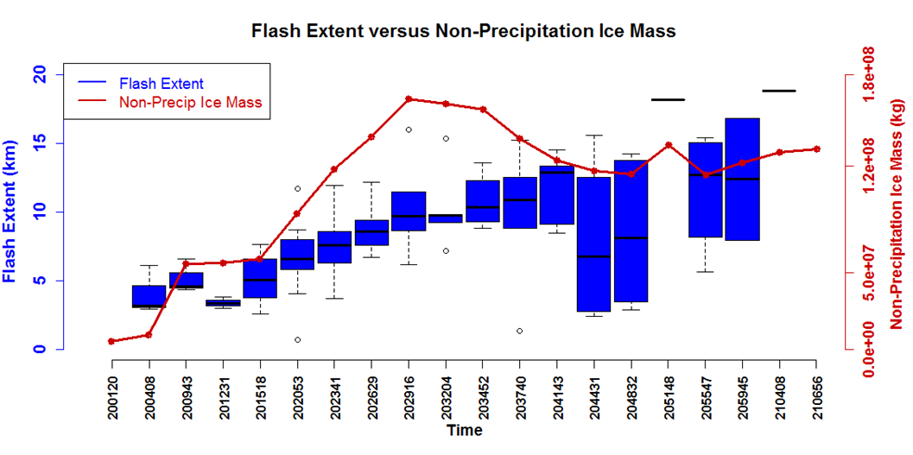
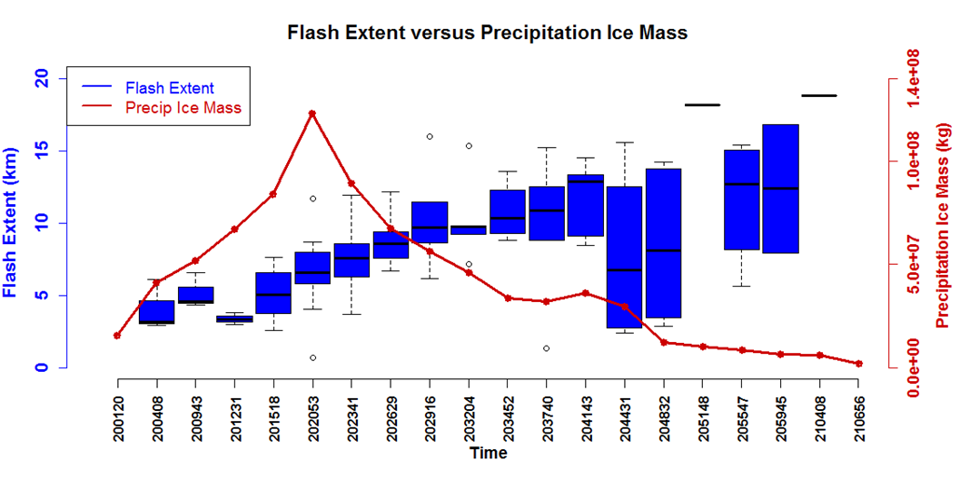
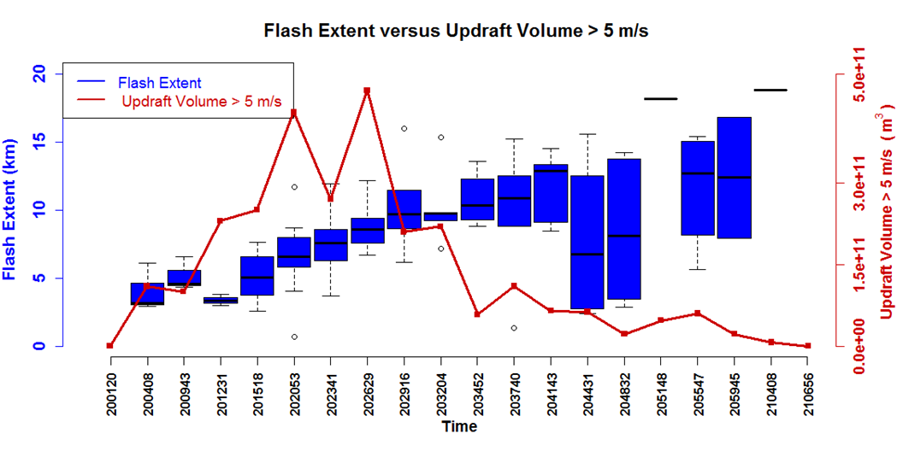
Flash Extent = (Convex Hull Flash Area) ^{1/2}
Flash Extent (Convex Hull) vs. Flash Count vs. Radar Microphysics/Kinematic
- Flash count correlated with MP precipitation ice and updraft.
- Median flash extent increases as convection pulses
- Largest flashes lag convective pulse but correlated to non-precipitation (anvil) ice
- Flash count and extent opposed; most large flashes when flash rate low (e.g., Bruning and MacGorman 2013)
Poster: Matthee et al. , AE33B-0342 (Today 1:40 PM)
Notes:
21 May 2013 Aircraft multicell cluster
Flash Length = (Convex Hull Flash Area)^(1/2)
Flash count is correlated with precipitation ice mass and convective updraft volume.
Median flash extent increases as convective engine pulses (e.g., peak in flash count, graupel volume, updraft)
Breadth of flash extent distribution lags convective pulse and is more correlated to non-precipitation ice volume (e.g., anvil).
Flash count and extent are somewhat opposed. Flashes with very large extent occur when flash rate is low (e.g., Bruning and MacGorman 2013)

Slide 9
NASA Lightning Nitrogen Oxides Model (LNOM)
Koshak et al. (2013)
LNOM run in Lagrangian (i.e., storm following cylinder) mode for multi-cell cluster sampled by DC3 aircraft on 21 May 2012 over AL
Subjective radar- and LMA-based definition of multicell cluster, shown earlier
Variable LNOM cylinder radius size and location that change each ARMOR radar volume time

Slide 10
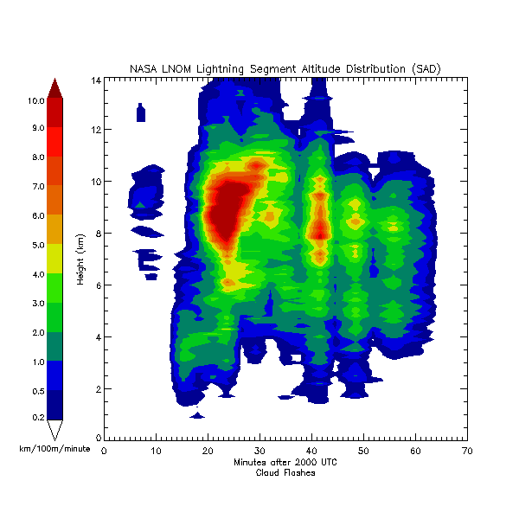
Time-Height Evolution
Max dBZ
NASA LNOM Lightning Segment Altitude Distribution (SAD)
Ground Flashes
Cloud Flashes
All Flashes
Cloud flashes dominate SAD
Ground SAD ≤ Cloud SAD, especially aloft
Yet, LNOx production from Ground Flash significant fraction of overall LNOx production, especially but not exclusively at low levels
NASA LNOM Lightning NO_{x} (LNOx)
Production
Notes:
IC lightning dominates segment altitude distribution (SAD) and is well correlated to graupel volume and updraft volume
In LNOM, even though Ground Flashes have much less SAD than Cloud Flashes, LNOx production from Ground Flashes is significant fraction of all flash production, especially but not exclusively at low levels.

Slide 11
Storm Integrated (≈ 1-hour) LNOM Profiles 21 May 2012 DC3 AL Aircraft Cluster
SAD All Flashes
LNOx Production All Flashes

Slide 12
LNOM Flash Extent [Σ(SAD)]vs. Convex Hull Length vs. Radar
SAD: “connect-the-dots”
Convex Hull: “polygon wrapper”
Flash Extent
ρ(LNOM, Convex Hull)=0.89
LNOM Flash
ρ(Rate, Extent) = 0.90
Radar Parameter | Flash Rate (min⁻¹) | Flash Extent Rate (km min⁻¹)
Graupel Echo Volume | ρ = 0.79 | ρ = 0.61
Precipitation Ice Mass | ρ = 0.78 | ρ = 0.55
Updraft Echo Volume | ρ = 0.76 | ρ = 0.61
Maximum Updraft | ρ = 0.60 | ρ = 0.41

Slide 13
LNOM LNOx Production
Cloud LNOx production highly correlated to total cloud flash extent;
Ground LNOx production also correlated to total ground flash extent
Ground LNOx governed in part by other CG flash parameters (e.g., peak current) in LNOM
Radar microphysical parameters (e.g., graupel volume) somewhat correlated (ρ=0.47) to Total LNOx Production
LNOx lags graupel (ρ_{lag}=0.64)

Slide 14
Summary
Dual-Doppler, dual-polarization radar, LMA and LNOM study of the 21 May 2012 DC3 aircraft case over Alabama
Coalescence-freezing, modest convective updrafts and subsequent graupel growth drives lightning production
Total lightning flash rate well correlated to kinematic (e.g., updraft volume) and microphysical properties (e.g., graupel volume) inferred from radar, as in past studies
To a somewhat lesser extent, LNOM flash extent and LNOx production also correlated to radar properties
LNOM SAD (“connect the dots”) flash extent well correlated to convex hull length scale of flash
Flash count and extent opposed; largest extent flashes lag the convective generator.

Slide 15
21 May 2012 Development Phase (1945-2001 UTC)
5 km CAPPI at 2001 UTC
0 °C Level
Z_{dr} > 0 dB
-10 °C Level
Z_{dr} Column
Z_{dr} ~ 2-3 dB
Z_{h} ~ 50-55 dBZ
raindrops
-40 °C Level
Warm Rain Coalescence
Z_{dr} ~ 3-4 dB
Z_{h} ~ 40-50 dBZ
raindrops
X-Z x-Section at 2001 UTC (y= 77km)
MP Hydrometeor Region
Z_{dr} 0-1 dB
Z_{h} ~ 40-45 dBZ
w_{max} ~ 2-4 m s⁻¹
Depressed values of ρ_{hv} (not shown) suggest mix of freezing/frozen raindrops, graupel/small hail
W 2, 4, 6 m s⁻¹
X-Z x-Section at 2001 UTC (y= 77km)
6 m s⁻¹ Updraft
Peaks into 0 °C to -10 °C layer
Sufficient to loft liquid drops into MP zone
Favors freezing of rain drops with time

Slide 16
21 May 2012 (Electrification of Northernmost Updraft 2004 UTC)
Sufficiently strong vertical motion to loft rain into mixed phase (MP) where freezing by 2001 UTC, likely resulted in the northernmost updraft producing 3 LMA flashes by 2004 UTC.
Northern Updraft
Z_{dr} < 1 dB
Z_{h} ~45-50 dBZ
Likely Graupel/Small Hail (PID Confirmed)
A. 5 km CAPPI at 2004 UTC
0 °C Level
-10 °C Level
-40 °C Level
B. X-Z X-Section at 2004 UTC
(y=75)
Z_{dr} > 0 dB
LMA flash initiation
Northern Updraft
Short lived & decayed
Z_{h} decrease to 50-55 dBZ
w_{max} ~ 2-4 m s⁻¹
Southern Updraft
Strengthens
Z_{h} decrease to 55 dBZ
w_{max} ~ 5-10 m s⁻¹
First Lightning
First flashes are associated with northern updraft

Slide 17
21 May 2012 (Decay and Dissipation Stages 2106 UTC)
A. 6 km CAPPI at 2106 UTC
Gradual Decay
Anvil (rich with ice crystals) extends nearly 40-50 km north of previous convection, but little to no graupel
W_{max} < 4 m s⁻¹
TLFR decreases to ~1 flash min⁻¹
More extensive flashes in anvil region
B. 7 km CAPPI at 2106 UTC
New Convection
Classic multicell evolution with additional cells developing along southwestward moving gust front

